Slide 1
Integrating with Loreal’s IOT devices.
-Ankur Khanna (Director)
-Robin Burgbacher (Solution Architect)
-Varun Kumar (Developer)

Slide 2
PROBLEM STATEMENT:-
-- How to communicate with Loreal-IOT devices and interact with Loreal device users (users who use Loreal Smart Hair Brush) in real time.
-- This can be extended to several use cases which needs a light weight form of communication.

Slide 3
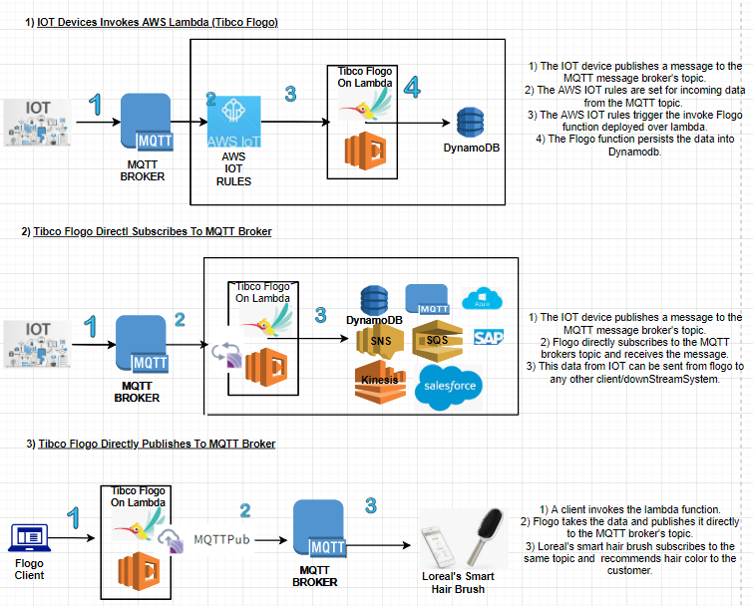

Slide 4
SOFTWARES/ PLATFORMS USED
1
1) Tibco Flogo – Cloud Solution For Publish/Subscriber messages to/from IOT devices.
2) Golang 1.0 – The programming language used in the background. It is currently the worlds. lightest/fastest programming language developed/implemented by Google.
3) MQTT 1.7.1 -- Messaging protocol used to communicate to the IOT device.
4) AWS Lambda – For running micro services code.
5) AWS IOT Platform – For maintain/grouping the IOT devices. Used to write IOT rules.
6) AWS IOT Dash Button – IOT device used for this project.
7) MQTT.fx Client – Test client used to trigger MQTT messages.
8) Spunk Cloud:- To capture logs from IOT devices.

Slide 5
MQTT

Slide 6
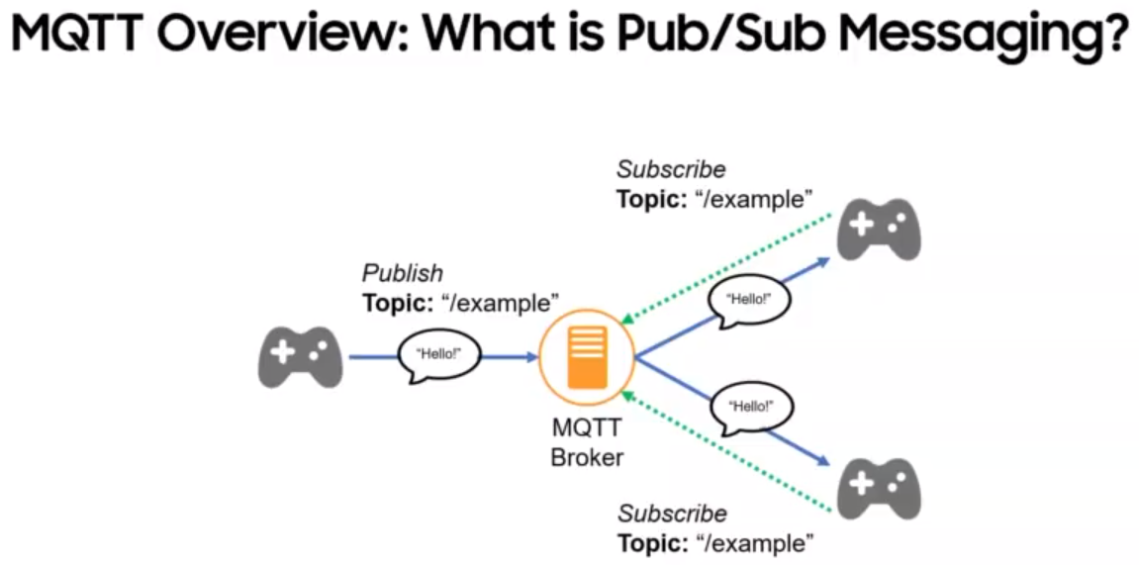
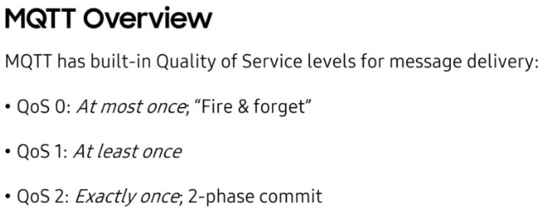
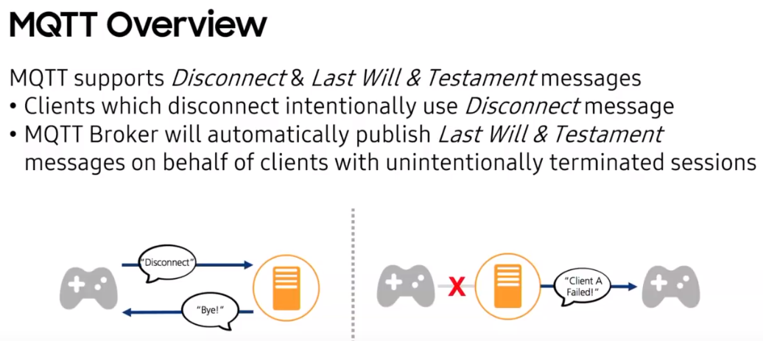
1
1) Mqtt is a featherweight iso compliant pub sub messaging protocol. It was specifically designed for IOT was designed by IBM.
2) Best part about MQTT is it bakes pub sub messaging into devices that absolutely have very low ram and processor speed. Publishers and Subscribers can talk to each other without knowing the addresses and ports of either parties.
3) Publishers and Subscribers don’t have to be online at the same time. Best example a car goes into a tunnel and receives the message on the mqtt topic once it is online at the other end of the tunnel.
4) Sender and receiver don’t have to work at the same speed. Rate limiting can be applied at the either parties to scale the reception of messages.
5) Mqtt supports messages up to 256mb in size.
6) Mqtt guarantees message delivery. The way this is done by using the concept of last will and testament messages.
7) Largest mqtt application in the world is FB messenger.
8) Mqtt doesn’t Guarantee consistency of messages i.e. sequencing across multiple publishers. in scenarios where you connect to the mqtt broker with an id and then connect to the mqtt message broker using the same id but from other device, in those scenarios the session needs to be transferred to the new device. But the sequencing can be built by using key-value store that supports p-ram consistency. 9) MQTT brokers can be run on Mosquito servers or Edge devices.

Slide 7
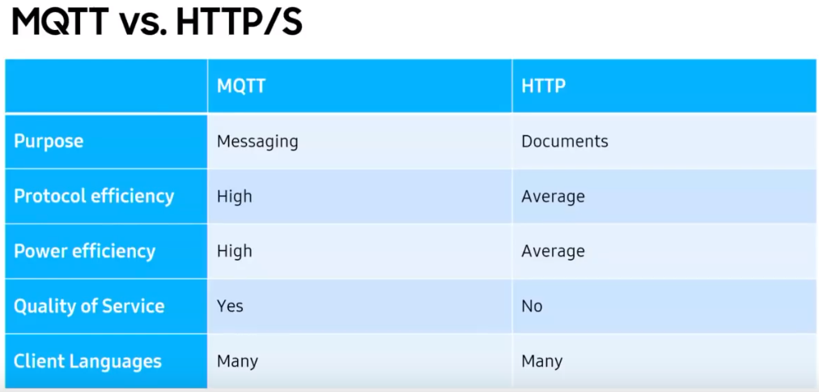
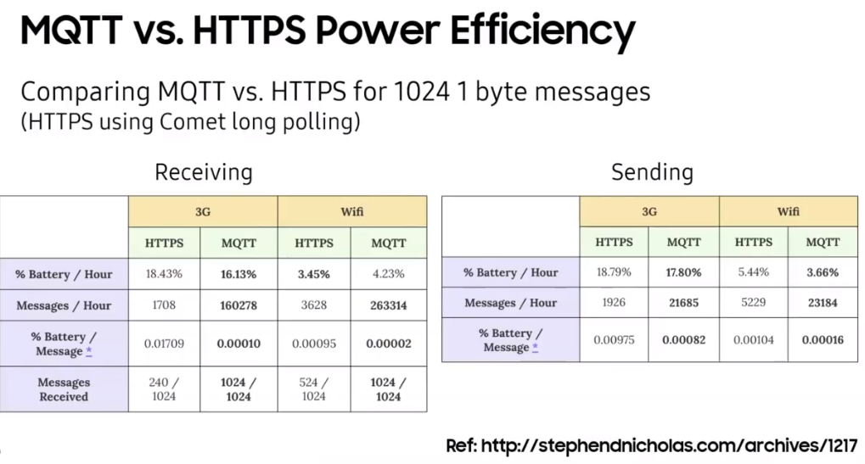
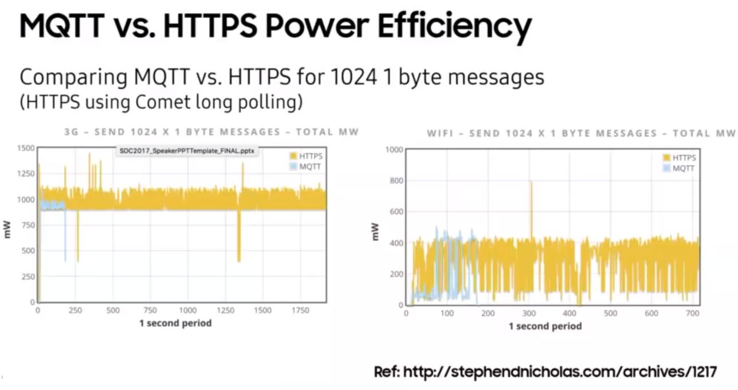
2

Slide 8
Tibco Flogo

Slide 9
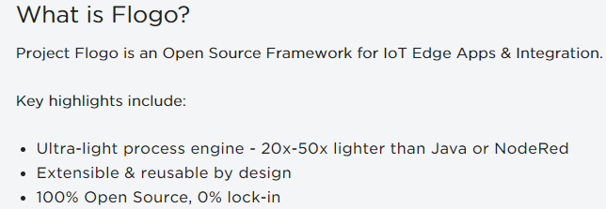

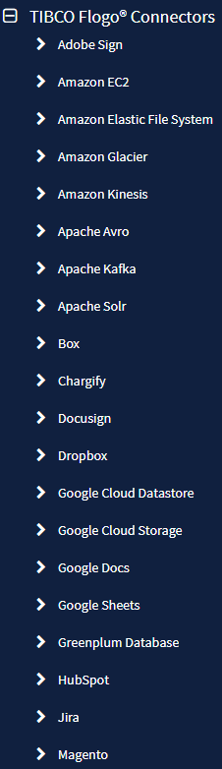
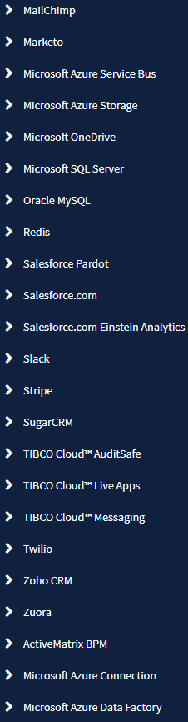
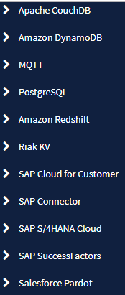
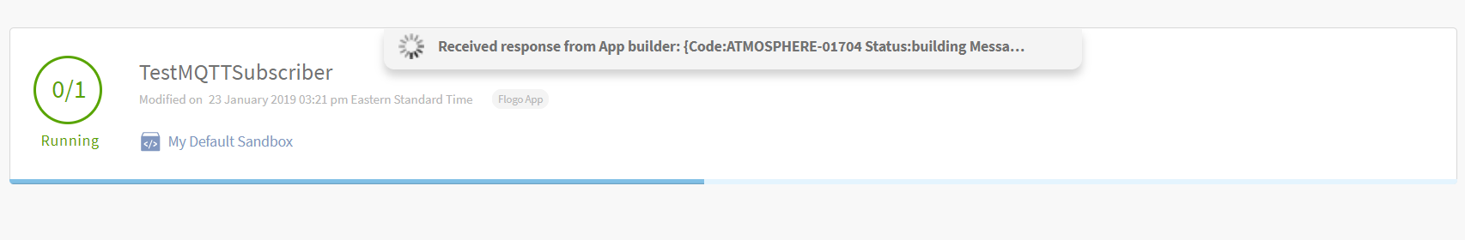
Concepts
Tiles
There are two categories of tiles used in a flow - Triggers and Activities. A flow starts with a trigger which is then followed by one or more activities. Each flow can have only one trigger.
Flow
Every TIBCO Flogo App must contain at least one flow. An app can consist of multiple flows. A flow is a process that contains the business logic of the app. A flow is activated by a trigger. You have the
option to create a flow with or without a trigger. A flow without a trigger is a blank flow. You can add
one or more triggers to a blank flow at any time after the flow creation. Each flow can contain one or
more activities.
Trigger
Triggers are used to activate a flow. A trigger can also be activated by an external system, such as
Salesforce.com, in which case the TIBCO Flogo App listens to changes happening in that external
system.
Activity
Activities perform specific tasks within the flow. A flow typically contains multiple activities

Slide 10
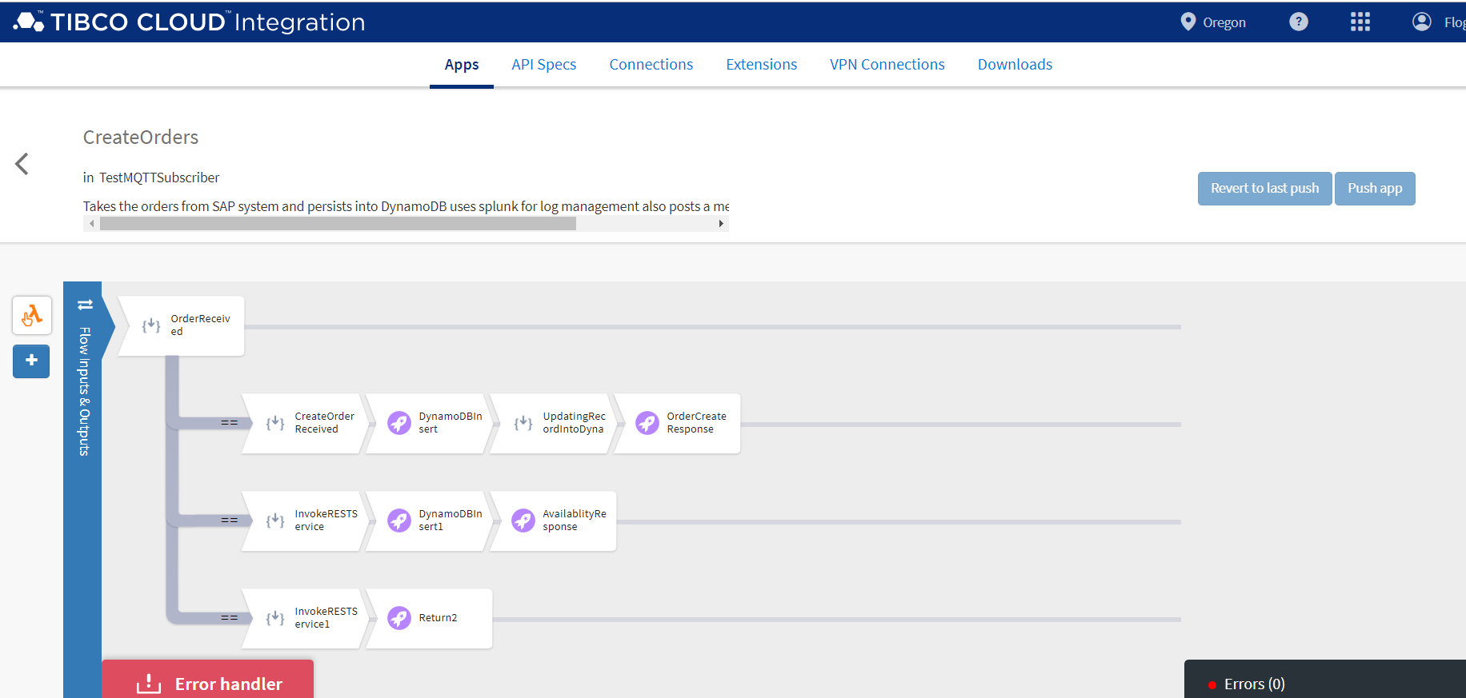
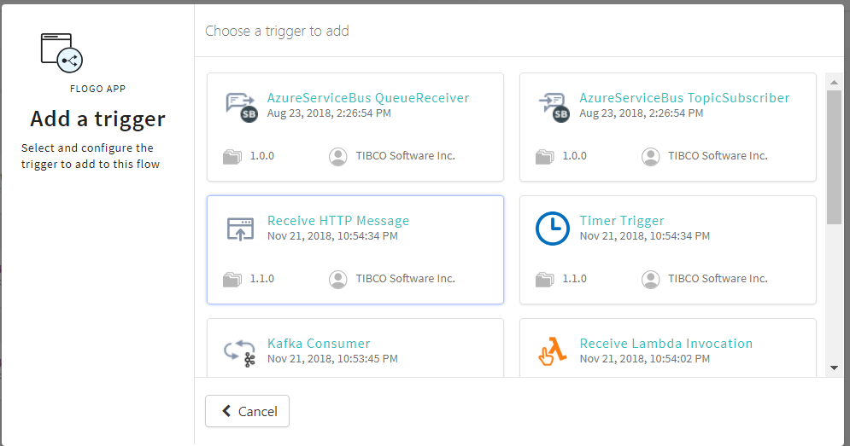

Slide 11
3
MQTT BROKER

Slide 12
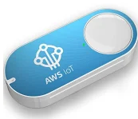
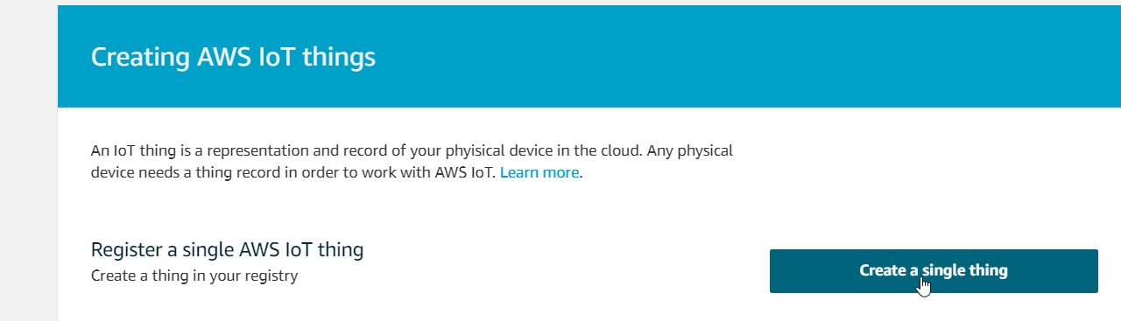
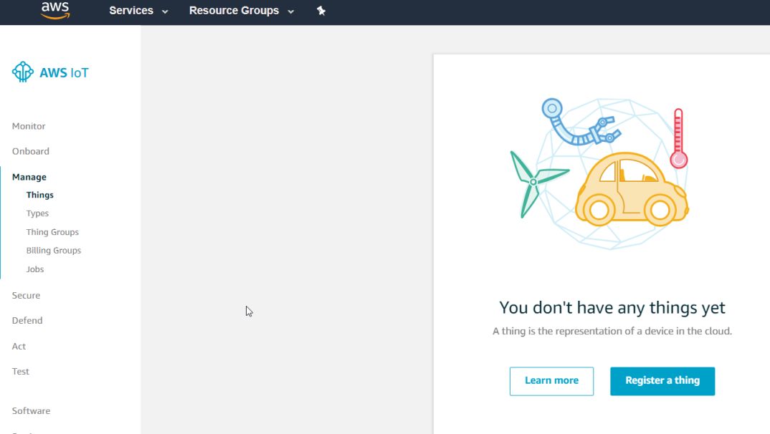
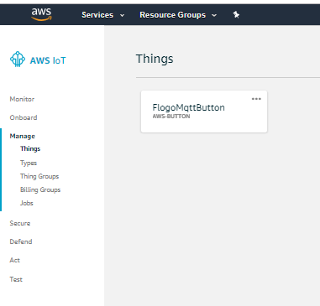
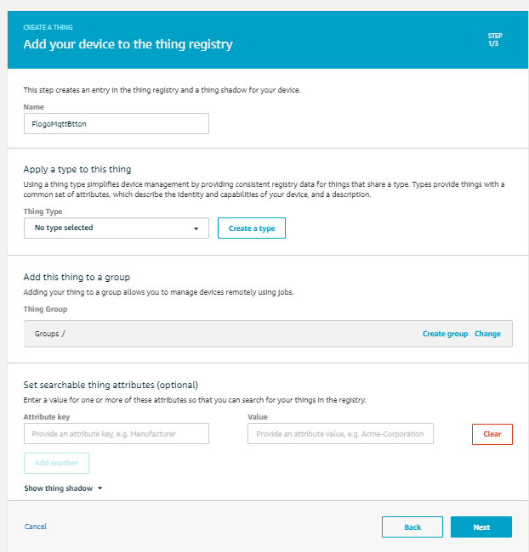
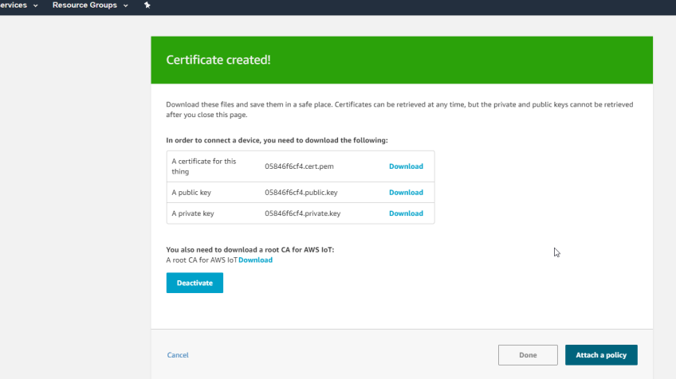
4
https://docs.aws.amazon.com/iot/latest/developerguide/iot-gs.html
Configure the AWS IOT button using the following steps.
1) Creat a thing for the IOT device.
2) Create a certificate.
3) Associate a policy.
4) assocate all three together.
5) Configure the button.

Slide 13
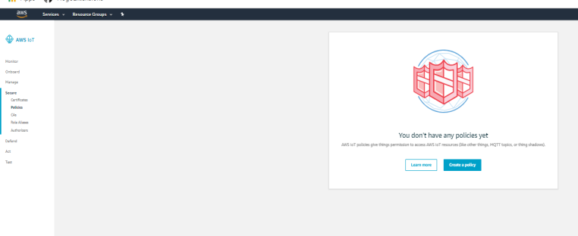
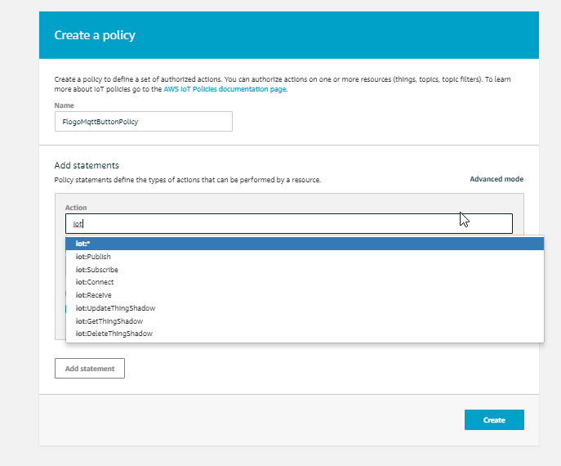
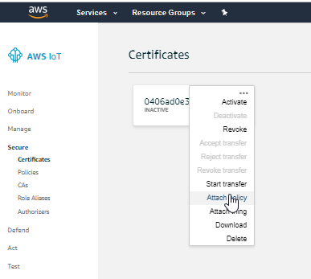
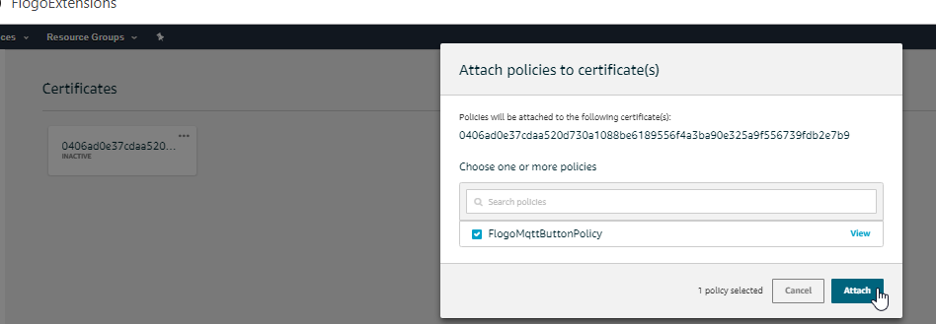
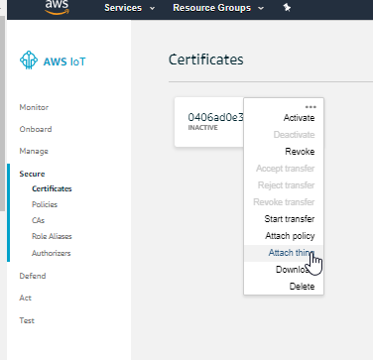
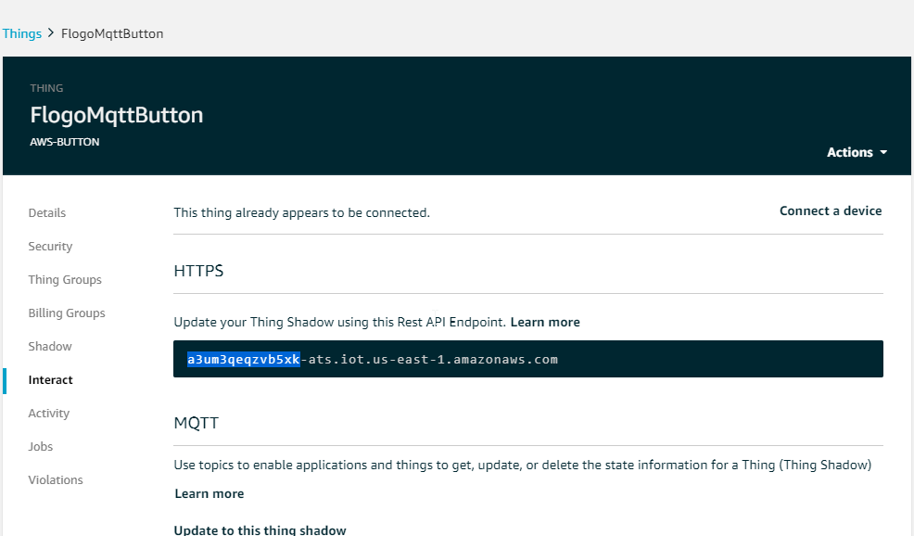
I will use iot:* to let any action.
Attach AWS:Iot to device certificate
The Thing is configured in AWS IOT. Highlighted is called subdomain and used when configuring the button.

Slide 14
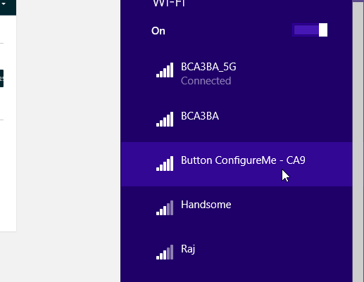
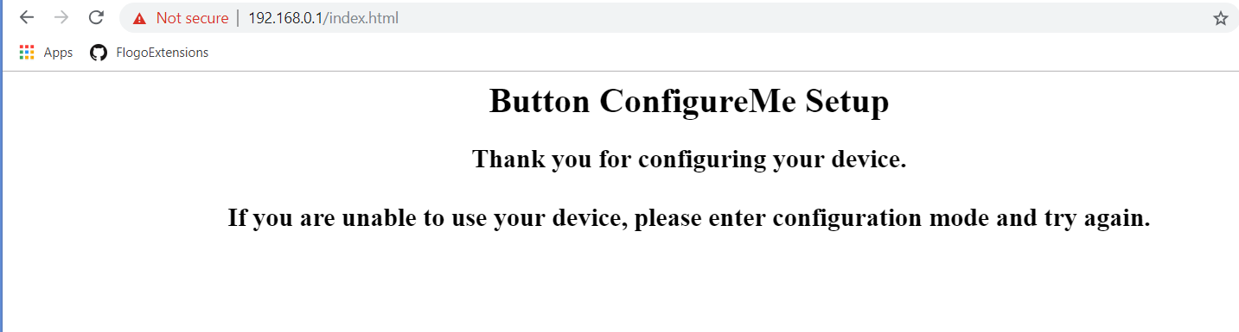
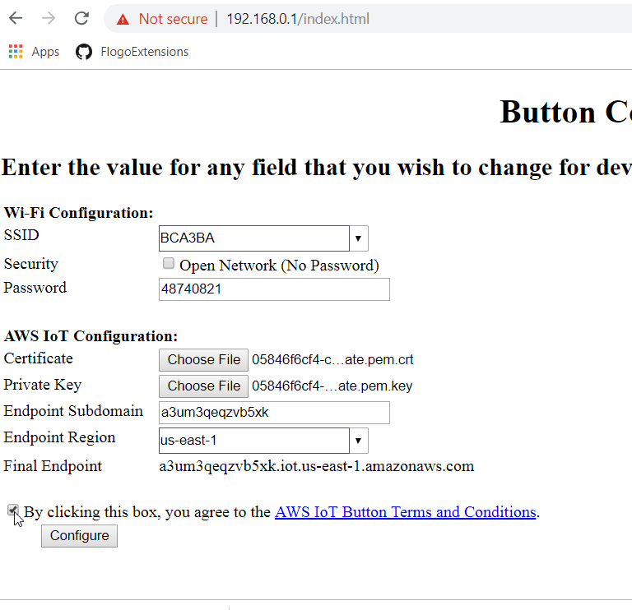

Slide 15
AWS IOT RULES

Slide 16
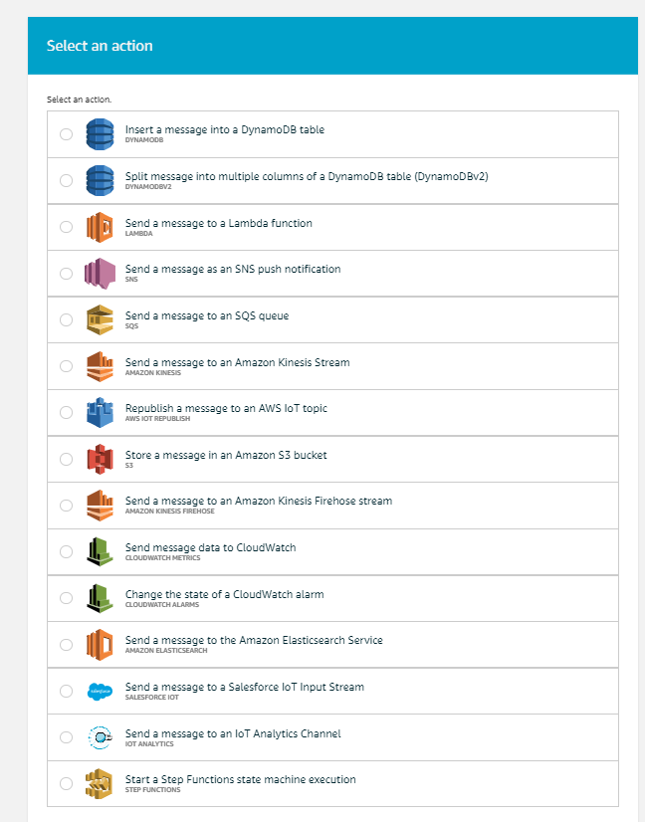
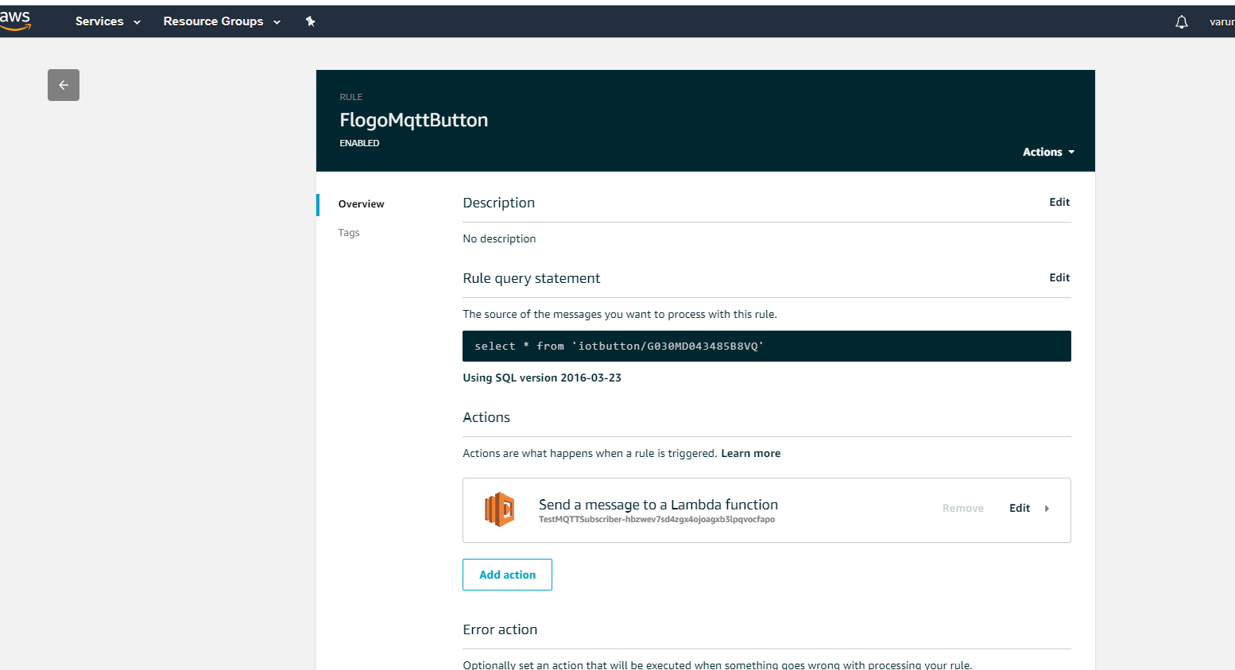
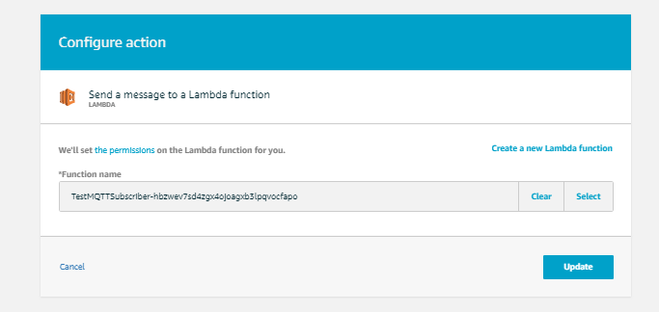

Slide 17
-- THE TECHNICAL IMPLEMENTATION IS DOCUMENTED HERE
TECHNICAL-IMPLEMENTATION

Slide 18

Thank You !

