Slide 1
FIELD PROJECT
Primer Design for Detection of
Glyphosate-Resistant EPSPS Gene
in Genetically Modified Crops
2nd BI
Reg no: 241FA14055
241FA14057
Submitted to :
Prof.Arun
Glyphosate-Resistant EPSPS Gene
Identification Using Bioinformatics
AB209952.1
Glycine max · CP4-EPSPS
Department of BioInformatics · Genetic engineering

Slide 2
Introduction
Genetically Modified Crops & the Need for Detection
01
What are GM Crops?
02
Global Scale
03
Why Detection Matters
Crops modified through recombinant DNA technology to express novel traits such as herbicide tolerance, insect resistance, or improved yield.
Over 190 million hectares planted globally. Key crops: soybean (58%), maize (27%), cotton (12%), canola (5%) — all commonly carry the CP4-EPSPS gene.
Mandatory GMO labeling laws in 60+ countries. Molecular PCR-based methods using gene-specific primers are the gold standard for detection.

Slide 3
Glyphosate & the EPSPS Target
Mechanism of Glyphosate Action
CP4-EPSPS — The Resistance Gene
Glyphosate inhibits EPSPS — a key enzyme in the Shikimate Pathway that synthesizes aromatic amino acids (Phe, Tyr, Trp) essential for plant survival.
By blocking EPSPS, glyphosate shuts down amino acid production → plant death.
This pathway is absent in animals and humans, making glyphosate selectively toxic to plants.
Derived from Agrobacterium tumefaciens strain CP4 — a soil bacterium. Its Class II EPSPS enzyme has low glyphosate binding affinity, allowing transformed plants to survive herbicide exposure.
Class II
~1623 bp
Roundup
Ready®
Soybean
Maize Cotton
EPSPS Type
Gene Size
Trade Name
Key Crops

Slide 4
Why Detect CP4-EPSPS?
01
Regulatory Compliance
02
Food Safety Testing
Over 60 countries mandate GMO labeling. PCR-based detection is the legal standard for verifying GM presence in crops and food products.
Food companies, importers, and testing labs use gene-specific primers to screen grain shipments, processed foods, and animal feed for GMO content.
03
Trade & Border Control
04
Breeding & Research
Nations with GM import restrictions test incoming shipments at ports. Specific primers allow rapid, low-cost field-level detection.
Confirms transgene integration in new GM lines during crop development, backcrossing programs, and variety registration processes.
05
Environmental Monitoring
06
Biosafety Assessment
Tracks unintended gene flow from GM crops to wild relatives or non-GM cultivars in field-scale ecological studies.
Regulatory risk assessments require reliable tools to confirm or deny the presence of specific transgenes in test environments.

Slide 5
Objective
Main Objective
To design and validate specific primers for the in silico detection of the glyphosate-resistant CP4-EPSPS transgene (AB209952.1) in Genetically Modified soybean (Glycine max) using freely available bioinformatics tools — NCBI, Primer3Plus, and Primer-BLAST.
Specific Objectives
1
Retrieve the CP4-EPSPS nucleotide sequence (AB209952.1) from NCBI GenBank
2
Design gene-specific primers using Primer3Plus with optimized thermodynamic parameters
3
Validate primer specificity using NCBI Primer-BLAST against the Glycine max genome
4
Obtain a primer pair that exclusively amplifies the CP4-EPSPS transgene with zero off-target hits

Slide 6
Tools & Methodology Overview
STEP 01
STEP 02
STEP 03
NCBI GenBank
Primer3Plus
Primer-BLAST
Sequence Retrieval
Primer Design
Specificity Validation
› Access AB209952.1
› Paste nucleotide sequence
› Enter Forward & Reverse primers
› Download FASTA format
› Set Tm 57–63°C, GC 40–60%
› Organism: Glycine max
› Identify CP4-EPSPS CDS (1623 bp)
› Product size 100–700 bp
› Confirm zero off-target hits
ncbi.nlm.nih.gov/nuccore
primer3plus.com
ncbi.nlm.nih.gov/tools

Slide 7
Step 1 — Sequence Retrieval from NCBI
Accession: AB209952.1 Glycine max transgenic cp4epsps gene — 5-enol-pyruvylshikimate-3-phosphate synthase class 2 precursor, complete cds
How to Retrieve the Sequence:
1
Go to NCBI Nucleotide
https://www.ncbi.nlm.nih.gov/nuccore/AB209952.1
2
Load the GenBank Record
Page shows full annotation of CP4-EPSPS in soybean
3
Click "FASTA" format link
Located just below the accession number at the top
4
Copy nucleotide sequence only
Do not include the >header line — only the A/T/G/C characters
5
Paste into Primer3Plus
Ready for primer design in the sequence input box

Slide 8
Step 2 — Primer Design in Primer3Plus
URL: www.primer3plus.com · Target Field: 400,200
Main Settings
Advanced Settings
Parameter
Min
Opt
Max
Parameter
Value
Primer Size (bp)
18
20
24
Max Self Complementarity
8
Primer Tm (°C)
57
60
63
Max 3' Self Complementarity
3
GC Content (%)
40
50
60
Max Poly-X
4
Product Size (bp)
100
—
700
GC Clamp
1
Primers Returned
—
5
—
Salt Concentration
50 mM
💡 After clicking Pick Primers → choose Pair 1 (best score) → validate in Primer-BLAST before accepting

Slide 9
Step 3 — Validation Using NCBI Primer-BLAST
URL: www.ncbi.nlm.nih.gov/tools/primer-blast/
Settings Entered in Primer-BLAST:
Interpret Results:
Field
Value
✅ Only 1 amplicon product found
Forward Primer
GTCTACGATTTCGACAGCAC
✅ Maps exclusively to AB209952.1
Reverse Primer
GTCTCGACGGTAAGGTTG
✅ No hits on Glycine max chromosomes
PCR Product Min
100 bp
PCR Product Max
500 bp
✅ Product size within 100–500 bp
Organism
Glycine max
❌ Off-target genomic hits found
Database
nr (non-redundant)
❌ Multiple products amplified

Slide 10
Results — Final Validated Primer Pair
Forward Primer (5'→3')
GTCTACGATTTCGACAGCAC
Reverse Primer (5'→3')
GTCTCGACGGTAAGGTTG
320 bp
20 / 18
56.67°C
54.82°C
50 / 55.6%
✅ None
Product Size
Length (F/R)
Tm Forward
Tm Reverse
GC% (F/R)
Off-targets
✅ Primer-BLAST Confirmed: Exclusively amplifies AB209952.1 — Zero off-target hits in Glycine max genome

Slide 11
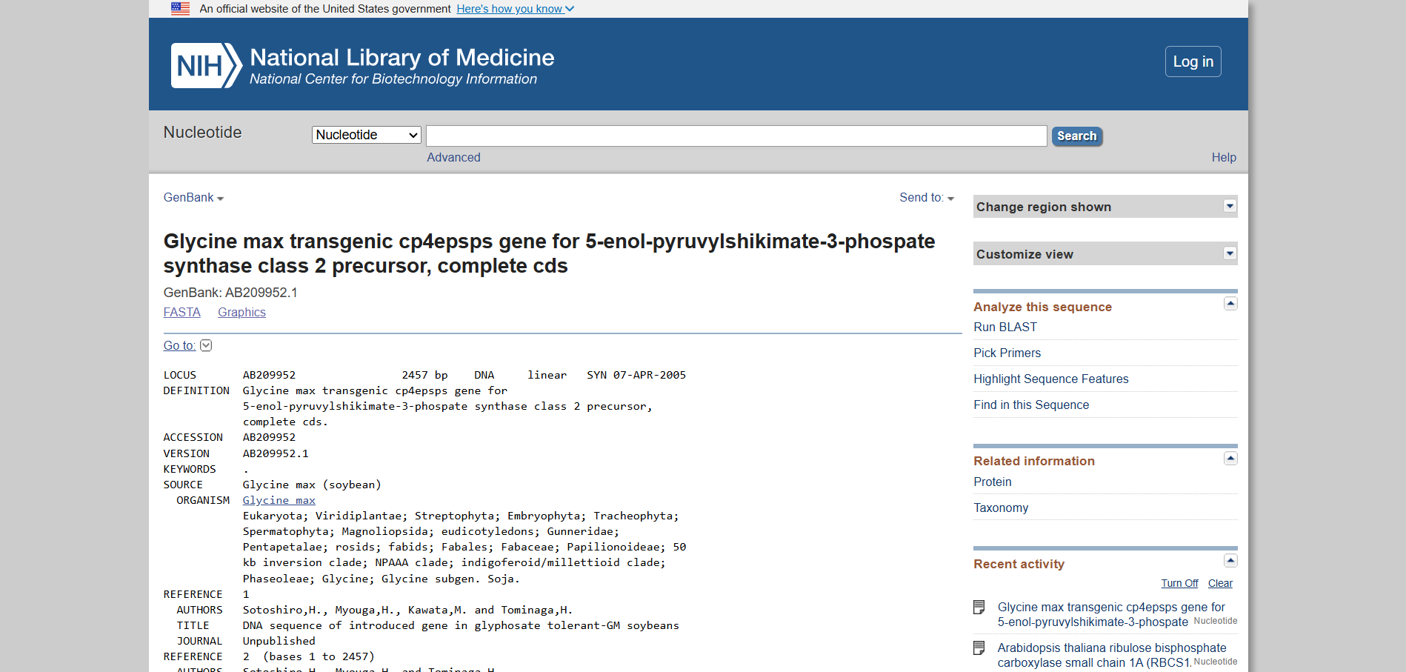
EXAMPLE:

Slide 12
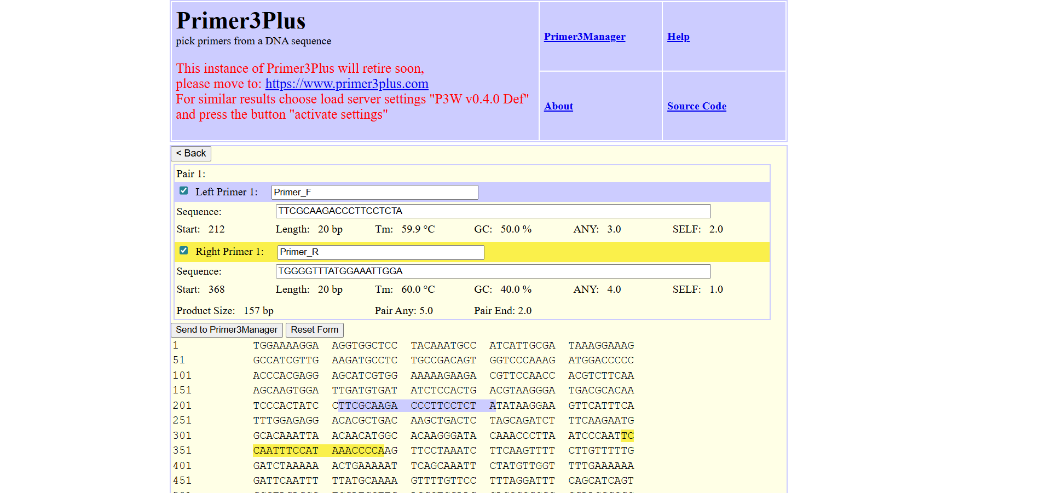

Slide 13
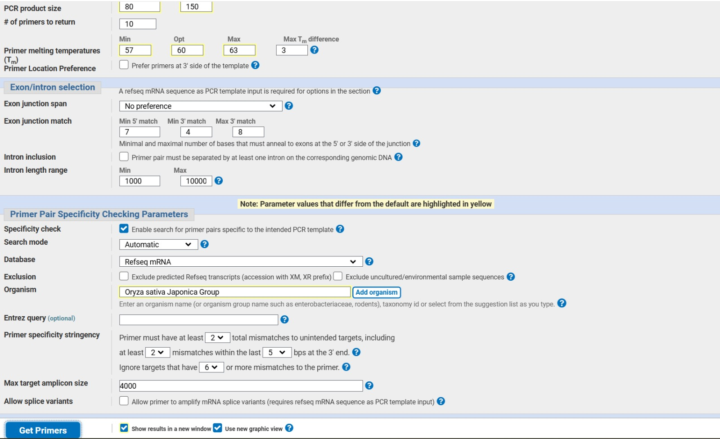

Slide 14
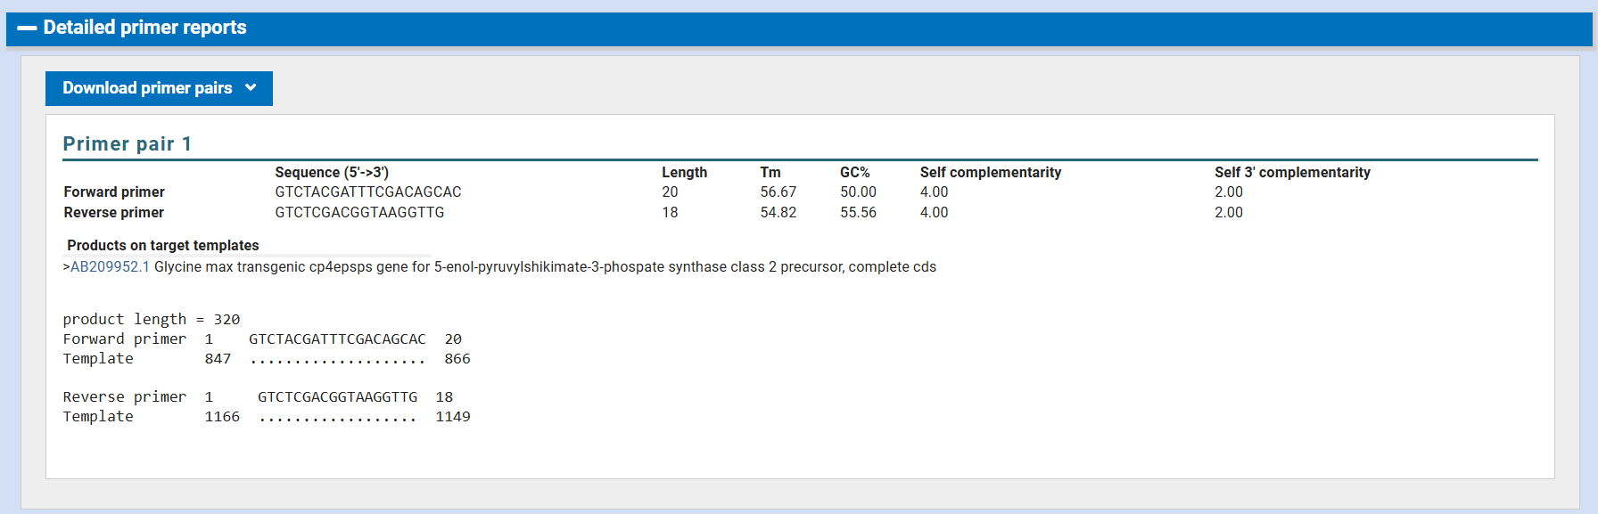

Slide 15
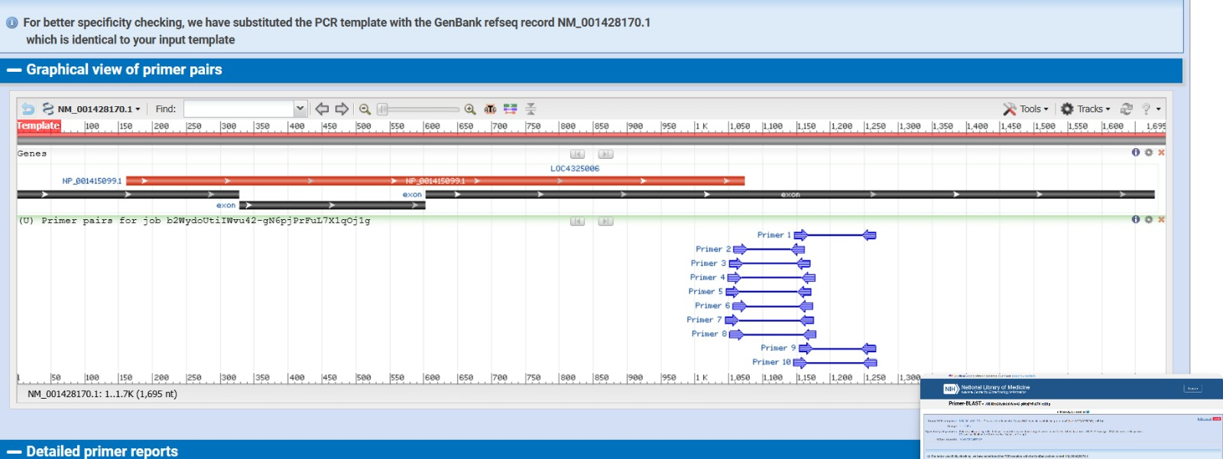

Slide 16
Applications
Where These Primers Can Be Used
GMO Crop Screening
Food & Feed Testing
Detect Roundup Ready traits in soybean, maize, cotton, and canola — the world's most widely grown GM crops.
Regulatory labs screen imported grain, processed food, and livestock feed for unauthorized GM content.
Plant Breeding
Environmental Monitoring
Confirm successful transgene integration in new GM events during backcrossing and line development.
Monitor gene flow and GM volunteer plants in ecological field studies.
Education & Research
Biosafety Compliance
Demonstrate molecular GMO detection in university and institutional molecular biology labs.
Support risk assessments by confirming presence or absence of specific transgenes in regulated environments.

Slide 17
Conclusion
1.
CP4-EPSPS sequence (AB209952.1) was retrieved from NCBI GenBank — the confirmed transgenic cp4epsps gene in Glycine max soybean
2.
Primer3Plus was used with optimized parameters: Tm 57–63°C, GC 40–60%, product size 100–700 bp, with target region 400,200
3.
Final primers validated by Primer-BLAST — Forward: GTCTACGATTTCGACAGCAC · Reverse: GTCTCGACGGTAAGGTTG
4.
Product size: 320 bp | No off-target amplification in Glycine max genome — high specificity confirmed
5.
Primers are suitable for GMO detection, regulatory testing, and research applications in molecular biology
Thank You
Primer Design Complete — In Silico · AB209952.1 · Glycine max

