Slide 1
DATA STORYTELLING
DATA
& STATISTICAL VALIDATION
US Retail Sales Intelligence · Task 4 · ApexPlanet
9,800
$2.26M
4 Years
p=0.0002
Transactions
Total Revenue
2015 – 2018
Hypothesis Result
Varun Kumar Vakamullu
Data Analytics Intern · ApexPlanet · February 2026
Varun Kumar Vakamullu · ApexPlanet Internship · Task 4
Slide 1 / 10

Slide 2
OVERVIEW
What We Cover Today
01
04
Business Context
Data Story
The challenge & dataset overview
Narrative arc: Problem → Analysis → Action
02
05
Key Findings
Recommendations
Revenue, growth & segment insights from Tasks 1-3
3 strategic actions backed by data
03
Hypothesis Testing
Technology vs Furniture — statistical proof
Varun Kumar Vakamullu · ApexPlanet Internship · Task 4
Slide 2 / 10

Slide 3
CONTEXT
The Business Challenge
Business Question: Which product category drives the most revenue — and is the difference statistically significant?
📦
📋
🏷
🗺
Dataset
Records
Categories
Regions
US Retail 2015-2018
9,800 Transactions
3 Product Types
4 US Regions
The Data Story Arc
🔍 Problem
→
📊 Analysis
→
💡 Findings
→
✅ Action
Varun Kumar Vakamullu · ApexPlanet Internship · Task 4
Slide 3 / 10

Slide 4
FINDINGS
4-Year Performance Snapshot
$722K
1,661
690
$827K
2018 Revenue
2018 Orders
2018 Customers
Tech Sales Total
↑ 20.3% YoY
↑ 28.2% YoY
↑ 8.7% YoY
#1 Category
🏆
2018 was the best year on record across all metrics — sales, orders and customers all hit new highs
🚀
Home Office is the fastest growing segment — up 51.2% in 2018 with the highest AOV at $475 per order
📍
West region leads at $710K. South lags at $389K — a $321K gap representing the biggest opportunity
⚠️
AOV declined 6.2% in 2018 despite record volumes — more orders but lower spend per transaction
Varun Kumar Vakamullu · ApexPlanet Internship · Task 4
Slide 4 / 10

Slide 5
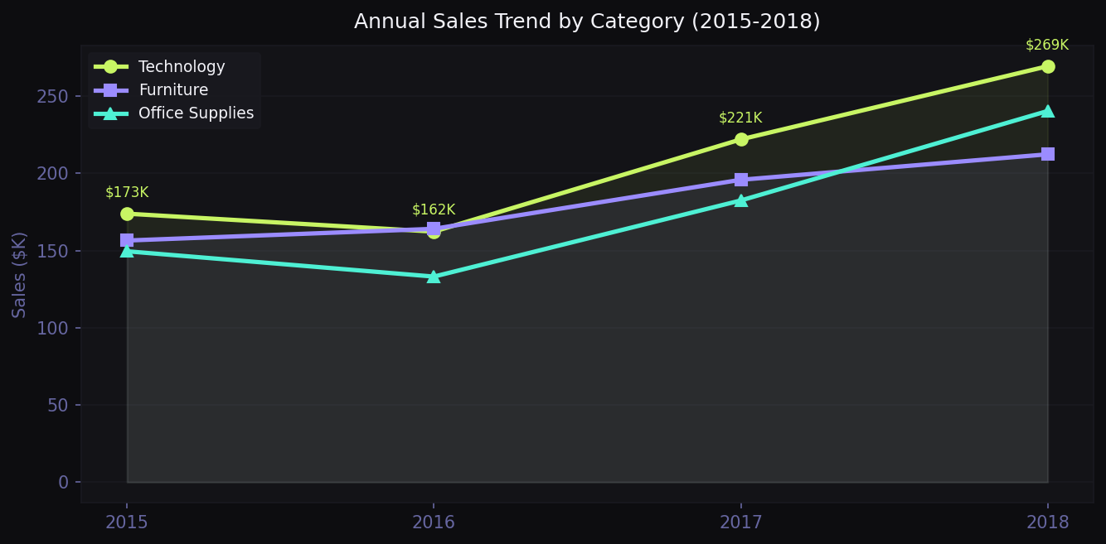
TREND
Annual Sales Trend by Category
Varun Kumar Vakamullu · ApexPlanet Internship · Task 4
Slide 5 / 10

Slide 6
HYPOTHESIS
Hypothesis Testing Setup
H₀ (Null Hypothesis)
There is NO statistically significant difference between Technology and Furniture average order values.
H₁ (Alternative Hypothesis)
Technology orders have a significantly HIGHER average value than Furniture orders.
Statistical Test
Significance Level
Welch's T-Test (unequal variance)
α = 0.05 (95% confidence)
Test Type
Sample Sizes
Two-tailed independent samples
Tech: n=1,813 | Furniture: n=2,078
Varun Kumar Vakamullu · ApexPlanet Internship · Task 4
Slide 6 / 10

Slide 7
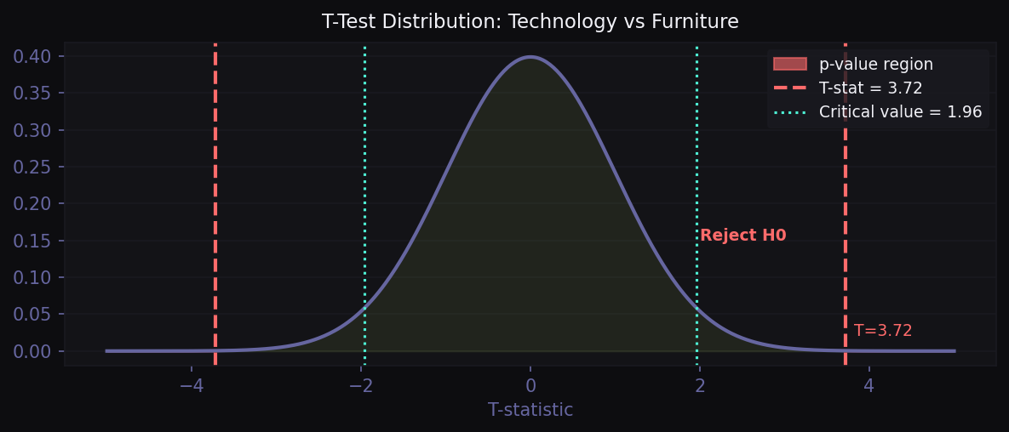
RESULTS
Statistical Test Results
3.72
0.0002
±1.96
0.122
Welch T-Statistic
P-Value
Critical Value
Cohen's d
✅ REJECT H₀
p = 0.0002 < α = 0.05
The difference is statistically significant.
Mean AOV — Technology
$456.40
Mean AOV — Furniture
$350.65
Difference
+$105.75
Effect Size (Cohen d)
Small (0.12)
Varun Kumar Vakamullu · ApexPlanet Internship · Task 4
Slide 7 / 10

Slide 8
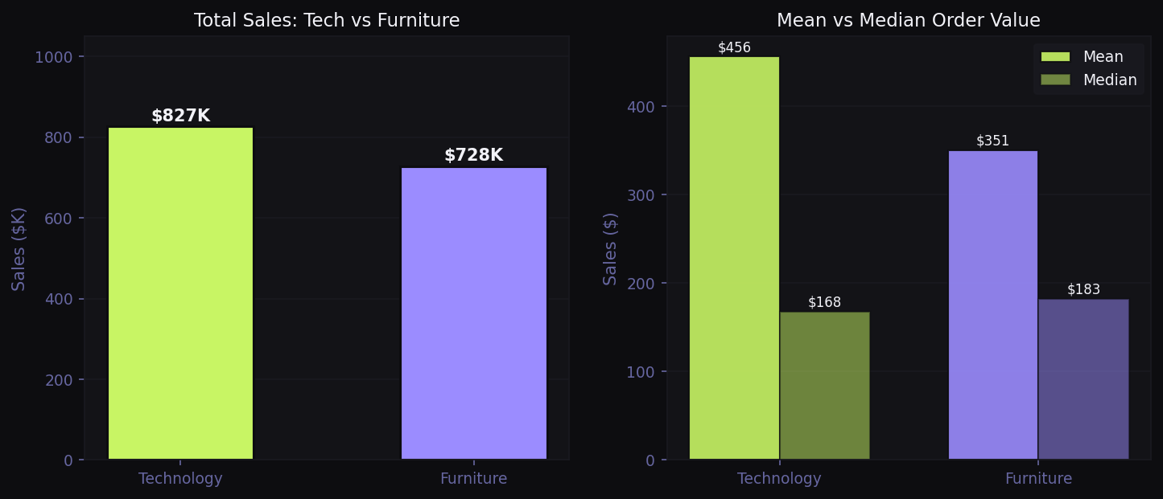
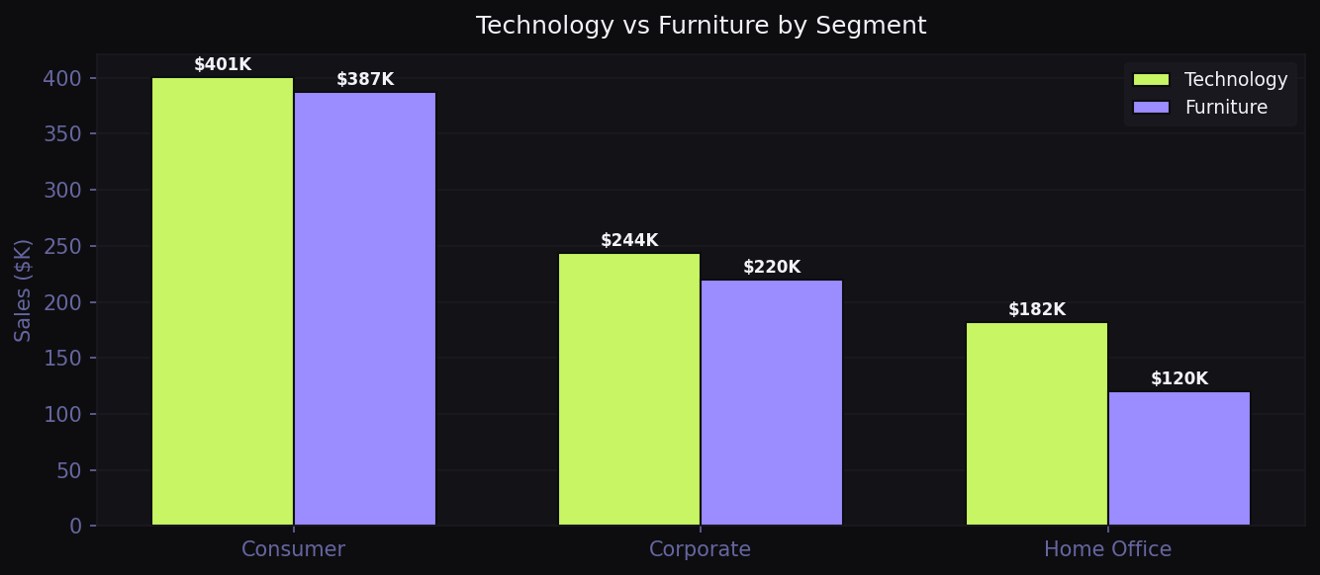
ANALYSIS
Technology vs Furniture — Deep Comparison
Varun Kumar Vakamullu · ApexPlanet Internship · Task 4
Slide 8 / 10

Slide 9
STORY
The Data Story
01 PROBLEM
A US retail business has 4 years of sales data. Leadership needs to know: which product category is most valuable — and can we prove it statistically rather than just eyeballing charts?
02 ANALYSIS
We segmented 9,800 transactions by category, region and customer type. Technology generated $827K vs Furniture's $729K. But is that gap real or due to random variation?
03 STATISTICAL PROOF
A Welch T-Test confirmed: T=3.72, p=0.0002. Since p < 0.05, the difference is statistically significant. We can reject the null hypothesis with 99.98% confidence.
04 BUSINESS CONCLUSION
Technology is not just accidentally higher — it is structurally more valuable per transaction. Every segment (Consumer, Corporate, Home Office) shows Technology as the top category.
Varun Kumar Vakamullu · ApexPlanet Internship · Task 4
Slide 9 / 10

Slide 10
ACTION
Strategic Recommendations
01
Double Down on Technology
💻
Technology is statistically proven to be the highest-value category. Prioritise stock, marketing spend and promotions in this category across all regions.
02
Accelerate Home Office Growth
🚀
Home Office grew 51.2% in 2018 with the highest AOV. Scale acquisition campaigns immediately — especially in the South region where it is most underserved.
03
Target the South Region
📍
South lags $321K behind West. A focused regional push in Technology and Home Office products could close this gap and add meaningful revenue in Year 5.
Bottom Line: Technology outperforms Furniture — statistically proven (p=0.0002). Invest where the data points.
Varun Kumar Vakamullu · ApexPlanet Internship · Task 4
Slide 10 / 10

