Slide 1
Team name : the measure makers
Members:
T. Pranith 230409120016
Roshbin gabriel 230409120014(Leader)
M. Varun kumar 230409120017
Sai tarun 230409120020
Ayush kumar singh 230409120028

Slide 2
Objectives and rationale
Objectives:
To summarize key education indicators across India through cards— such as total schools, total teachers, and enrollment — providing a quick national snapshot of the education landscape.
To analyze how different school types (Government, Private, Primary, Upper Primary) and their enrollment levels are distributed across states and districts, identifying regions with high or low participation rates.
To evaluate the availability of essential school infrastructure — including toilets, drinking water, and classroom conditions — and measure their impact on overall school performance and enrollment trends.
To assess the adequacy of teaching staff across districts, examining teacher-to-student ratios and availability of trained versus untrained teachers, highlighting areas facing staffing shortages.
To analyze gender-wise enrollment (male vs female) and explore correlations between female participation, school infrastructure, and staff availability — assessing equity in educational access.
To combine multiple education factors — teacher availability, infrastructure quality, and enrollment — into a single “Education Readiness Index (ERI)” to benchmark districts and states for policy improvement.
Rationale :
Strengthening educational infrastructure directly influences learning outcomes.
This analysis provides actionable insights for policy planners and local education boards.
Promotes equitable and inclusive education aligned with SDG-4 (Quality Education)

Slide 3
Data Understanding & Cleaning Summary
Dataset Overview:
: India Elementary School Dataset (District/State-wise)
Records: ~600+ districts across all Indian states.
Key Columns: Teacher counts, enrollment, infrastructure (toilets, water), gender-wise attendance.
Cleaning Steps: Merged multiple CSVs with identical columns using Python (Pandas).
Removed missing values and redundant “NAN_x/y” columns.
Renamed inconsistent fields for clarity.
Created calculated fields
Teacher_Availability_%
Infrastructure_Quality_Index
Female_Enrollment_%
Education_Readiness_Index

Slide 4
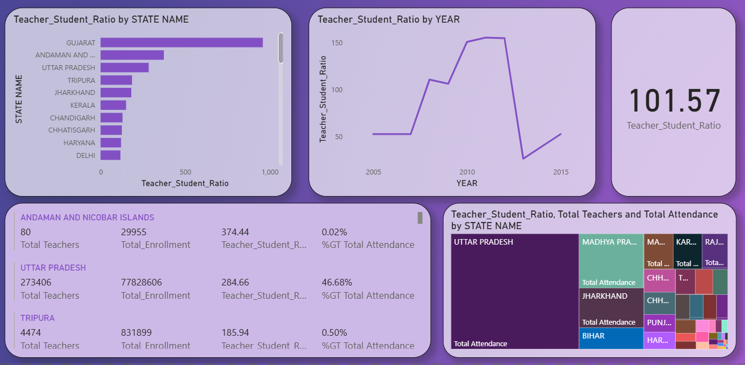
Dashboard Design and Structure
Dashboard Pages:
Page 1: India’s elementary education dashboard
Page 2: Enrollment and School Distribution
Page 3: Teacher Availability vs Student Attendance
Page 4: Infrastructure Quality Index
Page 5: Gender and Equity Analysis
Page 6: Composite Education Readiness Score
Design Flow:
Consistent colour palette (Education theme: lavender, purple)
Slicers for State & Year interactivity.
Sample dashboard design

Slide 5
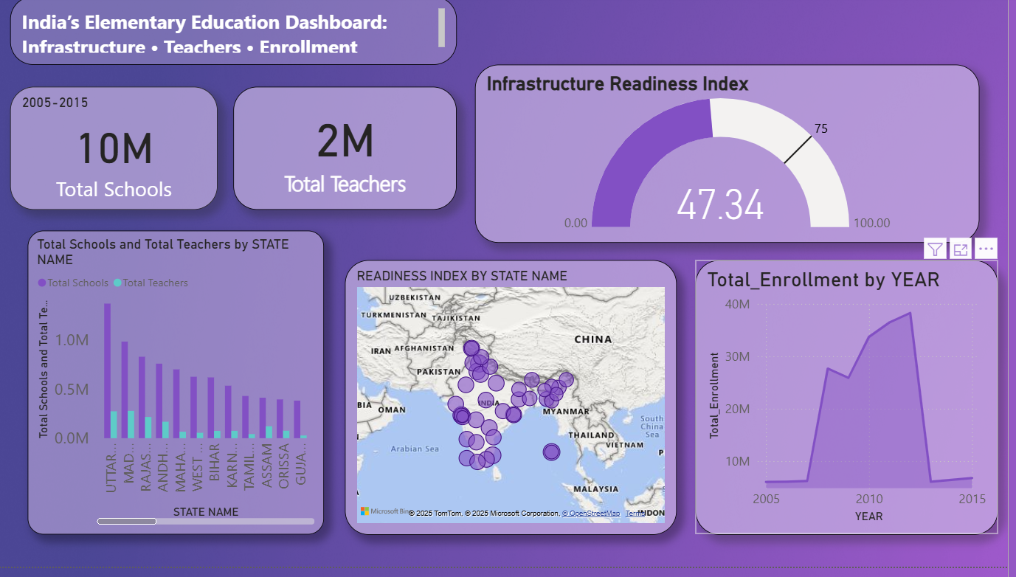
Key Insights and Analytics
India has over 10 million schools and 2 million teachers across all states.
The Infrastructure Readiness Index averages 47.34, indicating moderate progress nationwide.
Enrollment peaked around 2012–2013, showing strong engagement before a slight decline.
States like Uttar Pradesh, Madhya Pradesh, and Maharashtra lead in school and teacher count.

Slide 6
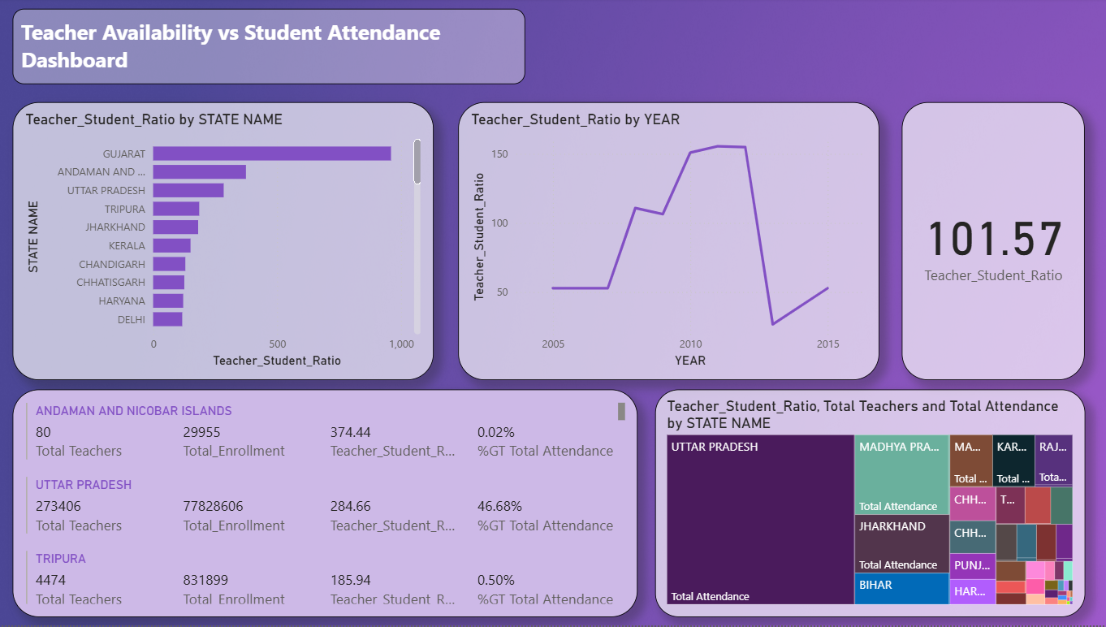
Recommendations or Policy Implications
Recommendations:
Improve staffing ratios in low-readiness districts through teacher redistribution.
Target infrastructure upgrades (water, toilets) where female participation lags.
Launch district-level performance monitoring using Education Readiness Index.
Encourage public-private partnerships to fill school infrastructure gaps.
Regular data audits to keep the readiness dashboard dynamic and up to date.

Slide 7
Conclusion and Learning Summary
Conclusion:
The Education Readiness Index (ERI) offers a comprehensive snapshot of India’s elementary education system.
Combining infrastructure, staffing, and enrollment gives a data-driven view of educational health.
This framework can guide policy, budget allocation, and performance improvement programs.
Learnings:
Strength in data cleaning and transformation using Python + Power BI.
Building multi-layer dashboards with calculated measures & DAX.
Translating data into actionable insights for real-world policy outcomes.

Slide 8
Thank you

