Slide 1


Finite State Automata (FSA) in Natural Language Processing-State Transitions and Language Recognition
DSA0302:-Natural Language Processing
Department: Artificial Intelligence & data science
.
Student Name:
B .Varun Kumar Reddy
Objective
Understand Finite State Automata, learn state transitions, recognize language patterns, and implement an FSA using Python.

Slide 2
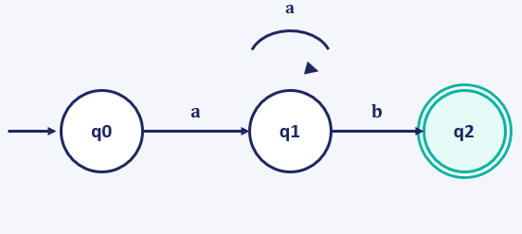
Introduction to Finite State Automata
What is Finite State Automata (FSA)?
FSA is a mathematical model that recognizes patterns or sequences of symbols using a finite number of states and transitions triggered by input characters.
Components
Start State, Input Alphabets, Transition Function, Initial State and Final (Accept) State.
Example — Recognizing Strings Ending With "ab"
q0 (Start) reads ‘a’ and moves to q1; q1 reads ‘a’ and loops back to itself; q1 reads ‘b’ and moves to q2, the Accept state.

Slide 3
State Transition Example
Input = "aaab"
q0 →(a)→ q1 →(a)→ q1 →(a)→ q1 →(b)→ q2
Final State = q2 → Result: Accepted
Input = "abaa"
q0 →(a)→ q1 →(b)→ q2 →(a)→ q1 →(a)→ q1
Final State = q1 → Result: Rejected

Slide 4
Python Program
FSA Implementation (Python)
def fsa(string):
state = 0
for ch in string:
if state == 0:
if ch == 'a':
state = 1
elif state == 1:
if ch == 'a':
state = 1
elif ch == 'b':
state = 2
elif state == 2:
if ch == 'a':
state = 1
else:
state = 0
if state == 2:
print("Accepted")
else:
print("Rejected")
fsa("aaab")
fsa("abaa")
fsa("cab")

Slide 5
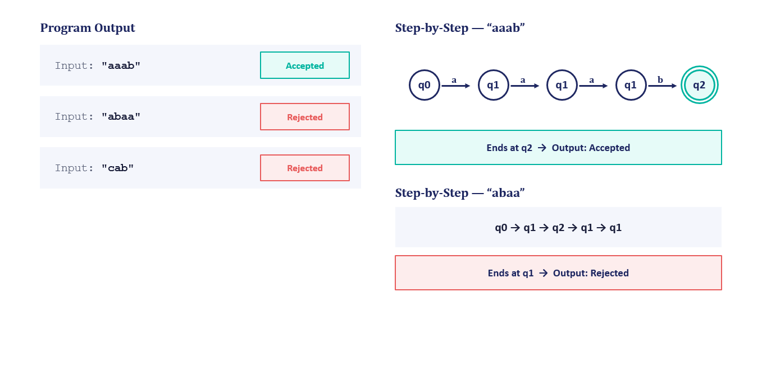
Output and Explanation
Program Output
fsa("aaab") → Accepted fsa("abaa") → Rejected fsa("cab") → Rejected
Step-by-Step: "aaab"
q0 → q1 → q1 → q1 → q2 — ends at the Accept state q2, so the result is Accepted.
Step-by-Step: "abaa"
q0 → q1 → q2 → q1 → q1 — ends at q1, not the Accept state, so the result is Rejected.

Slide 6
Applications, Advantages & Limitations
Applications
Spell checking, tokenization, lexical analysis, morphological analysis, pattern matching, chatbots, and search engines.
Advantages
Fast processing, easy implementation, low memory usage, and efficient pattern recognition.
Limitations
Cannot understand sentence meaning, cannot recognize complex grammar, and works only for regular languages.
Conclusion
FSA is a simple yet powerful computational model that recognizes valid patterns through state transitions, forming the foundation for lexical analysis, tokenization, spell checking, and pattern matching in NLP.

