Slide 1


IE6600 Computation and Visualization for Analytics
Group Project: Team 3
VARUN KUMAR
SATYAJIT LANKA
SHRIRAM VIJAYKUMAR
SARAVANAN ARUMUGAM

Slide 2
311 Service Requests Analysis

Slide 3
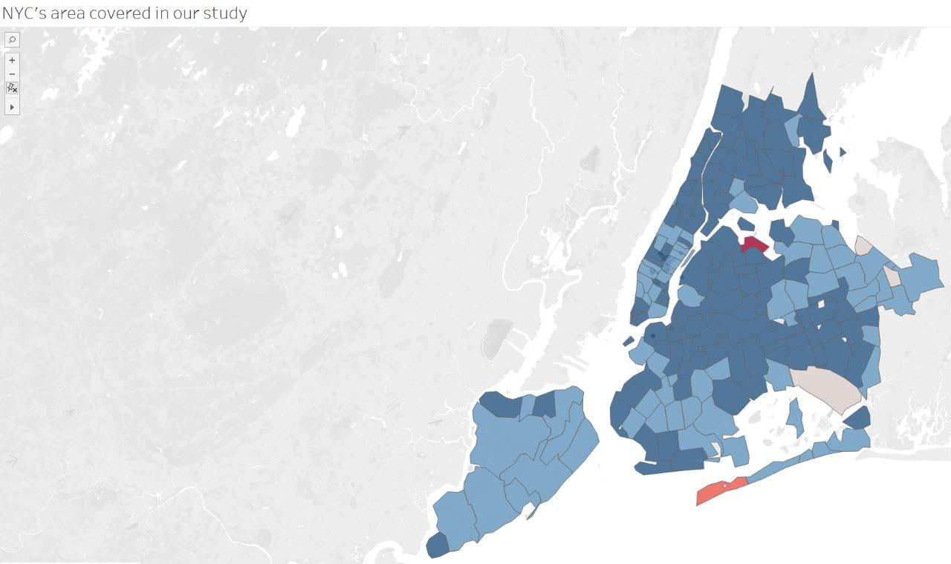
What is 311?

Slide 4
311 Service Requests
3-1-1 was created for non-emergency municipal services, so that 9-1-1 can handle emergencies.
First started in Baltimore Maryland in 1996, this was later implemented in NYC on March 09, 2003. Data became open source since 2010.
180 languages, 60000+ customers, 7700+ daily requests, 2,76,827 highest calls in a day via call, text, app, and website.

Slide 5
Objectives
To create a comprehensive interactive dashboard to visualize the 3-1-1 Dataset of New York City
To evaluate impact of Covid-19 on various municipal complaints
To compare multiple variables affecting these complaints in different period of timelines

Slide 6
Research Questions
Does the infamous Pareto principle apply to the 311 use case ?
Is population directly correlated with the volume of 311 complaints ?
Do people become more tolerant during holiday season ?
Did Covid actually impact the efficiency in NYC agencies service ?
Did the Covid impact the volume of 311 requests ?
Do New Yorkers actually sleep at night ?

Slide 7

Dataset
NYC 311 - data from 2010 to Sept 26, 2022
31,132,855 records with 41 columns (fields)
500+ types of complaint
NYC Population Census Data
Source: nycopendata.socrata.com, Big-Query
https://portal.311.nyc.gov/
Texting
311 - 692
Mobile App

Slide 8
Data Cleaning and Preparation
Filtering data on the basis of required time period
Removing unwanted columns (2gb, 20 columns with 11 million rows)
Removing Null values using Pandas library with Python
Created calculated field( 2.2gb, 24 columns with 11 million rows)
Implemented Tableau Prep to create calculated fields
Manually grouped complaints based on same types
Final data size of 2.3 gb with 25 columns and 12 million rows

Slide 9
VISUALIZATION

Slide 10
Future Work
Implement a machine learning based prediction model to predict the number of complaints generated by NYC to aid in allocation of resources more efficiently
Compute more data points and parameters with much higher computation power which will result in better in depth analysis of the 311 dataset.

Slide 11
Major Learnings
Tools like Tableau, Tableau Prep and Bigquery
Data processing and cleaning large datasets
Data visualization (Static and Interactive)
Creating dashboards
Storytelling skills

Slide 12
THANK YOU

