Slide 1


IE6600 Computation and Visualization for Analytics
Group Project: Team 3
VARUN KUMAR
SATYAJIT LANKA
SHRIRAM VIJAYKUMAR
SARAVANAN ARUMUGAM

Slide 2
Recap
Objective
Challenges
To create a comprehensive interactive dashboard to visualize the 3-1-1 Dataset of New York City and to evaluate impact of Covid-19 on various municipal complaints
Dataset Size (31 Million records, 18 gb, 12 years worth)
Modifying Dataset for EDA
Timestamp datatype mismatch in bigquery

Slide 3
Milestones Achieved
Dataset was broken into multiple smaller datasets, queried and cleaned partly in bigquery and in python
TIMESTAMP issue was solved by removing AM and PM Notation
Preliminary data exploration was done on the dataset using Python Jupyter Notebook
Notes:
smaller datasets into one bigger dataset.
Data warehousing was done using big query
For 3 thee datetime issue was solved by removing AM and PM notation

Slide 4
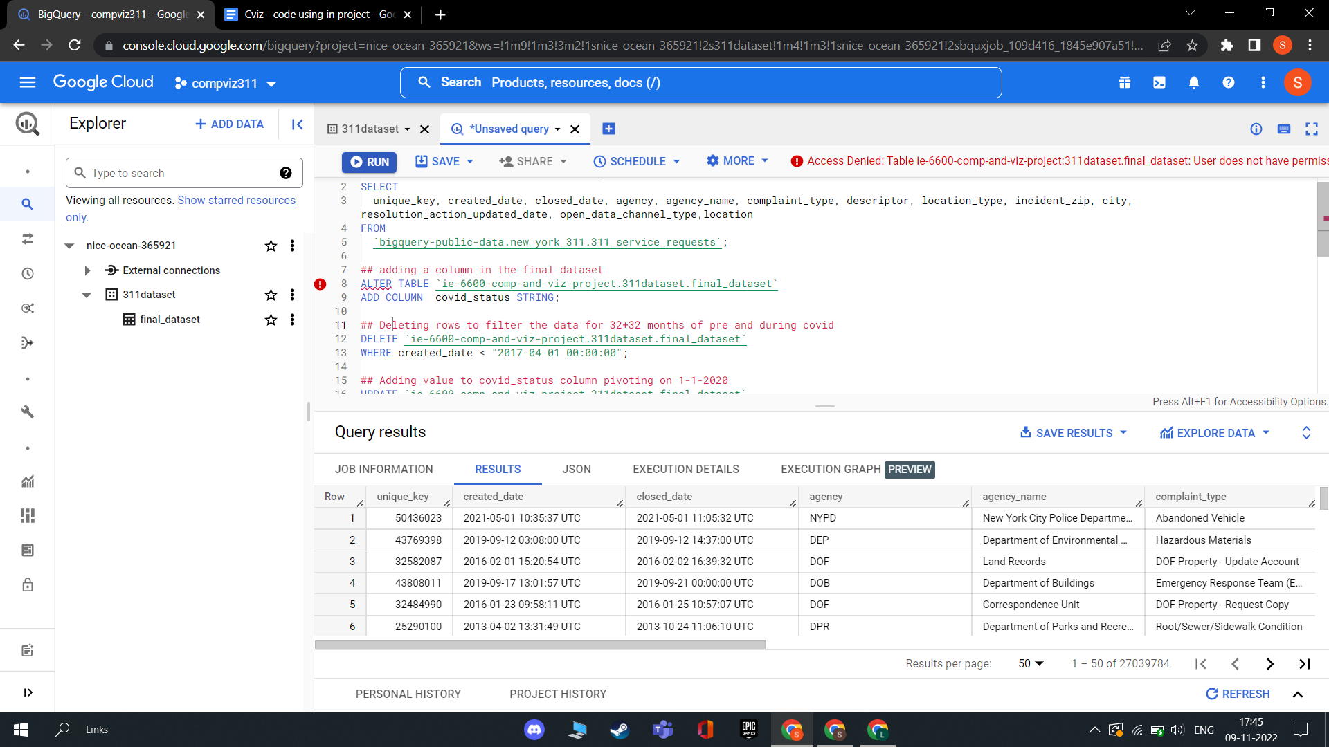
BigQuery

Slide 5
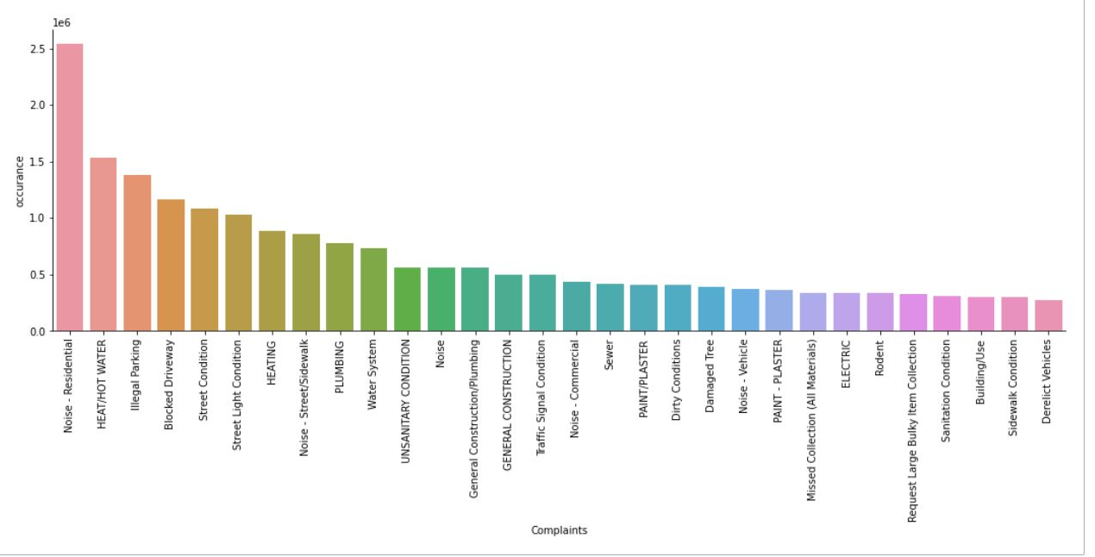
Count of complaints by types

Slide 6
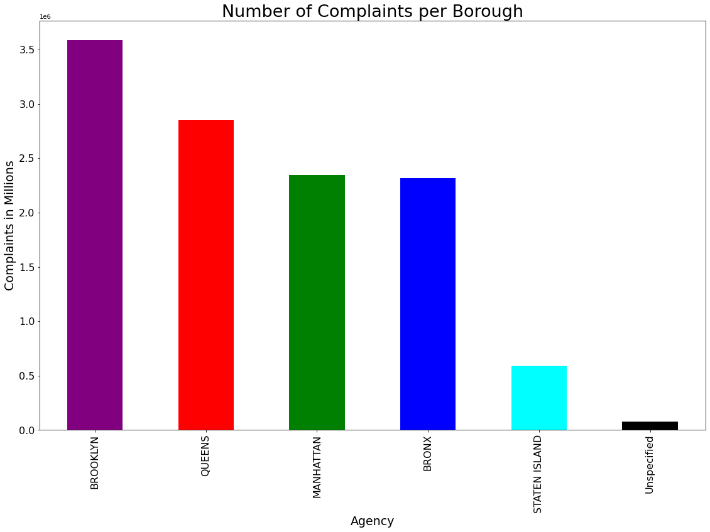

Slide 7
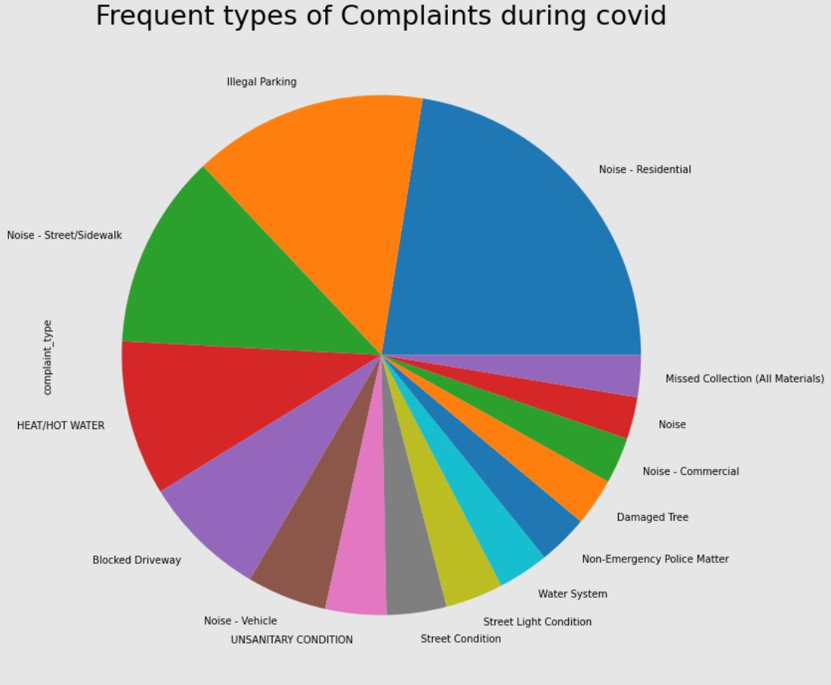

Slide 8
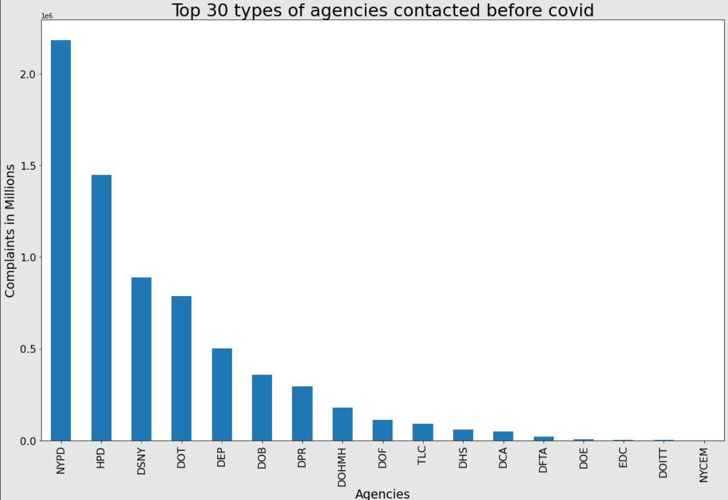
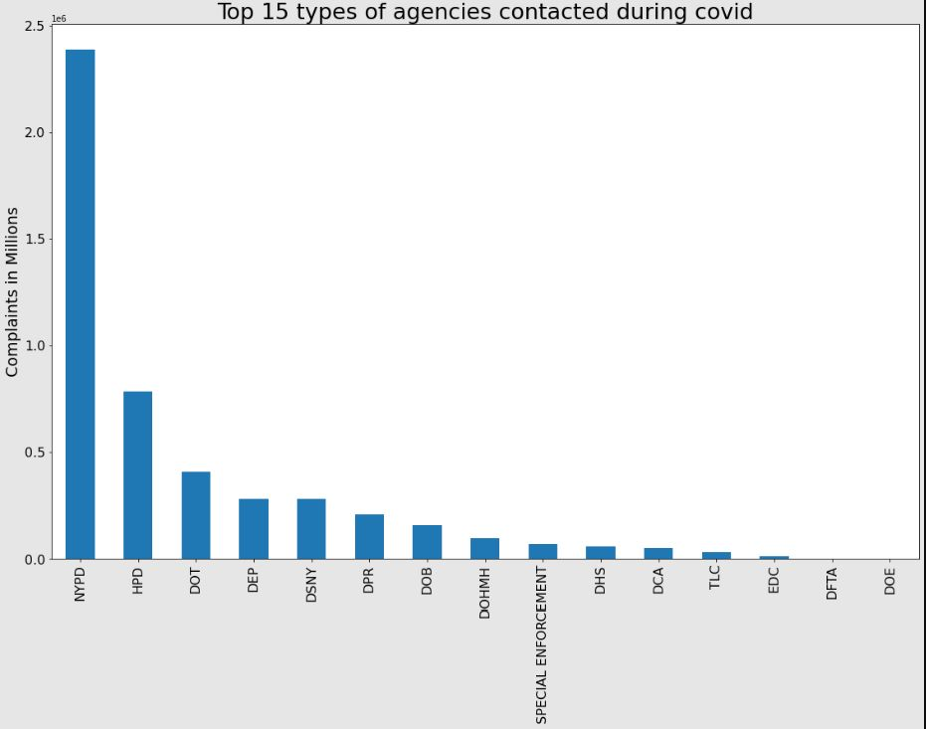

Slide 9
Future Steps & Timeline
Grouping & calculated columns - November 13, 2022
Furthur cleaning and preparation in Tableau Prep - November 20, 2022
Coming up with additional research questions and hypothesis - November 25, 2022
Visualization in Tableau with an interactive dashboard - November 30, 2022
Report Preparation - December 05, 2022

Slide 10
THANK YOU

