Slide 1
ANSIBLE

Slide 2
What is Ansible
Ansible is an open-source IT engine that automates application deployment, cloud provisioning, intra service orchestration, and other IT tools.
It is an automation and orchestration tool popular for the following reasons:
Simple to Install.
Free and open source.
Lightweight and consistent.
OpenSSH security features make it very secure.

Slide 3
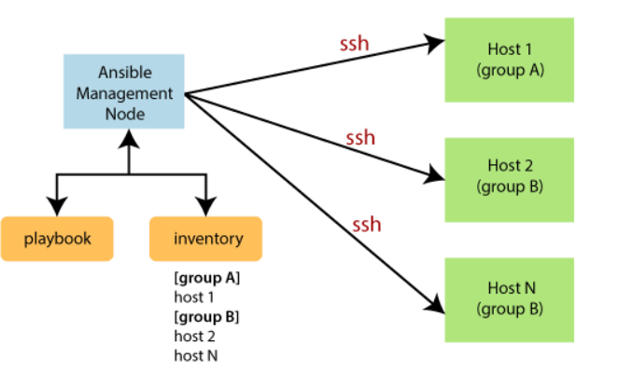
Workflow of Ansible

Slide 4
Terms | Explanation
Ansible Server | It is a machine where Ansible is installed and from which all tasks and playbooks will be executed.
Modules | The module is a command or set of similar commands which is executed on the client-side.
Task | A task is a section which consists of a single procedure to be completed.
Role | It is a way of organizing tasks and related files to be later called in a playbook.
Fact | The information fetched from the client system from the global variables with the gather facts operation.
Inventory | A file containing the data regarding the Ansible client-server.
Play | It is the execution of the playbook.
Handler | The task is called only if a notifier is present.
Notifier | The section attributed to a task which calls a handler if the output is changed.
Tag | It is a name set to a task that can be used later on to issue just that specific task or group of jobs.

Slide 5
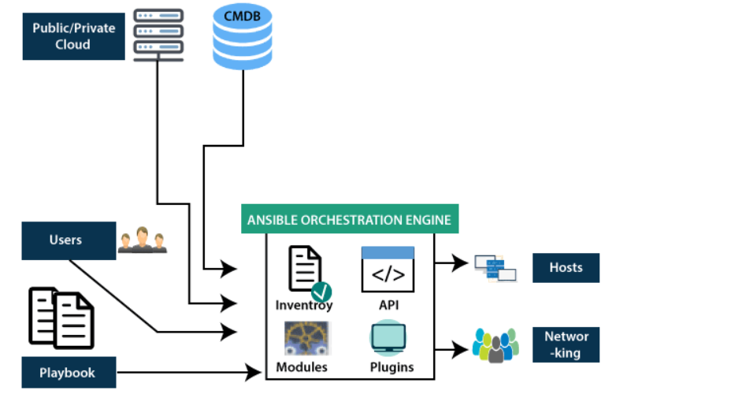
Ansible Architecture

Slide 6
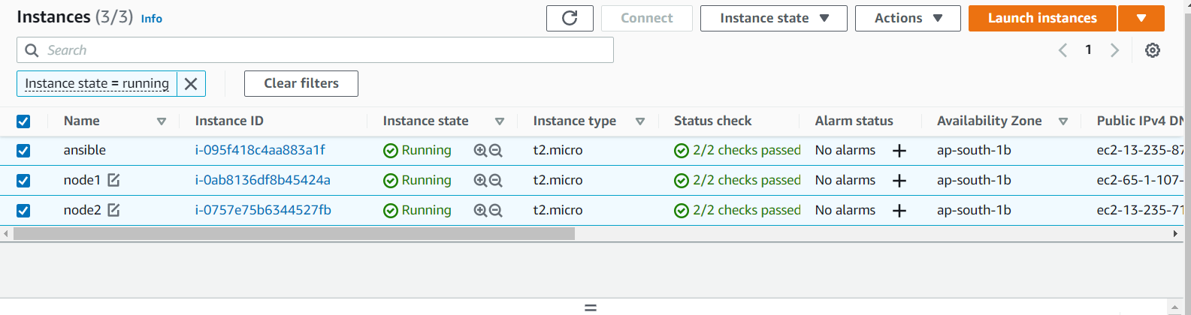
Install 2 or 3 linux instance

Slide 7
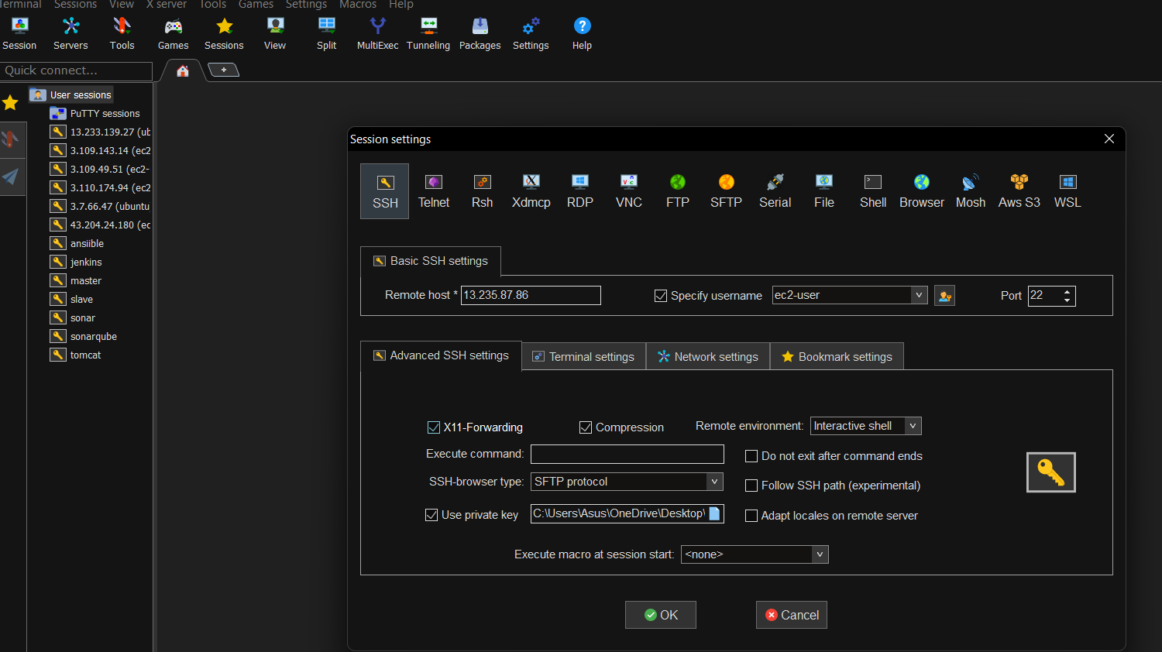
Connect the instances with mobaexterm or putty

Slide 8
Master node configuration

Slide 9
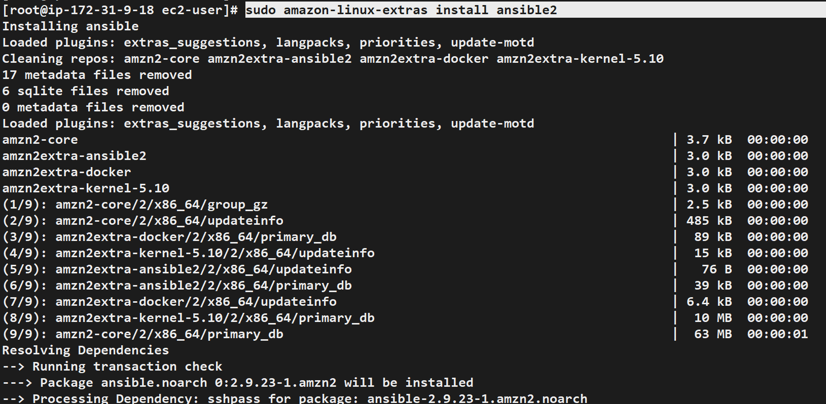
Install the ansible by executing following command.
sudo amazon-linux-extras install ansible2

Slide 10
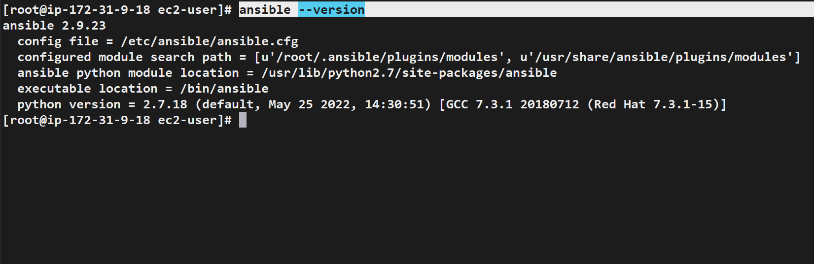
By executing this following command we check the version

Slide 11
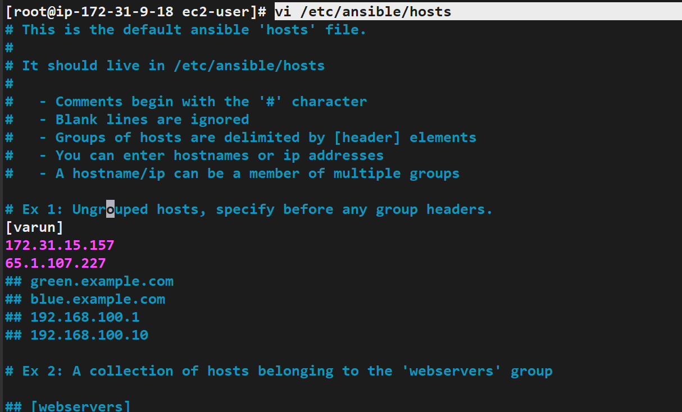
Add the slave nodes by adding them in group

Slide 12
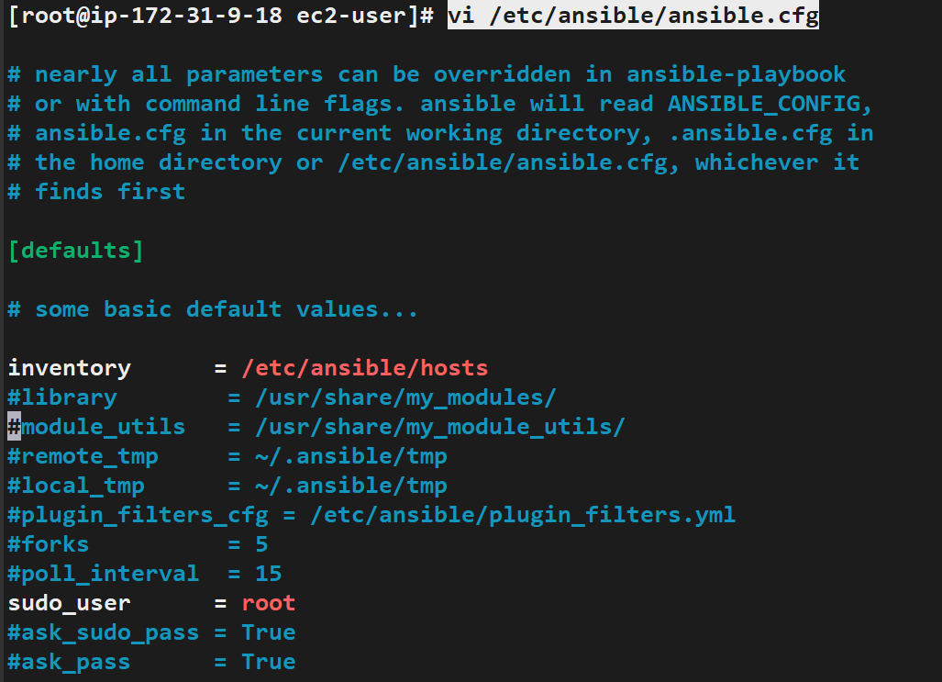
Configure the ansible.cfg by un commenting inventory

Slide 13
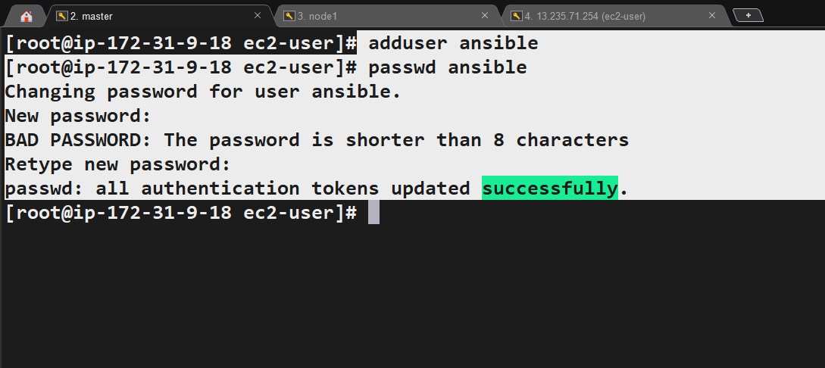
Add the username & pasword

Slide 14
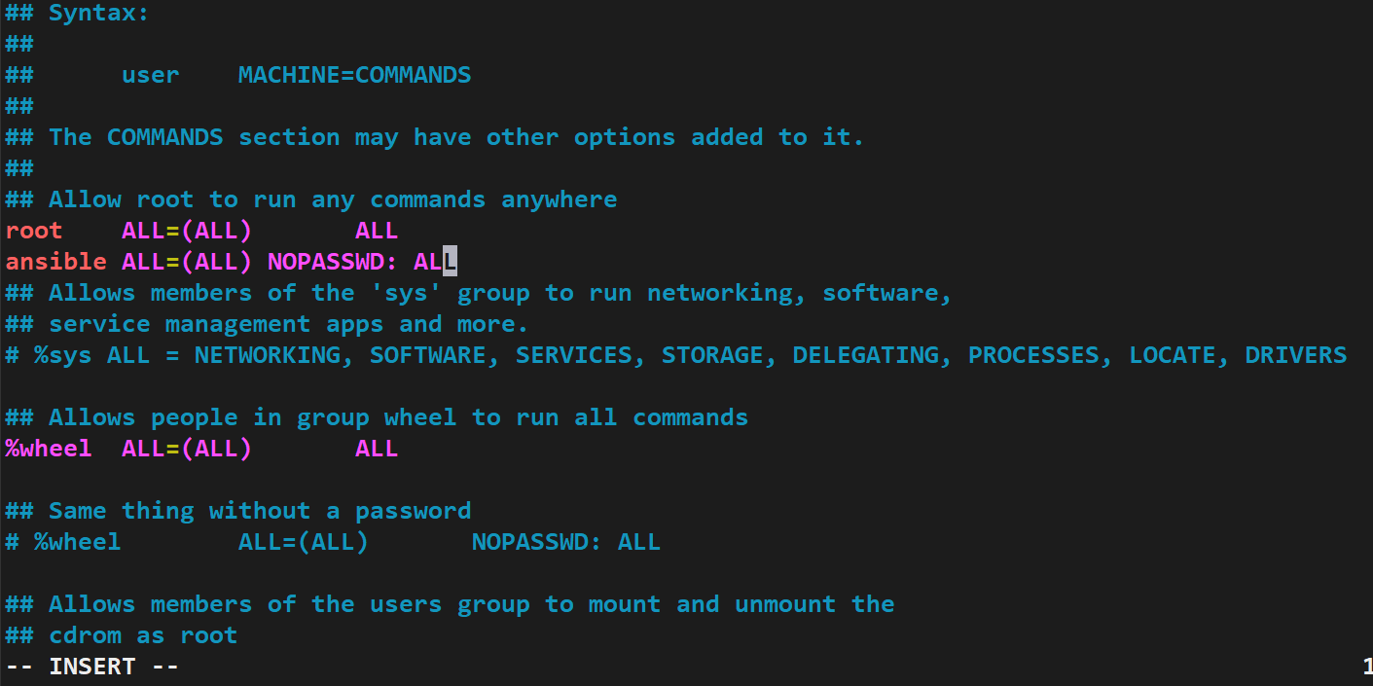
visudo
Inside visudo file add the username & login without using password

Slide 15
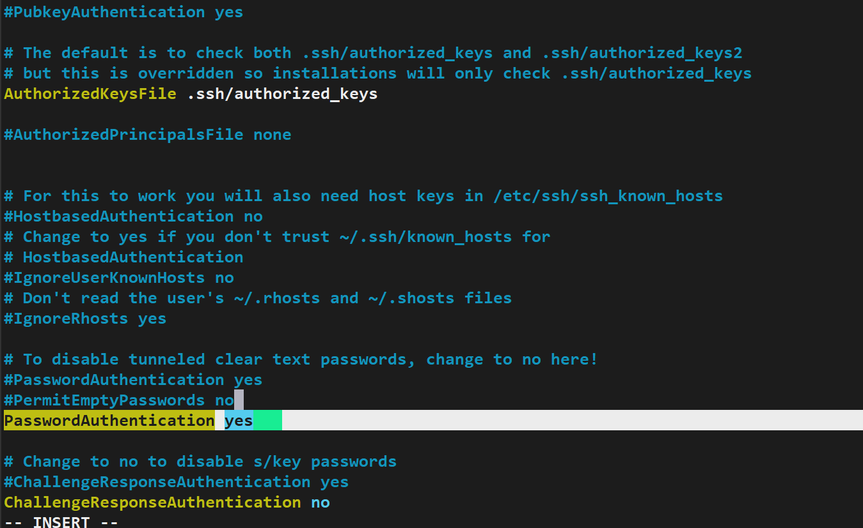
Vi /etc/ssh/sshd_config
Uncomment the passwordauthentication

Slide 16
Slave node configuration

Slide 17
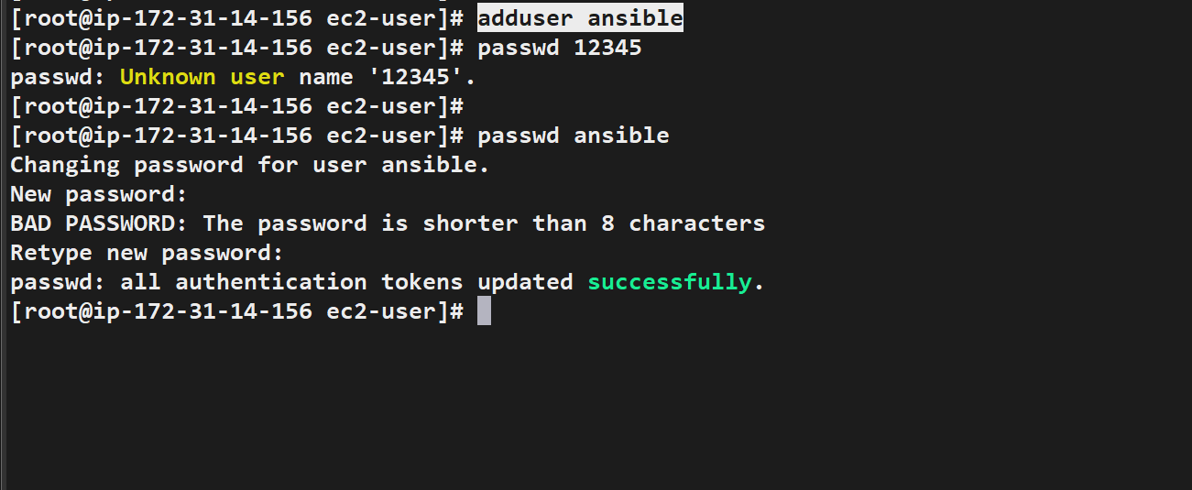
Add the username & password in slave node.

Slide 18
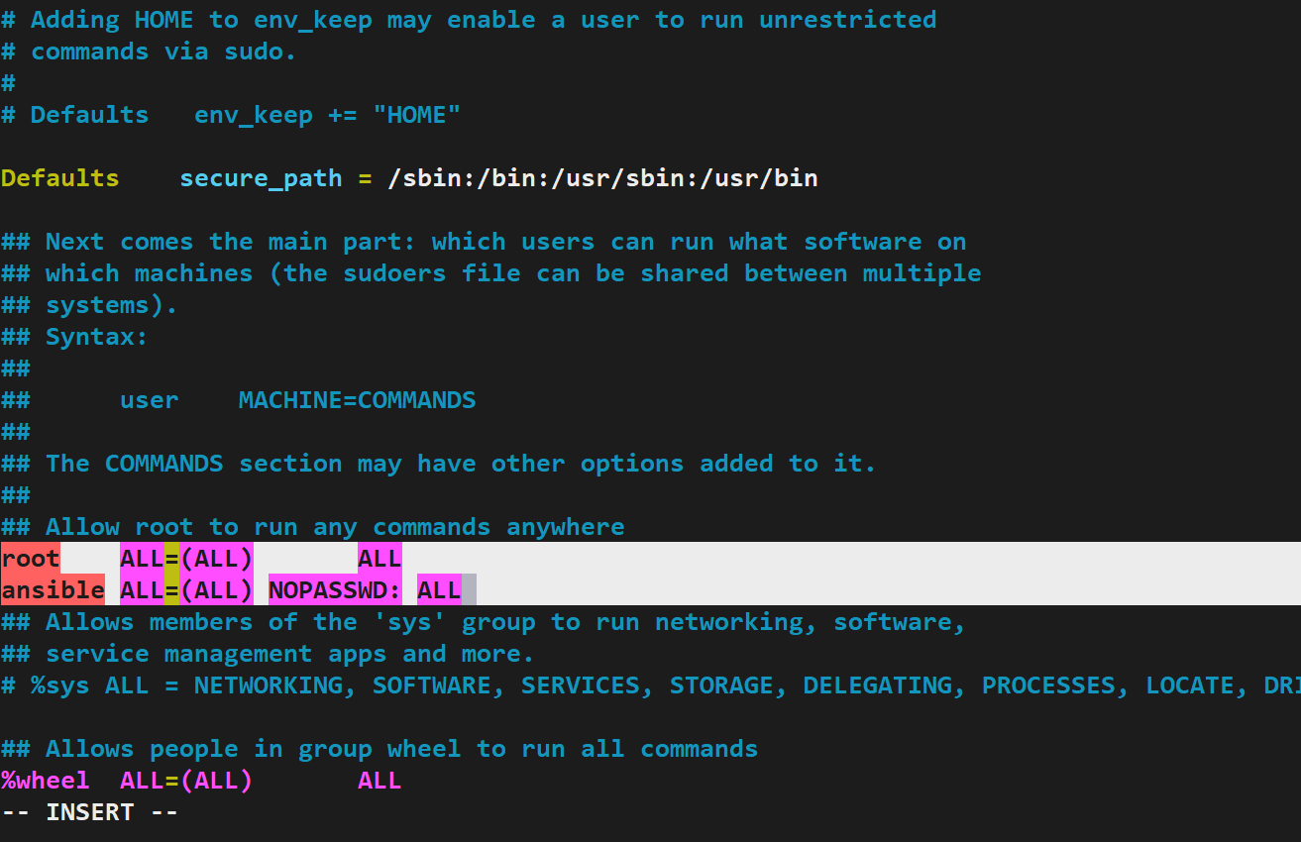
Inside visudo file add the username & login without using password

Slide 19
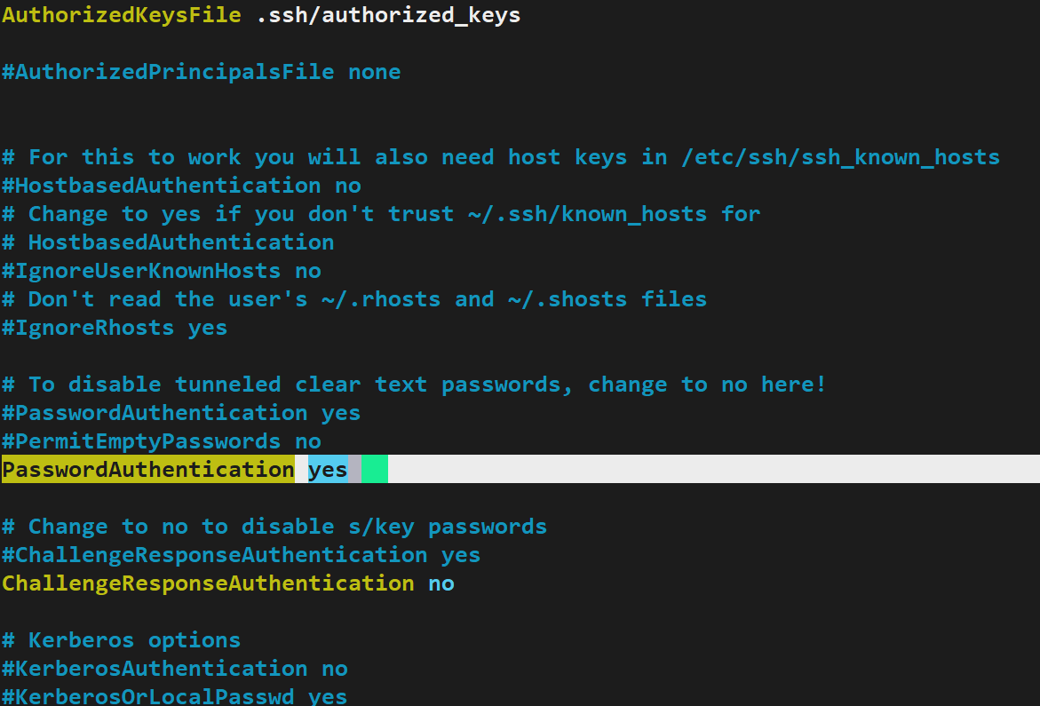
Uncomment the line

Slide 20
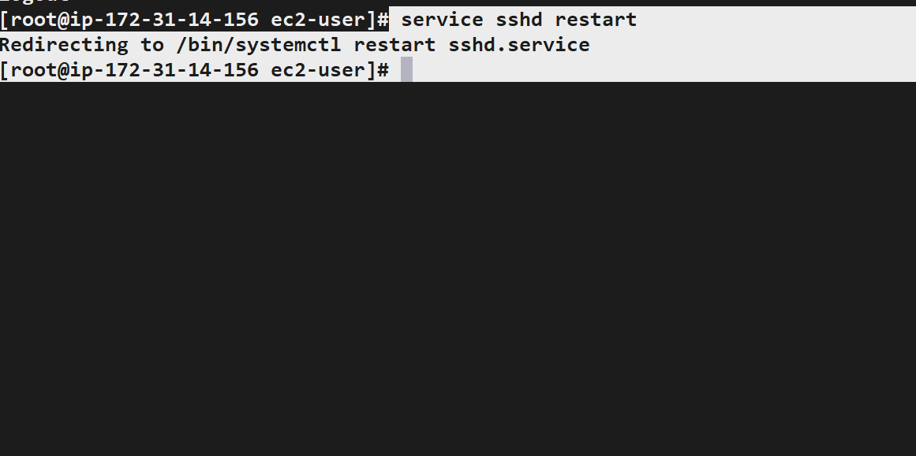
Restart the service by entering the fallowing command.

Slide 21
SSH connection between master & slave

Slide 22
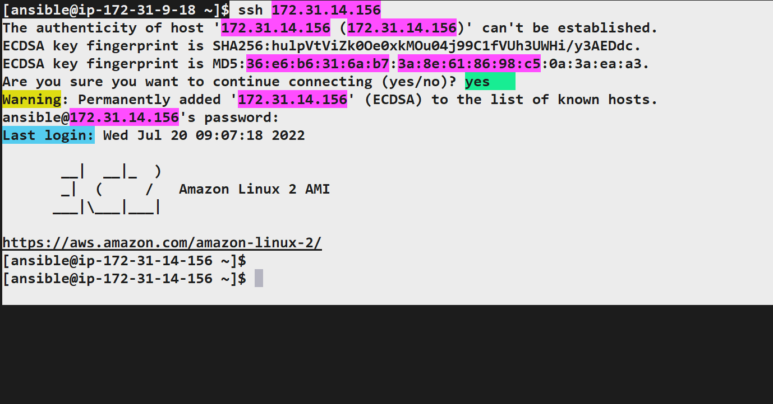
Connect the slave node by running ssh <slave node IP>

Slide 23
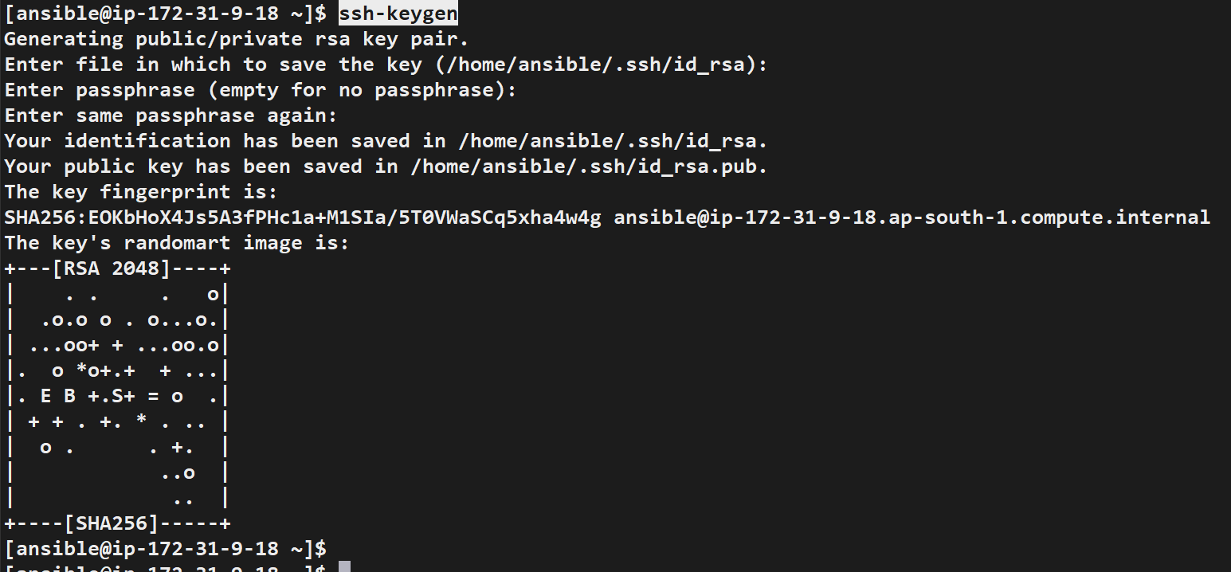
Do the key-gen in master as a user for password less login

Slide 24
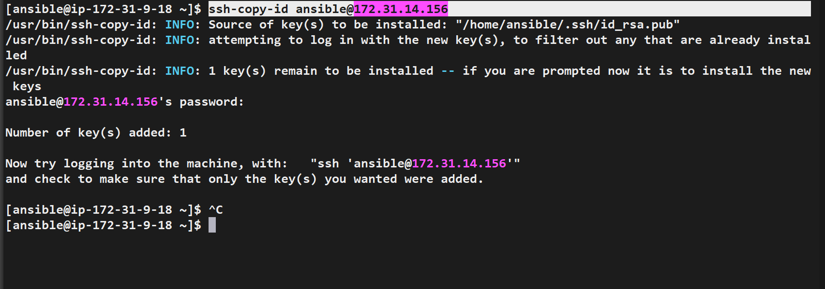
Copy the key to nodes
ssh-copy-id ansible@172.31.14.156

Slide 25
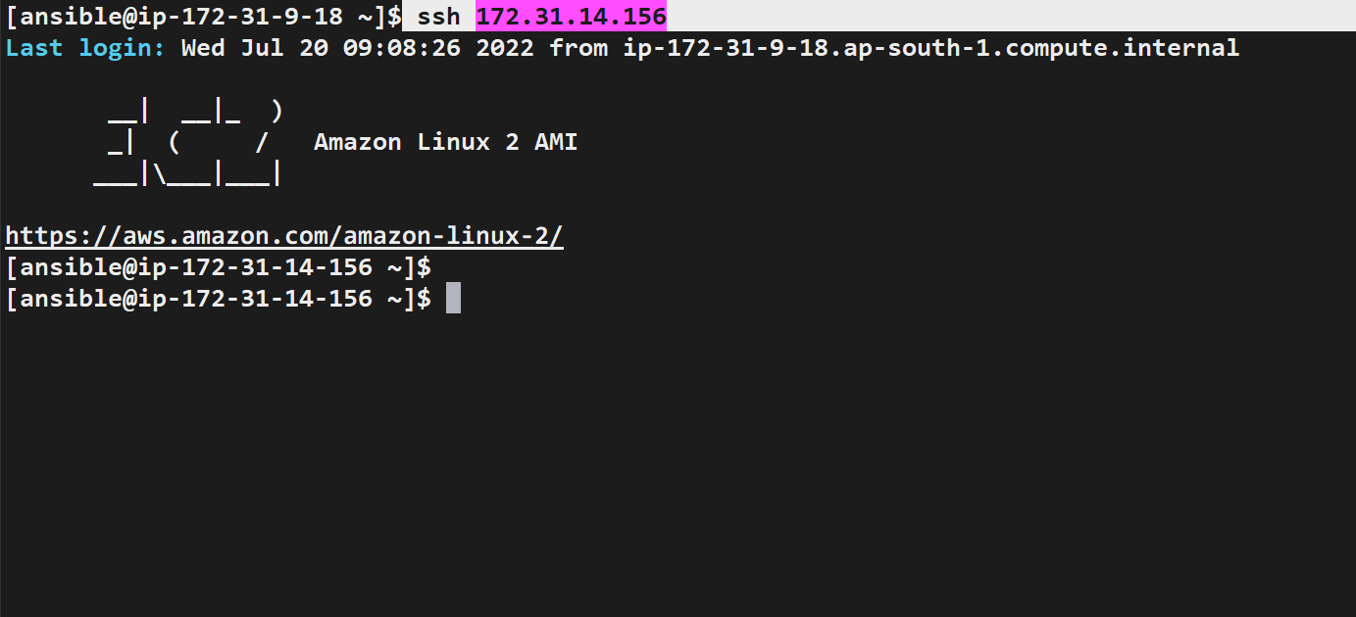
ssh <node IP> if we run this it will not ask the password

Slide 26
Adhoc commands
Ad-hoc commands are one of the simplest ways of using Ansible. These are used when you want to issue some commands on a server or bunch of servers. The ad-hoc commands are not stored for future use, but it represents a fast way to interact with the desired servers.

Slide 27
ansible <grp_name> -a “ls”
ansible <grp_name> -a “touch <file_name>
ansible all –a “touch <file>
ansible <grp_name> -a “ls –al”
ansible <grp_name> -a “sudo yum install httpd –y”
ansible <grp_name> -ba “yum install tree –y”
Ansible <grp_name> -ba “yum remove httpd –y”
-a = argument
-b= become
[0] = node number

Slide 28
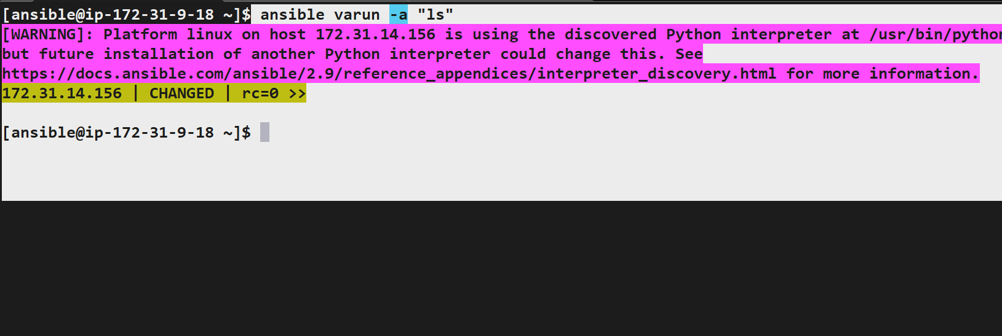

Slide 29
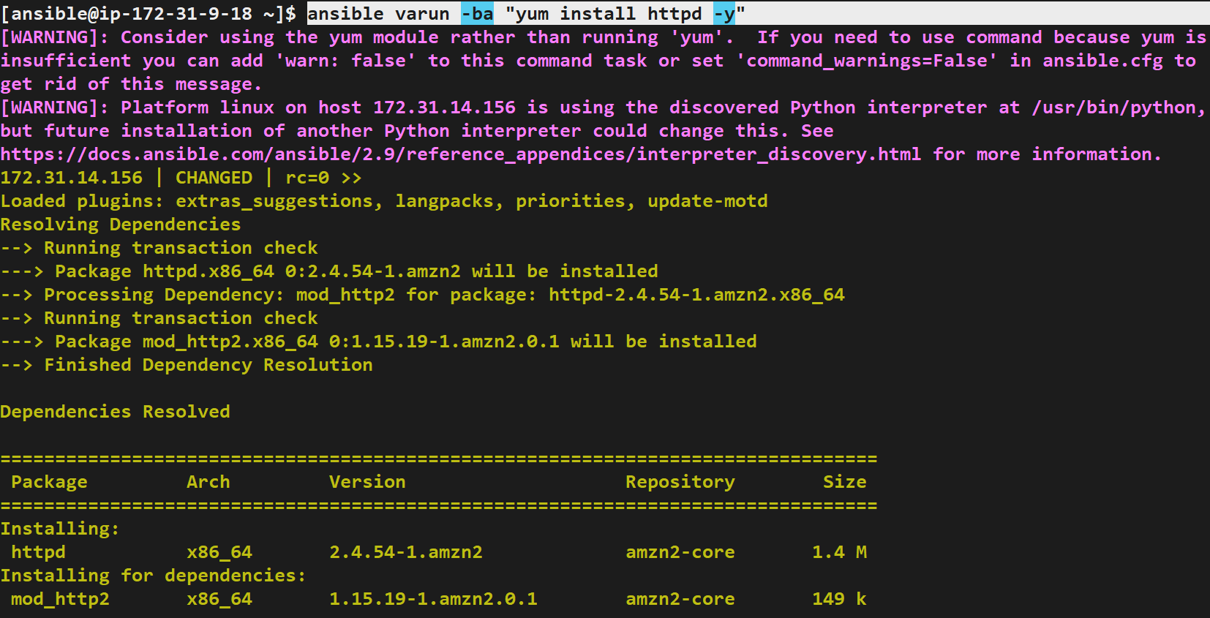

Slide 30
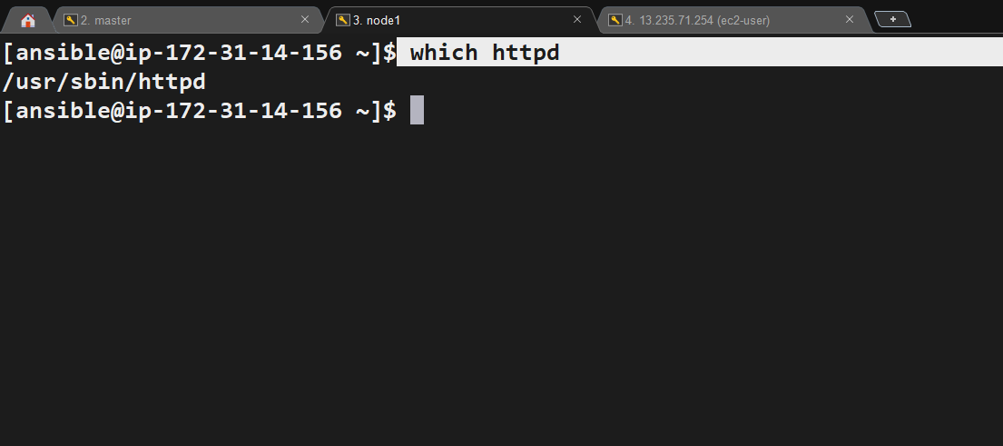

Slide 31
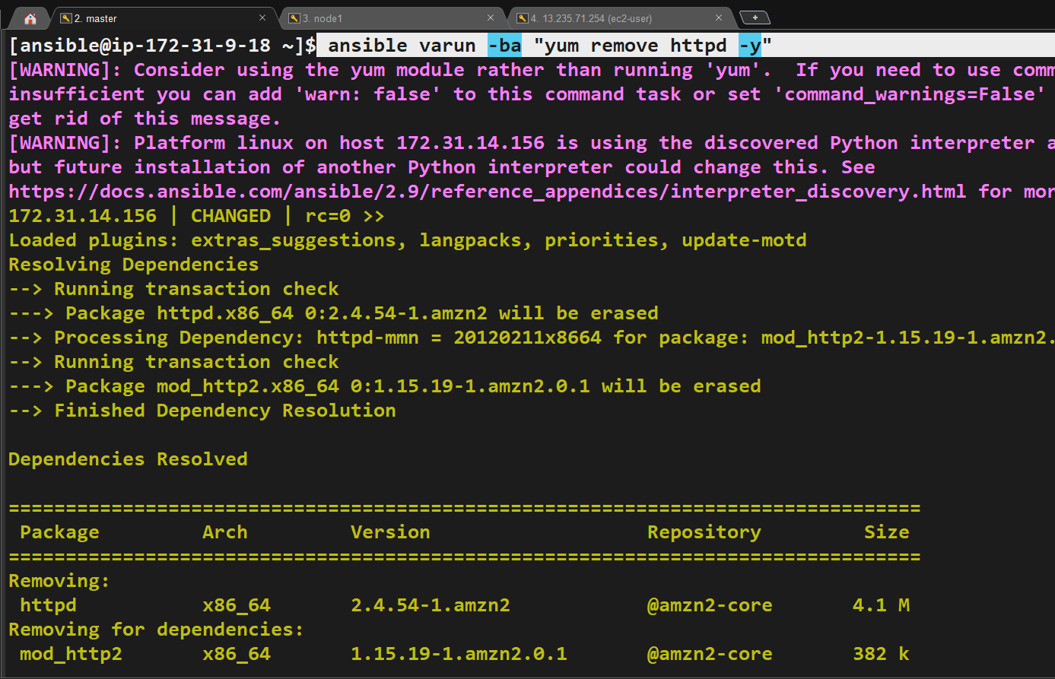

Slide 32
Module commands
Ansible modules are discrete units of code which can be used from the command line or in a playbook task.
The modules also referred to as task plugins or library plugins in the Ansible.
Ansible ships with several modules that are called module library, which can be executed directly or remote hosts through the playbook.
Users can also write their modules. These modules can control like services, system resources, files, or packages, etc. and handle executing system commands.

Slide 33
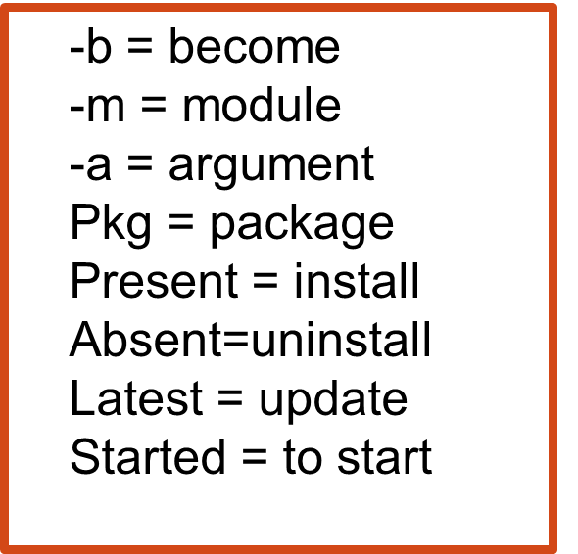
ansible <grp_name> -b –m yum –a “pkg=docker state=present”
ansible <grp_name> -b –m yum –a “pkg=httpd state=latest”
ansible <grp_name> -b –m yum –a “pkg=httpd state=absent”
ansible <grp_name> -b –m user –a “name=<user_name>”
ansible <grp_name> -b –m copy –a “src=<file_name> dest=<path>”

Slide 34
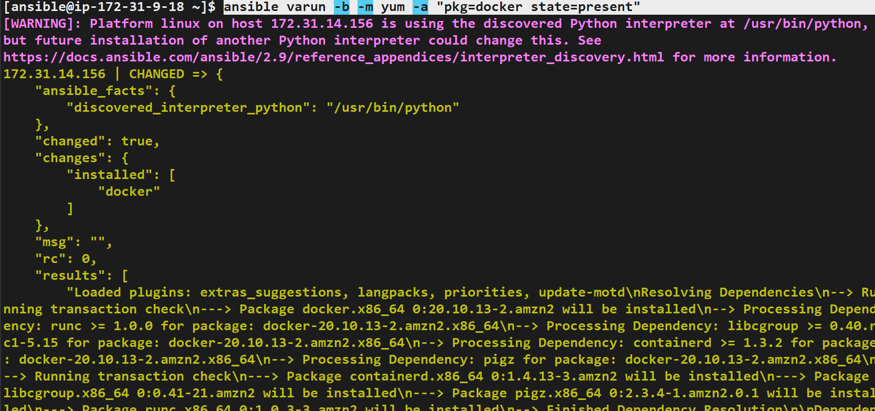

Slide 35
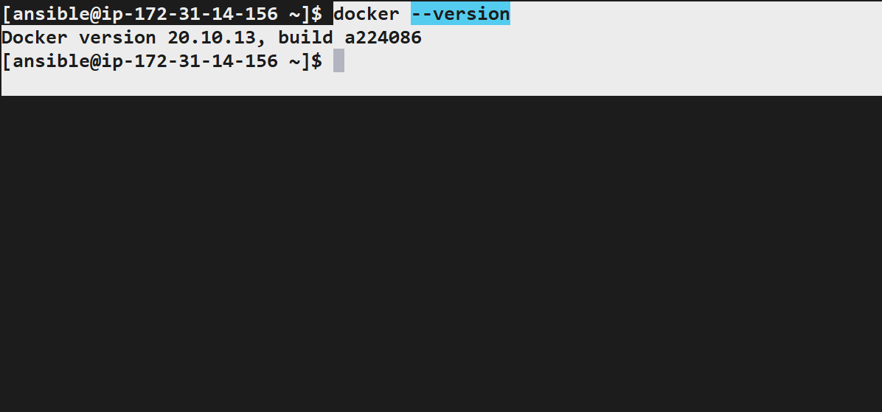

Slide 36
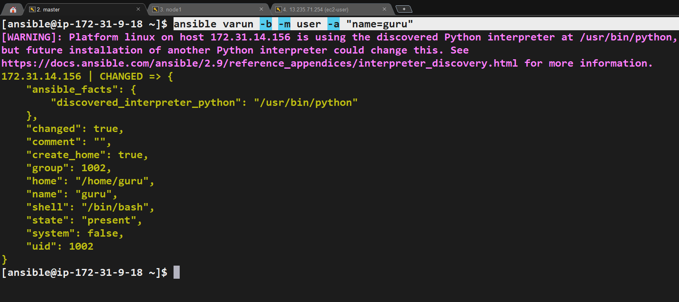

Slide 37
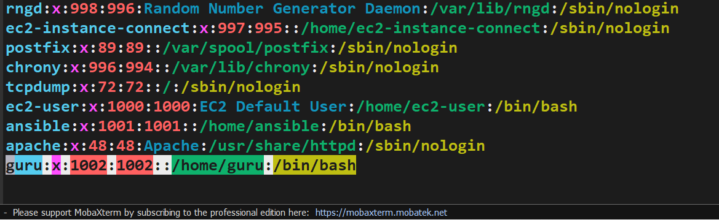

Slide 38
Setup

Slide 39
Setup is like a database.
It will gather the information from slave nodes.
Setup commands
ansible <grp_name> -m setup ----It will give the complete details of nodes
ansible <grp_name> -m setup –a “filter=*ipv4*” ----It show only IP of nodes

Slide 40
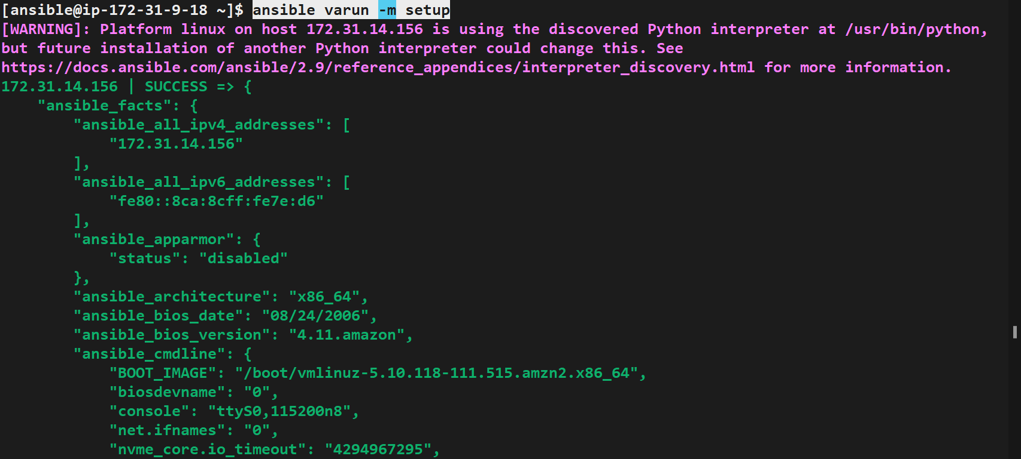

Slide 41
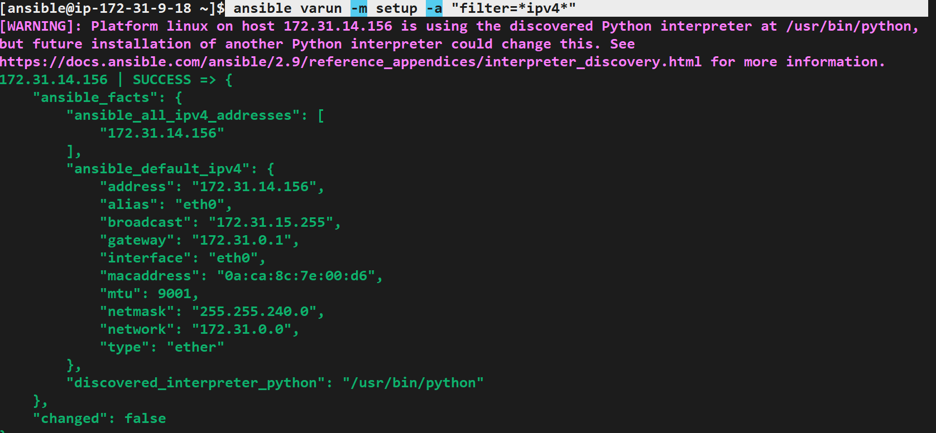

Slide 42
Playbook
Playbooks are the files where the Ansible code is written. Playbooks are written in YAML format. YAML means "Yet Another Markup Language," so there is not much syntax needed.
Playbooks are one of the core features of Ansible and tell Ansible what to execute, and it is used in complex scenarios. They offer increased flexibility.
Playbooks contain the steps which the user wants to execute on a particular machine. And playbooks are run sequentially. Playbooks are the building blocks for all the use cases of Ansible.
Ansible playbooks tend to be more configuration language than a programming language.

Slide 43
Sample playbook
---
-hosts: <grp_name>
-user: <user_name>
-become: yes
-connection: ssh
Target & Task playbook
---
-hosts: <grp-name>
-become: yes
-connection: ssh
-task:
-name: install httpd on linux
action: yum name=httpd state=installed

Slide 44
Sample playbook
---
- hosts: all
tasks:
- name: Print message
debug:
msg: Hello Ansible World
Playbook for installing nginx
---
- hosts: all
become: yes
vars:
page_title: My Landing Page
page_description: This is my landing page description.
tasks:
- name: Install Nginx
apt:
name: httpd
state: present

Slide 45
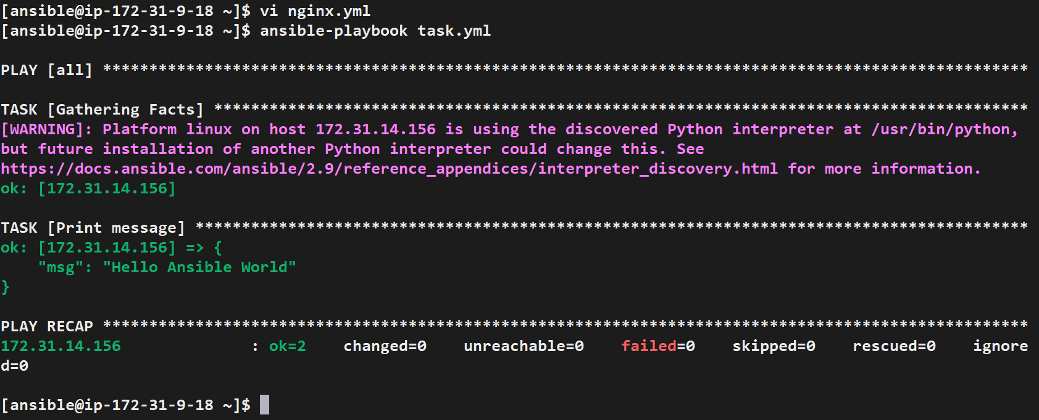

Slide 46
Handlers
A handler is exactly the same as a task ,but it will run when called by another task
Handlers are just like regular tasks in an ansible playbook,but are only run if the task contains a notify directive & also indicates that it changed something
Example:
tasks:
- name: Set host variables based on distribution
include_vars: "{{ ansible_facts.distribution }}.yml"
handlers:
- name: Restart web service
ansible.builtin.service:
name: "{{ web_service_name | default('httpd') }}"
state: restarted

Slide 47
Dry run
Check whether the playbook is formatted correctly
Cmd:
ansible-playbook <playbook_name> --check
. . .
- name: Update apt cache and install Nginx
apt:
name: nginx
state: latest
update_cache: yes

Slide 48
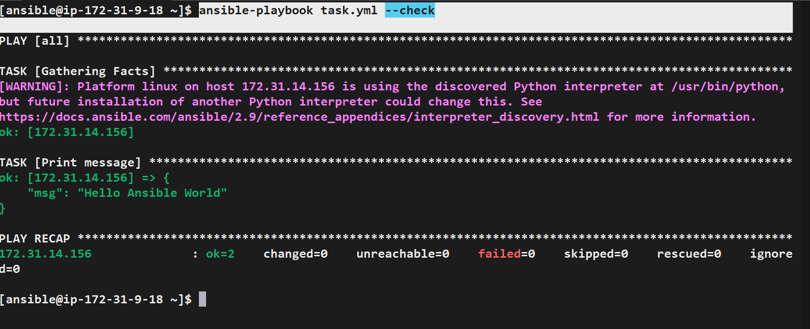
To check whether we written yaml file is correct.

Slide 49
Thank you

