Slide 1

JaCoCo

Slide 2
Why we need code Coverage
Testing is a most important part of a software development lifecycle. Without testing, the software is not ready for deployment. To test Java applications we mostly used Junit. JUnit framework is a Java framework that is used for testing. And now, JUnit is used as a standard when there is a need to perform testing in Java.

Slide 3
what is Code Coverage
Code Coverage is a software metric that is used to measure how many lines of our code are executed during automated tests. In other words, we can also say Code Coverage describes the percentage of code covered by automated tests and it checks which parts of code run during the test suite and which don’t.

Slide 4
what is JaCoCo
JaCoCo stands for Java Code Coverage. It is a free code coverage library for Java, which has been created by the EclEmma team. It creates code coverage reports and integrates well with IDEs like IntelliJ IDEA, Eclipse IDE, etc. JaCoCo also integrates with CI/CD tools like Jenkins, Circle CI, etc.,

Slide 5
Add the JaCoCo maven plugin to your pom.xml file.
<plugin>
<groupId>org.jacoco</groupId>
<artifactId>jacoco-maven-plugin</artifactId>
<version>0.8.3</version>
<executions>
<execution>
<id>prepare-agent</id>
<goals>
<goal>prepare-agent</goal>
</goals>
</execution>

Slide 6
<execution>
<id>report</id>
<phase>prepare-package</phase>
<goals>
<goal>report</goal>
</goals>
</execution>
<execution>
<id>post-unit-test</id>
<phase>test</phase>
<goals>
<goal>report</goal>
</goals>

Slide 7
<configuration>
<!-- Sets the path to the file which contains the execution data. -->
<dataFile>target/jacoco.exec</dataFile>
<!-- Sets the output directory for the code coverage report. -->
<outputDirectory>target/my-reports</outputDirectory>
</configuration>
</execution>
</executions>
<configuration>
<systemPropertyVariables>
<jacoco-agent.destfile>target/jacoco.exec</jacoco-agent.destfile>
</systemPropertyVariables>
</configuration>
</plugin>

Slide 8
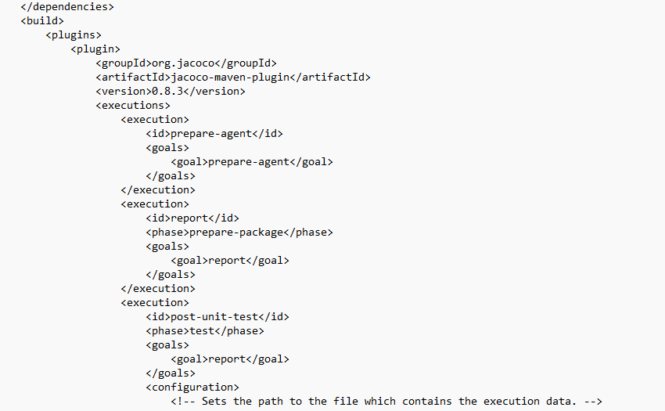
Adding the JaCoCo plugin inside the Pom.xml
Add the JaCoCo plugin inside the build before the plugin management.

Slide 9
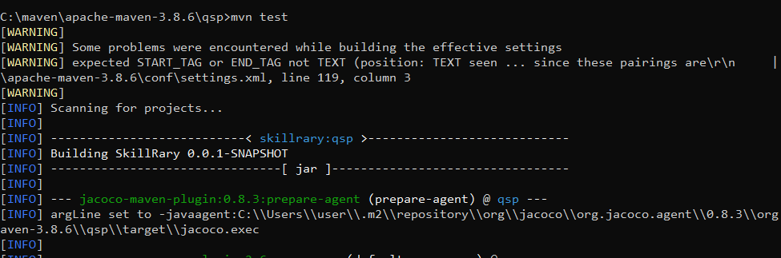
Testing the code
When we Run the command mvn test it will test the code .

Slide 10
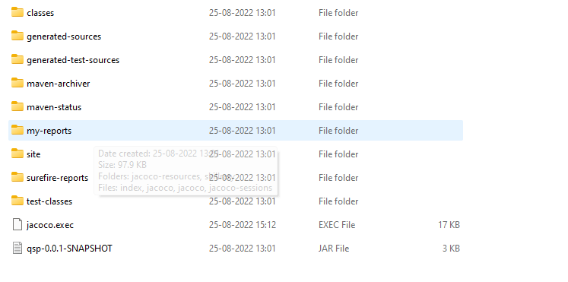
Report will Get Generated inside the Target folder

Slide 11
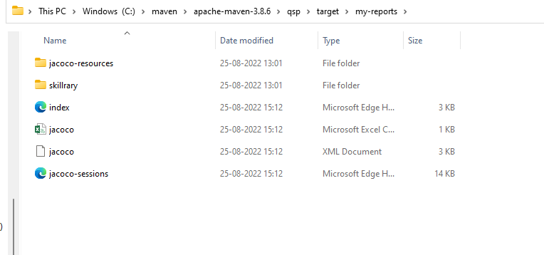
Generated Reports

Slide 12
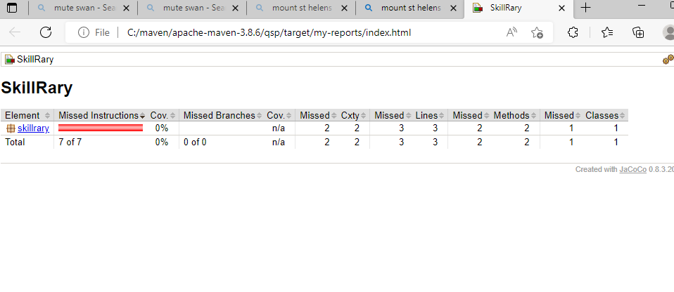
So you can see your report will be shown like this and the percentage completely depends on how you have written the test cases

Slide 13
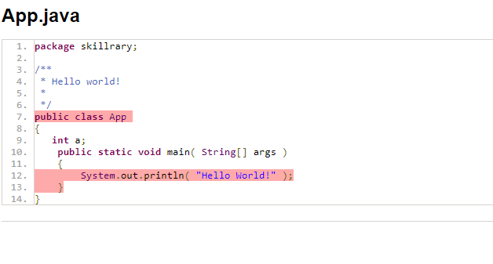
Note: The green color shows that all lines of code have been covered which means you have written the test cases for all the units. If you have encountered the yellow color line then partial code has been covered and if you have encountered with the red color then the code has not been covered.

Slide 14
Thank you

