Slide 1

Jenkins-Sonar-Jfrog
CI pipeline

Slide 2
JENKINS INSTALLATION IN
AWS-EC2 INSTANCE

Slide 3
JENKINS INSTALLATION IN AWS-EC2 INSTANCE
Launch the aws Linux instance & configure the instance.
Install the Jenkins by running the fallowing commands:
sudo wget -O /etc/yum.repos.d/jenkins.repo https://pkg.jenkins.io/redhat-stable/jenkins.repo
sudo rpm --import https://pkg.jenkins.io/redhat-stable/jenkins.io.key
sudo amazon-linux-extras install epel
sudo yum install java-11*
sudo yum install jenkins

Slide 4
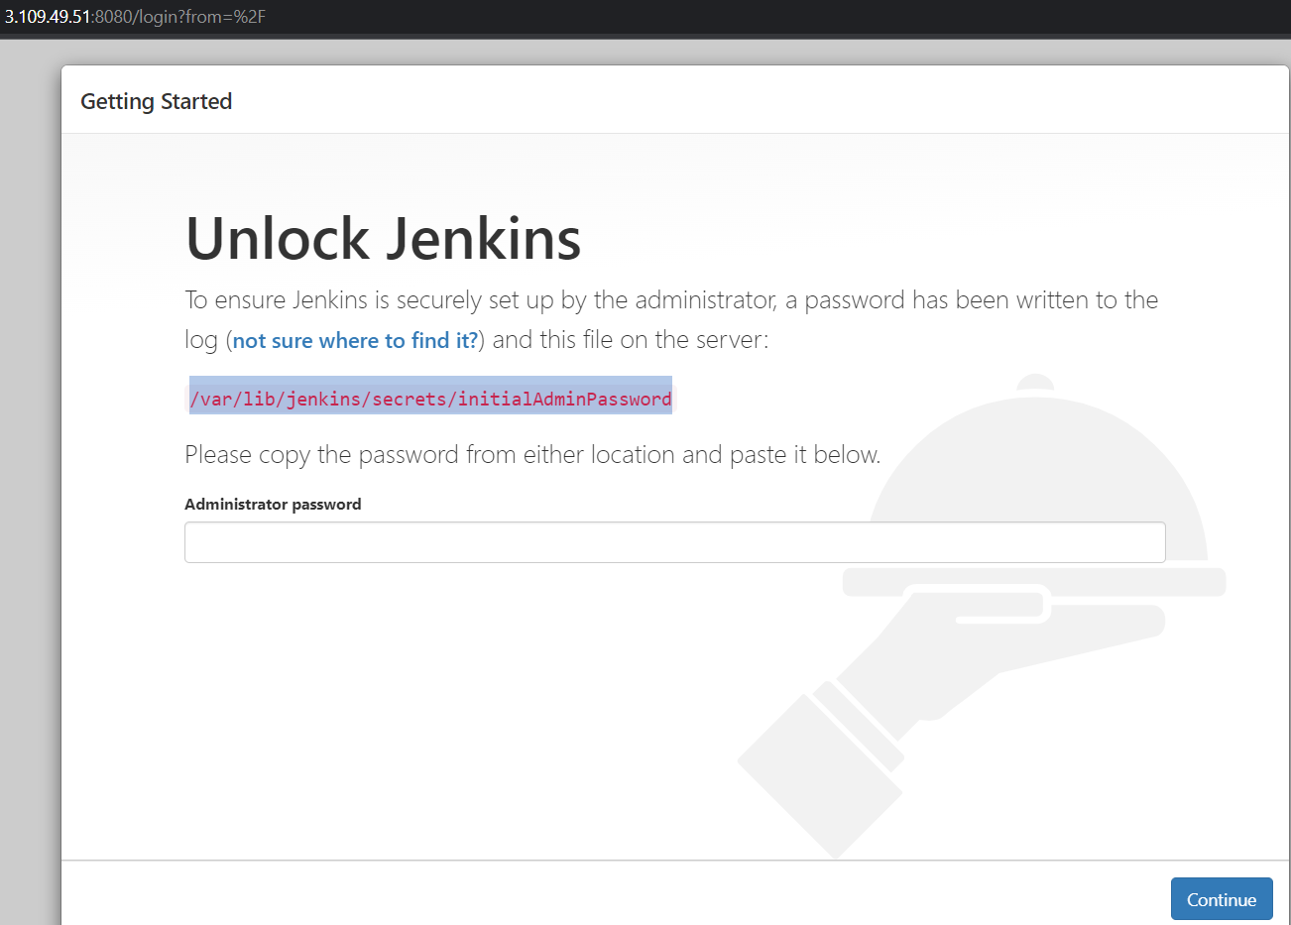
Copy the /var/lib/jenkins/secrets/initialAdminPassword

Slide 5
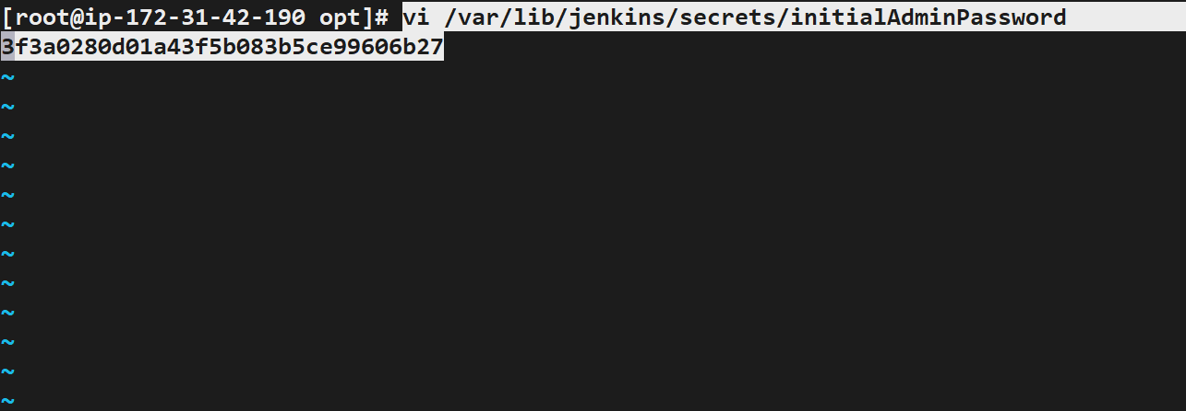
open this path using editors
Vi /var/lib/jenkins/secrets/initialAdminPassword

Slide 6
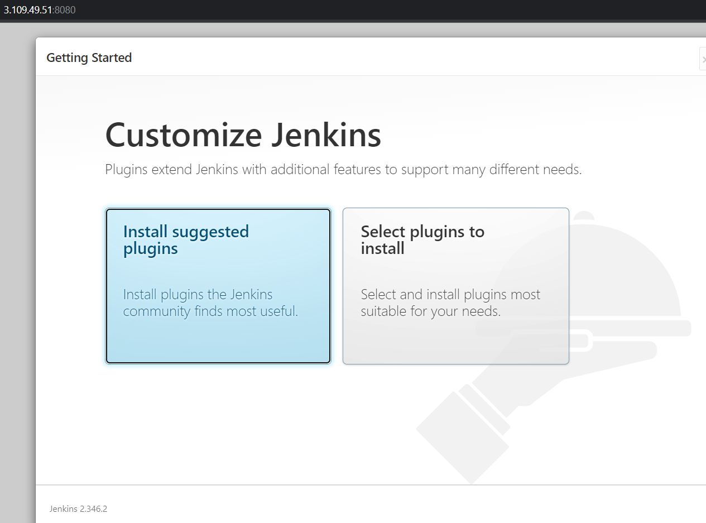
Click on install suggested plugins.

Slide 7
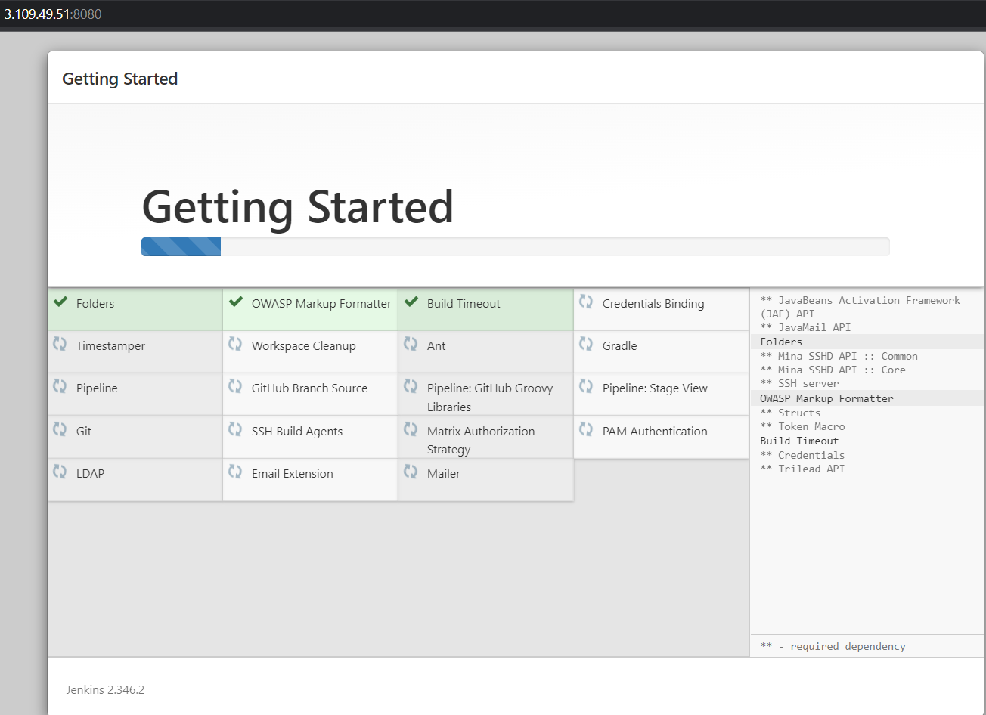
Wait till the plugins get install.

Slide 8
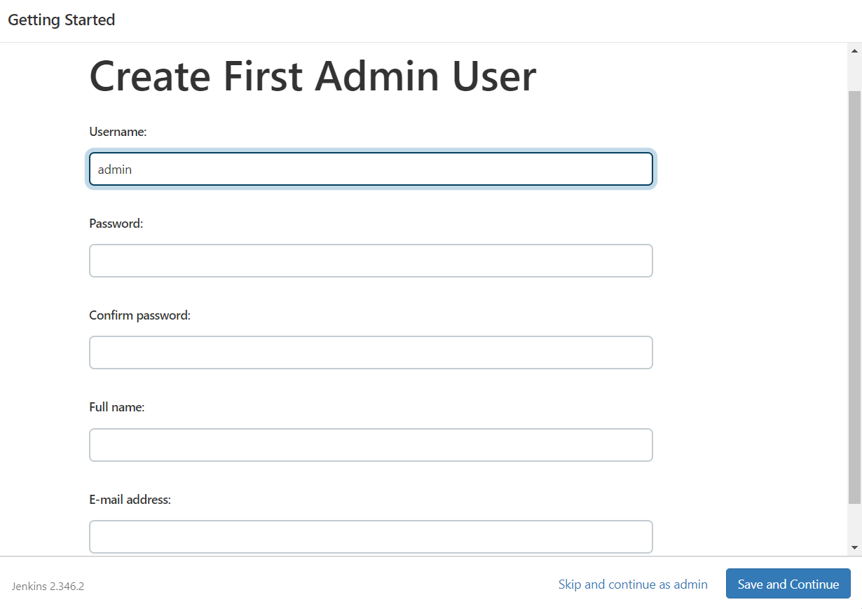
Add the user details & mail id, click on save&continue.

Slide 9
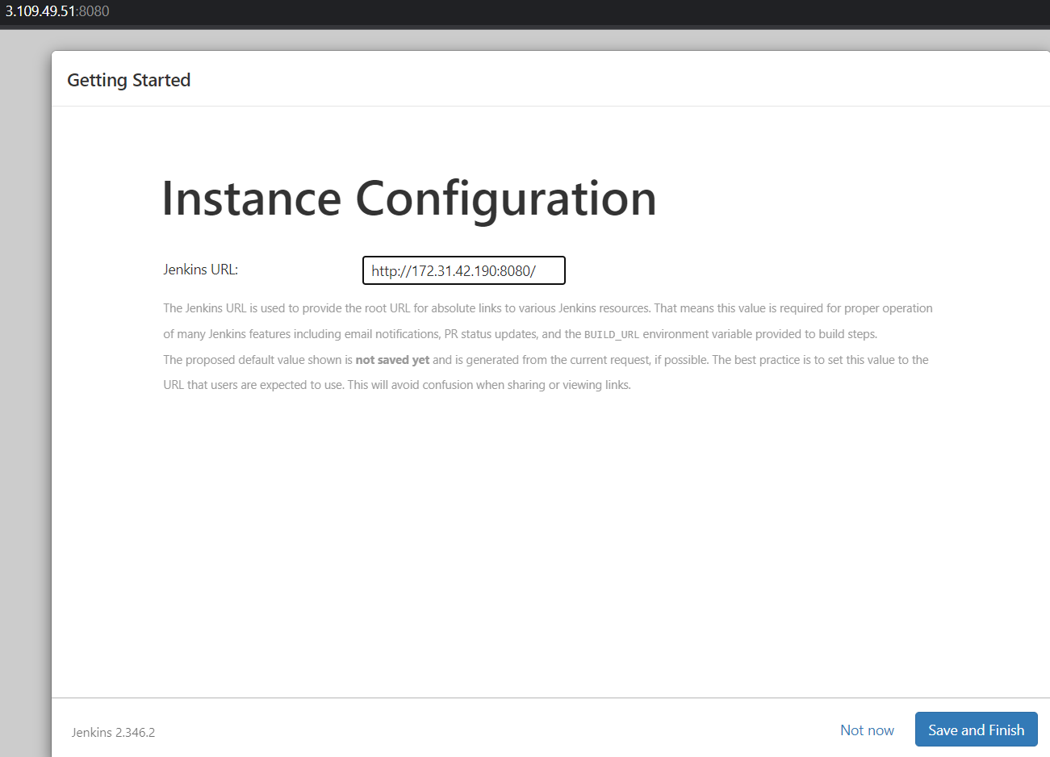
Add the instance IP along with port.

Slide 10
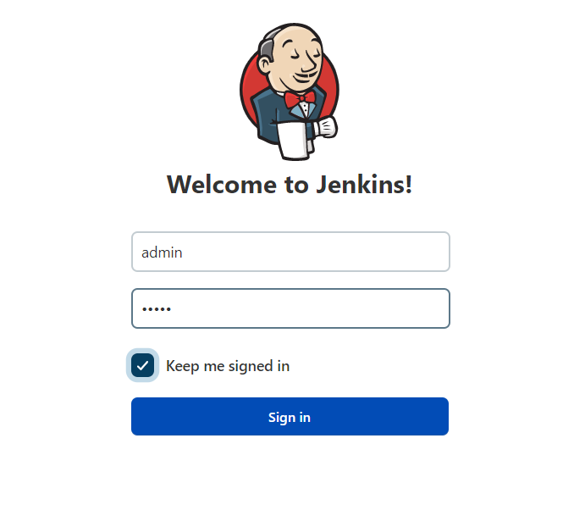
Provide the valid username & password which is created in create first admin user.

Slide 11
Installation of sonarQube & integrating with Jenkins

Slide 12
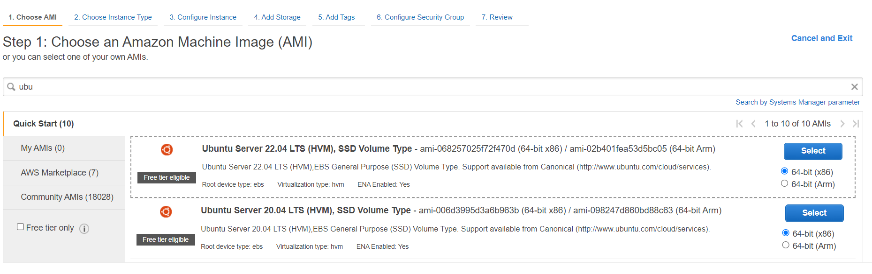
Choose the Ubuntu 22.04 AMI

Slide 13
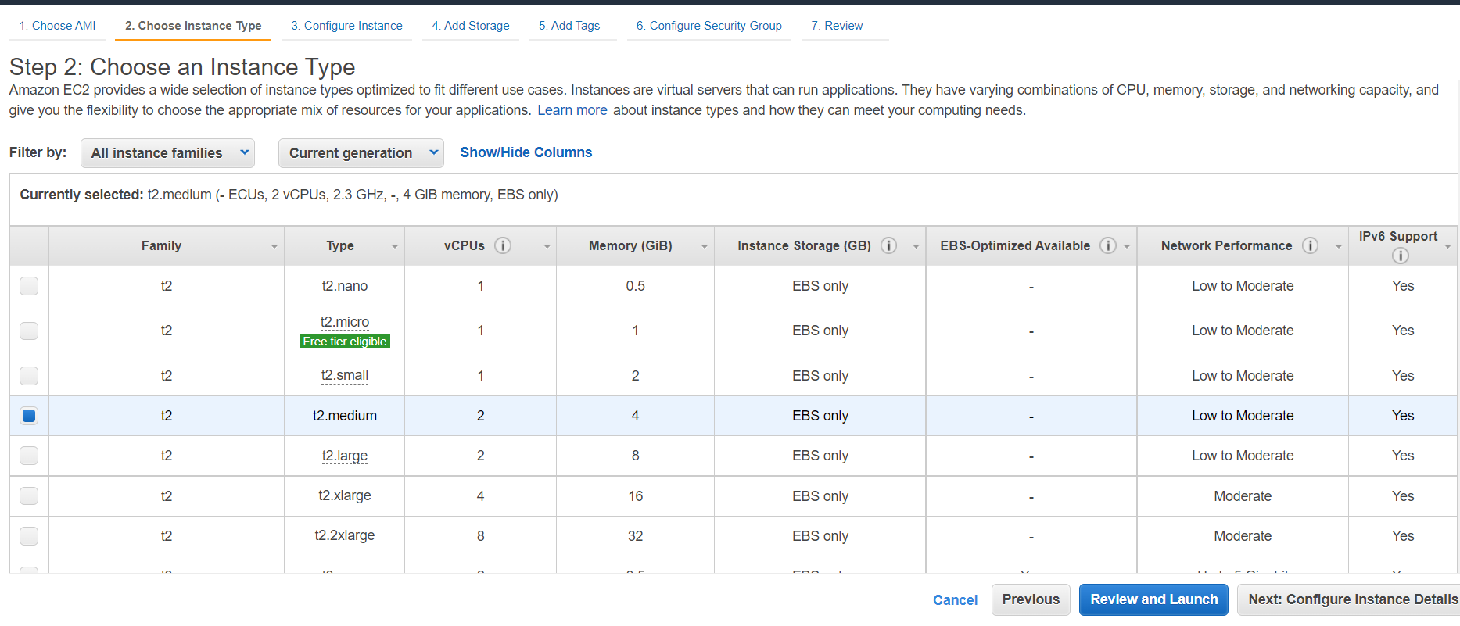
Choose the t2.medium instance.

Slide 14
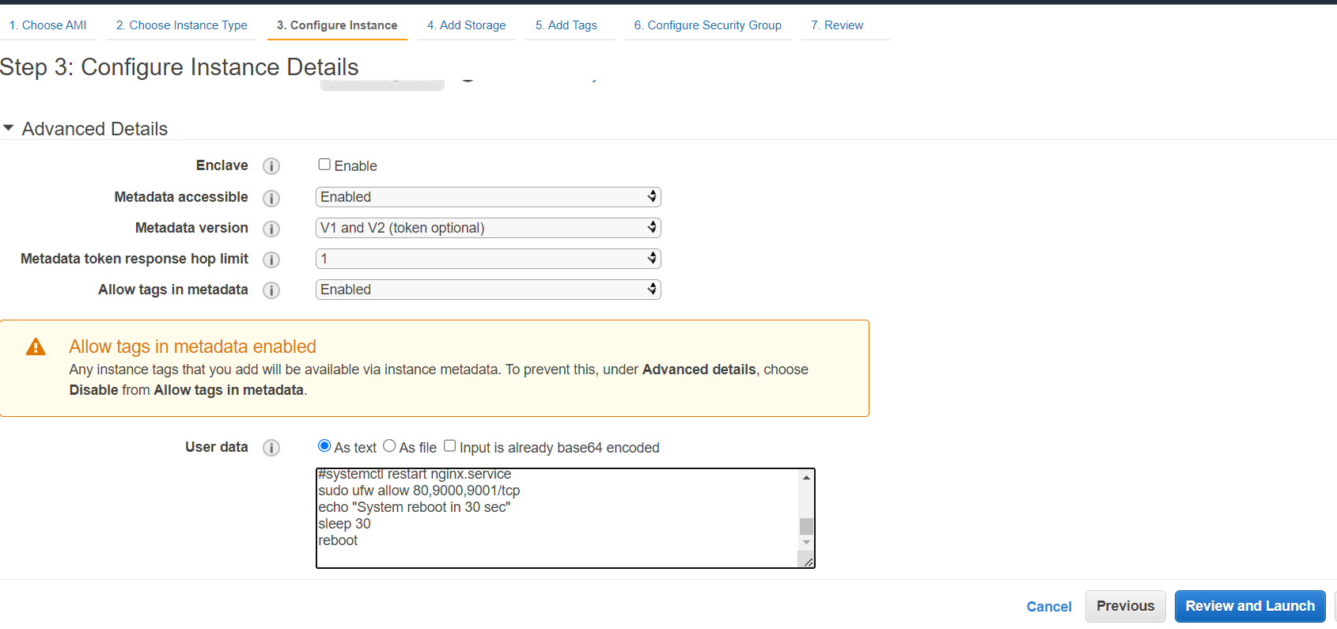

Slide 15
#!/bin/bash
cp /etc/sysctl.conf /root/sysctl.conf_backup
cat <<EOT> /etc/sysctl.conf
vm.max_map_count=262144
fs.file-max=65536
ulimit -n 65536
ulimit -u 4096
EOT
cp /etc/security/limits.conf /root/sec_limit.conf_backup
cat <<EOT> /etc/security/limits.conf
sonarqube - nofile 65536
sonarqube - nproc 409
EOT
sudo apt-get update -y
sudo apt-get install openjdk-11-jdk -y
sudo update-alternatives --config java
java -version
sudo apt update
wget -q https://www.postgresql.org/media/keys/ACCC4CF8.asc -O - | sudo apt-key add -
sudo sh -c 'echo "deb http://apt.postgresql.org/pub/repos/apt/ `lsb_release -cs`-pgdg main" >> /etc/apt/sources.list.d/pgdg.list'
sudo apt install postgresql postgresql-contrib -y
User data for installation of sonarqube

Slide 16
#sudo -u postgres psql -c "SELECT version();"
sudo systemctl enable postgresql.service
sudo systemctl start postgresql.service
sudo echo "postgres:admin123" | chpasswd
runuser -l postgres -c "createuser sonar"
sudo -i -u postgres psql -c "ALTER USER sonar WITH ENCRYPTED PASSWORD 'admin123';"
sudo -i -u postgres psql -c "CREATE DATABASE sonarqube OWNER sonar;"
sudo -i -u postgres psql -c "GRANT ALL PRIVILEGES ON DATABASE sonarqube to sonar;"
systemctl restart postgresql
#systemctl status -l postgresql
netstat -tulpena | grep postgres
sudo mkdir -p /sonarqube/
cd /sonarqube/
sudo curl -O https://binaries.sonarsource.com/Distribution/sonarqube/sonarqube-8.3.0.34182.zip
sudo apt-get install zip -y
sudo unzip -o sonarqube-8.3.0.34182.zip -d /opt/
sudo mv /opt/sonarqube-8.3.0.34182/ /opt/sonarqube
sudo groupadd sonar
sudo useradd -c "SonarQube - User" -d /opt/sonarqube/ -g sonar sonar
sudo chown sonar:sonar /opt/sonarqube/ -R
cp /opt/sonarqube/conf/sonar.properties /root/sonar.properties_backup

Slide 17
cat <<EOT> /opt/sonarqube/conf/sonar.properties
sonar.jdbc.username=sonar
sonar.jdbc.password=admin123
sonar.jdbc.url=jdbc:postgresql://localhost/sonarqube
sonar.web.host=0.0.0.0
sonar.web.port=9000
sonar.web.javaAdditionalOpts=-server
sonar.search.javaOpts=-Xmx512m -Xms512m -XX:+HeapDumpOnOutOfMemoryError
sonar.log.level=INFO
sonar.path.logs=logs
EOT
cat <<EOT> /etc/systemd/system/sonarqube.service
[Unit]
Description=SonarQube service
After=syslog.target network.target
[Service]
Type=forking
ExecStart=/opt/sonarqube/bin/linux-x86-64/sonar.sh start
ExecStop=/opt/sonarqube/bin/linux-x86-64/sonar.sh stop
User=sonar
Group=sonar
Restart=always

Slide 18
LimitNOFILE=65536
LimitNPROC=4096
[Install]
WantedBy=multi-user.target
EOT
systemctl daemon-reload
systemctl enable sonarqube.service
#systemctl start sonarqube.service
#systemctl status -l sonarqube.service
apt-get install nginx -y
rm -rf /etc/nginx/sites-enabled/default
rm -rf /etc/nginx/sites-available/default
cat <<EOT> /etc/nginx/sites-available/sonarqube
server{
listen 80;
server_name sonarqube.groophy.in;
access_log /var/log/nginx/sonar.access.log;
error_log /var/log/nginx/sonar.error.log;
proxy_buffers 16 64k;
proxy_buffer_size 128k;

Slide 19
location / {
proxy_pass http://127.0.0.1:9000;
proxy_next_upstream error timeout invalid_header http_500 http_502 http_503 http_504;
proxy_redirect off;
proxy_set_header Host \$host;
proxy_set_header X-Real-IP \$remote_addr;
proxy_set_header X-Forwarded-For \$proxy_add_x_forwarded_for;
proxy_set_header X-Forwarded-Proto http;
}
}
EOT
ln -s /etc/nginx/sites-available/sonarqube /etc/nginx/sites-enabled/sonarqube
systemctl enable nginx.service
#systemctl restart nginx.service
sudo ufw allow 80,9000,9001/tcp
echo "System reboot in 30 sec"
sleep 30
reboot

Slide 20
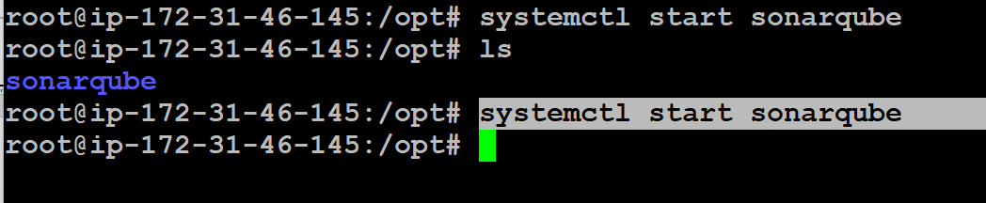
Once we run user data then sonar qube will be installed in /opt folder & to start sonarqube service we have to run
Systemctl start sonarqube

Slide 21
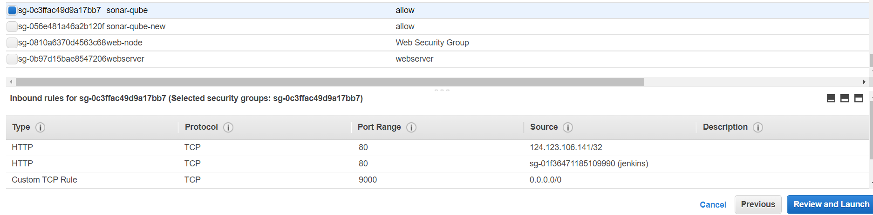
Allow the custom TCP 9000 port

Slide 22
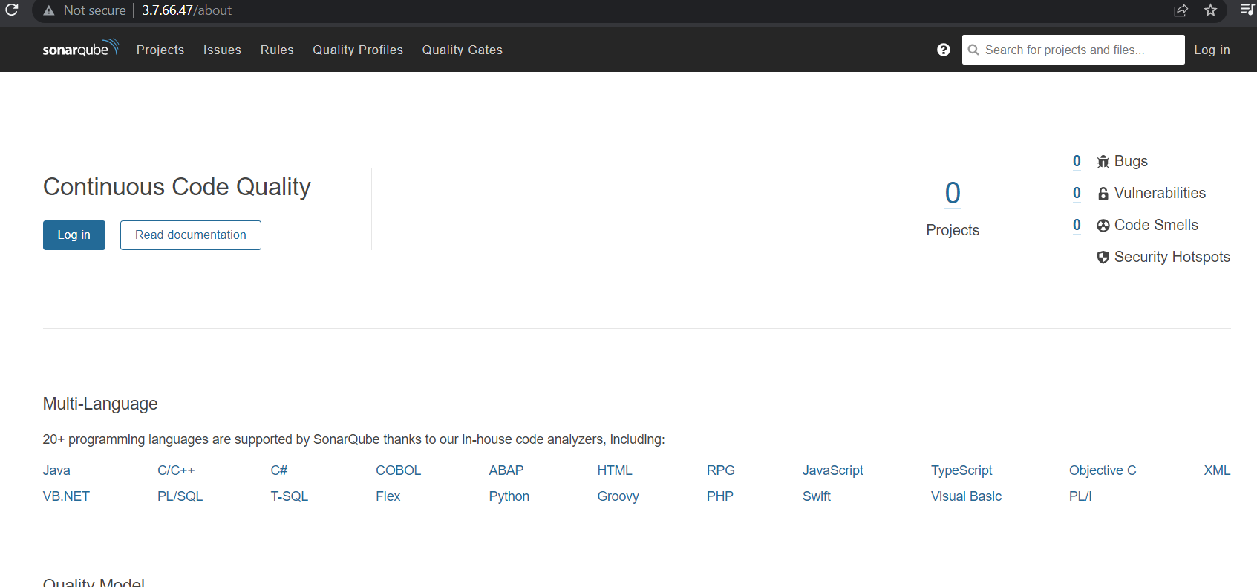
Copy the sonarqube instance IP with port in browser <IP:9000>
Click on login

Slide 23
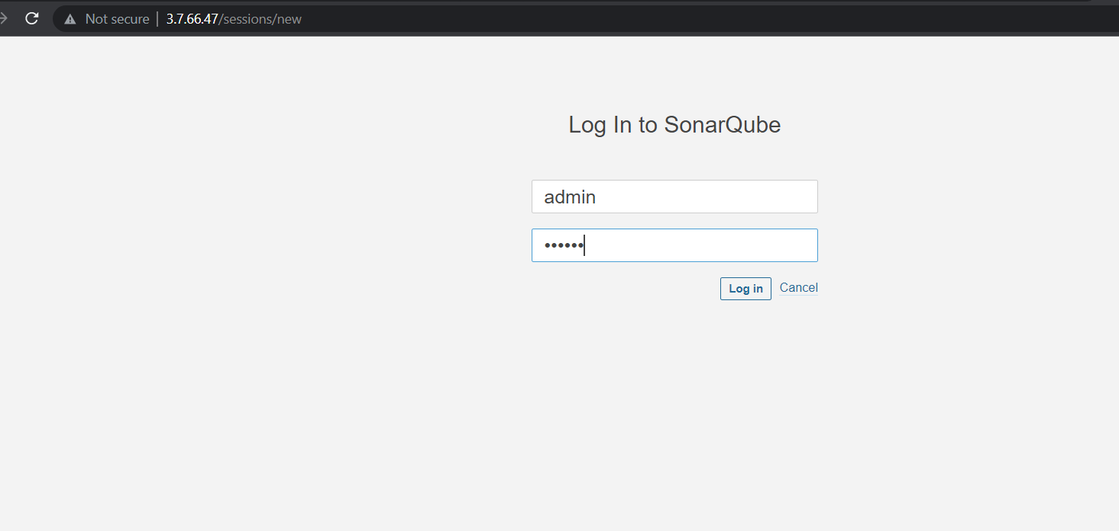
Add the
user name: admin
Passwd: admin

Slide 24
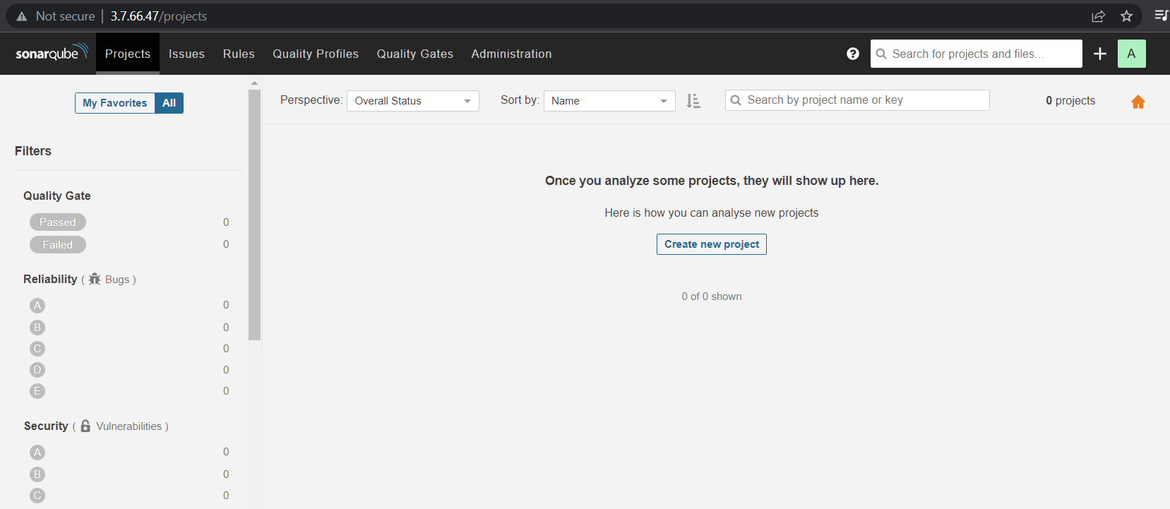
Click on create new project .

Slide 25
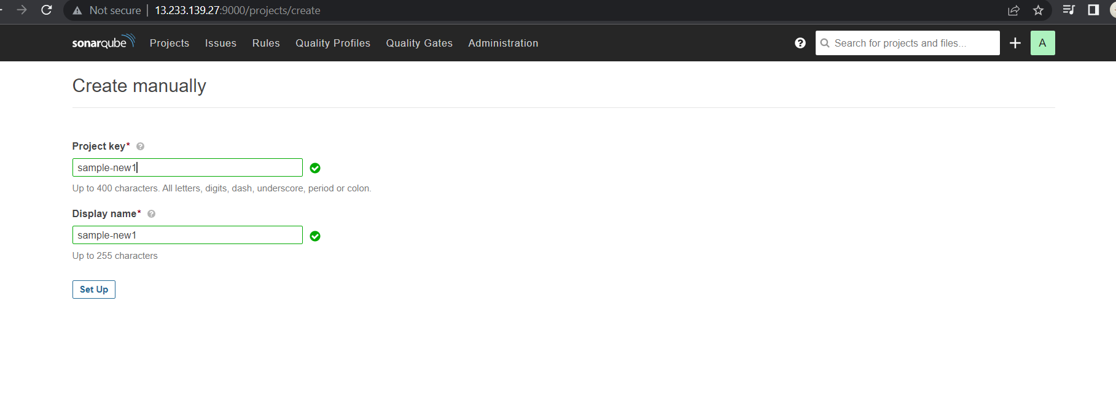
Give the project-key(project name).

Slide 26
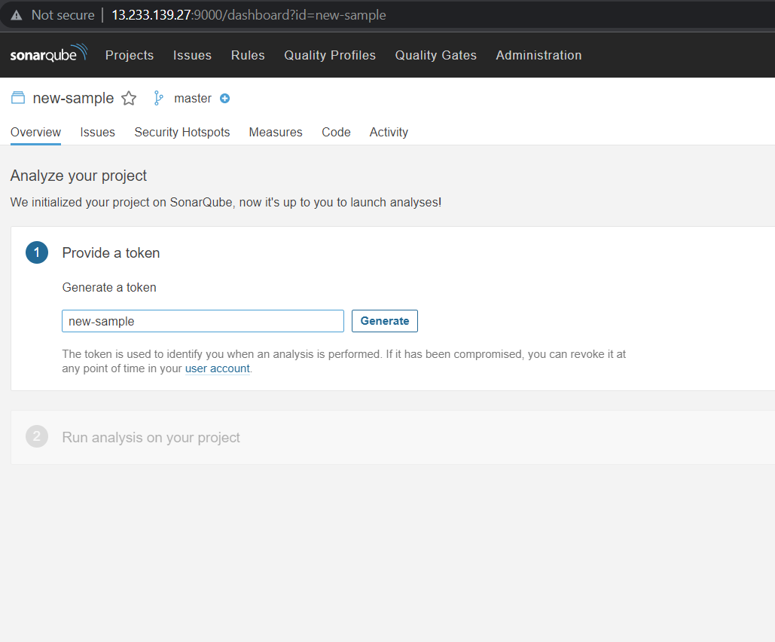
Give a name for token & click on generate.

Slide 27
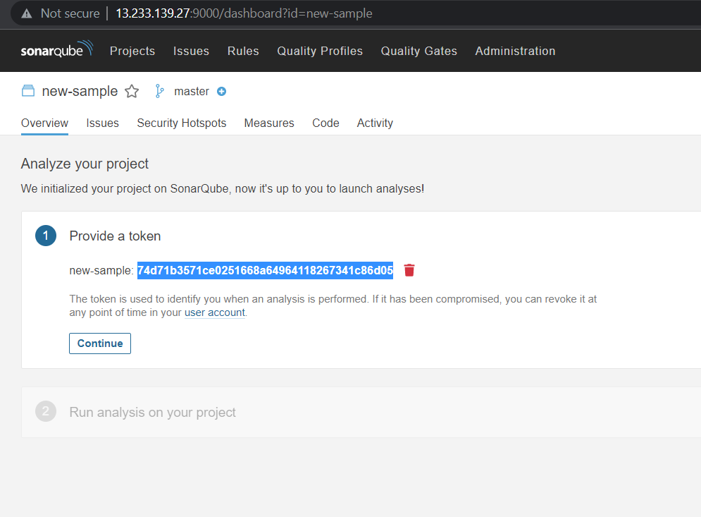
Copy the token & paste it for future reference.

Slide 28
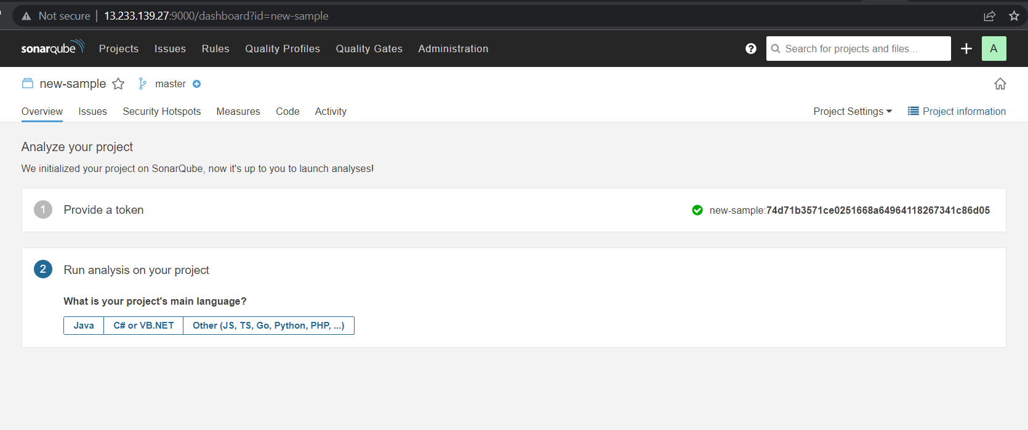
Choose the script in which language we are going to write the code.

Slide 29
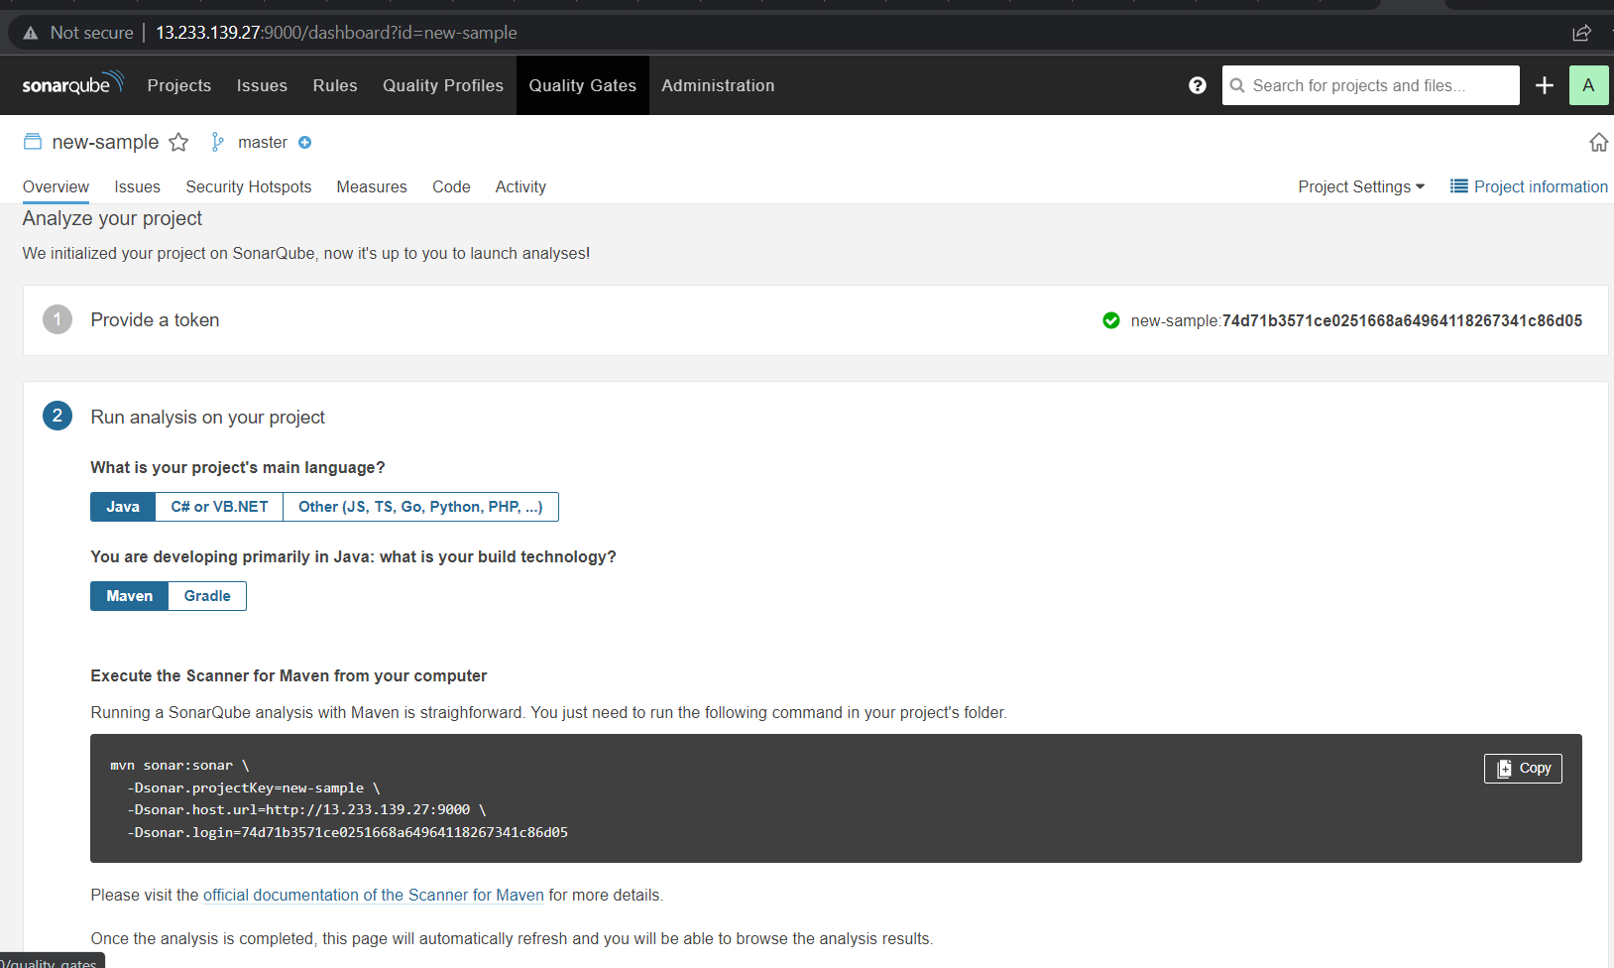
Choose the build tool which we are going to use in software development.

Slide 30
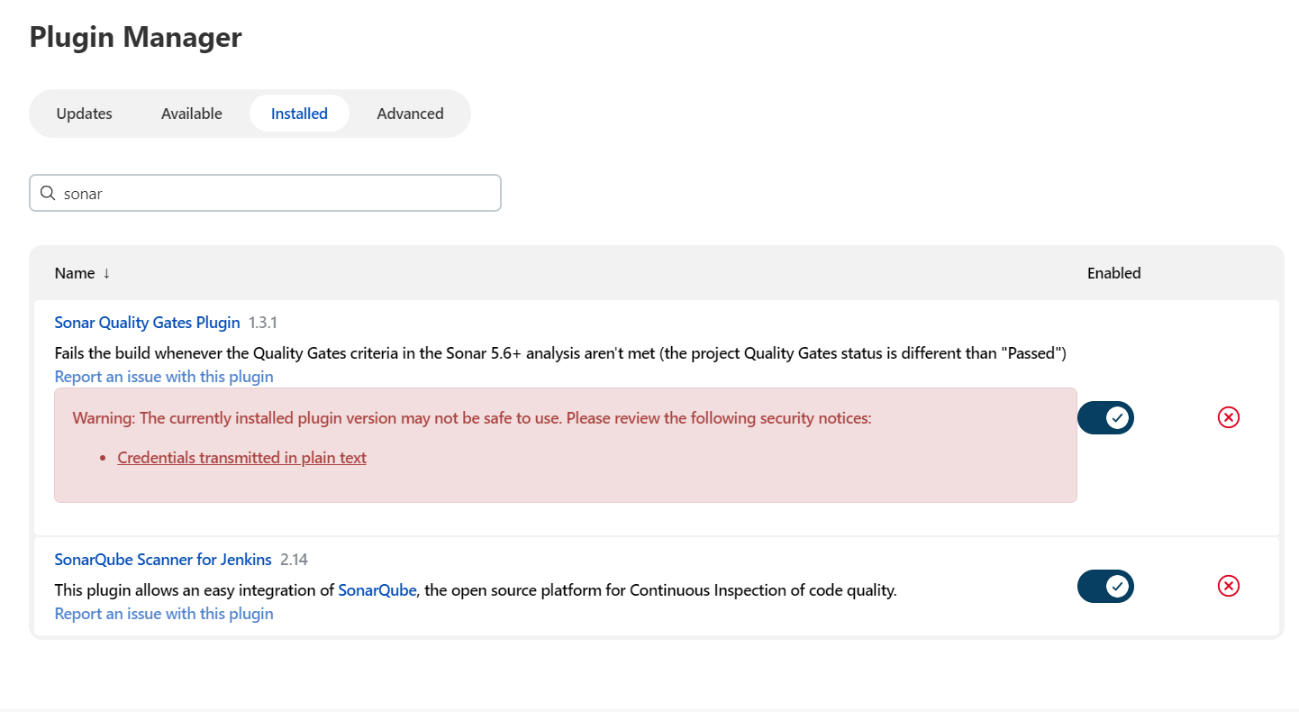
Install the following plugins for integrating with sonarqube
Sonar quality gates plugin.
Sonarqube scanner for Jenkins.

Slide 31
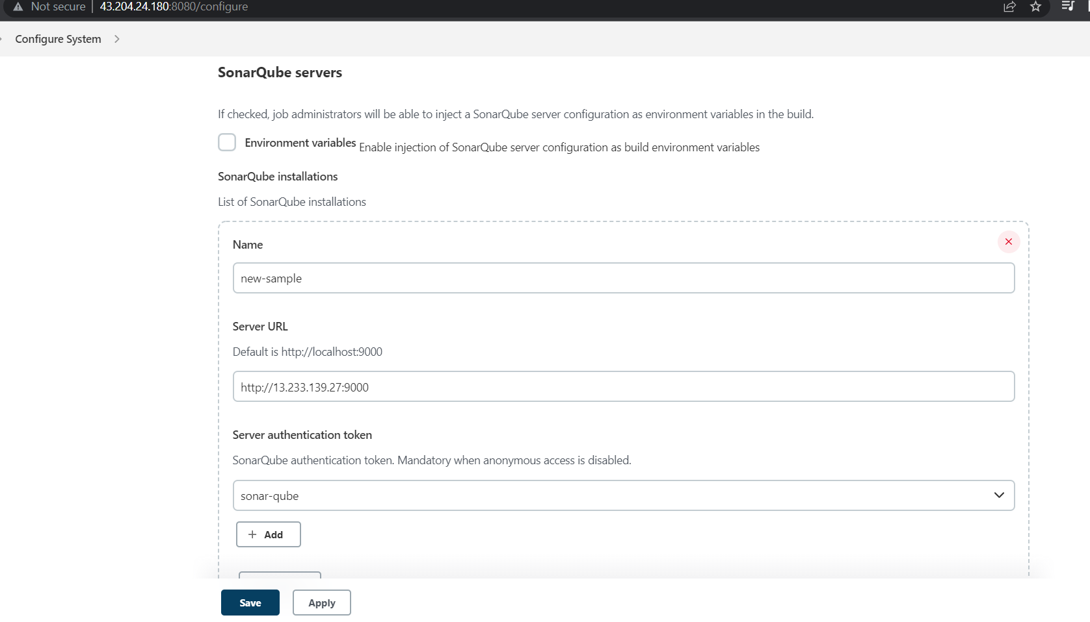
Open the configure system & provide the IP & server authentication token.

Slide 32
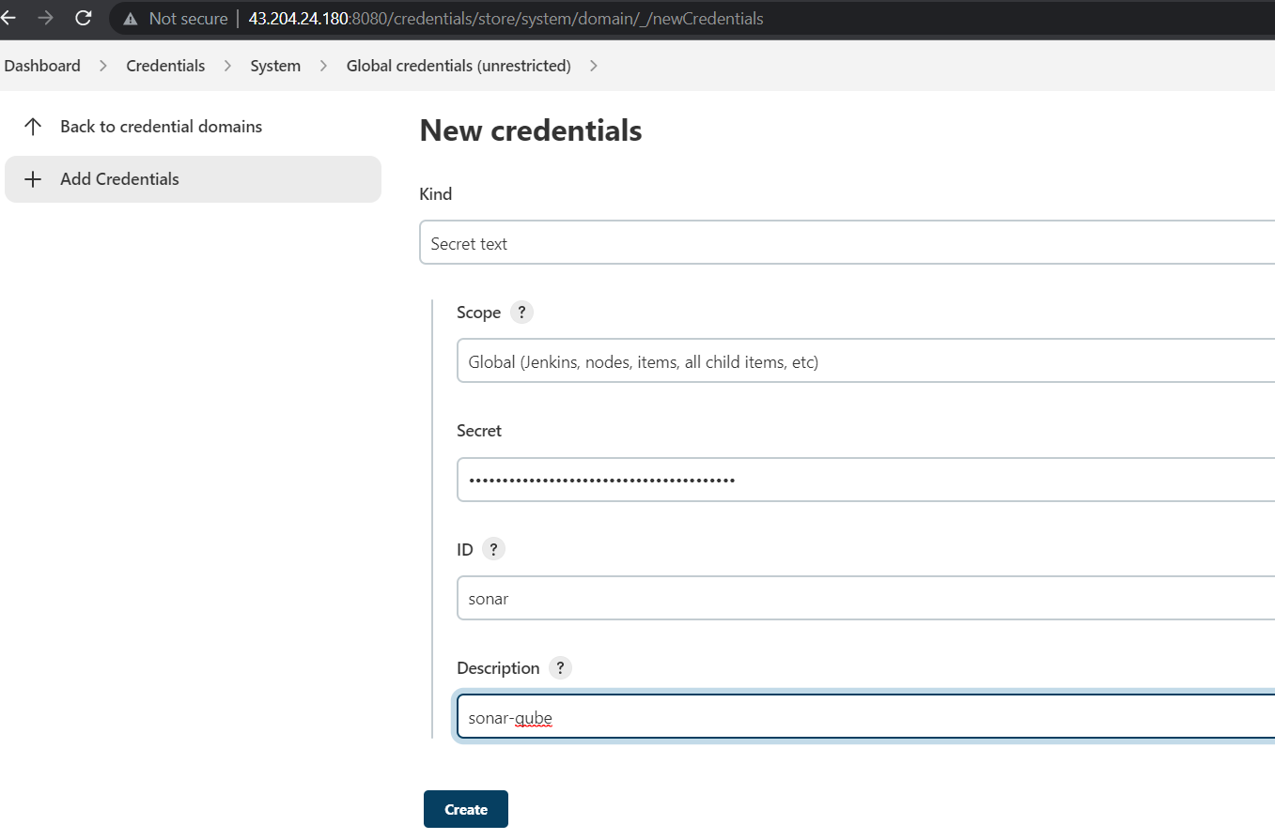
open the credentials & click on system, global credentials
Add the
sonarqube token.

Slide 33
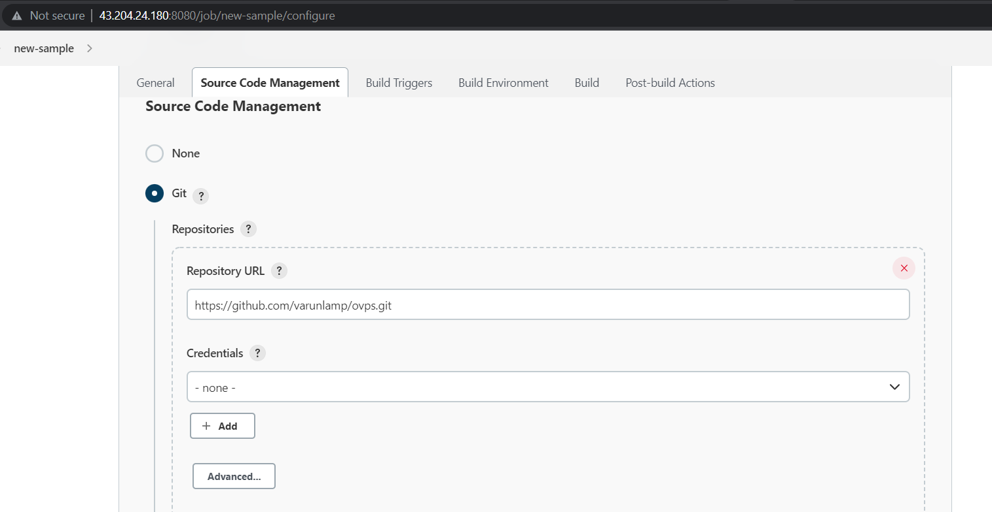
Provide the github repository url which consist of code.

Slide 34
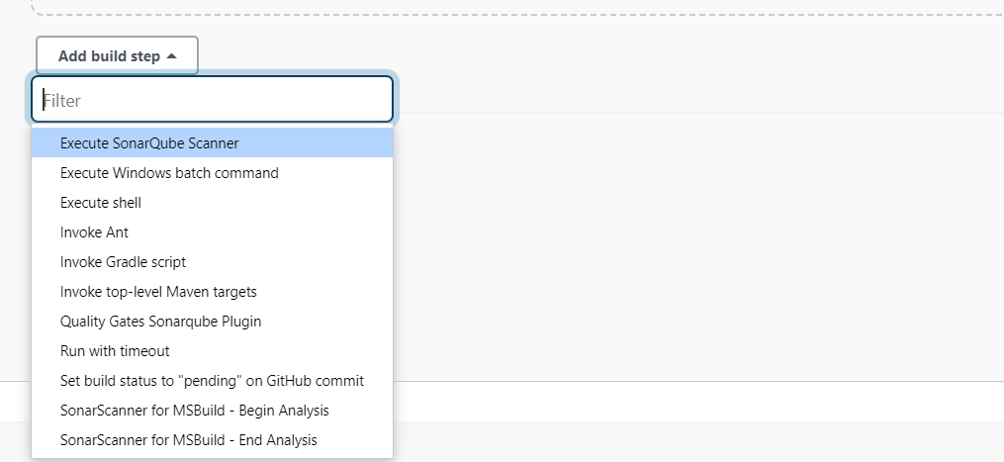
Click on add build step & select the
Execute sonarqube scanner.

Slide 35
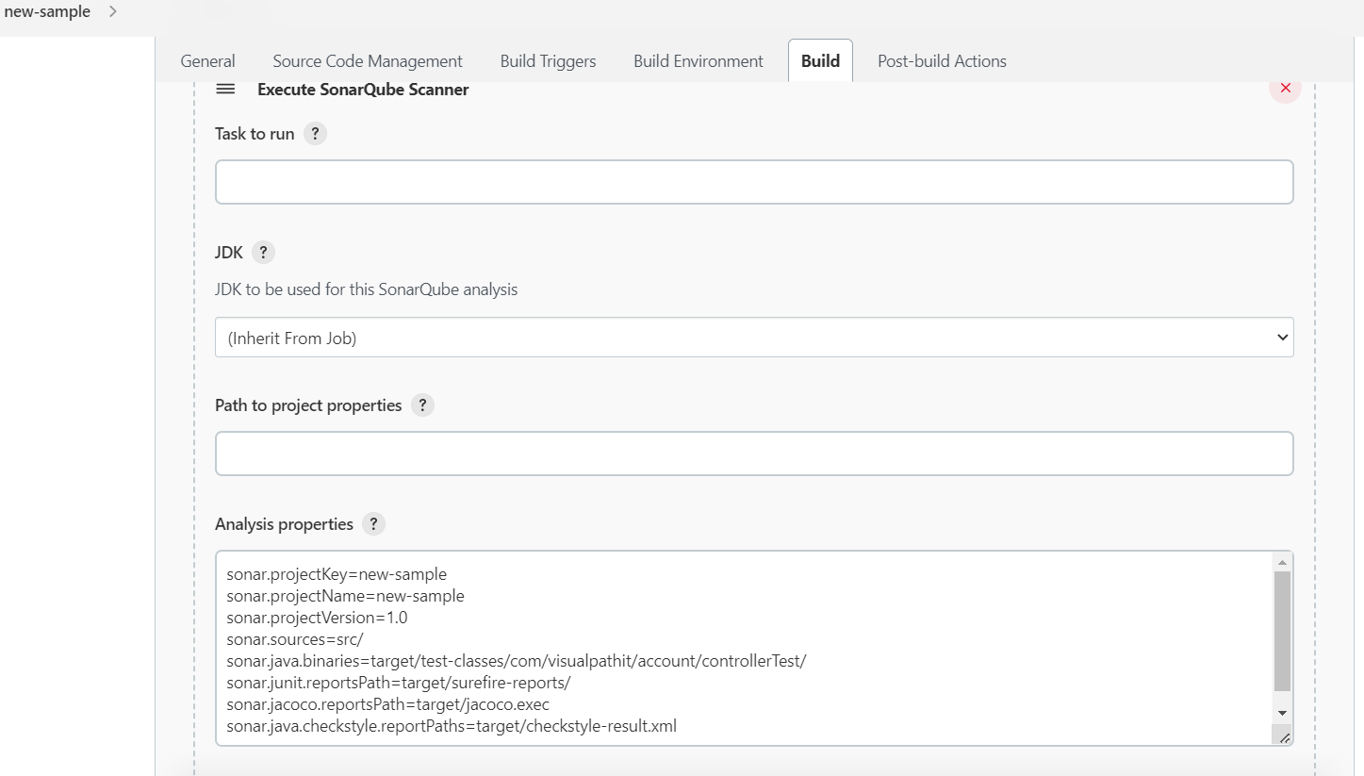
Add the properties which and all properties should be check in analysis properties.

Slide 36
Properties which need to be check in analysis properties.
sonar.projectKey=new-sample
sonar.projectName=new-sample
sonar.projectVersion=1.0
sonar.sources=src/
sonar.java.binaries=target/

Slide 37
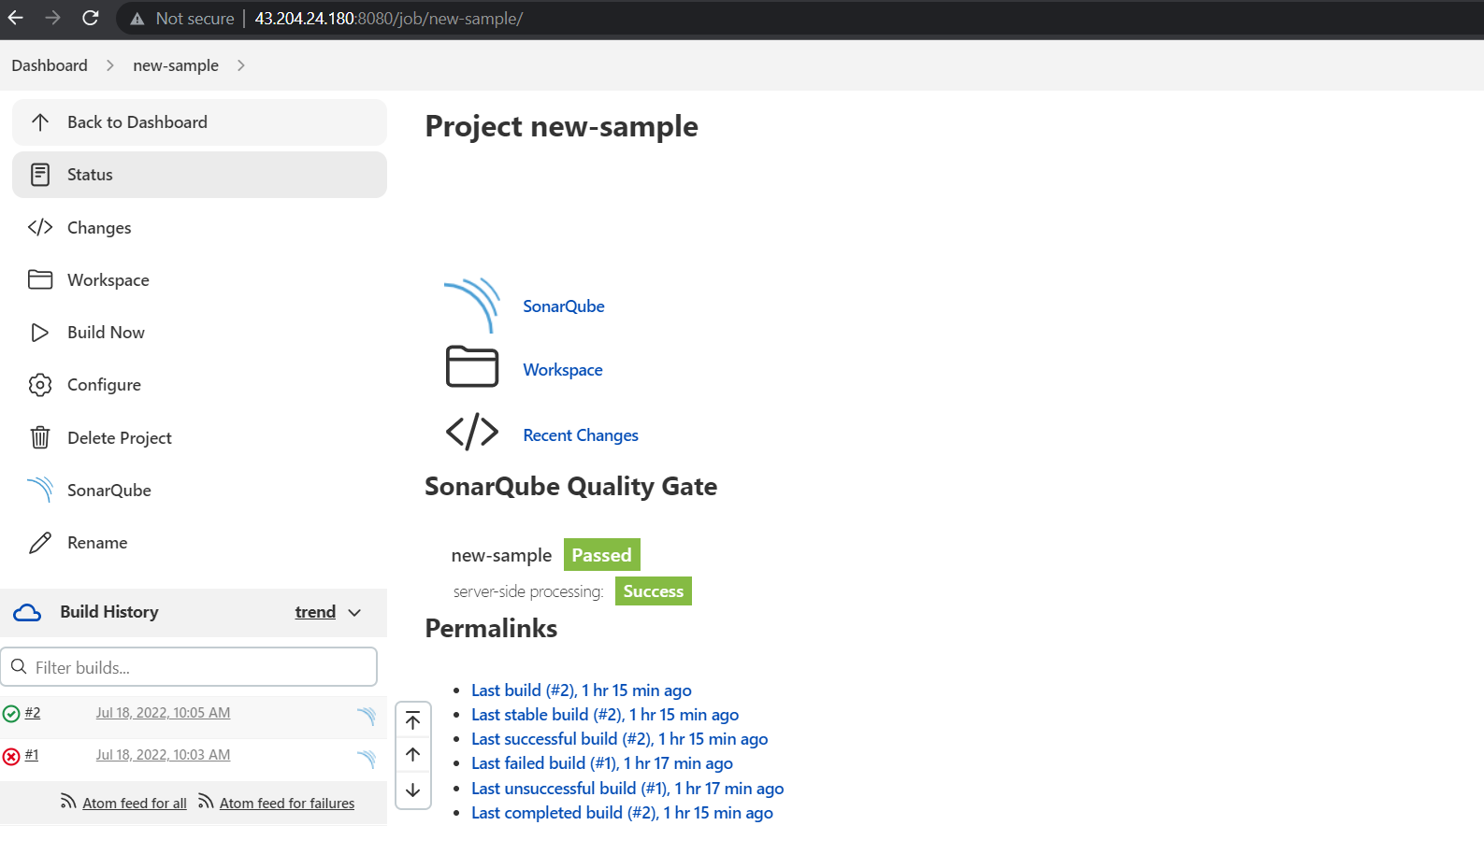
When we click on project it will display the report of bugs .

Slide 38
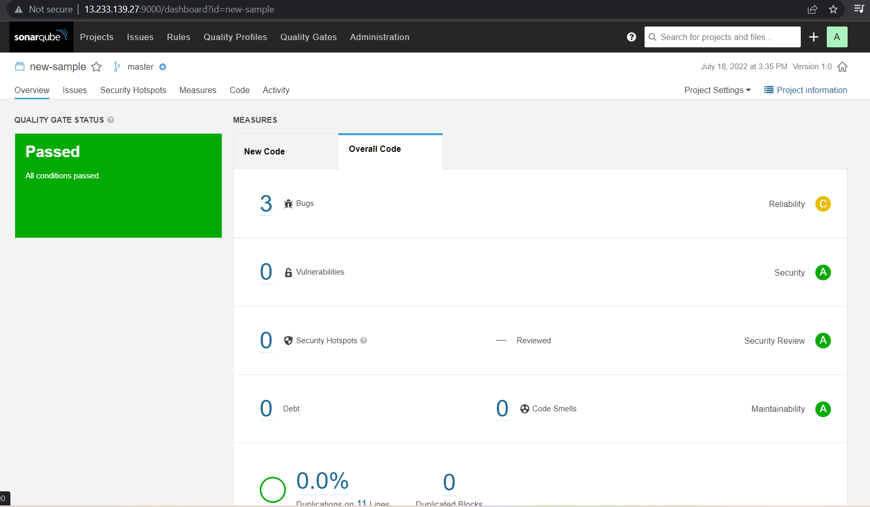
Generated report.

Slide 39
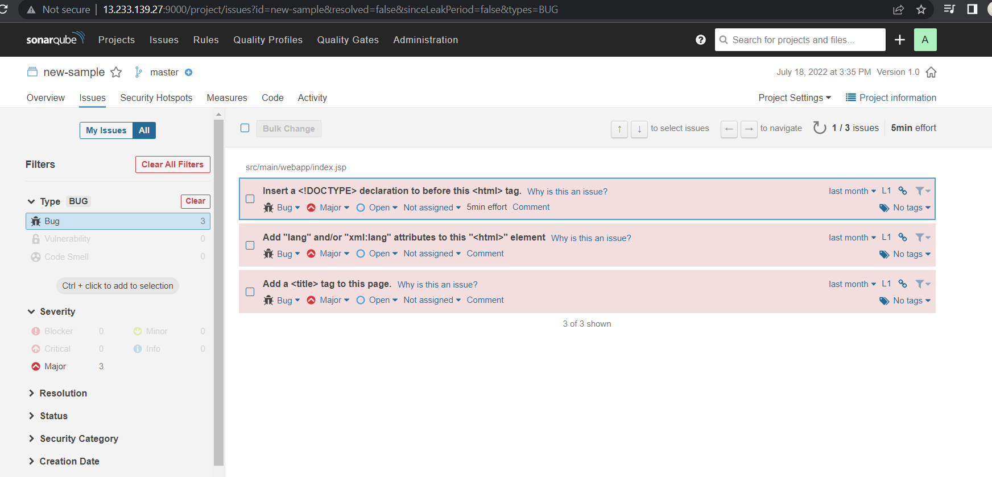
Bugs report/ it will display the errors & which needs to fix.

Slide 40
Installation of Jfrog
& integrating with Jenkins

Slide 41
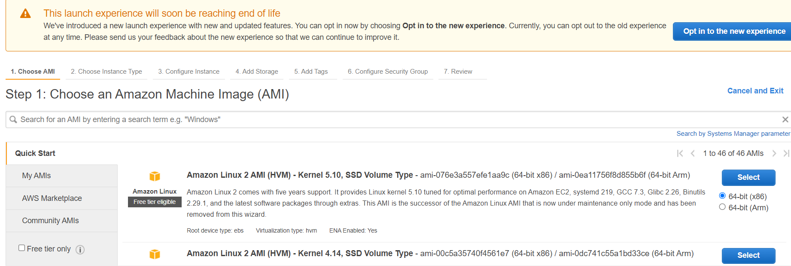
Choose the linux AMI

Slide 42
Choose the t2.medium instance.

Slide 44
Installation
sudo yum update
wget https://releases.jfrog.io/artifactory/bintray-artifactory/org/artifactory/oss/jfrog-artifactory-oss/[RELEASE]/jfrog-artifactory-oss-[RELEASE]-linux.tar.gz?_gl=1*1li7shh*_ga*NDE5NTQ4Mzk4LjE2NTc3OTg1NTM.*_ga_SQ1NR9VTFJ*MTY1Nzg3NzAzNi40LjEuMTY1Nzg3NzA4NS4xMQ..

Slide 45
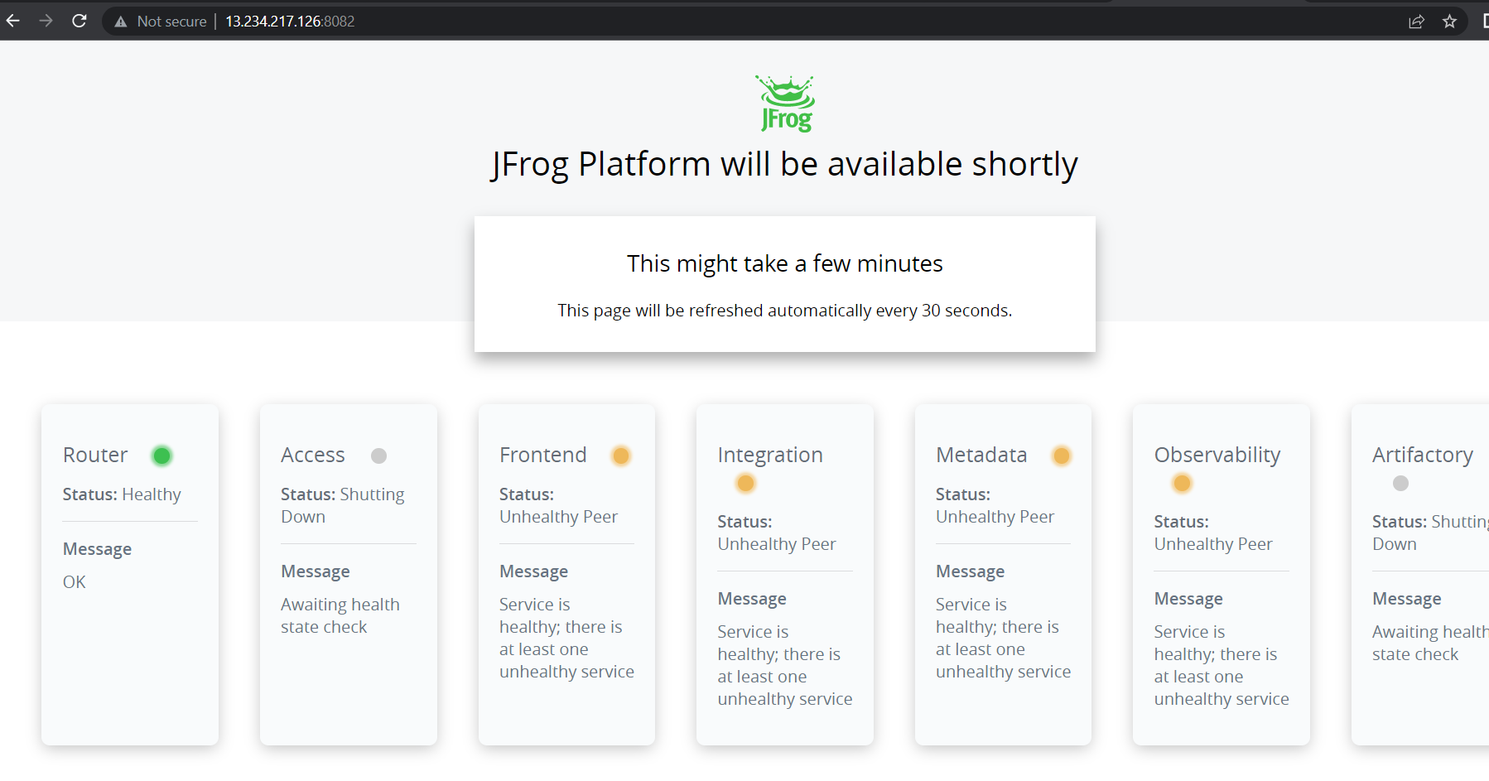
Copy the url of the instance and paste it in browser along with port <url:8082>

Slide 46
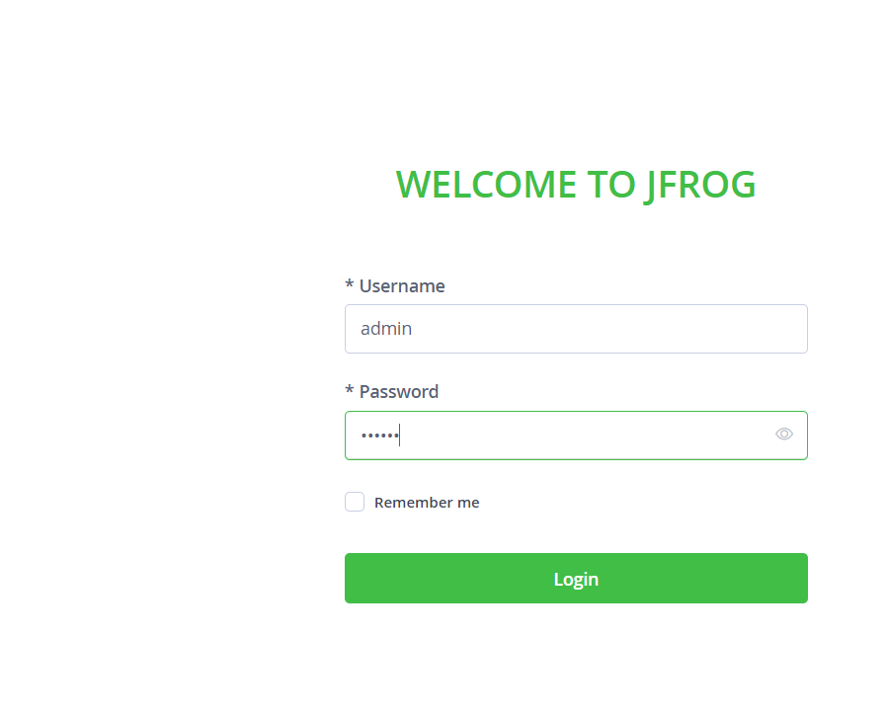
When we open jfrog we will get the login page we have to provide default login details
Un: admin
Pwd : password

Slide 47
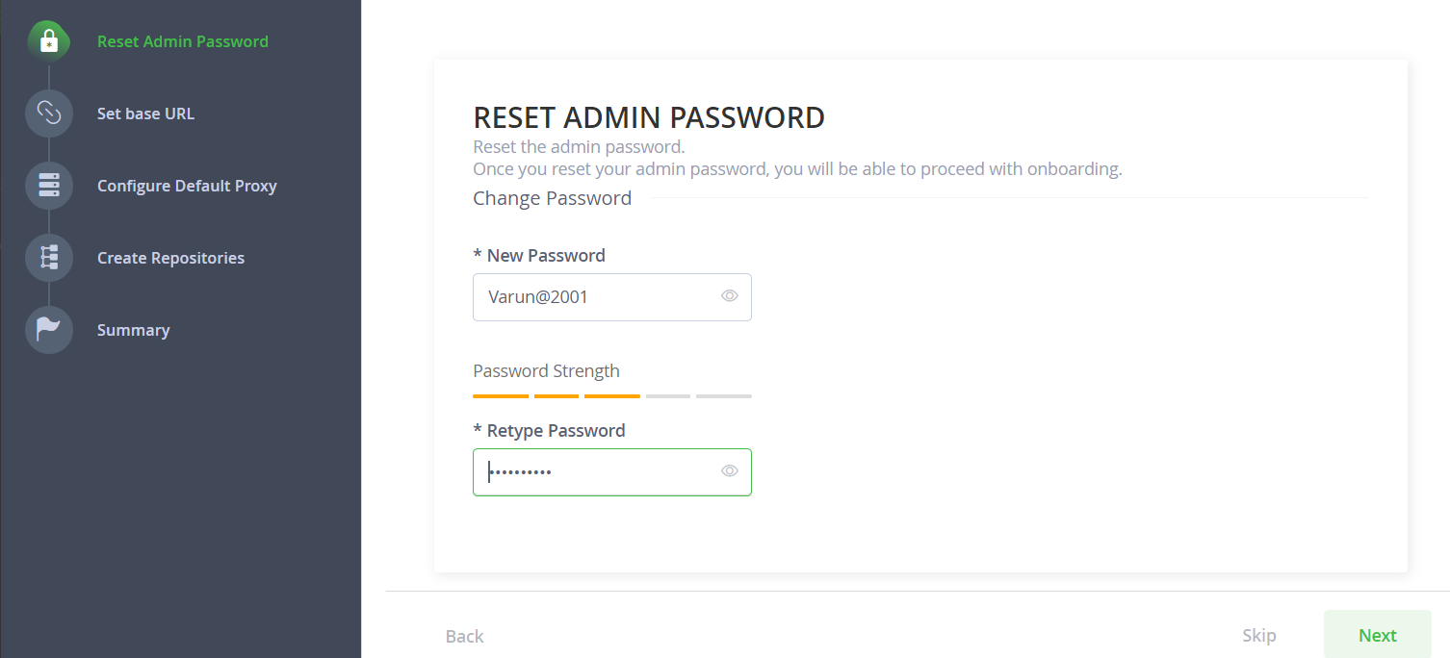
To reset admin password

Slide 48
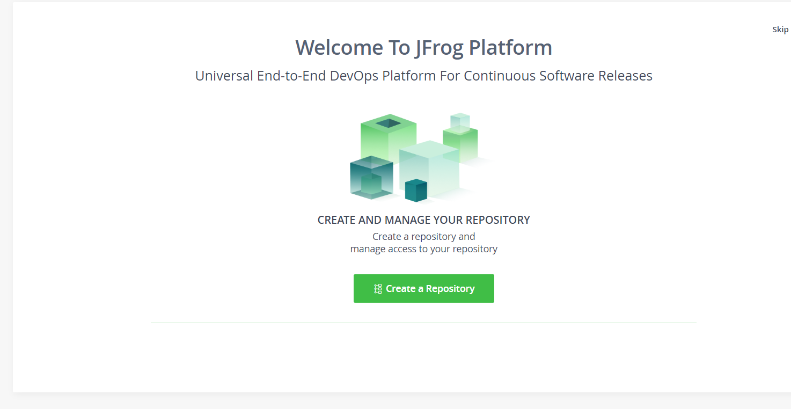
When we login we will get a welcome page.
click on create a repository

Slide 49
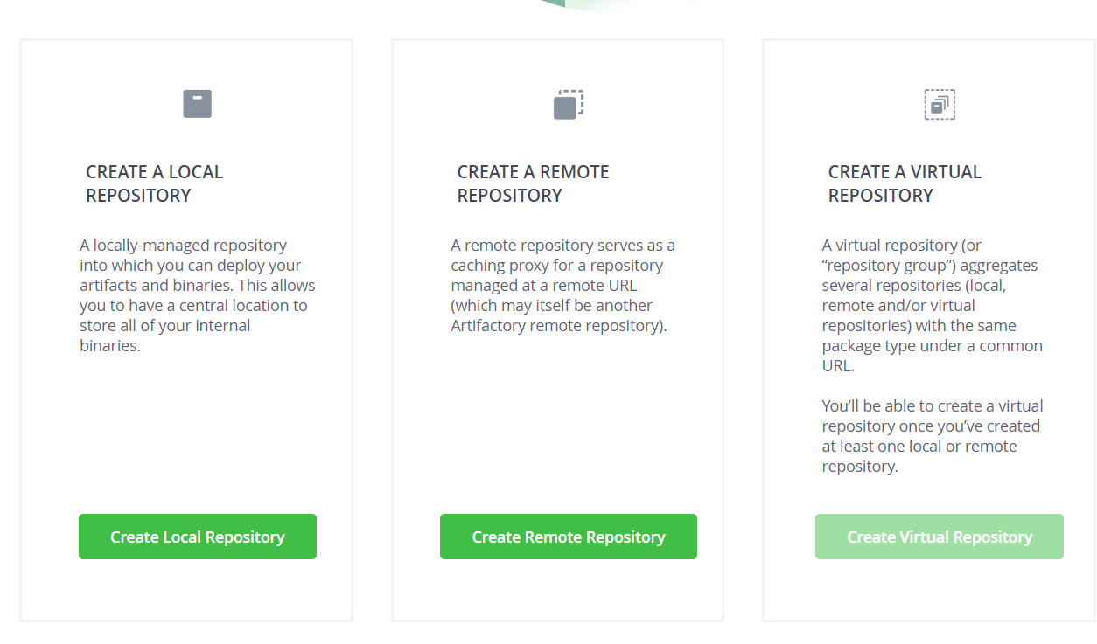
Choose the create local repository

Slide 50
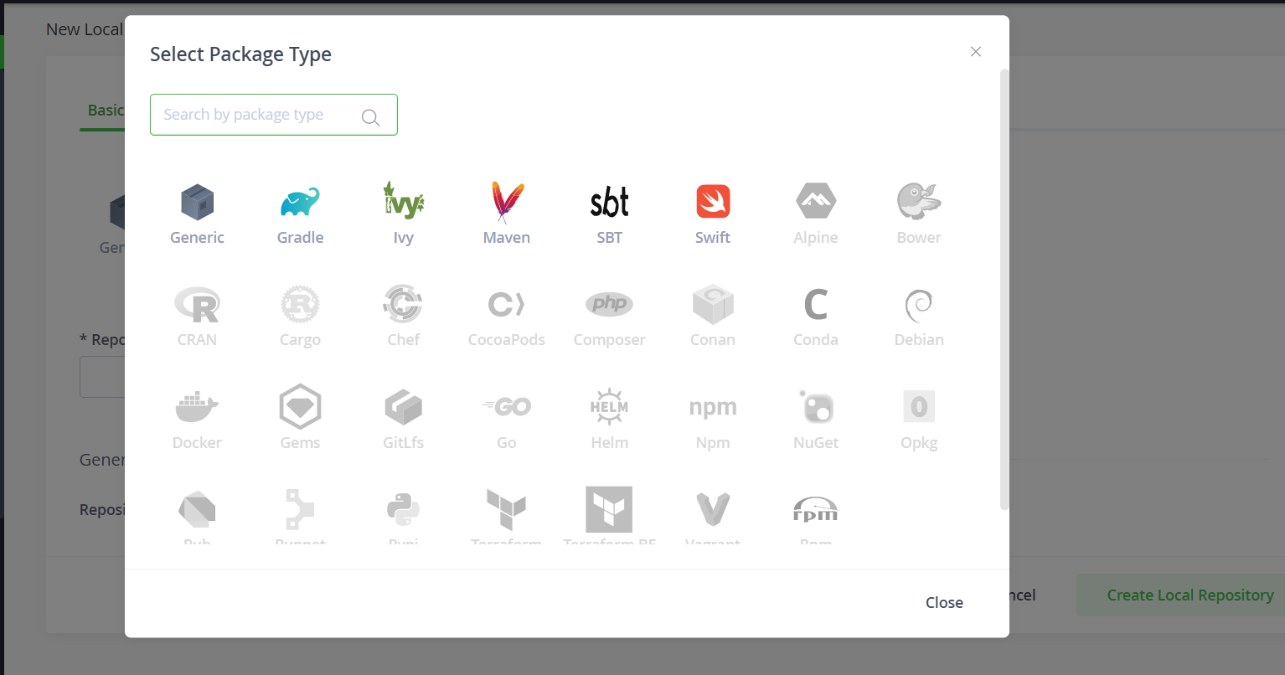
Select the package name based on the requirement here I am selecting maven.

Slide 51
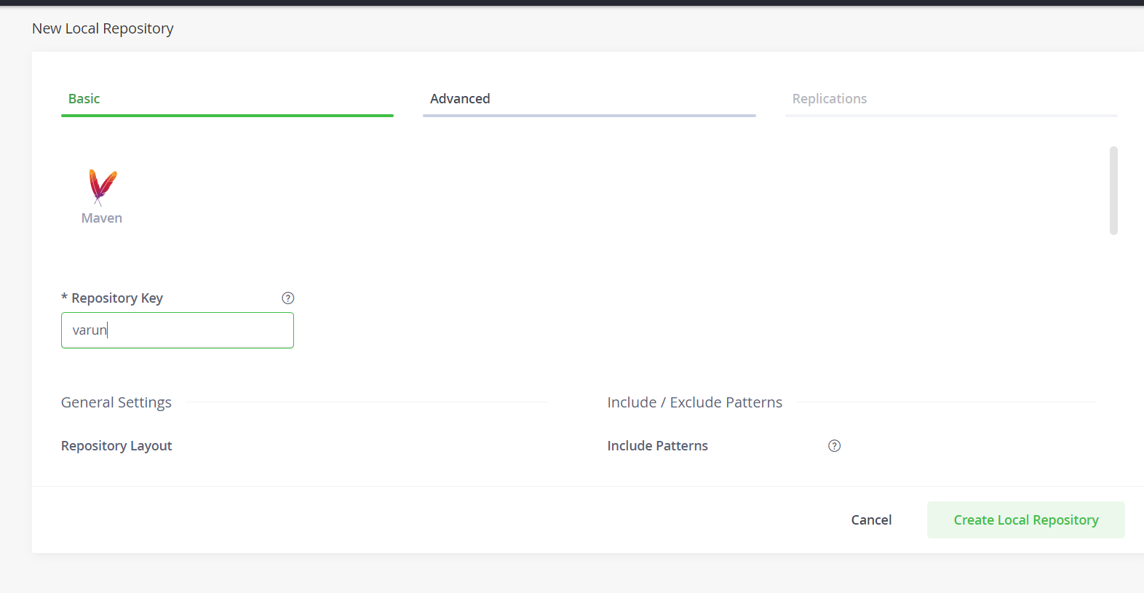
Give a name for repository key

Slide 52
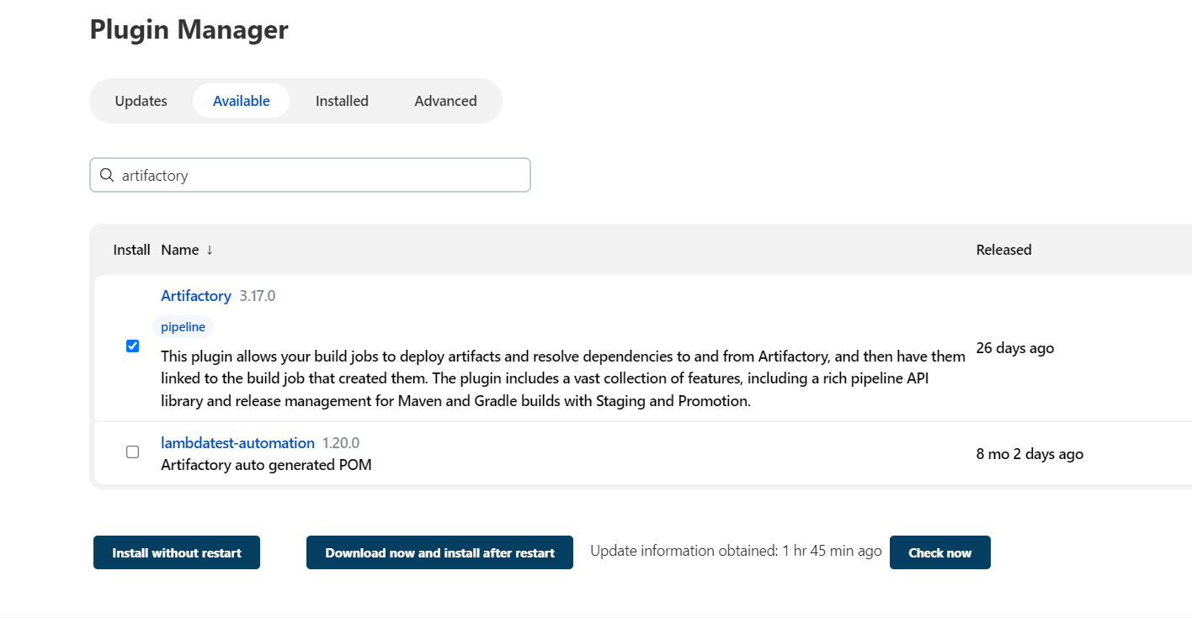
Go to manage Jenkins click on manage plugin choose available and install artifactory plugin.

Slide 53
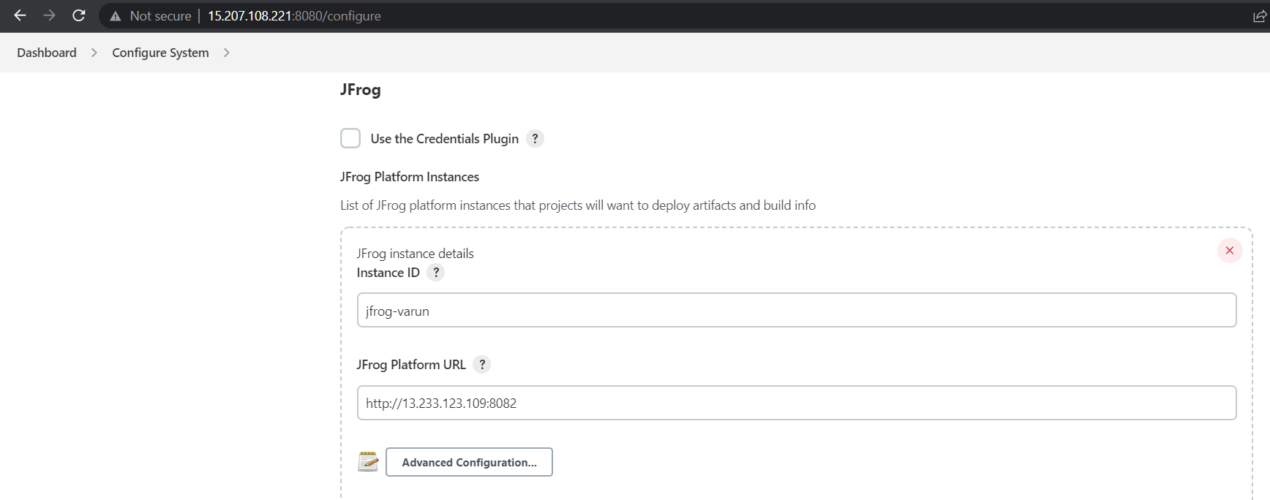
Click on manage Jenkins ,select the configure system & choose the jfrog ,add the required details like jfrog-url

Slide 54
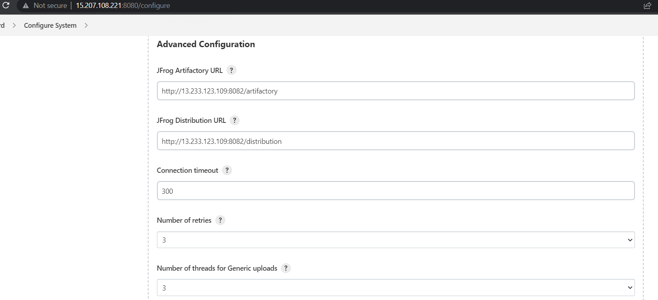
Click on advanced configuration &provide the jfrog artifactory url.

Slide 55
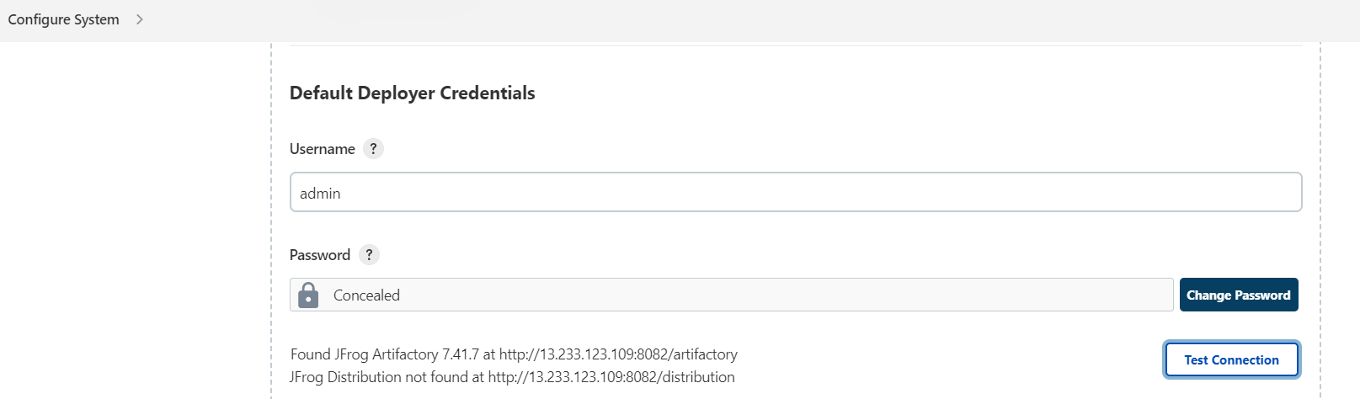
Provide the user name & password of Jfrog.

Slide 56
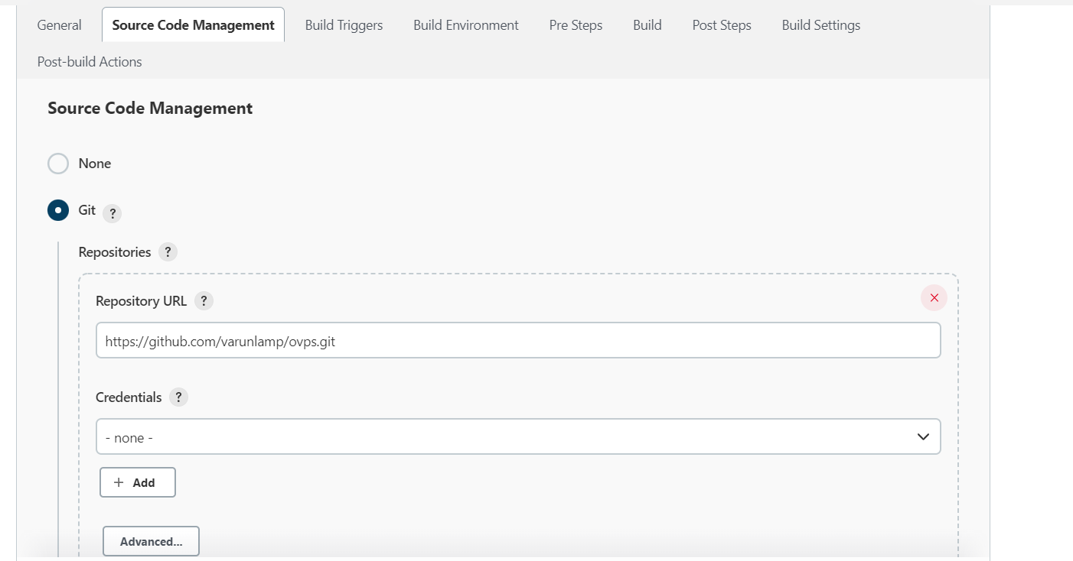
Create a new job click on source code management & select git provide the github repository Url.

Slide 57
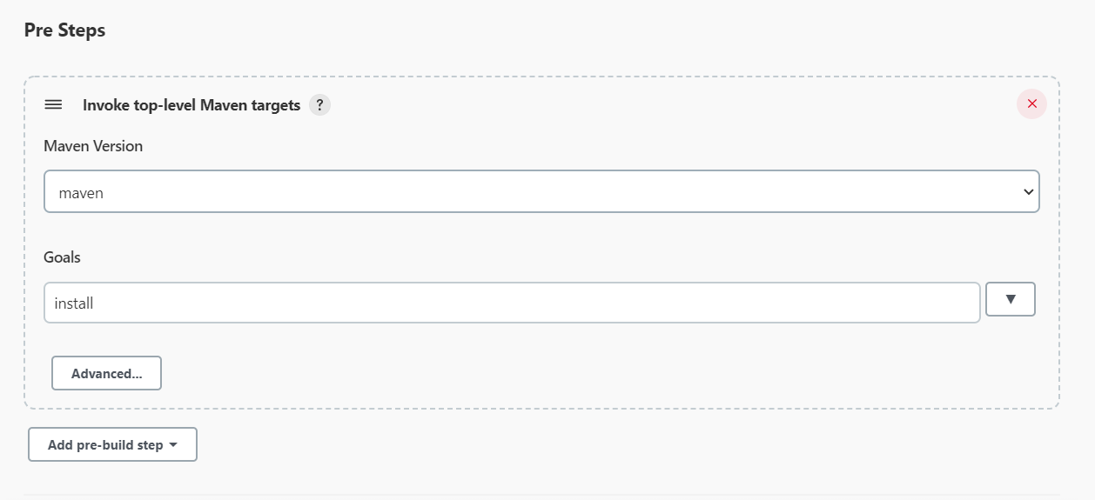
Choose maven version & provide the goal based on requirement.

Slide 58
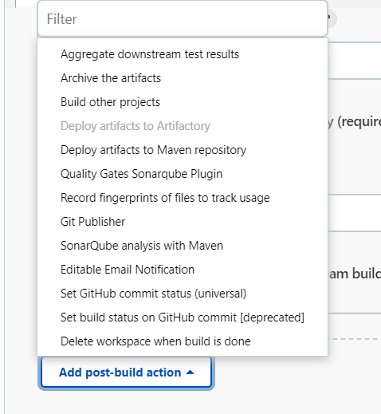
Click on add post-build action & choose deploy artifacts to artifactory option.

Slide 59
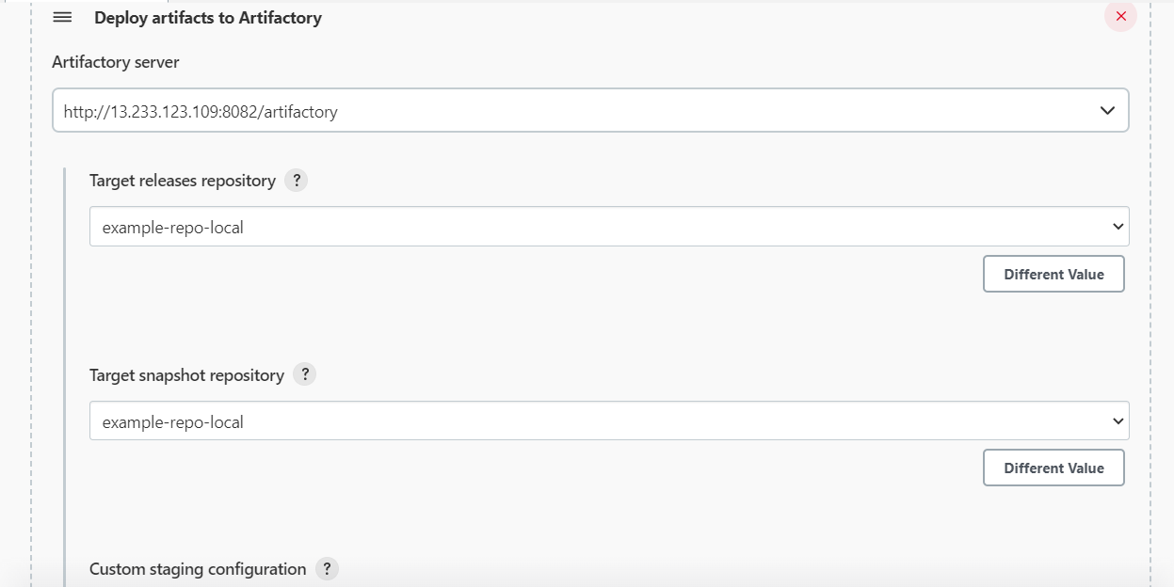
Check the details & provide the Repository name.

Slide 60
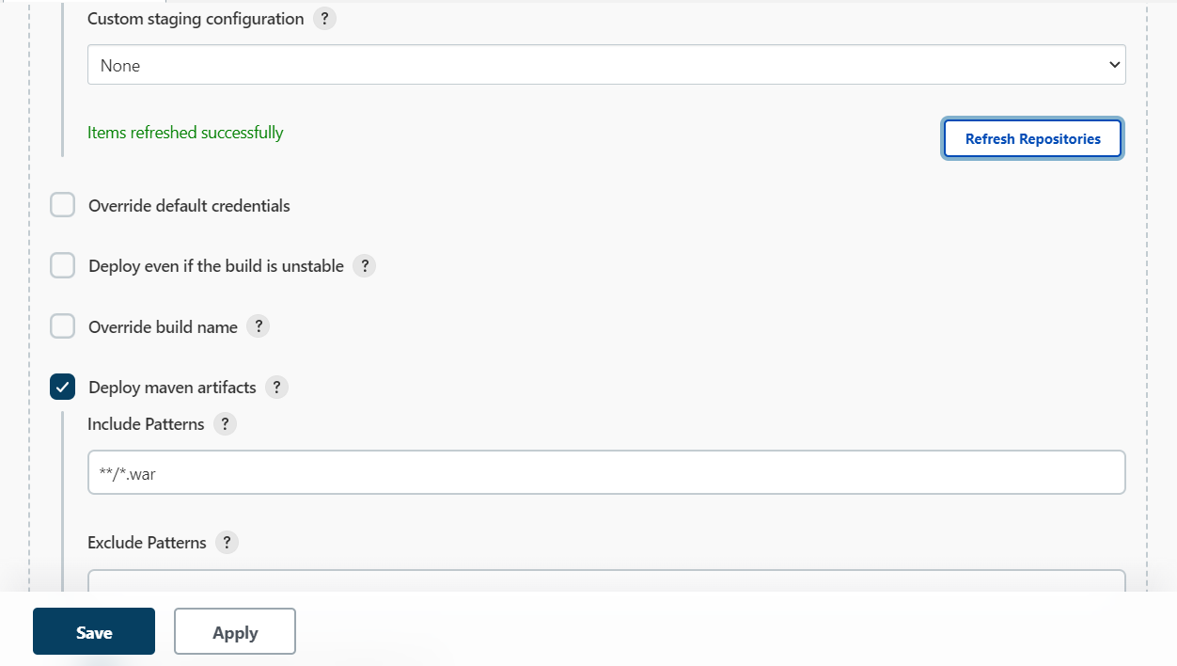
Provide the file pattern like war or jar.

Slide 61
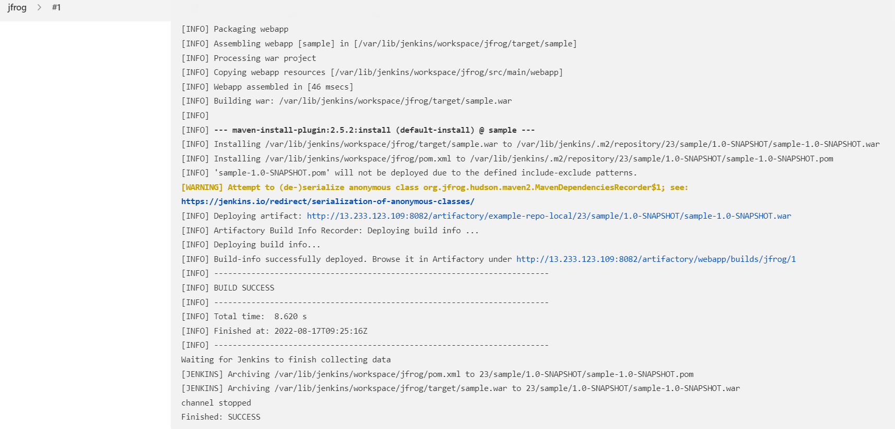
When we click on console output it will give complete information about build .

Slide 62
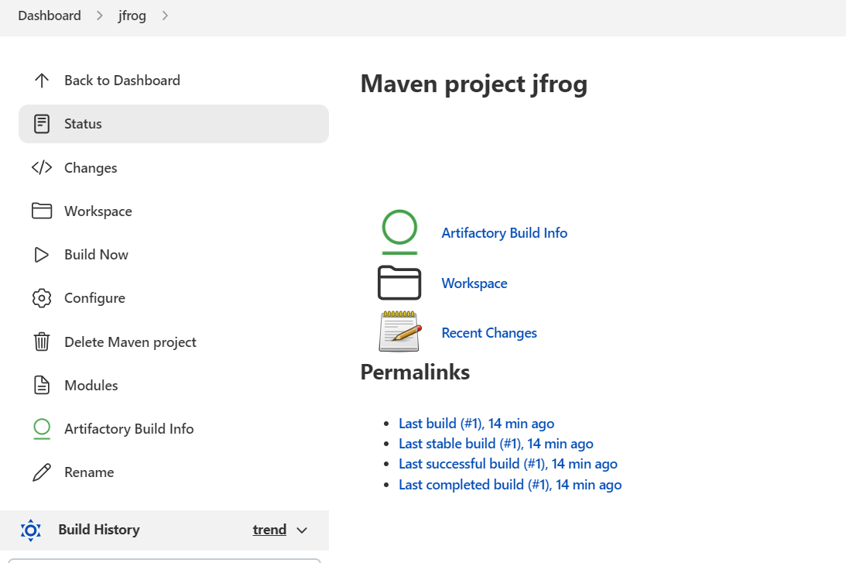
When we open the status in this page we will get the information about build status.

Slide 63
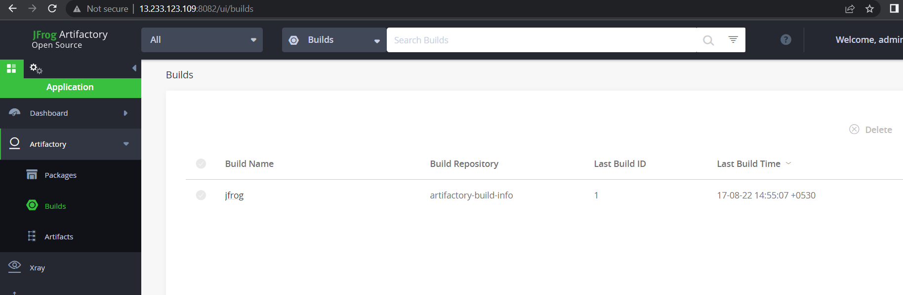
When we click on artifactroy build info we will get the information about the build artefact.

Slide 64
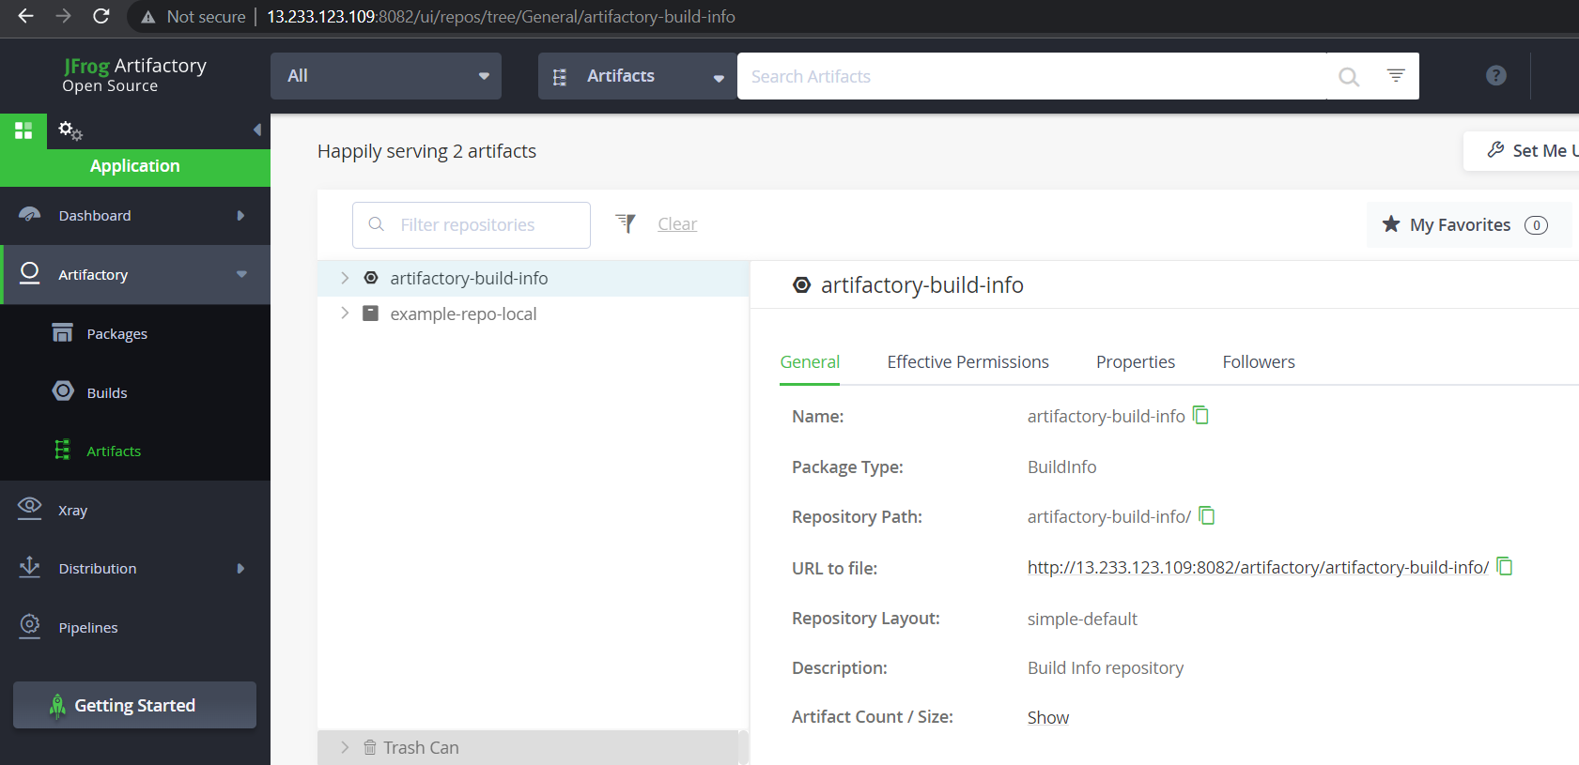
Click on artifactory & select the artifactory-build-info inside this we will get the complete information about artifactory.

Slide 65

When we paste the artifactory url we will get the page called index, from this we can download the artifactory.

Slide 66

Pipeline view

Slide 67
Building Jenkins pipeline using groovy script

Slide 68

Choose the pipeline for building pipelines

Slide 69
Groovy script for building pipeline
pipeline {
agent any
tools {
maven 'MAVEN-HOME'
}
stages {
stage ('compile') {
steps {
bat "mvn compile"
}
}
stage ('test') {
steps {
bat "mvn test"
}
}
stage ('package') {
steps {
bat "mvn package"
}
}
stage ('Build') {
steps {
bat "mvn install"
}
}
}
}

Slide 70

Add the Jenkins pipeline in github

Slide 71

Choose the pipeline script from scm
Provide the github repository url where Jenkins file is present

Slide 72

Provide the filename.

Slide 73

It will show the result in pipeline

Slide 74
Thank you

