Slide 1

SHELL SCRIPTING

Slide 2
Agenda
What is shell scripting?
Importance of shell scripting
Different types of shells
Creating Shell script
Making shell script executable
What is a variable?
System defined variables
Environment Variables

Slide 3
User defined variables
Constant variables
Local and Global variables
Special Variables
Comments
Operators
Flow Control Structure
Looping
Functions
Shell Manpage Help

Slide 4
Difference between script & programming
Script | programming
Weekly or loosely typed programming | Strickly typed & syntax based.
Scripting interpreter | Compiler based
Special environment not required | Required special environment &setup

Slide 5
What is shell
A shell is special user program which provide an interface to user to use operating system services. Shell accept human readable commands from user and convert them into something which kernel can understand. It is a command language interpreter that execute commands read from input devices such as keyboards or from files. The shell gets started when the user logs in or start the terminal.

Slide 6
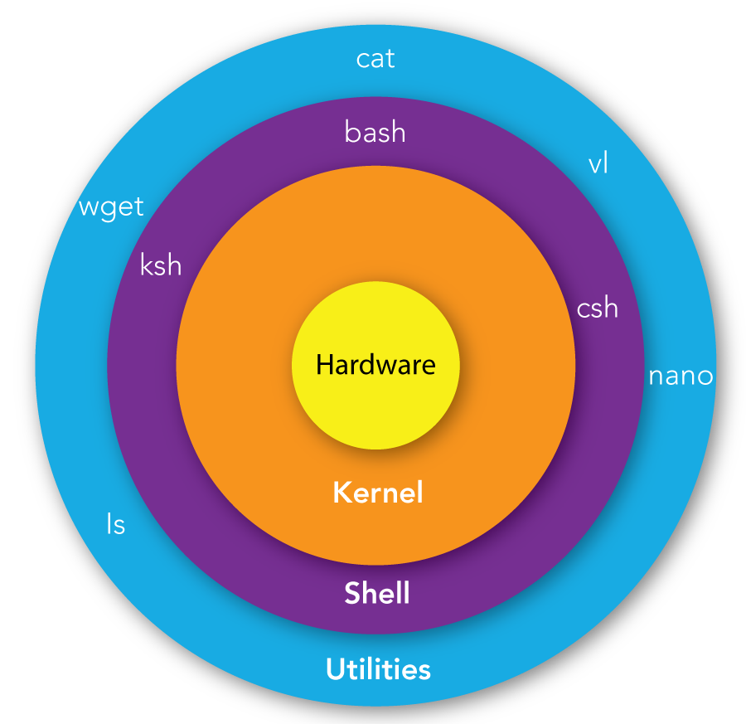
Structure of shell

Slide 7
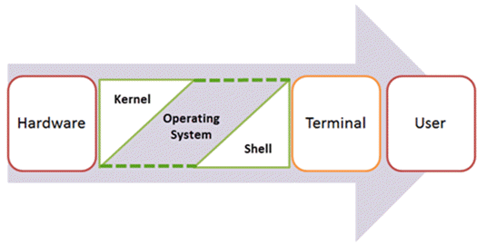
Processing of shell script

Slide 8
Shell is broadly classified into two categories –
Command Line Shell : Shell can be accessed by user using a command line interface. A special program called Terminal in linux/macOS or Command Prompt in Windows OS is provided to type in the human readable commands such as “cat”, “ls” etc. and then it is being execute. The result is then displayed on the terminal to the user.
Graphical shell : Graphical shells provide means for manipulating programs based on graphical user interface (GUI), by allowing for operations such as opening, closing, moving and resizing windows, as well as switching focus between windows. Window OS or Ubuntu OS can be considered as good example which provide GUI to user for interacting with program. User do not need to type in command for every actions.

Slide 9
There are several shells are available for Linux systems like –
BASH (Bourne Again SHell) : The original UNIX shell is known as sh, short for Shell or the Bourne Shell, named for Steven Bourne, the crea tor of sh.Bourne Shell has been considered a standard p art of UNIX for decades. The shell prompt is $, Executi on command sh.
CSH (C SHell) : Designed by Bill Joy at the University of California at Berkeley, the C shell was so named because much of its syntax parallels that of the C programming language. T he shell prompt is % and execution command Csh.
KSH (Korn SHell) : The korn shell is created by David korn at AT & T Bell laboratories .the KORN shell or ksh the prompt is $

Slide 10
What is shell scripting
Collection of linux commands is called as shell scripting.
Script is nothing but weekly or loosly coupled programming.
Why do we need shell scripts
To avoid repetitive work and automation
System admins use shell scripting for routine backups
System monitoring
Adding new functionality to the shell etc.

Slide 11
Advantages of shell scripts
The command and syntax are exactly the same as those directly entered in command line, so programmer do not need to switch to entirely different syntax.
Writing shell scripts are much quicker.
Quick start.
Interactive debugging etc.

Slide 12
Basics:-
echo:- To print the content
echo $0 : To display which shell we are working
echo $1, $2, ….. $n 1st, 2nd 3^{rd :} command line parameter
echo $# : Number of command line parameters
echo $$ : Process ID of the shell
echo $@ : same as $* but as a list one at a time (see for loops later )
echo $? : Return code ‘exit code’ of the last command

Slide 13
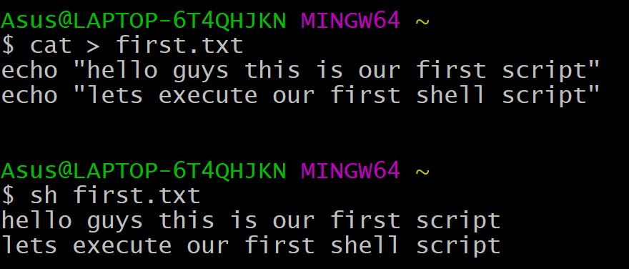
Basic shell scripts
Cat first.txt
We can write shell scripting with the extension of .sh or .txt

Slide 14

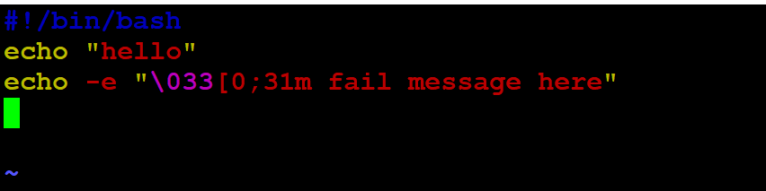
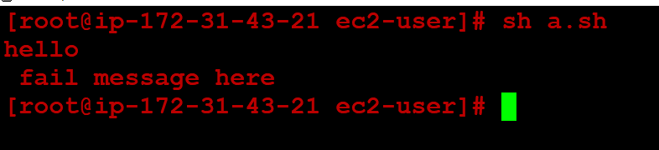
Printing the output in colours based on results
To print the output in RED colour.
echo –e “\033[0;31m fail message here”
31m is for printing the output in Red colour.
The result is printed in red colour.

Slide 15
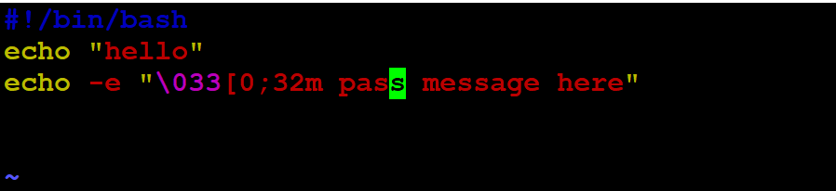
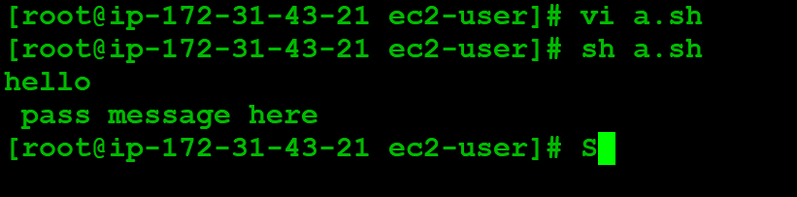
echo –e “\033[0;31m fail message here”
To print the output is green.
32m for printing the output in green colour.
The result is printed in green colour.

Slide 16
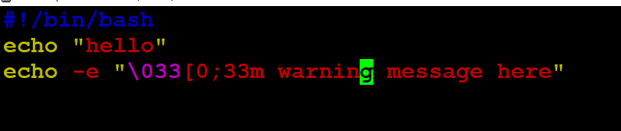
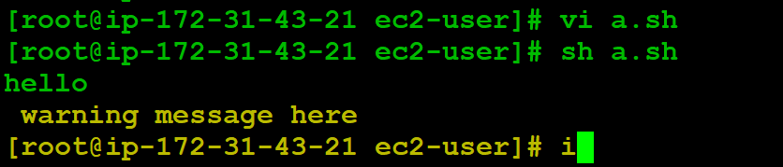
To print the output in green colour.
echo -e "\033[0;33m pass message here"
33m for printing the output in yellow colour as a symbol of warning.
The output is printed in green colour based on the condition passed.

Slide 17
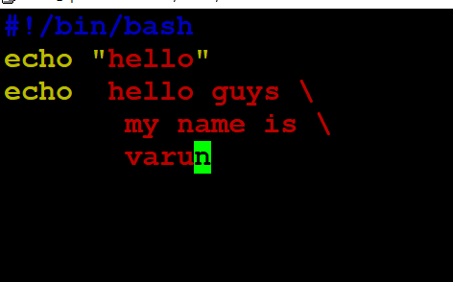
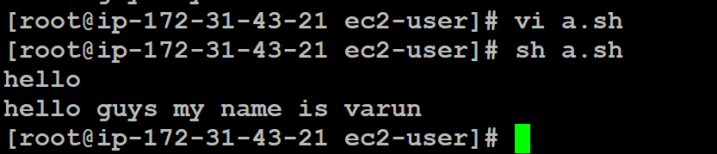
Multi-line print statement
Note : If we use single quote it will print the content as it is single quote is know as strong quote.
Backward slash indicates continuation sign by this we can print multi-line input as a single line output.
The output is printed in single line.

Slide 18
variable
variable is a named memory location which is used to store the date & it can be changed ‘n’ number of times during execution.
Note :
Variable names cannot be reserved words.
Variable name cannot have whitespace in between.
The variable name cannot have special characters.
The first character of the variable name cannot be a number.

Slide 19
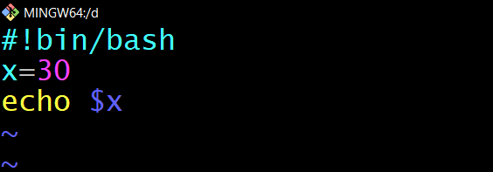
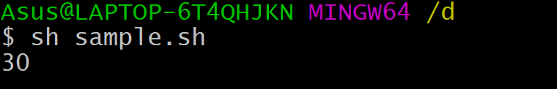
User defined variables
Example 1:
#!bin/bash
x=30
echo $x
When we a run the shell script it will print the x value.

Slide 20
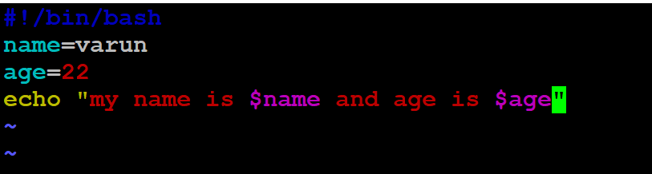
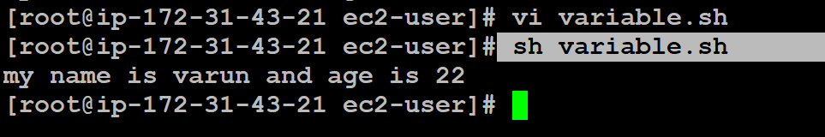
Basic script for storing the data of user.
#!/bin/bash
name=varun
age=22
echo "my name is $name and age is $age"
Based on the requirement we can manipulate the data.

Slide 21
System variables
echo ${HOME}
echo ${OSTYPE}
echo $PATH
echo ${$} ---It will print the process id.
echo $PWD
echo $HOSTNAME
echo $UID
Man bash ---manual of bash.
Sleep
echo {SECONDS}

Slide 22
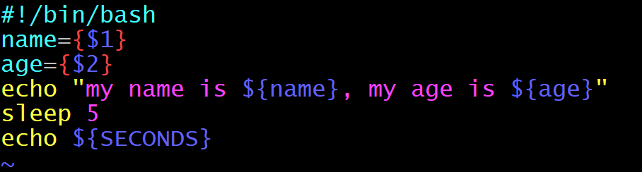
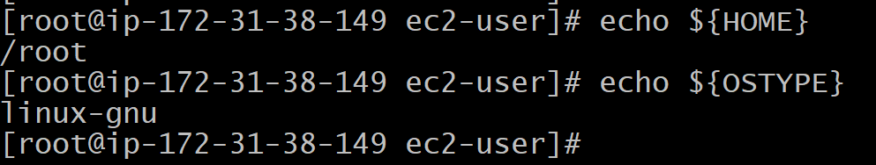
System variable
Using system variable SECONDS it will print the time.
Using HOME & OSTYPE.

Slide 23
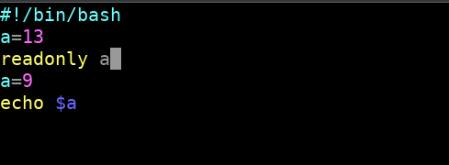
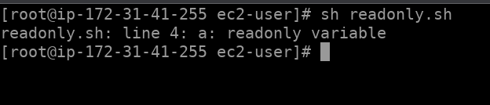
Read only :- After a variable is marked Read-only its value cannot be changed
vi readonly.sh
ex:
#!/bin/bash
a=13
readonly a
a=9
echo $a
sh readonly.sh

Slide 24
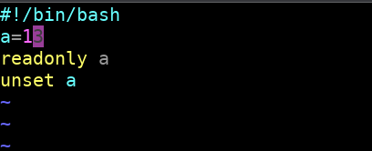

Readonly & unset
#!/bin/bash a=13 readonly a unset a
Unset will work only the values which are not declared with readonly

Slide 25
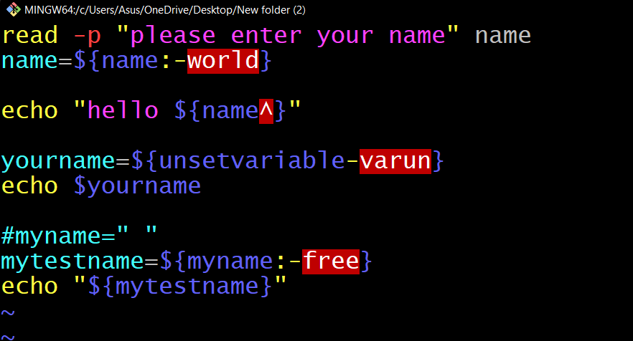
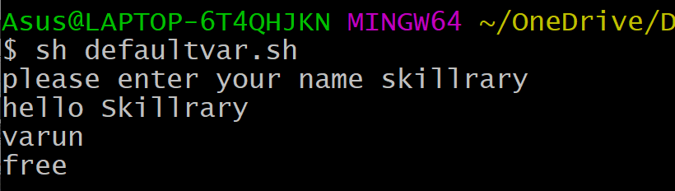
Setting Default variable
read -p "please enter your name" name
name=${name:-world}
echo "hello ${name^}"
yourname=${unsetvariable-varun}
echo $yourname
#myname=" "
mytestname=${myname:-free}
echo "${mytestname}"

Slide 26
Expressions:-
Arithmetic operator : +, -, *, /, %, =, ==, !=
Logical operator:
-eq = Equality condition.
-ne = Not equal.
-gt = greater than.
-ge = greater than /equal to.
-lt = less than.
-le = less then or eqal to

Slide 27
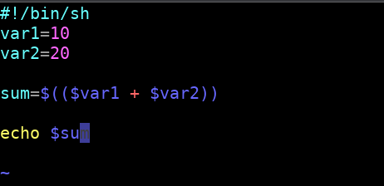

vi add.sh
var1=10
var2=20
sum=$(($var1 + $var2))
echo $sum
Sample addition program
Output of the addition script

Slide 28
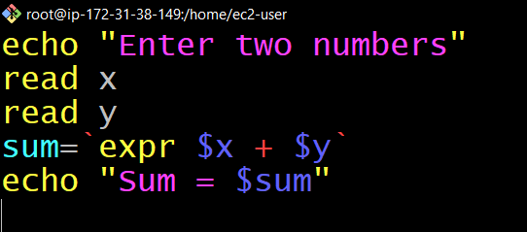
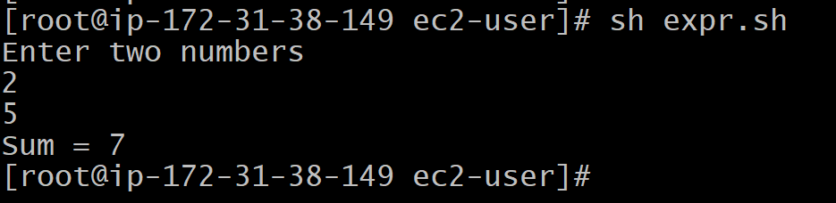
Expression
echo "Enter two numbers" read x read y sum=`expr $x + $y` echo "Sum = $sum"
echo "Enter two numbers"
read x
read y
sum=`expr $x + $y`
echo "Sum = $sum"

Slide 29
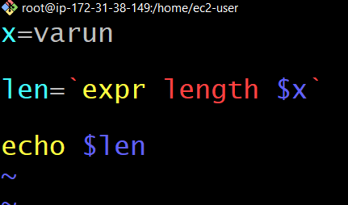
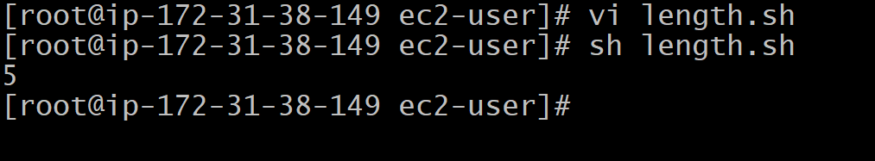
For String operations
Example : Finding length of a string
x=varun
len=`expr length $x`
echo $len
When we run this script it will count the number of strings & it will print.

Slide 30
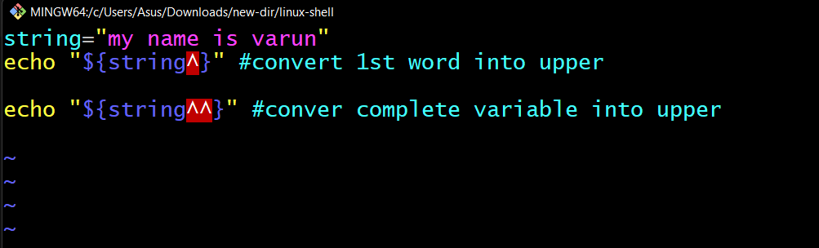
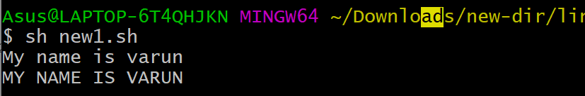
By using string operations converting lower to upper case
string="my name is varun"
echo "${string^}" #convert 1st word into upper
echo "${string^^}" #conver complete variable into upper
output

Slide 31
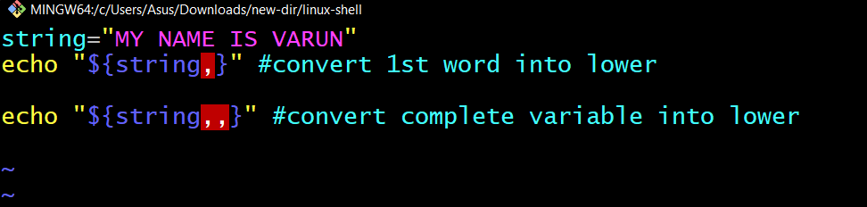
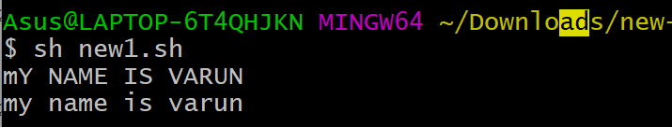
By using string operations converting upper to lower case
string="MY NAME IS VARUN"
echo "${string,}" #convert 1st word into lower
echo "${string,,}" #convert complete variable into lower
output

Slide 32
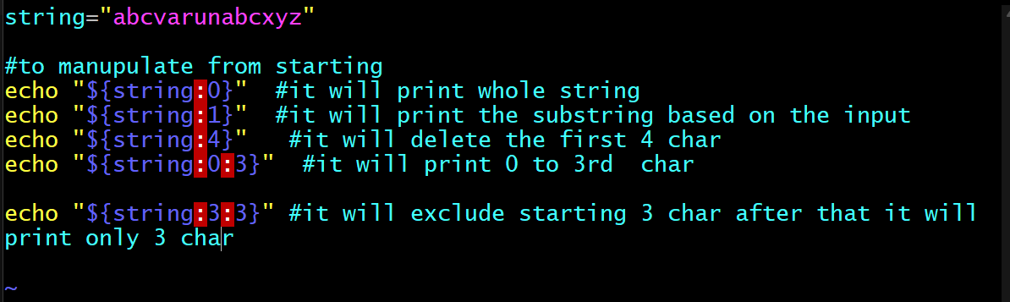
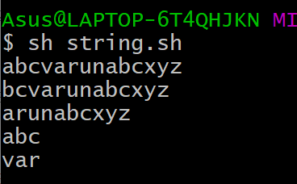
Converting string to substring
string="abcvarunabcxyz"
echo "${string:0}"
echo "${string:1}"
echo "${string:4}"
echo "${string:0:3}"
echo "${string:3:3}"
Output of the file

Slide 33
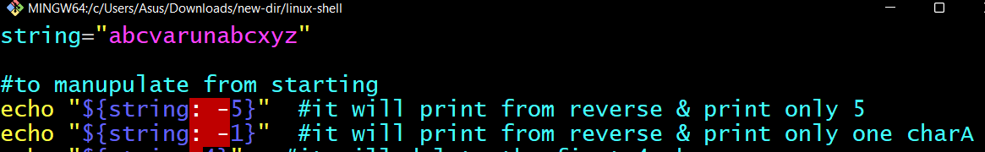
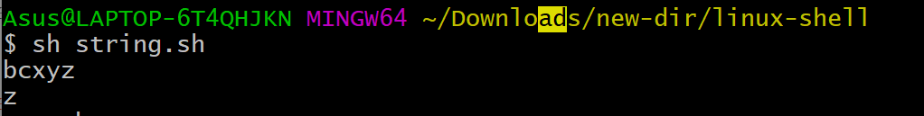
Reverse order
string="abcvarunabcxyz"
echo "${string: -5}"
echo "${string: -1}"

Slide 34
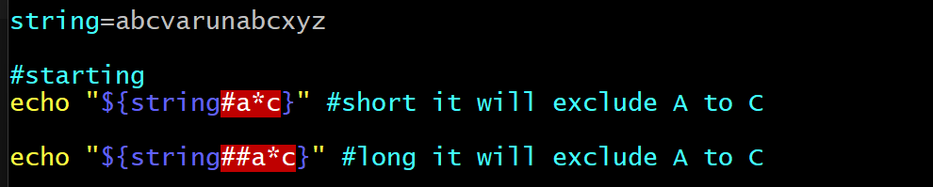
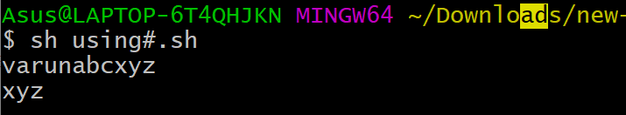
Using # starting
string=abcvarunabcxyz
#starting
echo "${string#a*c}"
echo "${string##a*c}"

Slide 35
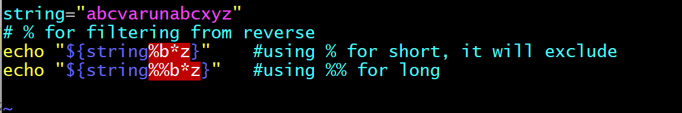
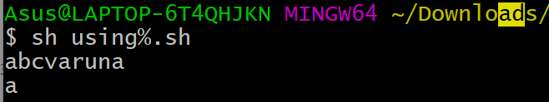
Using % for reverse
string="abcvarunabcxyz"
# % for filtering from reverse
echo "${string%b*z}" #using % for short, it will exclude
echo "${string%%b*z}" #using %% for long

Slide 36
Loops
Loop is a block of code that is repeated a number of times.

Slide 37
For loop :
A for loop is a control flow statement for specifying iteration, which allows code to be executed repeatedly.
Syntax:
for arg in list
do
command(s)
...
done
Where the value of the variable arg is set to the values provided in the list one at a time and the block of statements executed. This is repeated until the list is exhausted.
Example:
for i in 3 2 5 7
do
echo " $i times 5 is $(( $i * 5 )) "
done

Slide 38
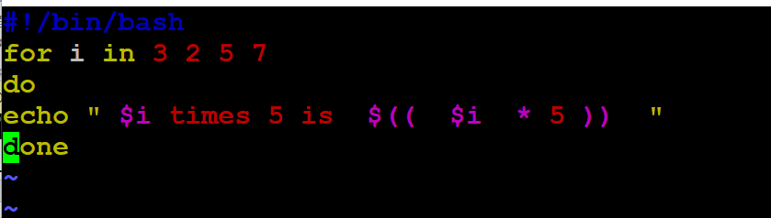
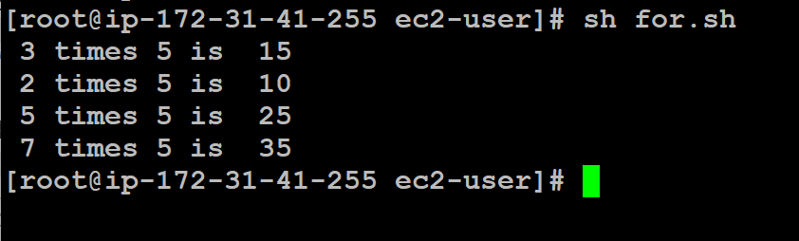
For loop program
i*5
It will print the output until loop terminate

Slide 39
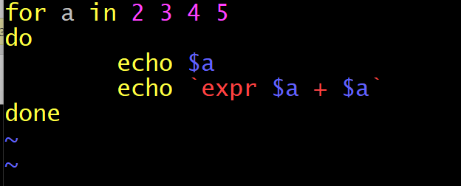
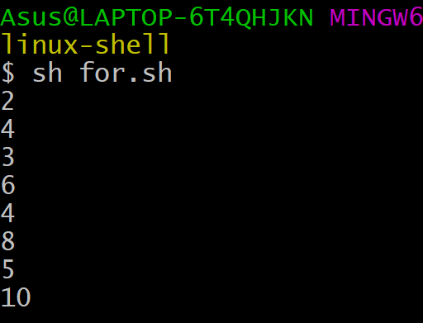
Ex 2 :-
for a in 2 3 4 5
do
echo $a
echo `expr $a + $a`
done

Slide 40
While loop:
The while loop enables you to execute a set of commands repeatedly until some condition occurs. It is usually used when you need to manipulate the value of a variable repeatedly.
Syntax:
while this_command_execute_successfully
do
this command
and this command
done

Slide 41
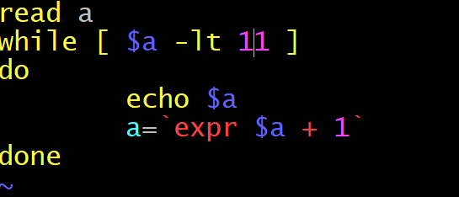
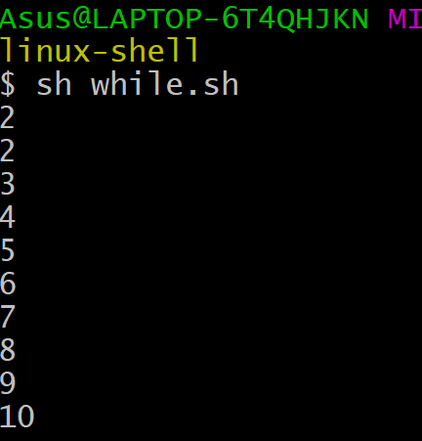
Example 1:
#script
read a
while [ $a -lt 11 ]
do
echo $a
a=`expr $a + 1`
done
Based on the input

Slide 42
EXAMPLE: Adding integers from 1 to 10
#!/bin/sh
i=1
sum=0
while [ $i -le 10 ]
do
echo Adding $i into the sum
i=`expr $i + 1 `
sum=`expr $sum + $i `
done
echo The sum is $sum.

Slide 43
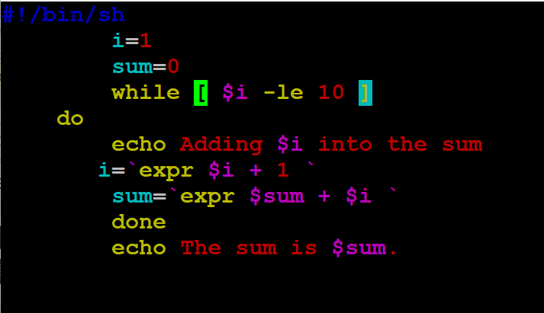
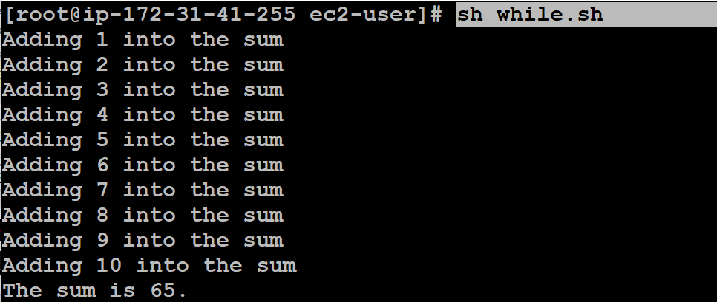
Sample while loop program
Adding integers from 1 to 10
The output of the while loop is 65

Slide 44
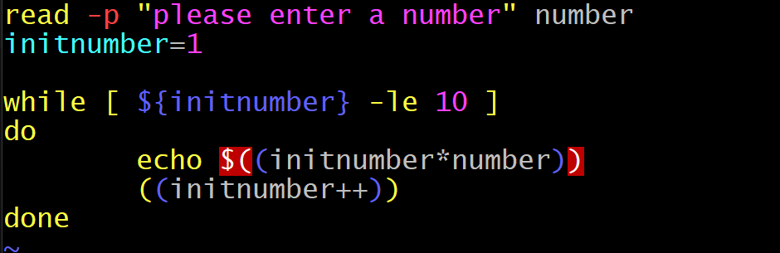

Slide 45
case - esac
used for pattern matching.
ex : case argument in
pattern 1) execute this command
and this
and this;;
pattern 2) execute this command
and this
and this;;
esac
Sample switch case script
#!/bin/bash
name="HowLinux"
case $name in
"Linux")
echo "Not quite right"
;;
"HowLinux")
echo "That's right!"
;;
esac

Slide 46
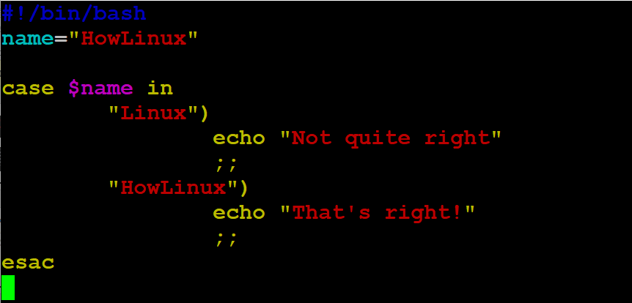
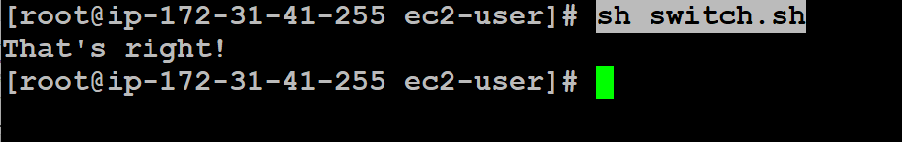
It will match the case
It will print the case which is matched

Slide 47
Conditional statements:-
If:- If the condition is true then only it will execute or-else it will not execute.
#!/bin/bash
echo "Enter a number"
read n
/root/apache-maven-3.8.6
printf "$n is less than 100\n"
fi

Slide 48


It will ask the input from the user based on the user input it will give the output.

Slide 49
If-else:- If specified condition is not true in if part then else part will be execute. To use multiple conditions in one if-else block, then elif keyword is used in shell.
#!/bin/bash
echo "Enter your name"
read name
if [[ $name == "varun" ]]; then
echo "You have won the prize"
else
echo "Try for the next time"
fi

Slide 50


If else condition script if condtion is true then it will print won or else it will print try for next time

Slide 51


Ex 2: read a
if [ `expr $a % 2` == 1 ]
then
echo "odd"
else
echo "even"
fi
The output of the script

Slide 52


Even by using if-else
#script
read a
if [ `expr $a % 2` == 0 ]
then
echo "even"
else
echo "odd"
fi
Result

Slide 53


Else-if:-
read a
if [ `expr $a % 2` == 0 ]
then
echo "even"
elif [ `expr $a % 2` == 1 ]
then
echo "odd"
fi
The if condition is false then it will execute elif block.

Slide 54
Ex2:-
#!/bin/bash
echo -n "Enter a number: "
read VAR
if [[ $VAR -gt 10 ]]
then
echo "The variable is greater than 10."
elif [[ $VAR -eq 10 ]]
then
echo "The variable is equal to 10."
else
echo "The variable is less than 10."
fi

Slide 55


It will take the input from the user based on the input it will check the condition & print the output.

Slide 56
Patterns
#!/bin/sh
a=0 while [ "$a" -lt 10 ] # this is loop1 do b="$a“ while [ "$b" -ge 0 ] # this is loop2 do echo -n "$b” b=`expr $b - 1` done echo a=`expr $a + 1`
done

Slide 57


The task is to print the numbers in serial like half-diamond shape.
The output of the pattern is printed in hald-diamond shape.

Slide 58
Functions
Functions are Group of statements it will get executed when ever it is called or invoked.
SYNTAX:
functionname()
{
block of commands
}
Example :
#!/bin/sh
# Define your function here
Hello () {
echo "Hello World"
}
# Invoke your function
Hello

Slide 59


Example
sum()
{
x=`expr $1 + $2`
echo $x
}
sum 5 3
Output of the function is 8

Slide 60

Passing the parameters
#!/bin/sh
# Define your function here
Hello () {
echo "Hello World $1 $2"
}
# Invoke your function
Hello varun polampalli
Arguments
Passing the parameter

Slide 61

Calling the functions
#!/bin/sh
# Calling one function from another
number_one () {
echo "This is the first function speaking..."
}
number_two () {
echo "This is now the second function speaking..."
}
# Calling function one.
number_one calling the number one function
When we run the script number_one function will get executed.

Slide 62


Command line arguments
Defining the value through command line
Passing the value .

Slide 63

Basic command line argument shell script for printing the value from 1 to 13 .

Slide 64

When we pass the command line arguments for 1 to 13
From 11 it will consider only 1st digit &it will print the value of 1
For this we have to use {}.

Slide 65
Shell Script to Perform Operations on a File
Most of the time, we use shell scripting to interact with the files. Shell scripting offers some operators as well as some commands to check and perform different properties and functionalities associated with the file.

Slide 66


File Reading Functionalities
Reading line by line: First, we take input using the read command then run the while loop which runs line after line.
read -p "Enter file name : " filename
while read line
do
echo $line
done < $filename

Slide 67


Counting characters, words & lines in the file:
We take three variables, one for counting characters, words, and lines respectively.
#script to count the char,words& lines from file
echo Enter the filename
read file
c=`cat $file | wc -c`
w=`cat $file | wc -w`
l=`grep -c "." $file`
echo Number of characters in $file is $c
echo Number of words in $file is $w
echo Number of lines in $file is $l

Slide 68


-d file: The operator looks over if the file is present as a directory. If Yes, it returns true else false. It is [-d $file] syntactically.
echo -e "Enter the name of the file : \c"
read file_name
if [ -d $file_name ]
then
echo "$file_name is a directory"
else
echo "$file_name is not a directory"
fi
Its checks whether new is directory or not if it is directory then it print if block or it will print else block.

Slide 69


-e file: The operator inspects if the file exists or not. Even if a directory is passed, it returns true if the directory exists. It is [-e $file] syntactically.
#To check whether file exist or not
echo "enter the file name"
read file
if [ -e $file ] #to check the exist or not
then
echo "file is present"
else
echo "file is not present"
fi

Slide 70


-f file: If the file is an ordinary file or special file, then it returns true else false. It is [-f $file] syntactically.
echo "enter the file name"
read file
if [ -f $file ]
then
echo "file is present"
else
echo "file is not present"
fi

Slide 71


-s file: This operator checks if the file has a size greater than zero or not, which returns true or false subsequently. It is [-s $file] syntactically.
#script
read -p "enter the file name" file
if [ -s $file ]
then
echo "file is > 0"
else
echo "file is= 0"
fi

Slide 72


-w file: If wringing is allowed over the file, then the operator returns true, and if not then false. It is [-w $file] syntactically.
echo -e "Enter the name of the file : \c"
read file_name
if [ -w $file_name ]
then
echo "$file_name is writable"
else
echo "$file_name is not writable"
fi

Slide 73


-x file: The operator looks over if the file is executable or not, and returns true and false subsequently. It is [-x $file] syntactically.
echo -e "Enter the name of the file : \c"
read file_name
if [ -x $file_name ]
then
echo "$file_name is executable"
else
echo "$file_name is not executable"
fi

Slide 74
THANK YOU

