Slide 1
Integrating Jenkins with sonarqube

Slide 2
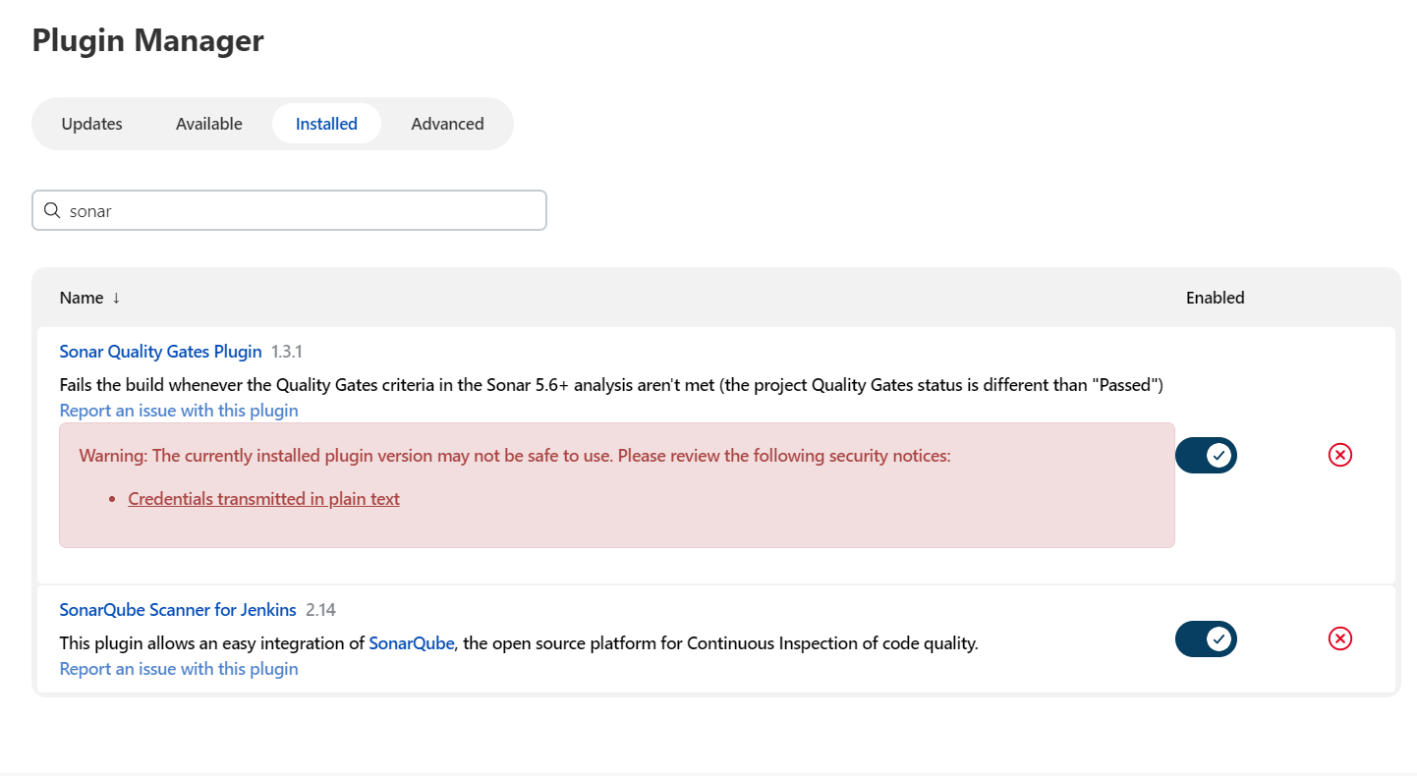
Install the following plugins for integrating with sonarqube.
1)Sonarqube scanner for Jenkins.

Slide 3
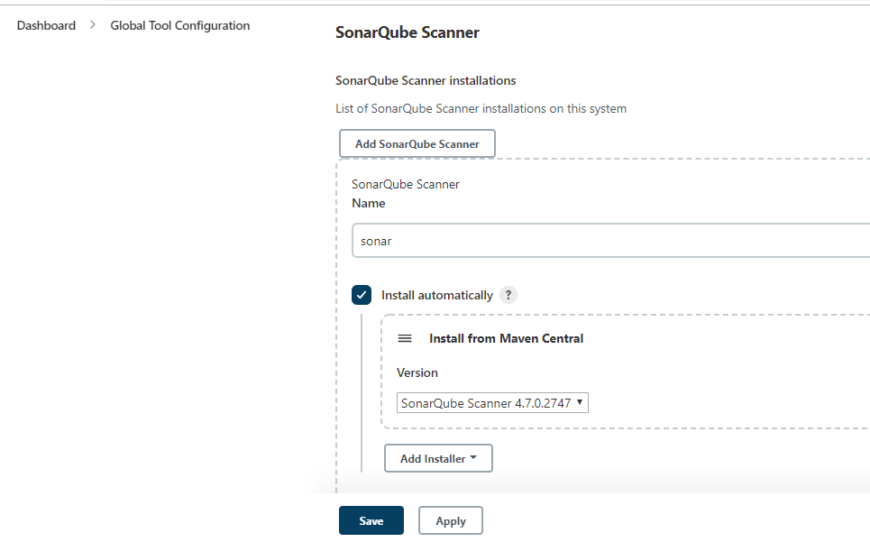
Click on add sonarqube scanner & choose install automatically

Slide 4
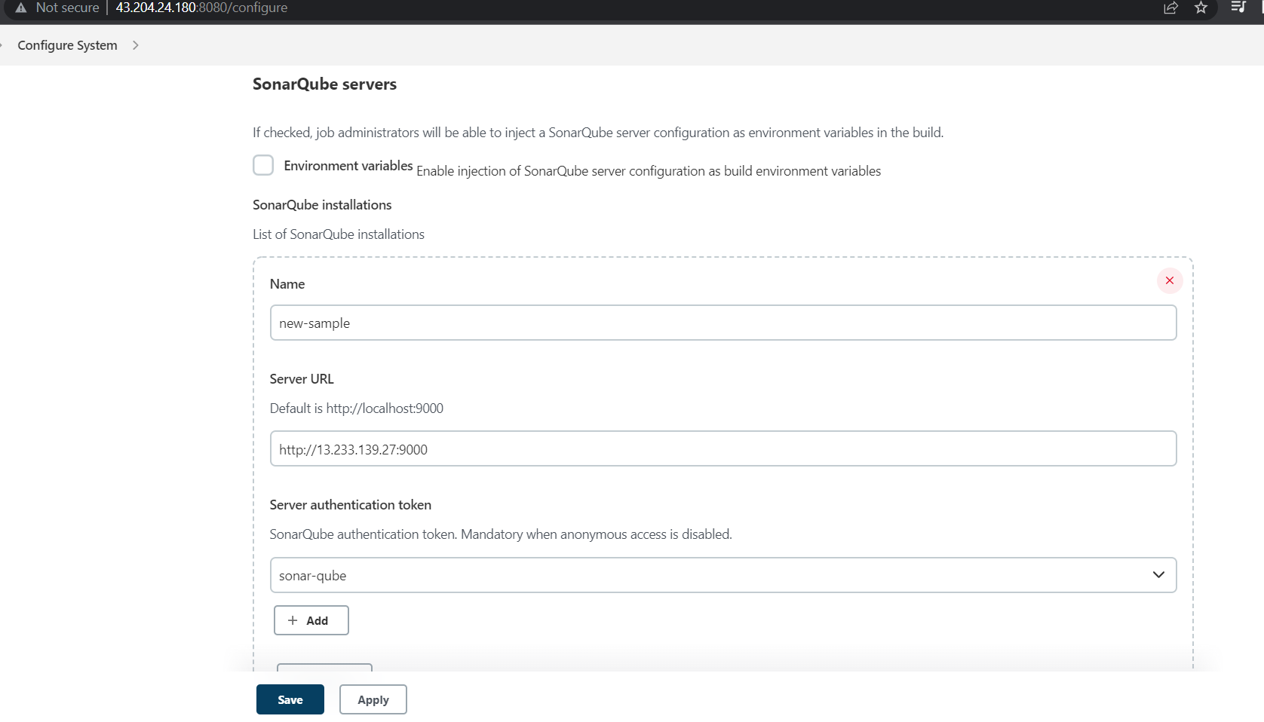
Open the configure system & provide the IP & server authentication token.

Slide 5
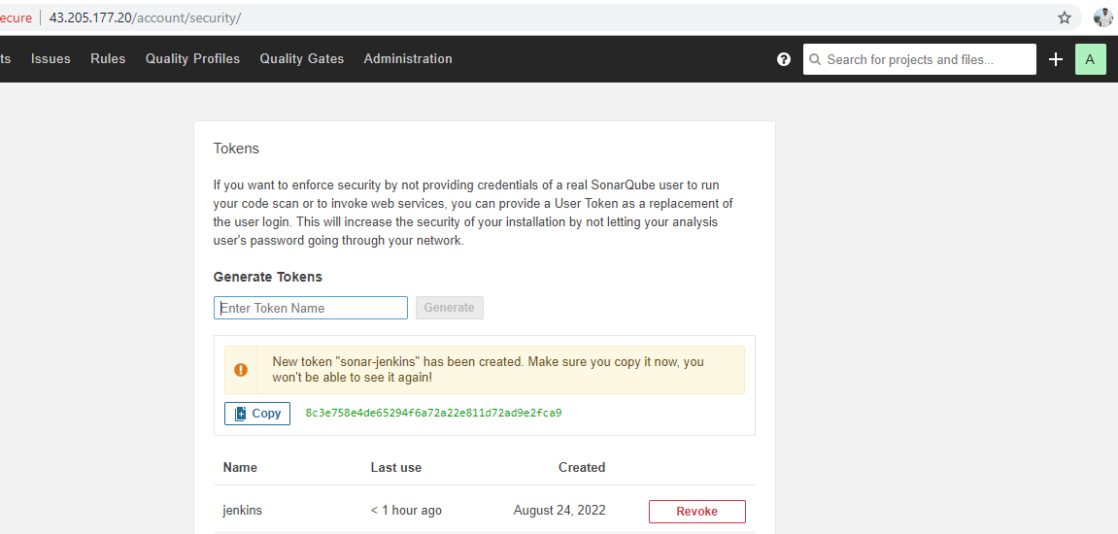
Click on administrator & click on security
Enter the token name & click on generate & copy the token

Slide 6
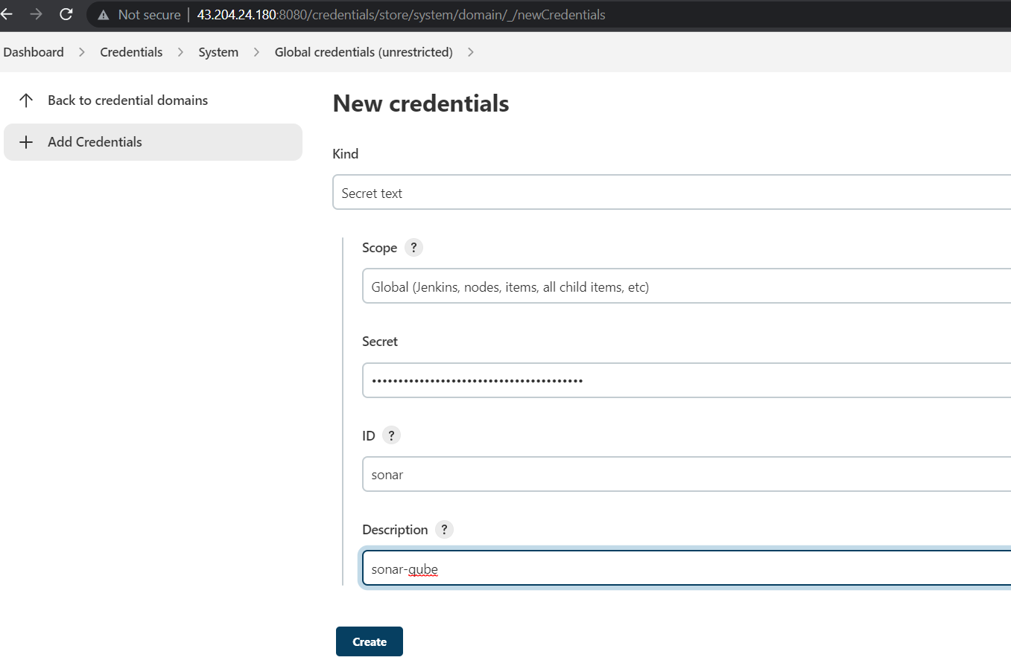
open the credentials & click on system, global credentials
Add the
sonarqube token.

Slide 7
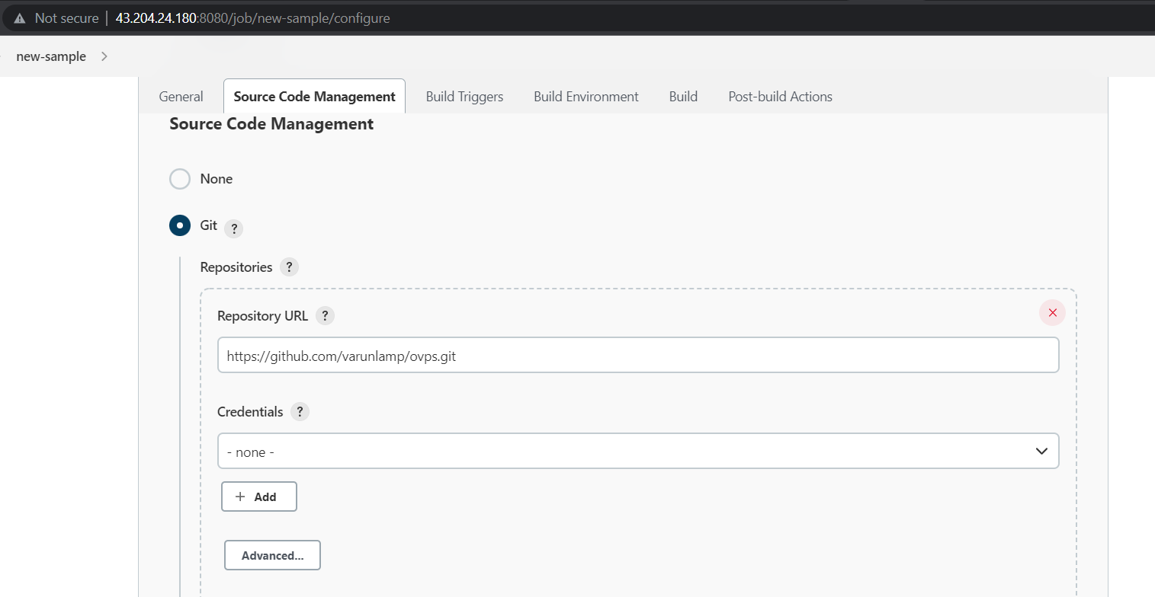
Provide the github repository url which consist of code.

Slide 8
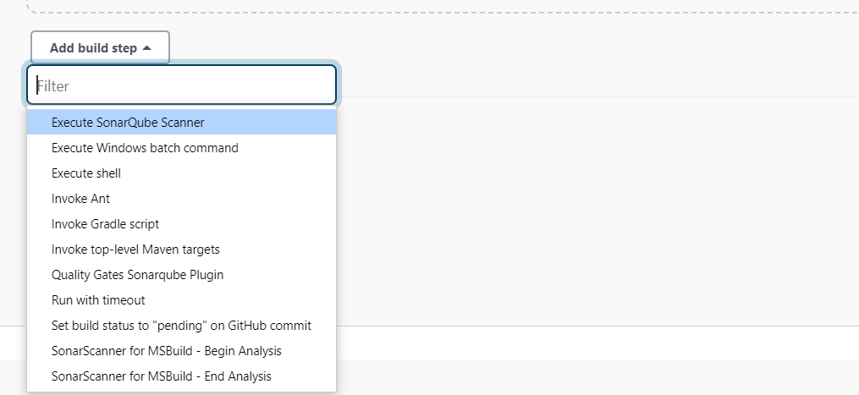
Click on add build step & select the
Execute sonarqube scanner.

Slide 9
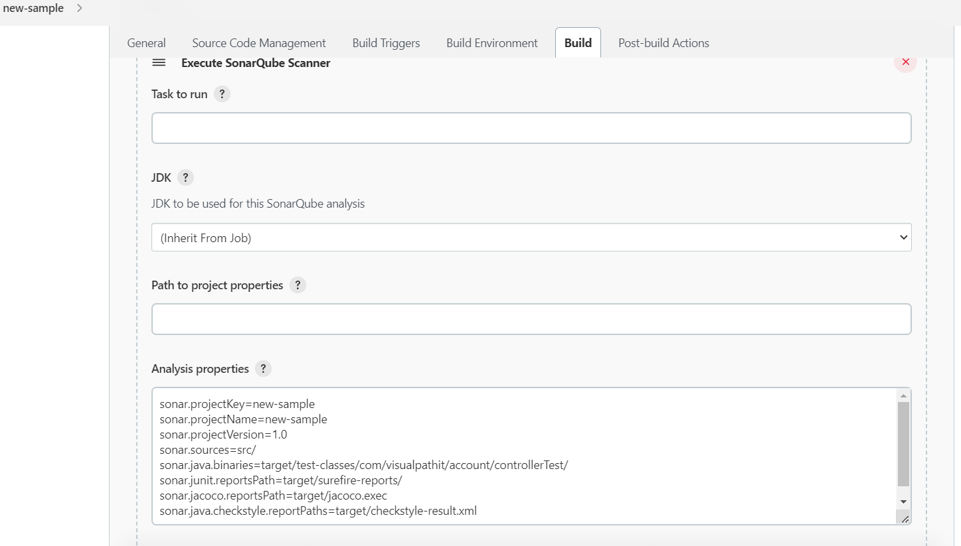
Add the properties which and all properties should be check in analysis properties.

Slide 10
Properties which need to be check in analysis properties.
sonar.projectKey=new-sample
sonar.projectName=new-sample
sonar.projectVersion=1.0
sonar.sources=src/

Slide 11
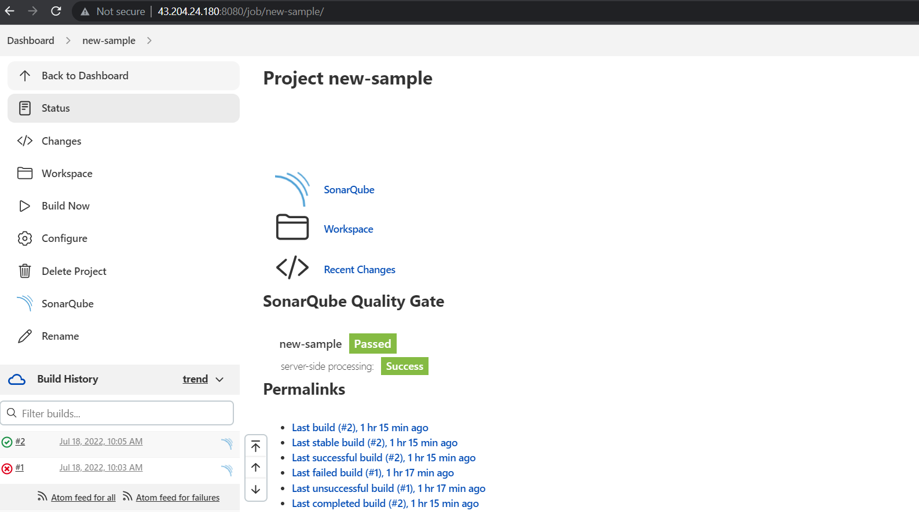
When we click on project it will display the report of bugs .

Slide 12
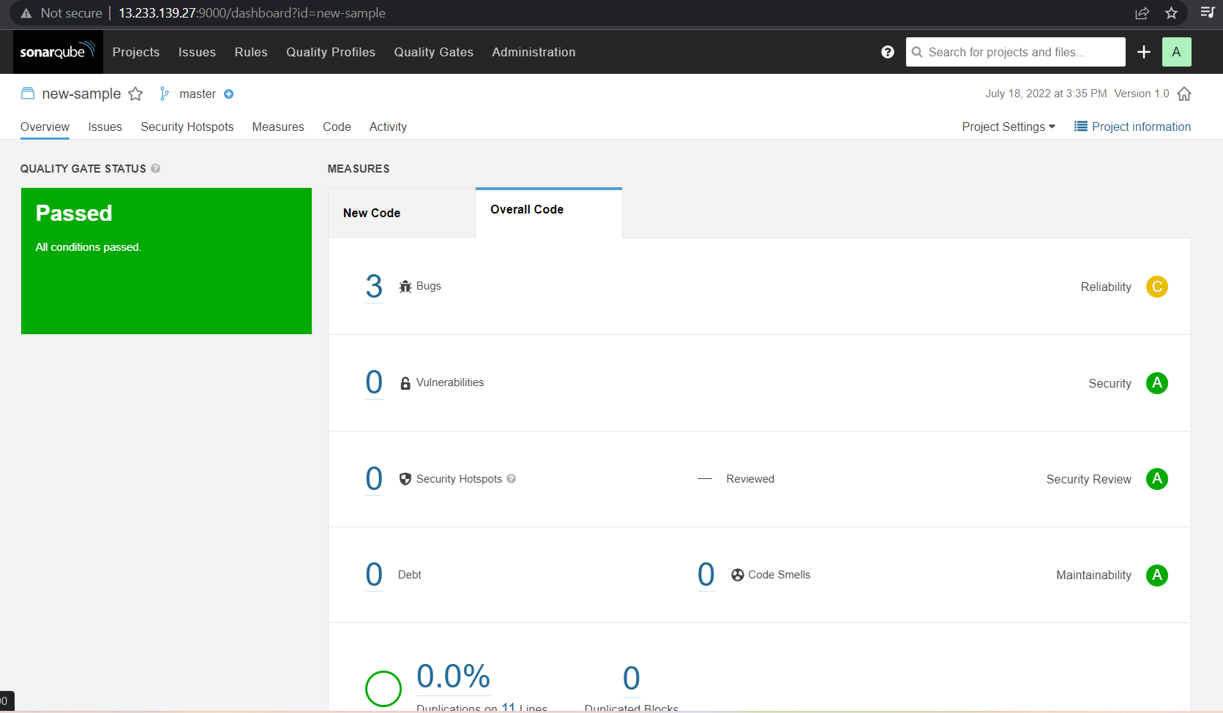
Generated report.

Slide 13
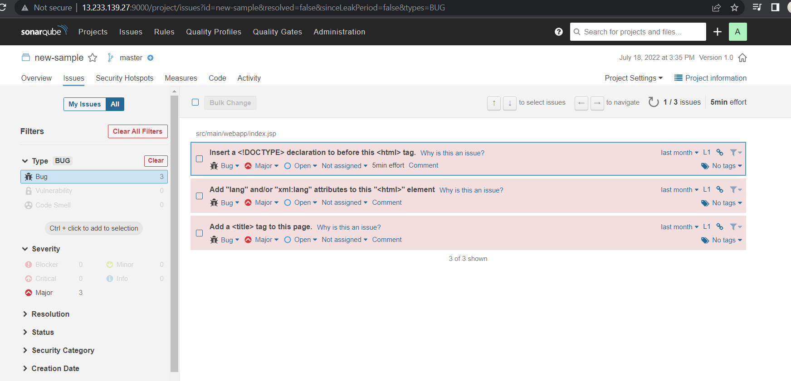
Bugs report/ it will display the errors & which needs to fix.

