Slide 1
AWS Route 53
Route 53 is a highly available and scalable domain name system (DNS) web service.
Route 53 provides three main functions:
Domain Registration
Domain name registration is required to ensure that no one else in the world can claim ownership of our site's address and to make finding your website simple.
Domain Name System (DNS) Service
It translates friendly domains names like www.Example.Com into IP addresses like 192.0.2.1
It responds to DNS queries using a global network of authoritative DNS servers, which reduces latency
It can route internet traffic to CloudFront, elastic beanstalk, ELB, or S3.

Slide 2
Health Checking
Can monitor the health of resources such as web and email servers.
Sends automated requests over the Internet to the application to verify that it's reachable, available, and functional.
CloudWatch alarms can be configured for the health checks to send notifications when a resource becomes unavailable.
Can be configured to route Internet traffic away from unavailable resources.
Some of the Supported DNS Resource Records
A (Address) Format:- It is an IPv4 address in dotted decimal notation e.g. 192.0.2.1.
AAAA Format :- It is an IPv6 address in colon-separated hexadecimal format. 0
CNAME Format:- It is the same format as a domain name.
MX (Mail Xchange) Format:- It contains a decimal number that represents the priority of the MX record and the domain name of an email server.
NS (Name Server) Format :- An NS record identifies the name servers for the hosted zone. The value for an NS record is the domain name of a name server.

Slide 3
Route 53 Hosted Zone
Hosted Zone is a container for records, which include information about how to route traffic for a domain (such as example.com) and all of its subdomains (such as www.example.com, retail.example.com, and seattle.accounting.example.com).
A hosted zone has the same name as the corresponding domain.
Two types of the Hosted Zones are
Public Hosted Zone – It uses for routing internet traffic to the resources for a specific domain and its subdomains.
Private hosted zone – It uses for routing traffic within a organization.

Slide 4
Routing Policy
When you create a record, you choose a routing policy, which determines how Amazon Route 53 responds to queries:
Simple Routing Policy - Use for a single resource that performs a given function for your domain, for example, a web server that serves content for the example.com website. You can use simple routing to create records in a private hosted zone.
Failover Routing Policy - Use when you want to configure active-passive failover. You can use failover routing to create records in a private hosted zone.
Weighted Routing Policy - Use to route traffic to multiple resources in proportions that you specify. You can use weighted routing to create records in a private hosted zone.
IP-Based Routing Policy - Use when you want to route traffic based on the location of your users, and have the IP addresses that the traffic originates from.

Slide 5
Load Balancers
A Load Balancer is a virtual machine or appliance that balances your web application load which could be HTTP or HTTPS traffic that we are getting in. It balances a load of multiple web servers so that no web server gets overwhelmed.
Types of Load Balancers are :-
Application Load Balancers.
Network Load Balancers.
Gateway Load Balancers.

Slide 6
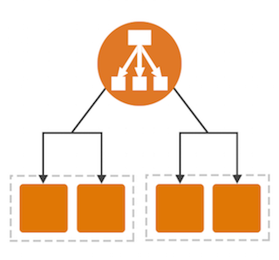
Application Load Balancers
An Application Load Balancer makes routing decisions at the application layer (HTTP/HTTPS), supports path-based routing, and can route requests to one or more ports on each container instance in your cluster.
Application Load Balancers support dynamic host port mapping.
This dynamic mapping allows you to have multiple tasks from a single service on the same container instance.

Slide 7
Network Load Balancer
A Network Load Balancer makes routing decisions at the transport layer (TCP/SSL). It can handle millions of requests per second.
After the load balancer receives a connection, it selects a target from the target group for the default rule using a flow hash routing algorithm.
It attempts to open a TCP connection to the selected target on the port specified in the listener configuration. It forwards the request without modifying the headers.

Slide 8
Gateway Load Balancer
Gateway Load Balancers allow you to deploy, scale, and manage virtual appliances, such as firewalls, intrusion detection and prevention systems, and deep packet inspection systems.
It combines a transparent network gateway (that is, a single entry and exit point for all traffic) and distributes traffic while scaling your virtual appliances with the demand.
A Gateway Load Balancer operates at the third layer of the Open Systems Interconnection (OSI) model, the network layer. It listens for all IP packets across all ports and forwards traffic to the target group that's specified in the listener rule.

Slide 9
AWS Cloud watch
CloudWatch collects monitoring and operational data in the form of logs, metrics, and events, and visualizes it using automated dashboards so you can get a unified view of your AWS resources, applications, and services that run on AWS.
Benefits of CloudWatch
It uses a single platform for observability.
Collect metrics on AWS and on premises.
Improve operational performance and resource optimization.
Derive actionable insights from logs.

Slide 10
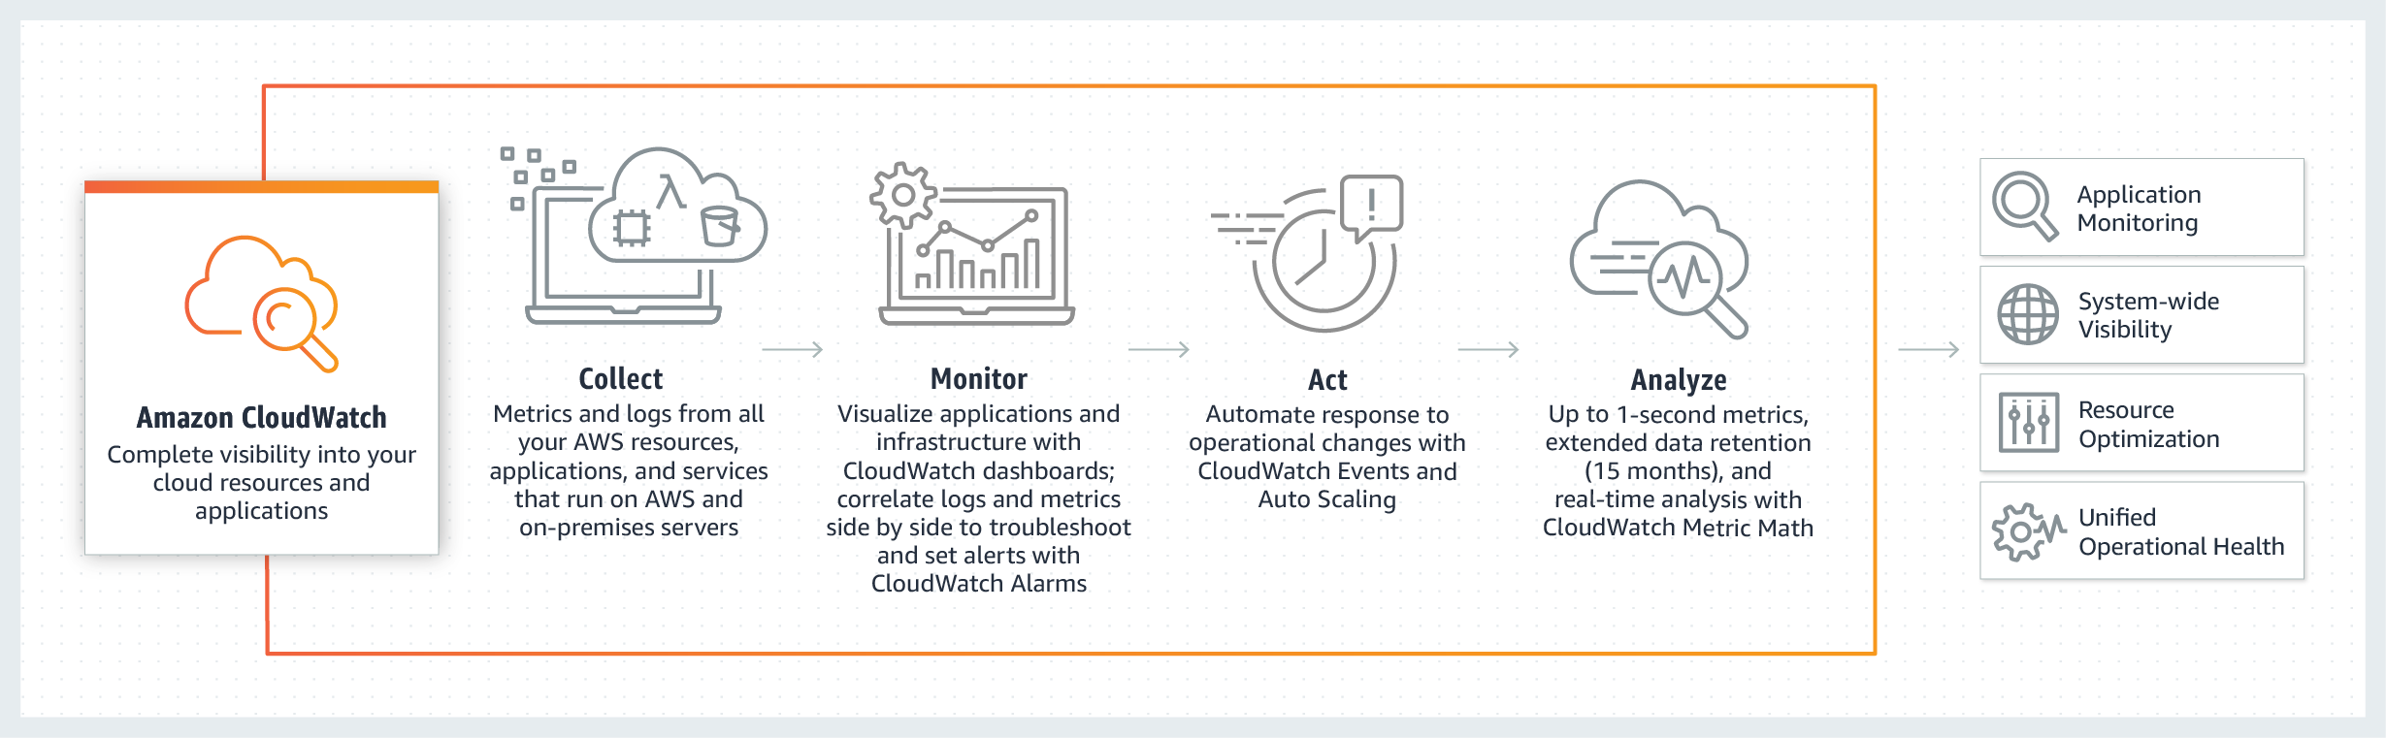
Working architecture of CloudWatch

Slide 11
autoscaling
AWS Auto Scaling monitors our applications and automatically adjusts capacity to maintain steady, predictable performance at the lowest possible cost. Using AWS Auto Scaling, it’s easy to setup application scaling for multiple resources across multiple services in minutes.
Benefits of AutoScaling
Setup scaling quickly.
Make smart scaling decisions.
Automatically maintain performance.
Pay only what we need.

Slide 12
Types of autoscaling
Vertical Scaling
Vertical scaling means we can scale by adding more power (CPU, RAM) to an existing machine.
Vertical scaling is limited to the capacity of one machine, scaling beyond that capacity can involve downtime
Horizonal Scaling
Horizontal scaling means that you scale by adding more machines into your pool of resources.
Adding more machines to the existing pool means we are not limited to the capacity of a single unit, making it possible to scale with less downtime.

Slide 13
Virtual private cloud(VPC)
A virtual private cloud (VPC) is defined as an isolated private cloud environment typically hosted and secured within another cloud, which is usually a public cloud.
The Key Components of VPC are:-
Subnet
Internet Gateway
NAT Gateway
Virtual private gateway
Peering Connection
VPC Endpoints
Egress-only Internet Gateway

Slide 14
Components of VPC
Subnet: A segment of a VPC’s where you can place groups to isolated resources.
Internet Gateway: VPC side of a connection to utilize public Internet.
NAT Gateway: A highly available, managed Network Address Translation (NAT) service for your resources in a private subnet to access the Internet.
Virtual private gateway: The Amazon VPC side of a VPN connection for secure transactions.
Peering Connection: To route traffic via private IP addresses between two peered VPCs.
VPC Endpoints: Enables private connectivity for your service in AWS without using an Internet Gateway, VPN, Network Address Translation (NAT) devices, or firewall proxies.
Egress-only Internet Gateway: A stateful gateway that provides egress only access for IPv6 traffic from the VPC to the Internet.

Slide 15
VPC Peering
A VPC peering connection is a networking connection between two VPCs that enables you to route traffic between them using private IPv4 addresses or IPv6 addresses.
Instances in either VPC can communicate with each other as if they are within the same network. we can create a VPC peering connection between our own VPCs, or with a VPC in another AWS account.

Slide 16
Internet gateway
Internet Gateway (IGW) is a horizontally scaled, redundant, and highly available VPC component that allows communication between your VPC and the internet.
Internet Gateway enables resources (like EC2 instances) in public subnets to connect to the internet. Similarly, resources on the internet can initiate a connection to resources in your subnet using the public.
If a VPC does not have an Internet Gateway, then the resources in the VPC cannot be accessed from the Internet (unless the traffic flows via a Corporate Network and VPN/Direct Connect).

Slide 17
Network Address translation
NAT Gateway does something similar to Internet Gateway (IGW), but it only works one way: Instances in a private subnet can connect to services outside your VPC but external services cannot initiate a connection with those instances.
If we have resources in multiple Availability Zones and they share one NAT gateway, and if the NAT gateway’s Availability Zone is down, resources in the other Availability Zones lose internet access.
We can associate exactly one Elastic IP address with a public NAT gateway.

Slide 18
Route table
Each subnet in your VPC must be associated with a route table, which controls the routing for the subnet (subnet route table). A subnet can be explicitly associated with custom route table.
Main route table automatically comes with VPC. It controls the routing for all subnets that are not explicitly associated with any other route table.
Custom route table is empty, by default and you add routes as needed.
A subnet can only be associated with one route table at a time, but you can associate multiple subnets with the same subnet route table.
Every route table contains a local route for communication within the VPC.
Gateway route table — it’s associated with an internet gateway or a virtual private gateway (gateway route table).
A gateway route table supports routes where the target is local or an elastic network interface in VPC.
Each route in a table specifies a destination and a target.

