Slide 1

CMR COLLEGE OF ENGINEERING & TECHNOLOGY
Kandlakoya, Medchal, Hyderabad - 501401
Department of Computer Science and Engineering
Comparative Study of Machine Learning Algorithms For Fraud Detection in Blockchain
Batch No.:80
Name of the student:
K. Pavan Reddy (20H51A0515)
M. Varun (20H51A0516)
T. Nihith Novah (20H51A0553)
Under esteemed guidance of
Ms. T. Adarana
(Assistant Professor)
Batch: 2020-2024 Major Project Phase 1

Slide 2
Outline
Abstract
Introduction
Research Objective
Problem Definition
Scope of the Project
Literature Review
Implementation of Existing system
Conclusion
References
Notes:
2

Slide 3
Abstract
Notes:
3

Slide 4
ABSTRACT
Fraudulent transactions significantly impact blockchain network trust and the economy.
Traditional consensus methods (e.g., proof of work or proof of stake) can't confirm the identity of participants, leaving the network susceptible to fraud.
Machine learning algorithms offer a potential solution to detect fraudulent transactions and participants.
Fraudulent exchanges in the blockchain economy deter investors and raise skepticism.
This study explores the effectiveness of controlled AI and deep learning models in identifying fraudulent transactions and users, integrating machine learning with blockchain technology.

Slide 5
INTRODUCTION
Notes:
5

Slide 6
Introduction
Detecting fraudulent transactions is a longstanding problem with economic and trust implications in blockchain technology.
Fraudulent transactions deter investment in Bitcoin and other blockchain solutions due to their suspicious nature.
Blockchain network members actively work to identify and prevent fraudulent transactions to maintain community integrity.
Multiple machine learning techniques have been explored, but no clear superior method for fraud detection has emerged yet.
Notes:
6

Slide 7
Research Objective
Notes:
7

Slide 8
Research objective
Compare the performance of various supervised machine learning models like SVM, Decision Tree, Naive Bayes, Logistic Regression, and few deep learning models in detecting fraudulent transactions in a blockchain network.
Such comparative study will help decide the best algorithm based on accuracy and computational speed trade-off.
Our goal is to see which users and transactions have the highest probability of being involved in fraudulent transactions.

Slide 9
Problem Definition
Notes:
9

Slide 10
Problem Definition
The challenge of detecting fraudulent transactions in blockchain networks has long-lasting negative consequences for the economy and trust in cryptocurrencies and blockchain solutions.
This study conducts a comparative analysis of supervised machine learning and deep learning models, including SVM, Decision Trees, Naive Bayes, and Logistic Regression, to determine the most effective fraud detection algorithm, considering the trade-off between accuracy and computational speed.
The primary objective is to identify users and transactions with the highest likelihood of engaging in fraudulent activities, enhancing the security and trustworthiness of blockchain networks.

Slide 11
Scope of the Project
Notes:
11

Slide 12
Scope of the Project
Develop advanced machine learning models for analyzing and predicting fraudulent and legitimate transaction frequencies and volumes in a blockchain network.
Evaluate model performance, considering accuracy and computational speed trade-offs, to identify the most suitable algorithm for fraud detection.
The project also aims to pinpoint users and transactions with the highest likelihood of involvement in fraudulent activities, enhancing fraud detection and prevention in the blockchain network.

Slide 13
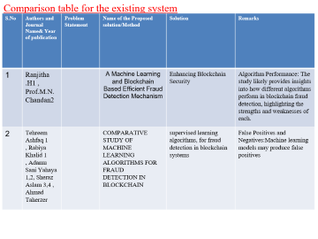
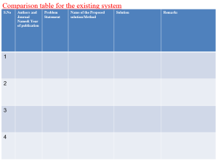
Literature Review
Notes:
13

Slide 14
Comparison table for the existing system
S.No | Authors and Journal Name& Year of publication | Problem Statement | Name of the Proposed solution/Method | Solution | Remarks
1 | Ranjitha .H1 , Prof.M.N.Chandan2 |  | A Machine Learning and Blockchain Based Efficient Fraud Detection Mechanism | Enhancing Blockchain Security | Algorithm Performance: The study likely provides insights into how different algorithms perform in blockchain fraud detection, highlighting the strengths and weaknesses of each.
2 | Tehreem Ashfaq 1 , Rabiya Khalid 1 , Adamu Sani Yahaya 1,2, Sheraz Aslam 3,4 , Ahmad Taherzer |  | COMPARATIVE STUDY OF MACHINE LEARNING ALGORITHMS FOR FRAUD DETECTION IN BLOCKCHAIN | supervised learning algorithms, for fraud detection in blockchain systems | False Positives and Negatives:Machine learning models may produce false positives

Slide 15
Comparison table for the existing system
S.No | Authors and Journal Name& Year of publication | Problem Statement | Name of the Proposed solution/Method by authors | Solution | Remarks
5 | Anuska Rakshit1, Shriya Kumar2, Ramanathan L 3 |  | Blockchain for Fraud Detection: Work-History Prevention System | Video Fraud Detection using Blockchain | Regulation's Crucial Role in Ensuring Security and Consensus in Complex and Dispersed Environments
6 | Safa Alsafari 7 and Ibrahim A. Hameed 8 |  | Challenges and Solutions in Financial Sector Cybersecurity and Fraud Prevention. | The proposed system model consists of two layers: blockchain and machine learning | Blockchain Limitations: Blockchain, while providing security and privacy, may not address all issues, including loss of privacy, Sybil attacks, and double-spending attacks.
7
8

Slide 16
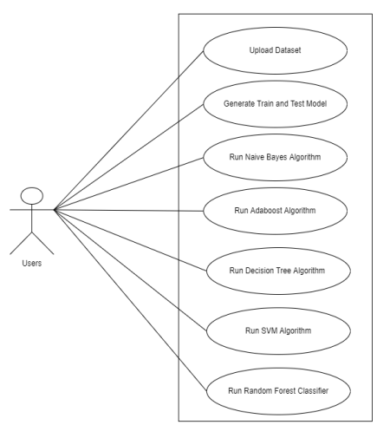
Implementation of Existing System
1.Synthetic data generation using SMOTE oversamples malicious entities, reducing classification bias. Results, depicted for balanced dataset.
Observing log loss during XGBoost training. The small gap between training and test data log loss suggests the model's capability for real-world anomaly detection in blockchain networks.
2.Blockchain technology is a powerful tool for preventing fraud in business networks. It creates an unalterable transaction record, ensures data security, and addresses privacy concerns by anonymizing data and enforcing permission-based access. The consensus process adds an extra layer of validation before transactions are added to the blockchain.
3.Preprocessing and Data Handling.
Model Building and Evaluation: Various machine learning and deep learning techniques are employed to predict transaction success. Models are evaluated using bootstrapping to estimate parameters and determine efficacy based on mean accuracy values.

Slide 17
Result
Model predicts blockchain transaction fraud by training on a Bitcoin dataset, addressing data imbalance with synthetic data points and utilizing XGboost and random forest for classification.
The system is effective at detecting fraud, exhibiting resilience against double-spending and Sybil attacks, as verified through simulations.
This research aims to leverage blockchain technology to reduce corruption and fraud by addressing transparency issues and inefficiencies in government schemes.
Blockchain's security and adherence to the triad of cryptography (confidentiality, integrity, authenticity) position it as the future of finance, enabling transparency for individuals to track financial flows and ensure fairness.

Slide 18
Conclusion
Blockchain's potential in mitigating online fraud and intrusions is highlighted, emphasizing the role of machine learning and data-mining algorithms in identifying fraudulent activities.
Machine learning algorithms, including XGboost and random forest, are proposed to enhance transaction authenticity and security. While effective, they acknowledge potential vulnerabilities to adversarial attacks.
The field is dynamic, and ongoing research is essential to address emerging challenges and threats, underscoring the importance of collaboration with experts to ensure the integrity of blockchain systems in the face of evolving threats.
We conclude that our aim is to see which users and transactions have the highest probability of being involved in fraudulent transactions and find the which algorithm predicts fraud accurately in blockchain network.

Slide 19
References
[1]. Cai, Y., Zhu, D. Fraud detections for online businesses: a perspective from blockchain technology. Financ Innov 2, 20 (2016).
[2]. Hyv¨arinen, H., Risius, M. & Friis, G. A Blockchain-Based Approach Towards Overcoming Financial Fraud in Public Sector Services. Bus Inf Syst Eng 59, 441–456 (2017). https://doi.org/10.1007/s12599-017- 0502- 4
[3]. Xu, J.J. Are blockchains immune to all malicious attacks? Finance Innov 2, 25 (2016). https://doi.org/10.1186/s40854-016-0046-5
[4]. Ostapowicz M., ˙ Zbikowski K. (2019) Detecting Fraudulent Accounts on Blockchain: A Supervised Approach. In: Cheng R., Mamoulis N., Sun Y., Huang X. (eds) Web Information Systems Engineering – WISE 2019. WISE 2020. Lecture Notes in Computer Science, vol 11881. Springer, Cham. https://doi.org/10.1007/978-3- 030-34223-4 2
[5]. Podgorelec, B., Turkanovi´c, M. and Karakatiˇc, S., 2020. A Machine Learning-Based Method for Automated Blockchain Transaction Signing Including Personalized Anomaly Detection. Sensors, 20(1), p.147.

Slide 20
Thank You!

