Slide 1
Multiple Linear Regression for CO2 Emissions.
Analyzing vehicle data to predict CO2 emissions using multiple linear regression.
TEAM MEMBERS
Varun Mangla - 23MCA062
Ashish Kr Agrawal - 23MCA015

Slide 2
Data Preparation
1
Import Libraries
NumPy, Matplotlib, Pandas used for analysis.
2
Upload Dataset
CO2_Emissions.csv file with vehicle specifications and emissions data from KAGGLE.COM
3
Rename Columns
Improve readability of feature names.

Slide 3
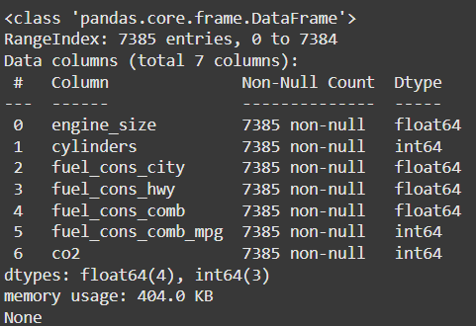
Exploratory Data Analysis
1
Dataset Shape
7385 rows, 7 columns initially.
2
Data Types
Mix of float64 and int64 data types.
3
Missing Values
No null values found in dataset.

Slide 4
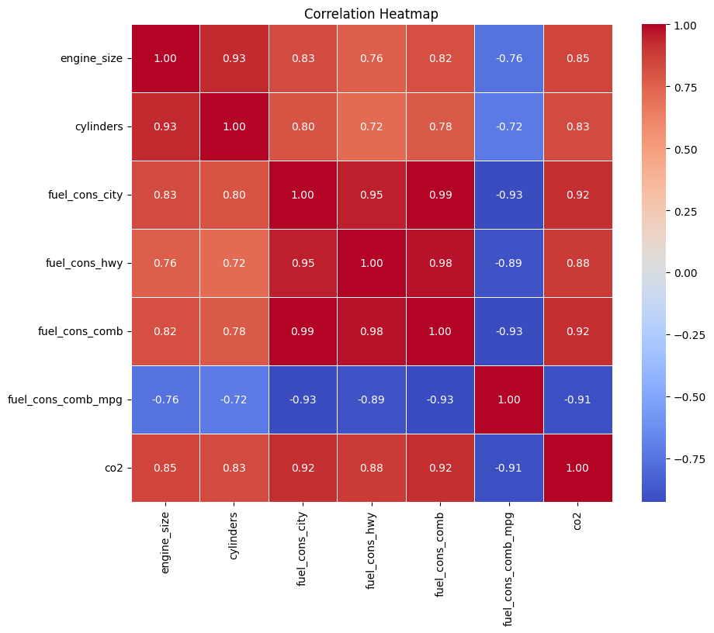
Correlation Analysis
Heatmap
Visualized correlations between features.
Strong Correlations
Identified highly correlated features.
Feature Selection
Dropped redundant features to improve model.

Slide 5
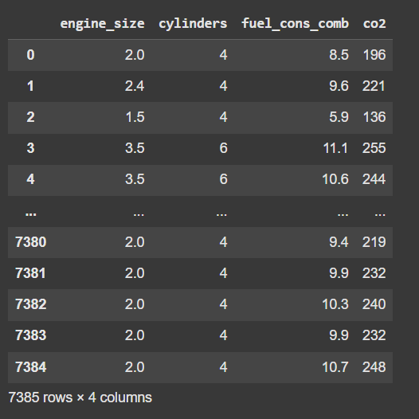



Data Preprocessing
Feature Selection
Kept engine size, cylinders, fuel consumption, CO2.
Scaling
StandardScaler applied to normalize feature values.
Train-Test Split
80% training, 20% testing data.

Slide 6



Model Training
Algorithm
Features
Target
Linear Regression from scikit-learn library.
Engine size, cylinders, fuel consumption.
CO2 emissions in g/km.

Slide 7
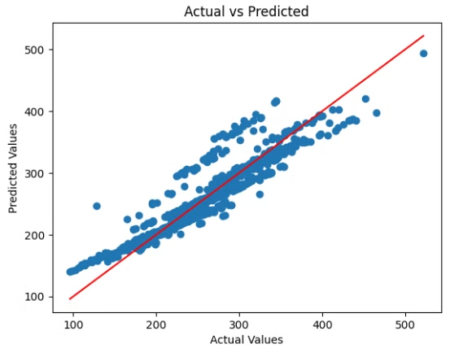
Results Visualization
Scatter Plot
Trend Line
Interpretation
Actual vs. predicted CO2 emissions visualized.
Red line shows ideal prediction scenario.
Model shows good fit with some outliers

Slide 8

MODEL EVALUATION
Mean Absolute Error (MAE): 13.56 On average, the model's predictions are off by 13.56 units from the actual values.
Mean Squared Error (MSE): 421.59 The average squared difference between predicted and actual values is 421.59, indicating a moderate error level.
Root Mean Squared Error (RMSE): 20.53 The model's predictions are, on average, off by 20.53 units, providing an error measure in the same units as the target variable.
R-squared (R²): 0.88 The model explains 88% of the variance in the target variable, suggesting a strong fit to the data.

Slide 9
Conclusion and Future Work
1
Model Performance
R-squared of 0.88 indicates good predictive power.
2
Limitations
Some prediction errors are indeed there, there is definitely room for improvement.
3
Next Steps
Exploration of complex models such as neural networks or random forests, which might capture non-linear relationships. Additionally, using more diverse datasets might improve model.

