Slide 1
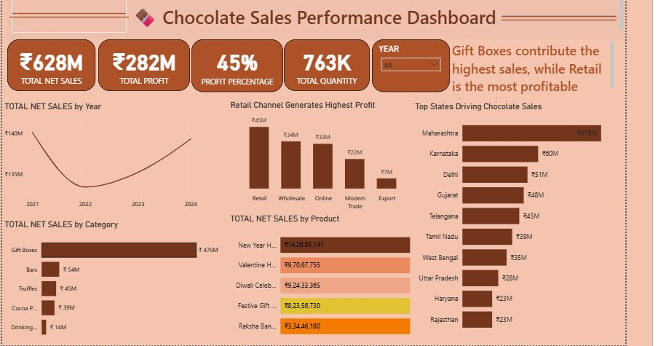
🍫
POWER BI PROJECT
Chocolate Sales
Analysis Dashboard
Power BI & Business Intelligence Project
Created by Kashish Mathur
Data Analyst Intern · Decode Data Academy
github.com/kashish
linkedin.com/in/kashish
Transforming Chocolate Sales Data into Strategic Business Insights

Slide 2
PROJECT OVERVIEW
🎯
Objective
💼
Business Problem
Analyze chocolate sales performance across products, regions & channels to drive data-informed business decisions.
Stakeholders lacked visibility into profitability drivers, underperforming SKUs, and regional sales patterns.
📊
Dashboard Capabilities
✨
Business Value
Interactive KPI cards, trend charts, category drill-downs, regional maps, and return rate analytics.
Enabled 360° sales visibility, identified top growth opportunities, and supported strategic pricing decisions.
Chocolate Sales Analysis Dashboard · Kashish Mathur · Decode Data Academy

Slide 3
DATASET OVERVIEW
🛒
🍫
🏭
Sales Transactions
Products Dataset
Warehouses Dataset
~200K Rows
~500 SKUs
~50 Warehouses
Core transactional data with order details, quantities, pricing and return flags
Product catalog with SKUs, categories, promo codes and cost data
Warehouse locations, region mapping and operational metadata
KEY COLUMNS & FIELDS
Column Name | Dataset | Description | Type
product_sku | Products | Unique product identifier | String
promo_code | Sales | Promotional discount code applied | String
total_amount | Sales | Net sale amount after discounts | Numeric
warehouse_id | Warehouses | Warehouse dispatch location ID | Integer
return_flag | Sales | Indicates if order was returned | Boolean
Chocolate Sales Analysis Dashboard · Kashish Mathur · Decode Data Academy

Slide 4
TECH STACK & TOOLS USED
📊
🔢
🐍
🐼
Power BI
DAX
Python
Pandas
Interactive dashboard & reporting
Data Analysis Expressions for KPIs
Data processing & automation
Data cleaning & transformation
📗
🧹
📈
🧠
Excel
Data Cleaning
Data Viz
Business Intel
Raw data source & validation
Preprocessing & quality checks
Visual storytelling & design
Insight extraction & analysis
Chocolate Sales Analysis Dashboard · Kashish Mathur · Decode Data Academy

Slide 5
DATA CLEANING & PREPROCESSING
❌ BEFORE CLEANING
✅ AFTER CLEANING
₹1,23,456.00 (with ₹ and commas)
→
123456.0 (clean float)
23-05-2023 / 05/23/2023 (mixed)
→
2023-05-23 (uniform datetime)
NaN, NULL, blank values
→
Imputed / removed appropriately
warehouse_id = 'W12' (string)
→
warehouse_id = 12 (int)
return_flag = 'Yes'/'No' (text)
→
return_flag = 1/0 (binary)
Duplicate transaction rows
→
De-duplicated clean rows
🐍 df['total_amount'] = df['total_amount'].str.replace('[₹,]', '', regex=True).astype(float) | df['date'] = pd.to_datetime(df['date'], dayfirst=True)
Chocolate Sales Analysis Dashboard · Kashish Mathur · Decode Data Academy

Slide 6
POWER BI DASHBOARD OVERVIEW
📌 KPI Cards — Total Sales, Profit, Margin & Orders
📈 Year Trends — Sales trajectory 2021–2024
🏆 Channel Rankings — Retail leads profitability
🗺️ State Analysis — Maharashtra #1 at ₹109M

Slide 7
DASHBOARD KPIs — KEY METRICS AT A GLANCE
📈
💰
🎯
₹628M
₹282M
45%
TOTAL NET SALES
TOTAL PROFIT
PROFIT %
+8.2% YoY
44.9% Margin
Industry Benchmark
📦
🏷️
🔄
763K
₹823
3.2%
TOTAL QUANTITY
AVG SELL PRICE
RETURN RATE
Units Sold
Per Unit
Below Average
Chocolate Sales Analysis Dashboard · Kashish Mathur · Decode Data Academy

Slide 8
SALES TREND ANALYSIS
📌 KEY INSIGHTS
• Sales dipped in 2022 but recovered strongly through 2023–24 • Q4 (Oct–Dec) consistently drives peak performance — festive & gifting season • Seasonal demand peaks align with Diwali, Valentine's & New Year promotions
Chocolate Sales Analysis Dashboard · Kashish Mathur · Decode Data Academy

Slide 9
PRODUCT & CATEGORY PERFORMANCE
📌 KEY INSIGHTS
• Gift Boxes dominate at ₹476M (75%+ of total sales) — premium packaging drives value • New Year Hampers lead individual SKU revenue at ₹14.27 Cr • Drinking Chocolate (₹14M) is the lowest performer — potential for reformulation/promotion
Chocolate Sales Analysis Dashboard · Kashish Mathur · Decode Data Academy

Slide 10
REGIONAL & CHANNEL INSIGHTS
Top States by Net Sales (₹M)
Maharashtra
₹109M
Karnataka
₹60M
Delhi
₹51M
Gujarat
₹48M
Telangana
₹45M
Tamil Nadu
₹39M
West Bengal
₹35M
Uttar Pradesh
₹28M
Haryana
₹23M
📌 Maharashtra leads at ₹109M (2.4x next state) • Retail channel most profitable at ₹45M • Export channel is highest growth opportunity
Rajasthan
₹23M
Chocolate Sales Analysis Dashboard · Kashish Mathur · Decode Data Academy

Slide 11
BUSINESS INSIGHTS & RECOMMENDATIONS
01
🎯 Focus on High-Margin Products
04
🏭 Warehouse Operational Excellence
Gift Boxes carry premium margins. Increase marketing investment in holiday bundles and premium packaging to maximize profitability per unit.
Top-performing warehouses in Maharashtra show superior order fulfillment rates. Replicate their operational models across underperforming regions.
05
🗺️ Regional Expansion Strategy
02
📉 Optimize Underperforming SKUs
South & East India markets (Haryana, Rajasthan) show low penetration at ₹23M. Targeted regional campaigns can unlock significant growth.
Drinking Chocolate (₹14M) underperforms significantly. Conduct pricing analysis and targeted promotions or consider SKU rationalization.
03
🏷️ Promotion Strategy Balance
06
📅 Seasonal Demand Planning
Promo codes drive volume but compress margins. Shift from blanket discounts to loyalty-based or time-limited offers on high-velocity products.
Q4 drives ~35% of annual revenue. Pre-build inventory and launch campaigns 4–6 weeks before Diwali, Christmas, and Valentine's seasons.
Chocolate Sales Analysis Dashboard · Kashish Mathur · Decode Data Academy

Slide 12
SKILLS DEMONSTRATED
🧹 Data Cleaning
📊 Dashboard Dev
90%
95%
Python, Pandas, handling nulls, type conversion
Power BI, interactive visuals, slicers & filters
🔢 DAX Formulas
💼 Business Analysis
85%
88%
Calculated columns, measures, time intelligence
KPI design, insight extraction, stakeholder focus
📖 Data Storytelling
🎨 Visualization
92%
90%
Narrative structure, executive-level presentation
Chart selection, color theory, UX principles
🔍 Problem Solving
🤝 Communication
87%
93%
Breaking complex data problems into actionable insights
Translating technical findings to business language
Chocolate Sales Analysis Dashboard · Kashish Mathur · Decode Data Academy

Slide 13
Thank
You!
🚀 Open to Data Analyst Opportunities
Project Summary
Kashish Mathur
✓ 200K+ transactions analyzed
✓ 6 interactive KPI metrics tracked
✓ 10 state-level insights extracted
✓ 5 channel performance segmented
✓ Strategic recommendations delivered
Data Analyst Intern | Decode Data Academy
📧 kashish@email.com
💼 linkedin.com/in/kashish
🐙 github.com/kashish
"Turning data into decisions, one dashboard at a time" 🍫

