Slide 1
Predicting Instagram Likes Using Machine Learning and CLIP Vision Transformer

Slide 2
Introduction and Problem Definition
Objective: Predict the number of likes on Instagram posts using metadata and image content.
Approach: Combine traditional machine learning techniques with advanced models like CLIP to enhance prediction accuracy.

Slide 3
Data Overview
Data Source: Instagram post metadata and associated images.
Features: Likes, comments, follower count, timestamp, and image paths.
Image Analysis: CLIP model to extract visual features.

Slide 4
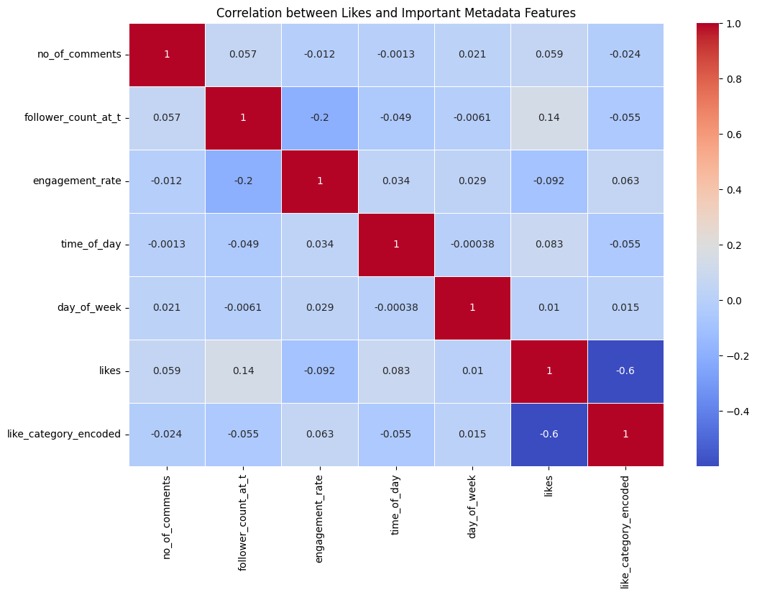
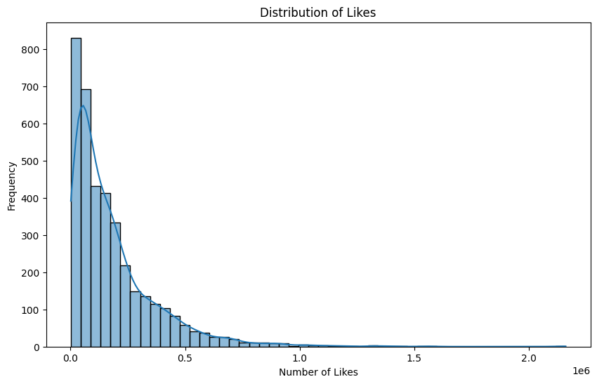
Exploratory Data Analysis (EDA)
Key Insights:
- Distribution of likes.
- Correlation between features (e.g., follower count and likes).

Slide 5
Image Feature Extraction with CLIP
CLIP Overview: A powerful model by OpenAI that links text and image representations.
Process: Extracted high-dimensional image features using CLIP to incorporate visual content into the prediction model.
Benefit: Enhanced understanding of how visual content influences engagement.

Slide 6
Model Selection and Training
Models Used: Linear Regression, RandomForestClassifier, XGBoost, CLIP-enhanced models, XGB+PCA, Stacking Classifier(RF + XGB + SVC), CatboostClassifier
Training: Combined metadata features with image features from CLIP.
Splitting: Train-test split with 80-20 ratio to validate performance.

Slide 7
Model Performance
Evaluation Metrics: Mean Absolute Error (MAE), Accuracy, Precision, Recall, F1-score.
Findings:
- XGBoost outperformed basic models.
- CLIP-enhanced models provided significant improvements in prediction accuracy.

Slide 8
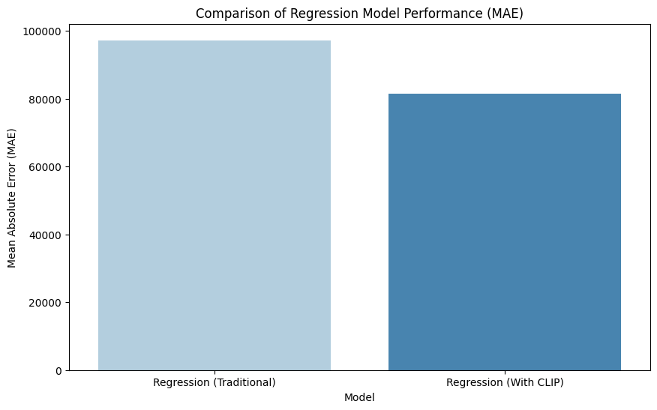
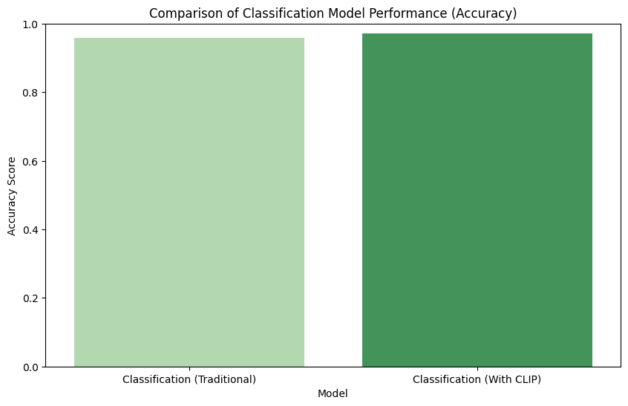
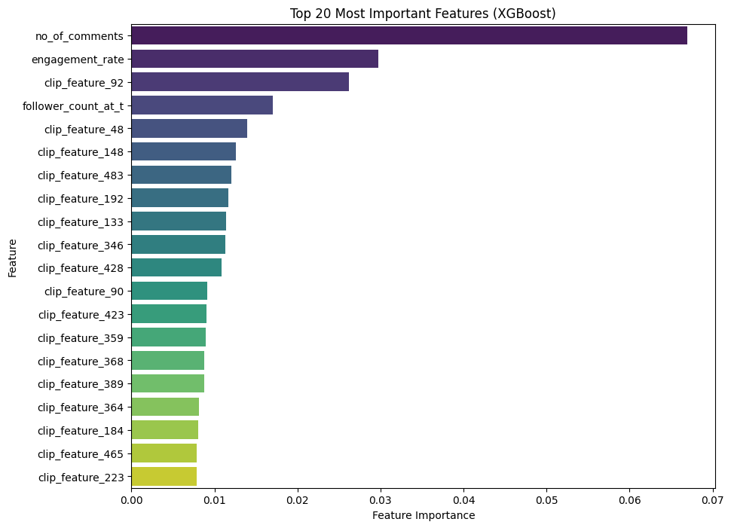
Comparison of Regression models
with and without clip features
Comparison of Classification models
with and without clip features
20 most important features using xgb
feature importance score

Slide 9
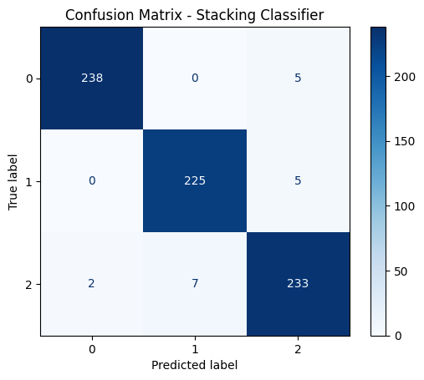
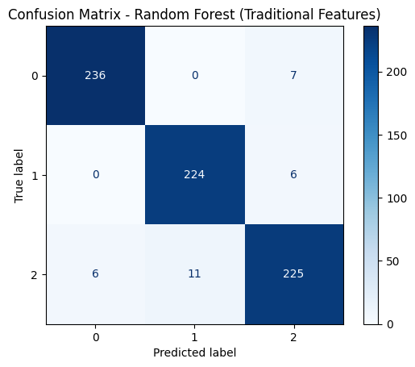
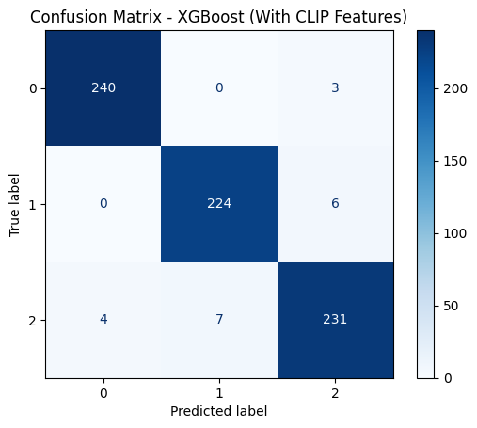

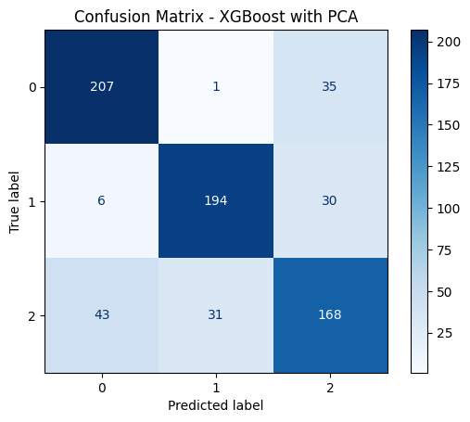
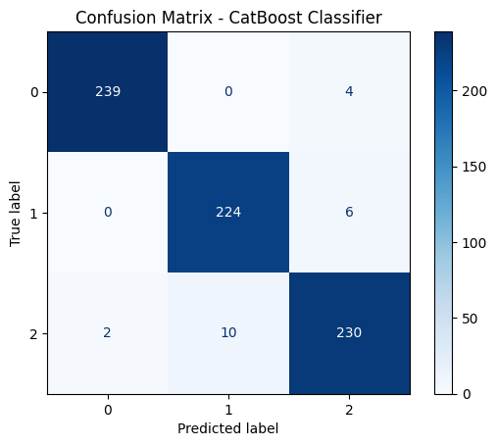
Confusion matrices of different classifiers

Slide 10
Key Findings
Classification
Accuracy (CatBoost Classifier): 0.9692
Accuracy (XGBoost with PCA): 0.7958
Accuracy (XGBoost (With selected CLIP Features)): 0.9762
Accuracy (XGBoost (With CLIP Features)): 0.9720
Accuracy (Random Forest (Traditional Features)): 0.9580
Regression
Mean Absolute Error (Traditional Features): 97272.96433000006
Mean Absolute Error (With CLIP Features): 81443.1082142197

Slide 11
Conclusion
Summary: Successful integration of advanced visual features using CLIP led to improved predictions.
Future Work: Potential improvements include tuning hyperparameters, exploring more sophisticated models, and incorporating additional social media metrics like image analysis to get the gender, number of people inside it, the brightness etc.

Slide 12
Contact Information
Contact Details: varunjay@usc.edu
LinkedIn Profile: https://www.linkedin.com/in/mehtavarunj/
Github code: https://github.com/mehtavarunj/Predict_insta_likes

