Slide 1
E – Commerce Website For Shopping Malls And Marts
Shri Shankaracharya Institute of Professional Management & Technology, Raipur
Major Project(Phase-I) Report on
CSE 7th Semester
Department of Computer Science and Engineering,
Batch 2019-2023
Session July – Dec 2022
Presentation Date: 24/01/23
Project Group Members:
Mudit Ranjan Shrivastava
Varun Mishra
Piyush Agarwal
Project Guide
Prof. Devbrat Sahu
(Asst. Prof., CSE )

Slide 2
Introduction about Project
We have observed the loop holes even in the smart cities where we have apps and websites like Snapdeal, Amazon, Flipkart, etc. Which covers a lot of things to offer to users but when it comes to offers , availability and deals over the products then users need to visit the shop physically which can be a waste of time for many users.
So, why not to have a map in our hands in terms of an application/software which can give the user access to all kinds of useful information at one place where the end user will get to know about all the offers, rate and availability of any product in one platform. There the user can easily plan where they want to go, and this can save a lot of time and energy for them. Basically, we have organized the unorganized system.

Slide 3
Application Area
Why did you opt to work on this project?
We have observed the loop holes even in the smart cities where we have apps and websites like Snapdeal, Amazon, Flipkart, etc. Which covers a lot of things to offer to users but when it comes to offers , availability and deals over the products then users need to visit the shop physically which can be a waste of time for many users.
Benefits of this project?
1.Easy Access 2. Time saver 3. Cost effective 4. Business friendly
Who are the End Users of this project?
End users are seller and buyer of the product.

Slide 4
Literature Review
Literature Survey
Effective e-Commerce implementations can help buyers and sellers realize substantial cost savings, increase revenue, provide faster delivery, reduce administration costs, and improve customer service. Thus, e-Commerce might be a major area for research thanks as it has helped us to reduce the crucial factors for both sellers and buyers.
Problem Identification
We have identified that holes even in the smart cities where we have apps and websites like Snapdeal, Amazon, Flipkart, etc. Which covers a lot of things to offer to users but when it comes to offers , availability and deals over the products then users need to visit the shop physically which can be a waste of time for many users

Slide 5
Methodology
Start
User Login
Incorrect
Check Credentials
Correct
Search product
Get Location
Work Flow Diagram

Slide 6
Experimental Setup

Slide 7
Database
In an e-commerce application, the main purpose of a database is to store information for retrieving the product details, customer information, track transactions, and further, maintain the inventory.
In this project we have used SQL that is Structured Query Language for storing and retrieving data.

Slide 8
Result & Conclusion
This project will help both seller and buyer to sell their product easily and effectively whereas the buyer will be able to get the best deals and details regarding the nearest store available across the defined domain.

Slide 9
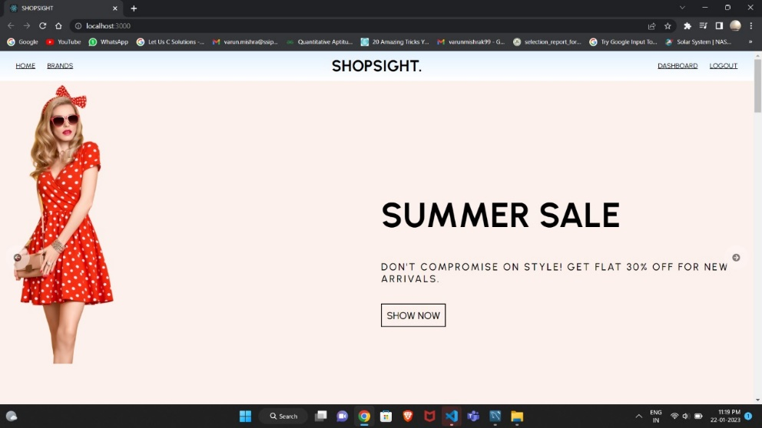
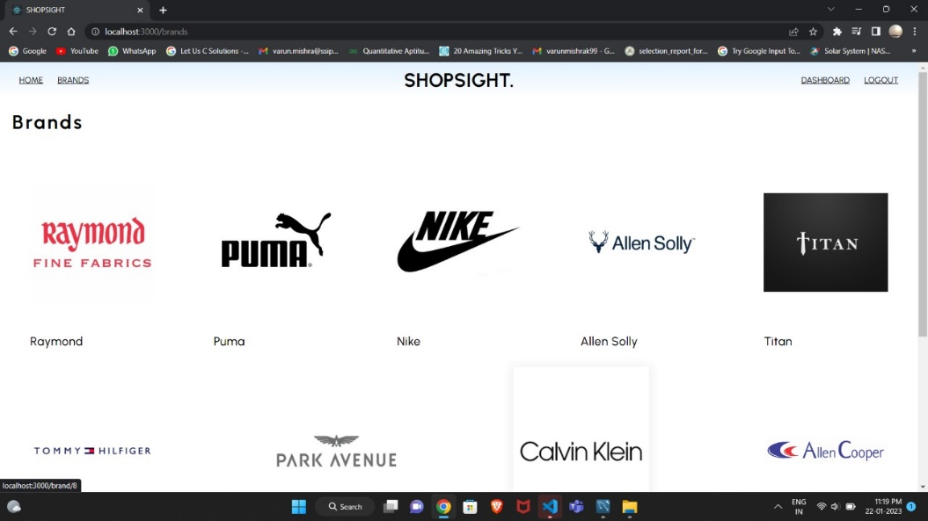
Snapshot with description
Home Page
Brands Section

Slide 10
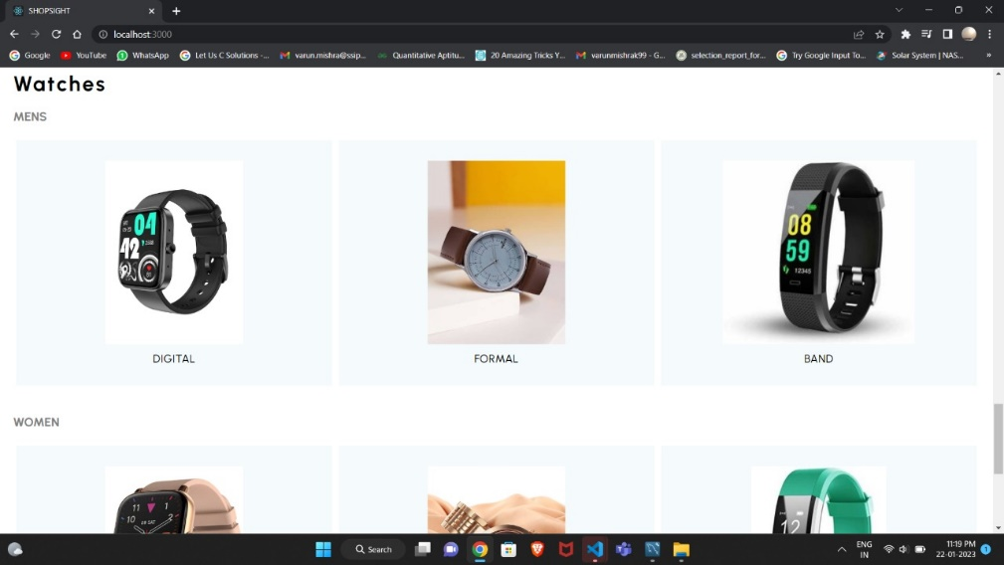
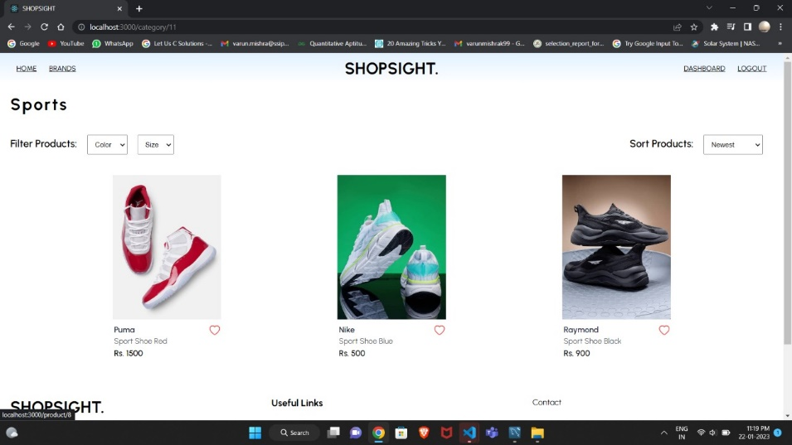
Watch Section
Sports Section

Slide 11
References
Text Book
Toby Velte, Anthony Vote and Robert Elsenpeter, “Cloud Computing: A Practical Approach”, McGraw Hill, 2002
The Definitive Guide by David Flanagan
CSS Secrets: Better Solutions to Everyday Web Design Problems by Lea Verou
A solid introduction to web design concepts can be found in Learning Web Design: A Beginner’s Guide to HTML, CSS, JavaScript, and Web Graphics by Jennifer Robbins.
Web Resources
http://www.stackoverflow.com
https://www.w3schools.com

Slide 12


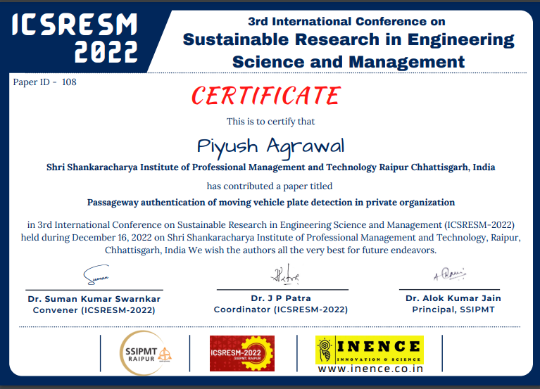
Paper Publication Details

