Slide 1

ROAD ACCIDENT PREDICTION USING DATA MINING
PRESENTED BY
SANDEEP PS &VARUN MK
UNDER THE GUIDENCE OF
Mr.LAKSHMIKANTHA V & Mr.PREMSINGH M
ASSITANT PROFESSOR HOD&ASSITANT PROFESSOR
MANDYA UNIVERSITY,MANDYA MANDYA UNIVERSITY,MANDYA

Slide 2
INTRODUCTION
Road accidents are a major global issue, causing significant
casualties and economic losses. Predictive models using
machine learning techniques, like Convolutional Neural
Networks (CNN) and Support Vector Machines (SVM),
are crucial for anticipating accidents and guiding preventive
measures. This study explores the efficacy of CNN and SVM
in predicting road accidents using images from road cameras.
CNNs excel in image classification tasks, while SVMs are
effective in binary classification. By comparing these
algorithms, the study aims to determine the most
accurate approach for accident prediction. The findings
could enhance road safety by helping traffic authorities,
urban planners, and policymakers allocate
resources more effectively and implement
targeted interventions to reduce road accidents.

Slide 3
OBJECTIVES
To preprocess the collected data, including resizing, normalization, and augmentation, to ensure consistency and enhance the robustness of the predictive models.
To design and implement a Convolutional Neural Network (CNN) architecture optimized for image classification, leveraging its ability to automatically extract relevant features from raw data.
To develop a Support Vector Machine (SVM) model for road accident prediction, utilizing feature extraction techniques to transform the image data into a format suitable for SVM classification.
To train both the CNN and SVM models using the preprocessed image dataset and evaluate their performance using standard metrics such as accuracy, precision, recall, and F1-score.
To compare the performance of the CNN and SVM models and determine which algorithm yields higher accuracy in predicting road accidents based on data.

Slide 4
PROBLEM STATEMENT
The problem addressed in this study lies in the imperative need to develop accurate predictive models for road accidents using data. Despite advancements in machine learning techniques, selecting the most suitable algorithm for this task remains a challenge. This study addresses this gap by comparing the performance of Convolutional Neural Networks (CNN) and Support Vector Machines (SVM) in predicting road accidents based on data. The overarching issue is to identify the algorithm that offers the highest accuracy in accident prediction, thereby enabling authorities to implement proactive measures effectively. By tackling this problem, the study aims to enhance road safety strategies, reduce accident rates, and minimize the associated societal and economic impacts.

Slide 5

LITERATURE SURVEY
[1].Traffic Accident Prediction based on CNN Model :-
This paper proposes deep learning-based new road traffic accident prediction applying a “Convolutional Neural Network model” (CNN). It uses traffic accident influencing circumstances like light, weather, traffic flow to make a state matrix describing the traffic state and CNN model. This paper utilizes examples to examine the accuracy of the proposed model.
[2].A model of traffic accident prediction based on convolutional neural network:
In this paper, a new road traffic accident prediction model (TAP-CNN) is established by using traffic accident influencing factors, such as traffic flow, weather, light to build a state matrix to describe the traffic state and CNN model. This paper uses samples to test the accuracy of the new model. The experimental results show that the TAP-CNN model is more effective than the traditional neural network model to predict the traffic accident. It provides a reference for the forecast of the traffic accident.

Slide 6
EXISTING SYSTEM
The existing system for road accident prediction often utilizes K-means clustering as a foundational method. K-means clustering is applied to identify clusters or patterns within historical accident data, such as accident locations, road conditions, and time of occurrence. By grouping similar instances together, K-means helps in identifying accident-prone areas or conditions. However, this method primarily relies on structured data and may not effectively capture the nuanced patterns present in data. While K-means clustering serves as a valuable starting point for understanding accident patterns, its reliance on predefined features and assumptions limits its ability to adapt to complex and evolving scenarios
Disadvantages
Dependency structured data
Inability to Capture Complex Patterns
Assumption of Predefined Features

Slide 7
PROPOSED SYSTEM
The proposed system for road accident prediction aims to leverage machine learning techniques, specifically Convolutional Neural Networks (CNN) and Support Vector Machines (SVM), trained on a numerical dataset derived from various factors influencing road accidents. This dataset includes features such as weather conditions, accident type, traffic density, and historical accident data. By utilizing machine learning algorithms trained on this numerical dataset, the proposed system can effectively identify patterns and correlations between these features and accident occurrences. Unlike traditional methods that rely solely on structured data analysis, the integration of machine learning models allows for the exploration of complex relationships and nonlinearities within the data, leading to more accurate and reliable predictions.

Slide 8

REQUIREMENTS
HARDWARE REQUIREMENTS
Processor : Intel i5 2.53GHz
Hard Disk : 40GB
RAM : 8 GB or above
SOFTWARE REQUIREMENTS
Operating system : Windows 8 and above
Front End : Flask (HTML, CSS, JS, BS)
Coding Language : Python
IDE : IDLE
TOOLS &TECHNOLOGIES
HTML
CSS
NUMPY
PANDAS
TENSORFLOW
PYTHON
JAVASCRIPT

Slide 9
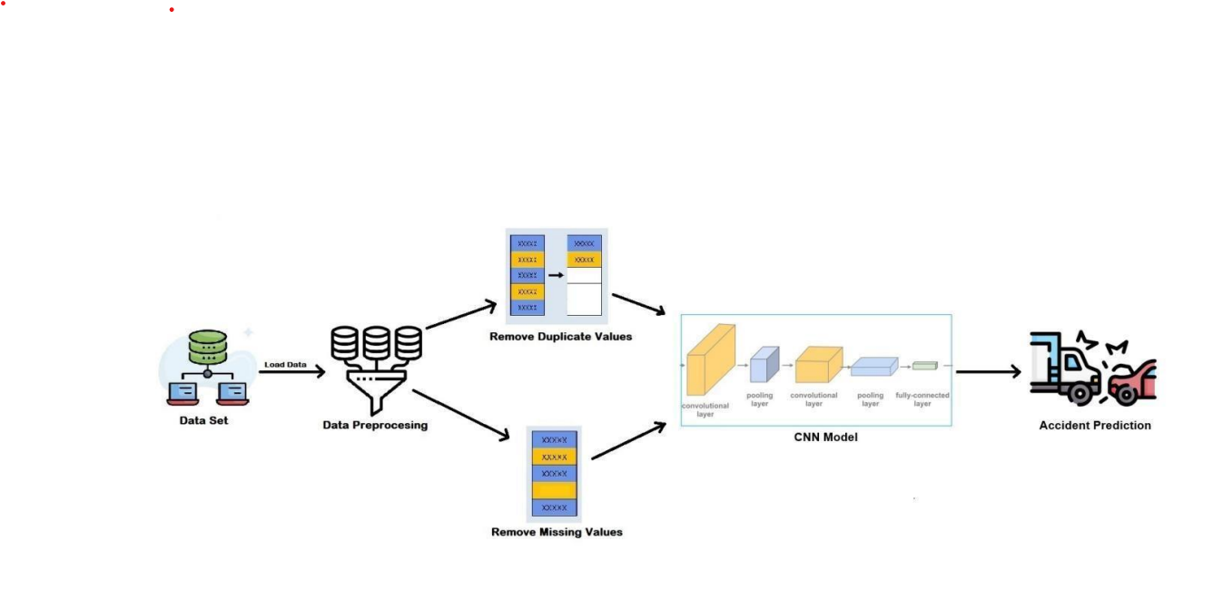
METHODOLOGY
ADVANTAGES:-
➢ By leveraging machine learning algorithms such as CNN and SVM, the system can identify complex patterns and relationships within the numerical dataset that may not be apparent through traditional analysis methods.
➢ The integration of various factors such as weather conditions, road infrastructure, and historical accident data into the numerical dataset allows for a more comprehensive analysis of the factors influencing road accidents.
➢ Machine learning models trained on the numerical dataset can adapt to changing road conditions and traffic dynamics over time.

Slide 10

IMPLEMENTATION
Input Data Preparation
Data preprocessing
Model architecture design
Model training
Model Evaluation
Fine-Tuning and Hyper parameter Optimization
Prediction
Interpretation & visualization

Slide 11
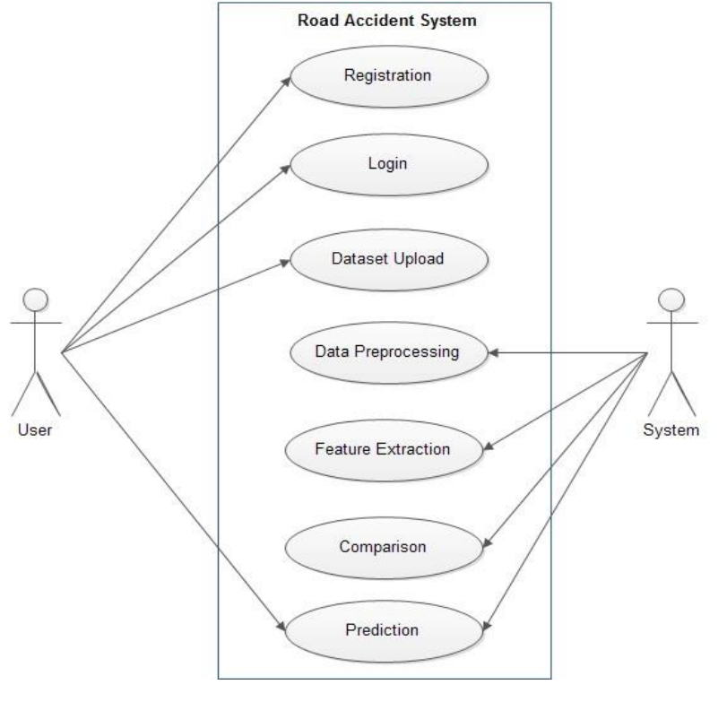
USE CASE DIAGRAM

Slide 12
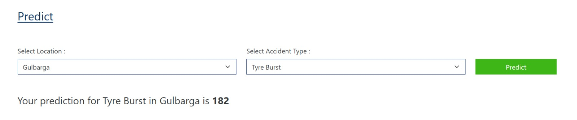
RESULT

Slide 13
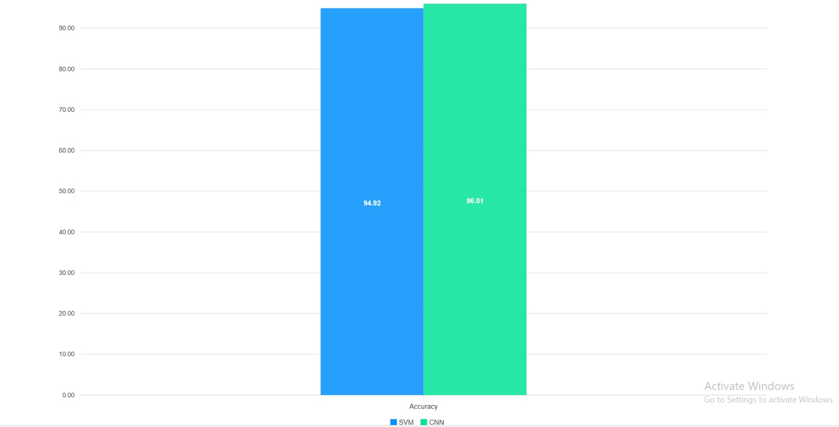
GRAPHICAL REPRESENATION OF A RESULT BASED ON THE CNN & SVM

Slide 14
CONCLUSION
In conclusion, the proposed road
accident prediction system offers a
comprehensive and data-driven
approach to enhancing road
safety through the integration of machine
learning techniques, specifically Convolutional Neural
Networks (CNN) and Support Vector Machines (SVM), trained on a
numerical dataset. By leveraging the power of these algorithms, the system aims to
accurately predict road accidents based on various factors such as weather conditions, road infrastructure, and traffic density. Through the systematic collection, preprocessing, and analysis of numerical data, the system can identify patterns and correlations that contribute to road accidents, providing valuable insights for stakeholders to implement proactive measures and targeted interventions. The integration of machine learning models enables the system to
adapt to evolving road conditions and traffic dynamics, ensuring continuous
improvement in predictive accuracy over time.
CONCLUDED

Slide 15
FUTURE ENHANCEMENT
01
Integration of Additional Data Sources: The system can be enhanced by incorporating additional data sources such as real-time traffic data, vehicle telemetry, and social media feeds.
Advanced Machine Learning Techniques: Future iterations of the system can explore advanced machine learning techniques such as deep learning, reinforcement learning, and ensemble methods.
Multimodal Prediction Models: Developing multimodal prediction models that combine information from numerical datasets with image data from road cameras or satellite imagery can enhance the system's predictive capabilities.
Geospatial Analysis: Incorporating geospatial analysis techniques can enable the system to identify accident hotspots, analyze spatial patterns, and prioritize interventions based on geographic regions.
02
03
04

Slide 16


