Slide 1


Department of Computer Science and Engineering
CA3: Project Submission and Presentation
Employee Attrition Prediction using HR Analytics
(Industry Domain: HR Analytics)
Session: 2026-27
Presented By:
Name: Varun Mundhada
PRN: 23070521184
Technology:
Apache Spark, MLlib, Streamlit
Project Guide: Dr. Priya Dasarwar
Symbiosis Institute of Technology, Nagpur Campus (SIT-N)

Slide 2

Presentation Outline:
Introduction & Problem Statement
Objectives & Scope
Literature Review
Dataset & Exploratory Analysis (Spark SQL)
Methodology & System Architecture
Spark MLlib Pipeline & Model Training
Results & Model Comparison
Feature Importance & Scalability
Web Application Demo
Business Insights, Conclusion & Future Scope
GitHub Repository & References

Slide 3
Introduction & Problem Statement
Why employee attrition matters
• Every resignation costs the organisation hiring, onboarding and training spend, months of lost productivity and the knowledge that leaves with the employee.
• HR usually learns that someone is unhappy only when the resignation arrives — too late to act.
• HR systems already hold the data needed to see the risk earlier: role, pay, overtime, travel, tenure, promotions and satisfaction surveys.
Problem statement
Given the HR records of an organisation's employees, predict which employees are likely to leave, identify the factors driving each person's risk, and present this to HR through an easy-to-use application — built on a scalable big-data pipeline (Apache Spark).
Type of problem | Data | Platform | Output for HR
Supervised binary classification (Left / Stayed), imbalanced classes | IBM HR Analytics — 1,470 employees, 35 attributes, 16.1% left | Apache Spark 3.5: PySpark, Spark SQL, MLlib | Risk score, risk band, drivers and suggested actions
Notes:
Start with why attrition matters: cost of replacement, knowledge loss. HR usually reacts too late. Our system predicts risk early and explains it.

Slide 4
Objectives & Scope
# | Objective | Delivered as
1 | Analyse the factors associated with attrition using Apache Spark | Spark SQL analysis of 12 factors + MLlib correlation matrix
2 | Build a reusable Spark MLlib feature pipeline | 6-stage pipeline with in-pipeline feature engineering
3 | Train, tune and compare four classifiers with class-imbalance handling | LR, Decision Tree, Random Forest, GBT — 5-fold CV, class weights
4 | Select model and threshold without touching the test set | Stratified 85 / 15 split; CV + out-of-fold tuning; test used once
5 | Explain every prediction in HR terms | What-if risk drivers mapped to retention actions
6 | Deploy a working application and prove scalability | Streamlit web app; pipeline run on ~735k rows
Scope
End-to-end: data analysis → model development → evaluation → explanation → deployment → documentation. Uses a public, anonymised dataset; Spark runs in local mode, and the same code runs on a cluster unchanged.

Slide 5
Literature Review
Study | Approach | Key finding
Saradhi & Palshikar (2011), Expert Syst. Appl. | Employee churn as classification; NB, SVM, LR, DT, RF | SVM best; models must be judged on the minority (leaver) class
Alao & Adeyemo (2013) | Decision trees: C4.5, C5.0, REPTree, CART | Readable rules linking salary, length of service and age to attrition
Punnoose & Ajit (2016), IJARAI | Seven classifiers incl. XGBoost | Gradient boosting best and robust to noisy HR data
Zhao et al. (2019), IntelliSys / Springer | Ten algorithms on small, medium, large HR data | Boosted-tree ensembles most reliable across data sizes
Fallucchi et al. (2020), Computers | IBM HR dataset; six classifiers | Overtime, income, total working years and age are key predictors
Yahia et al. (2021), IEEE Access | "Big data to deep data" people analytics; ensembles | Ensembles with feature selection improve attrition prediction
Zaharia et al. (2016); Meng et al. (2016) | Apache Spark and Spark MLlib | Unified in-memory engine; ML pipelines that scale out
Research gap addressed by this project
Most studies stop at a notebook score on one machine. This project (i) builds on a scalable big-data engine, (ii) keeps model / threshold selection separate from the final test, (iii) explains each prediction as HR actions, and (iv) delivers a working application.
Notes:
Key message: the literature agrees on predictors and on tree ensembles, but rarely builds on a big-data engine, rarely keeps tuning separate from the test, and rarely delivers a usable app.

Slide 6
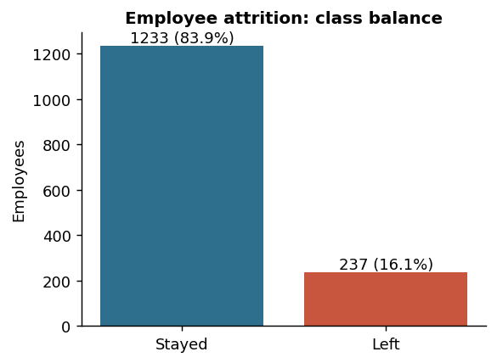
Dataset Description
Group | Attributes
Target | Attrition (Yes / No)
Personal | Age, Gender, MaritalStatus, DistanceFromHome, Education, EducationField
Job | Department, JobRole, JobLevel, JobInvolvement, BusinessTravel, OverTime, PerformanceRating, TrainingTimesLastYear
Compensation | MonthlyIncome, DailyRate, HourlyRate, MonthlyRate, PercentSalaryHike, StockOptionLevel
Satisfaction | Environment, Job, Relationship Satisfaction (1–4), WorkLifeBalance (1–4)
Tenure | TotalWorkingYears, NumCompaniesWorked, YearsAtCompany, YearsInCurrentRole, YearsSinceLastPromotion, YearsWithCurrManager
Removed | EmployeeCount, Over18, StandardHours (same value for every row); EmployeeNumber kept as ID only
Source: IBM HR Analytics Employee Attrition & Performance (Kaggle)
Size: 1,470 employees × 35 attributes, no missing values
Imbalance: 237 left (16.1%) — a model that always says "stays" is 84% accurate and useless

Slide 7
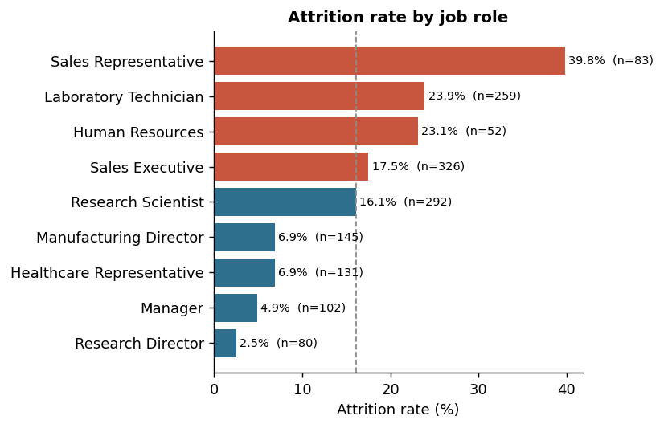
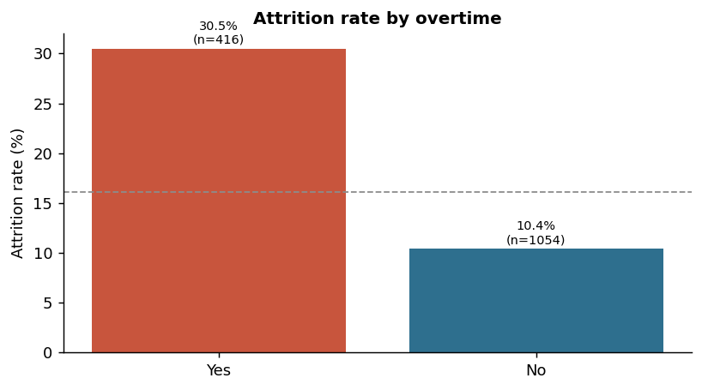
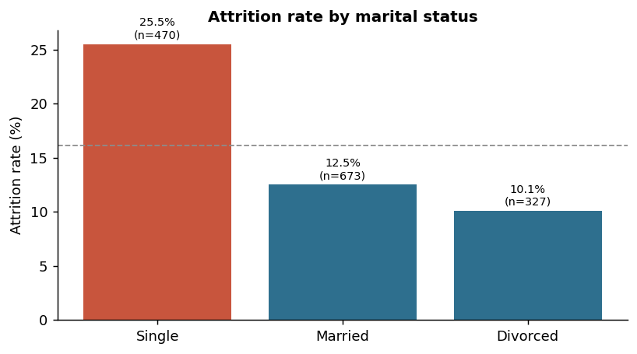
Exploratory Analysis with Spark SQL (1/2)
SELECT factor, COUNT(*), AVG(label) FROM hr GROUP BY factor — red bars are above the company-wide attrition rate of 16.1% (dashed line)
• Overtime: 30.5% of overtime workers leave vs 10.4% of others — almost 3×
• Job role: Sales Representatives 39.8% vs Research Directors 2.5%
• Marital status: single 25.5% vs married 12.5%
Notes:
Explain the method: GROUP BY aggregations in Spark SQL. Red bars are above the company average.

Slide 8
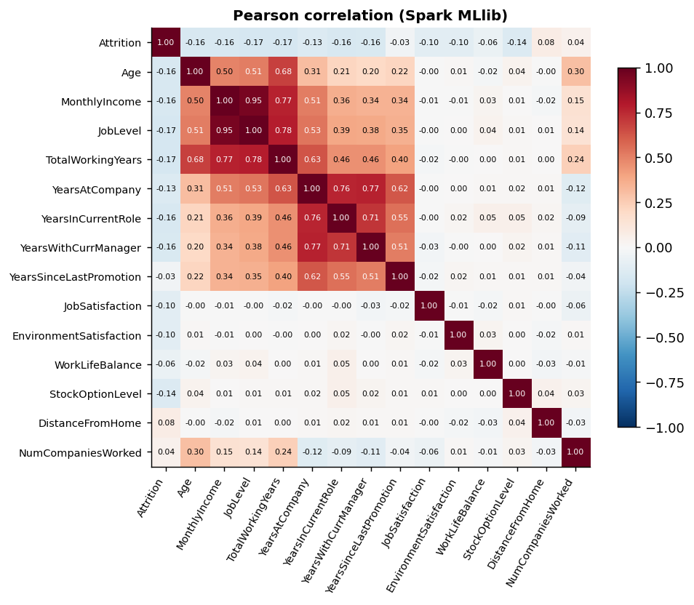
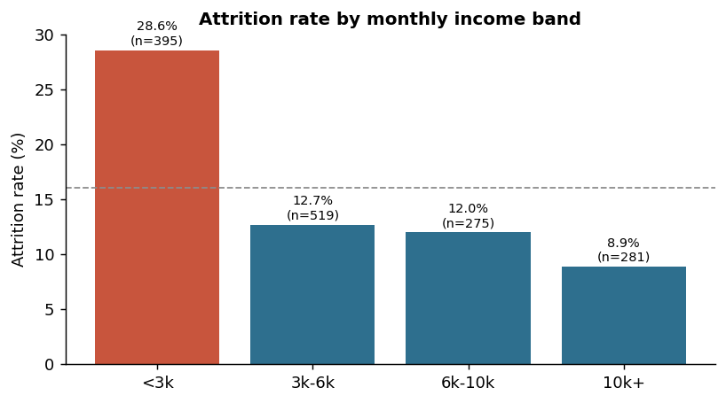
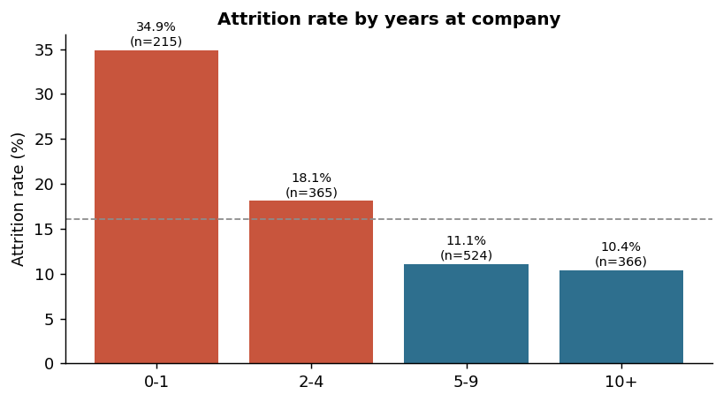
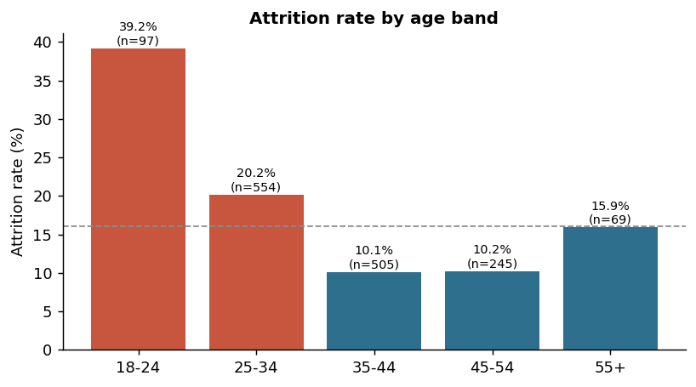
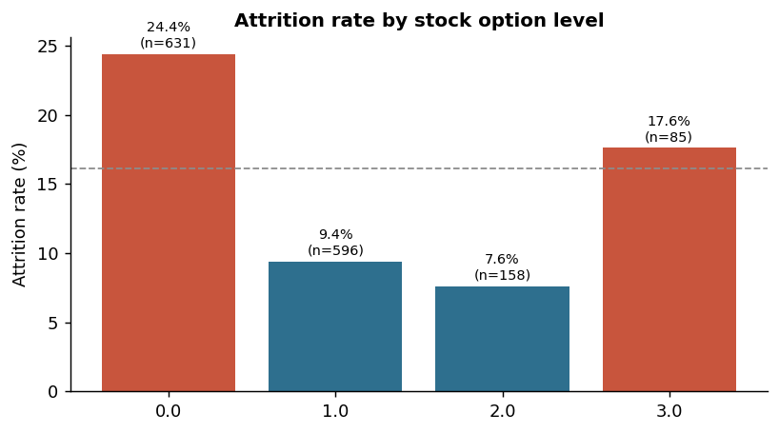
Exploratory Analysis with Spark SQL (2/2)
Correlation matrix computed with Spark MLlib. No single variable exceeds |0.17| with attrition, so a multivariate model is needed; income, level and experience are highly collinear.
Highest risk: young, early-tenure, low-income, level-1 employees without stock options

Slide 9
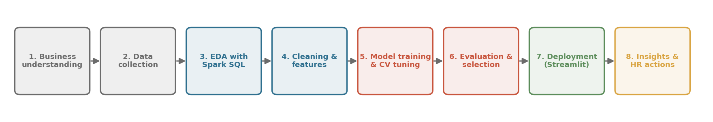
Methodology
Step | What was done
Data processing | PySpark DataFrames; constant columns removed; label encoded; numerics cast to double
Feature engineering | IncomePerJobLevel, TenureRatio, YearsPerCompany, PromotionGap, SatisfactionIndex (SQLTransformer)
Data split | Stratified 85 / 15, hash-based so it is identical on every run: 1249 development · 221 test (used once)
Class imbalance | Leavers weighted by stayers / leavers ratio (≈5.2) through MLlib weightCol
Tuning | CrossValidator, 5 folds, ROC-AUC, ParamGridBuilder grid per model, parallelism 4
Selection | Best model by CV AUC; threshold that maximises F1 on out-of-fold predictions
Final evaluation | Test set used once: AUC, accuracy, precision, recall, F1, confusion matrix

Slide 10
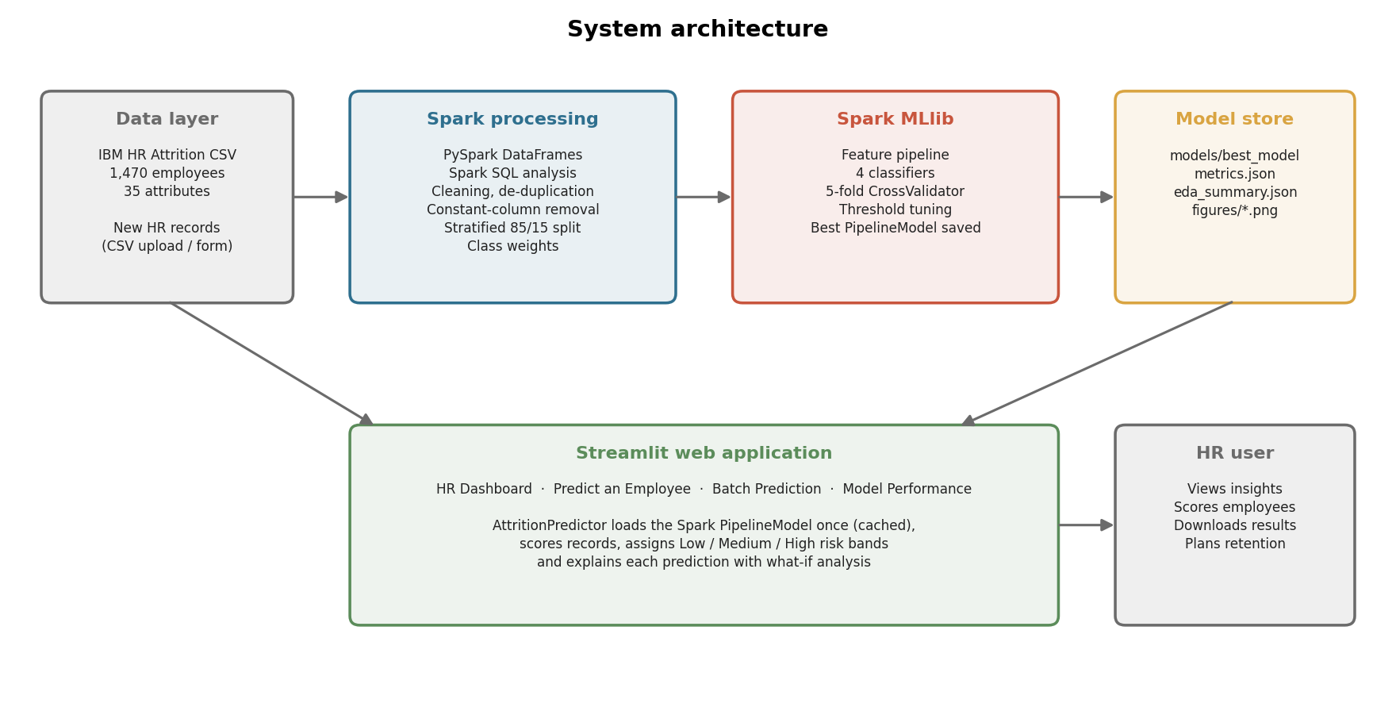
System Architecture

Slide 11
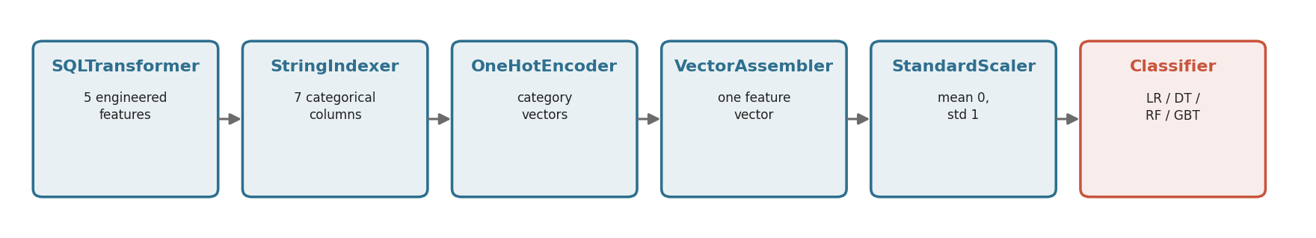
Spark MLlib Pipeline & Models
Model | Hyper-parameter grid (5-fold CV) | Best parameters found
Logistic Regression | regParam {0.001, 0.01, 0.1} × elasticNet {0, 0.5, 1} | regParam=0.01, elasticNetParam=0.5
Decision Tree | maxDepth {3, 5, 7} × minInstancesPerNode {5, 20} | maxDepth=7, minInstancesPerNode=20
Random Forest | numTrees {100, 200} × maxDepth {5, 8} | numTrees=200, maxDepth=8
Gradient-Boosted Trees | maxIter {50, 100} × maxDepth {3, 5}, stepSize 0.1 | maxIter=100, maxDepth=3
The whole pipeline (not only the classifier) is cross-validated, so encoders and the scaler are re-fitted inside every fold — no information leaks from the held-out folds. The saved PipelineModel accepts raw HR records directly.

Slide 12
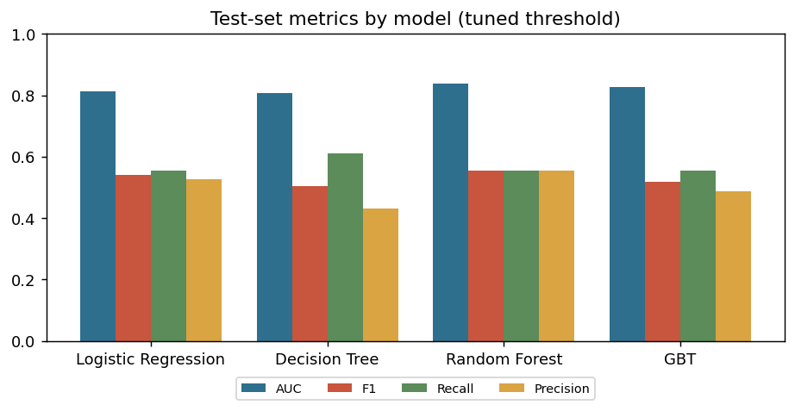
Results — Model Comparison
Model | CV AUC | OOF AUC | Test AUC | Acc. | Prec. | Recall | F1 | Thr.
Logistic Regression ★ | 0.839 | 0.843 | 0.813 | 0.846 | 0.526 | 0.556 | 0.540 | 0.68
Decision Tree | 0.679 | 0.737 | 0.807 | 0.805 | 0.431 | 0.611 | 0.506 | 0.67
Random Forest | 0.804 | 0.807 | 0.839 | 0.855 | 0.556 | 0.556 | 0.556 | 0.38
Gradient-Boosted Trees | 0.774 | 0.772 | 0.827 | 0.833 | 0.488 | 0.556 | 0.519 | 0.54
Selected model: Logistic Regression
• Highest cross-validated AUC (0.839) → chosen; test AUC 0.813 on 221 unseen employees
• Finds 56% of the employees who actually left, with precision 53% and F1 54% (threshold 0.68)
• Model and threshold were chosen on development data only — the test numbers are an unbiased estimate
• CV AUC = mean of 5 folds; OOF = out-of-fold predictions; test metrics at each model's tuned threshold
Notes:
Best model Logistic Regression. Explain AUC = probability a random leaver is ranked above a random stayer.

Slide 13
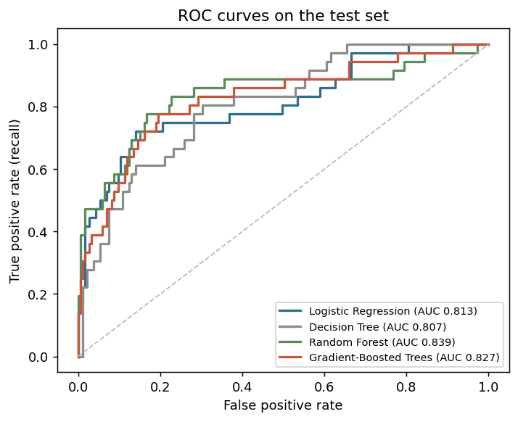
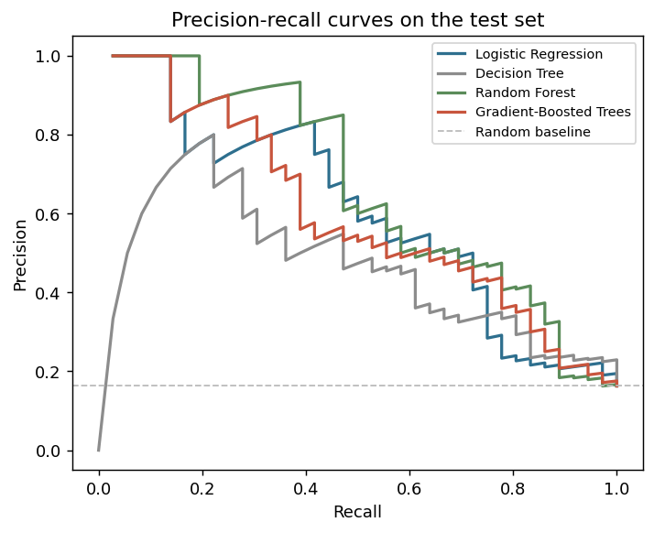
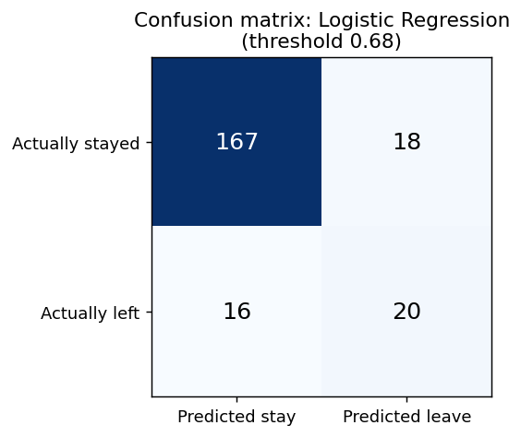
Results — ROC Curves & Confusion Matrix
• Of 36 test employees who left, the model correctly flagged 20 and missed 16.
• Of 185 who stayed, it cleared 167 and raised 18 false alarms.
• Every model ranks employees far better than chance (diagonal). HR can move the threshold to trade precision for recall.

Slide 14
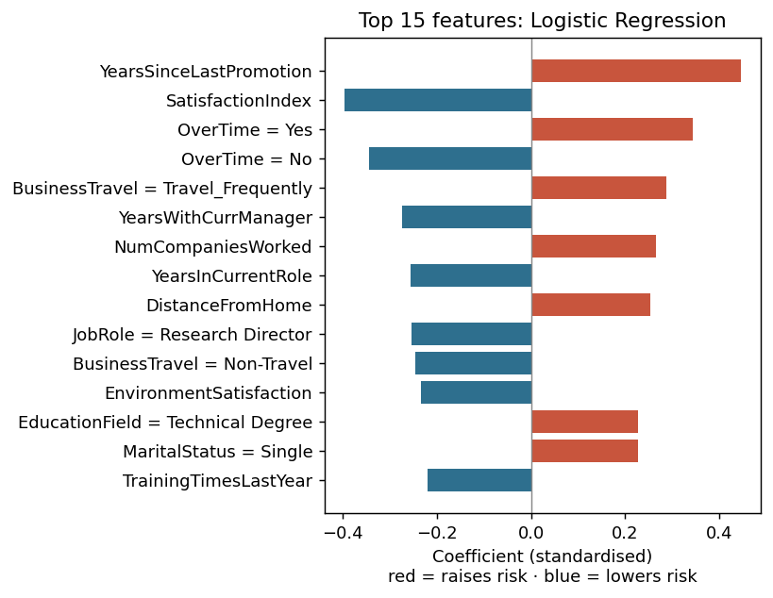
Key Drivers of Attrition
What the model learned
1. YearsSinceLastPromotion (▲ raises risk)
2. SatisfactionIndex (▼ lowers risk)
3. OverTime = Yes (▲ raises risk)
4. BusinessTravel = Travel_Frequently (▲ raises risk)
5. YearsWithCurrManager (▼ lowers risk)
6. NumCompaniesWorked (▲ raises risk)
7. YearsInCurrentRole (▼ lowers risk)
8. DistanceFromHome (▲ raises risk)
Explaining one employee (what-if)
For each factor, the app sets it to the typical value of employees who stayed and re-scores with Spark. The drop in leave probability = that factor's contribution, shown with a suggested HR action.

Slide 15
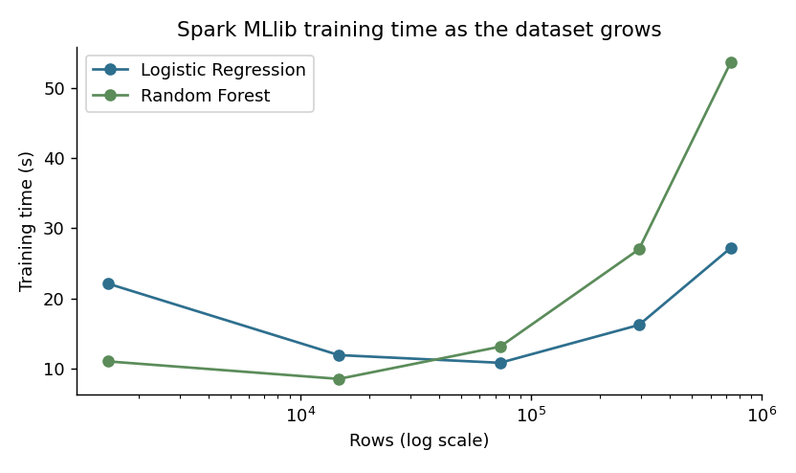
Big Data — Scalability Test
Rows | Model | Fit (s) | Score (s)
1,470 | Logistic Regression | 22.1 | 3.2
1,470 | Random Forest | 11.0 | 1.4
14,700 | Logistic Regression | 11.9 | 1.4
14,700 | Random Forest | 8.5 | 1.7
73,500 | Logistic Regression | 10.8 | 1.5
73,500 | Random Forest | 13.1 | 1.4
294,000 | Logistic Regression | 16.2 | 2.1
294,000 | Random Forest | 27.0 | 2.7
735,000 | Logistic Regression | 27.2 | 3.8
735,000 | Random Forest | 53.7 | 3.4
• Data enlarged up to 500× (≈735,000 rows) with ±5% noise on numeric columns
• Same Spark pipeline, no code change at any size
• Time grows far slower than data: Spark uses every core; on a cluster, every machine
• First (smallest) run includes Spark start-up and JVM warm-up

Slide 16
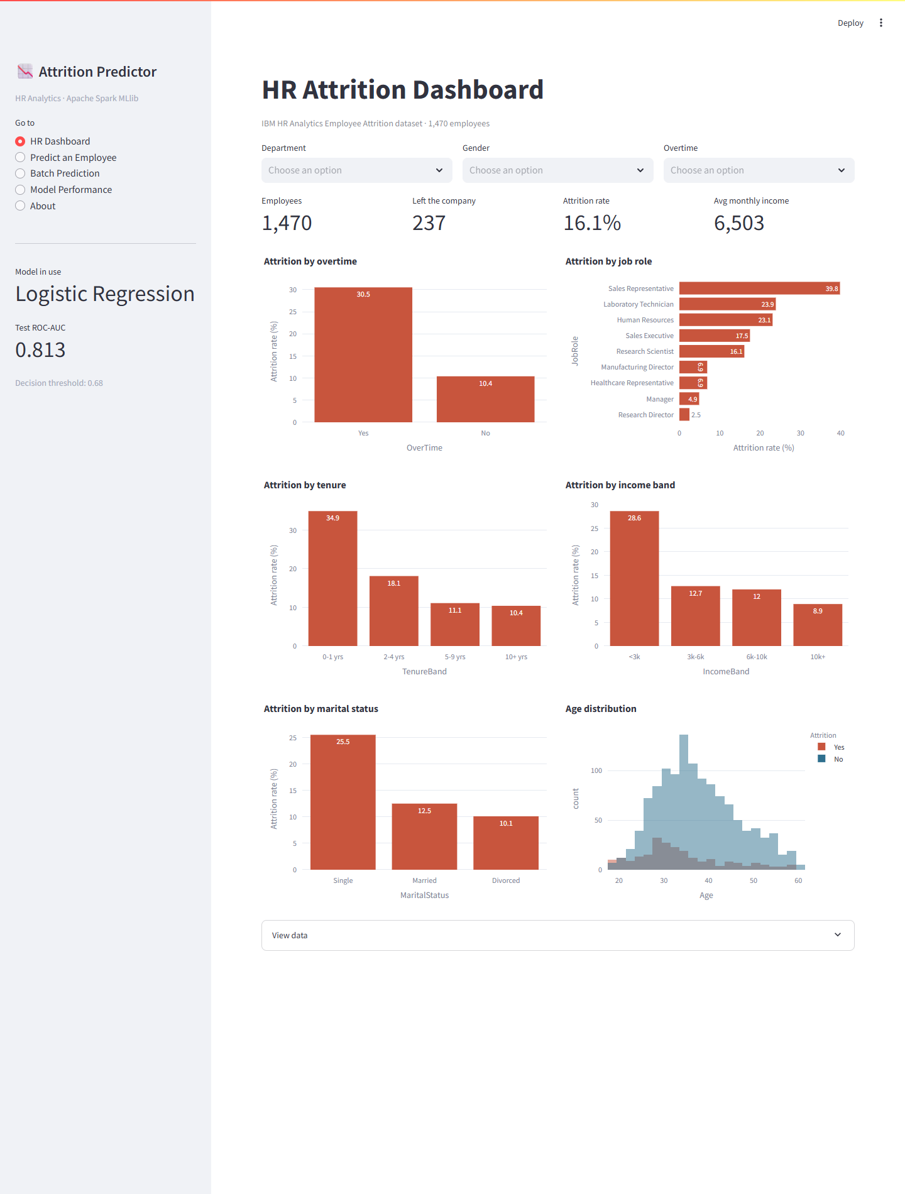
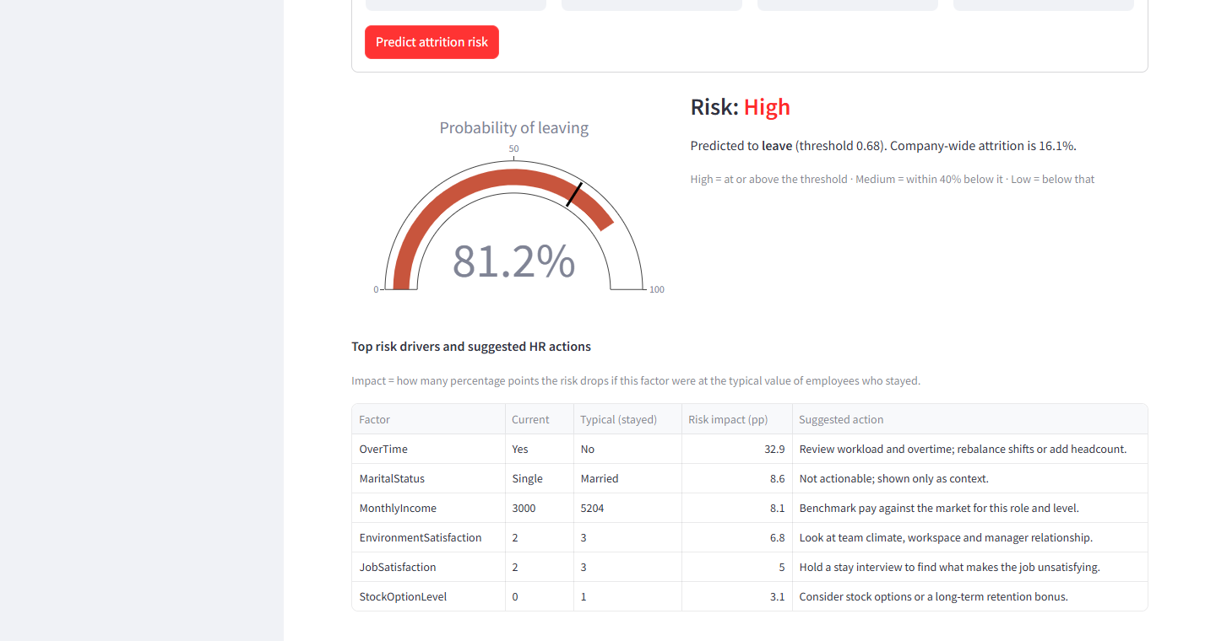
Web Application — HR Dashboard & Prediction
HR Dashboard: KPIs and filters (department, gender, overtime)
Single prediction: risk gauge, drivers and suggested HR actions
Notes:
Live demo: open the app (run_app.bat), show dashboard filters, then predict one high-risk employee.

Slide 17
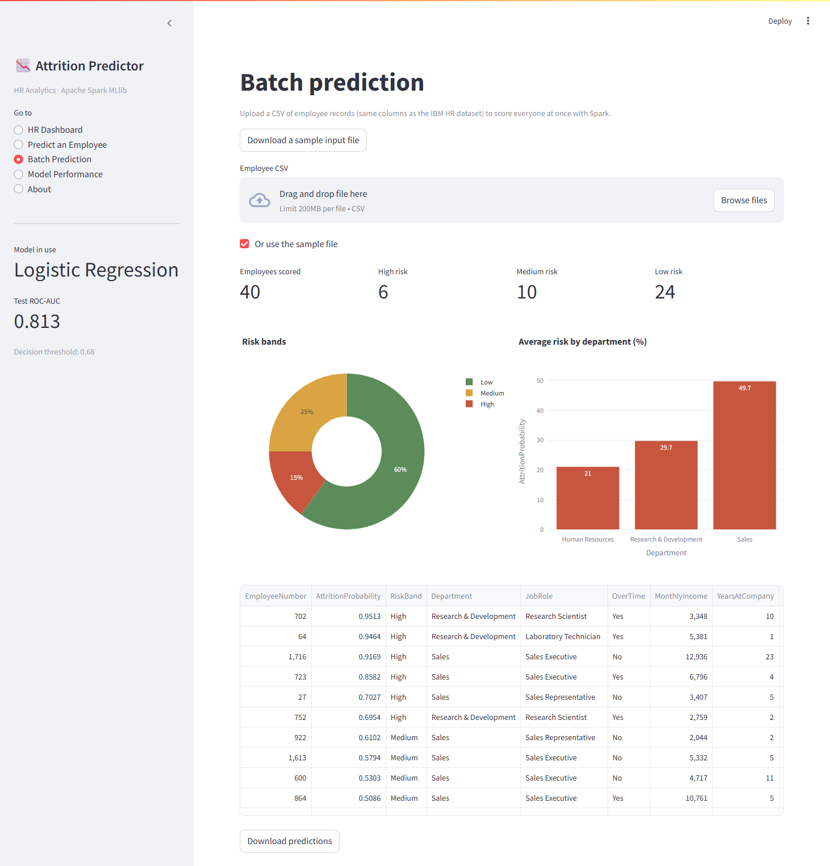
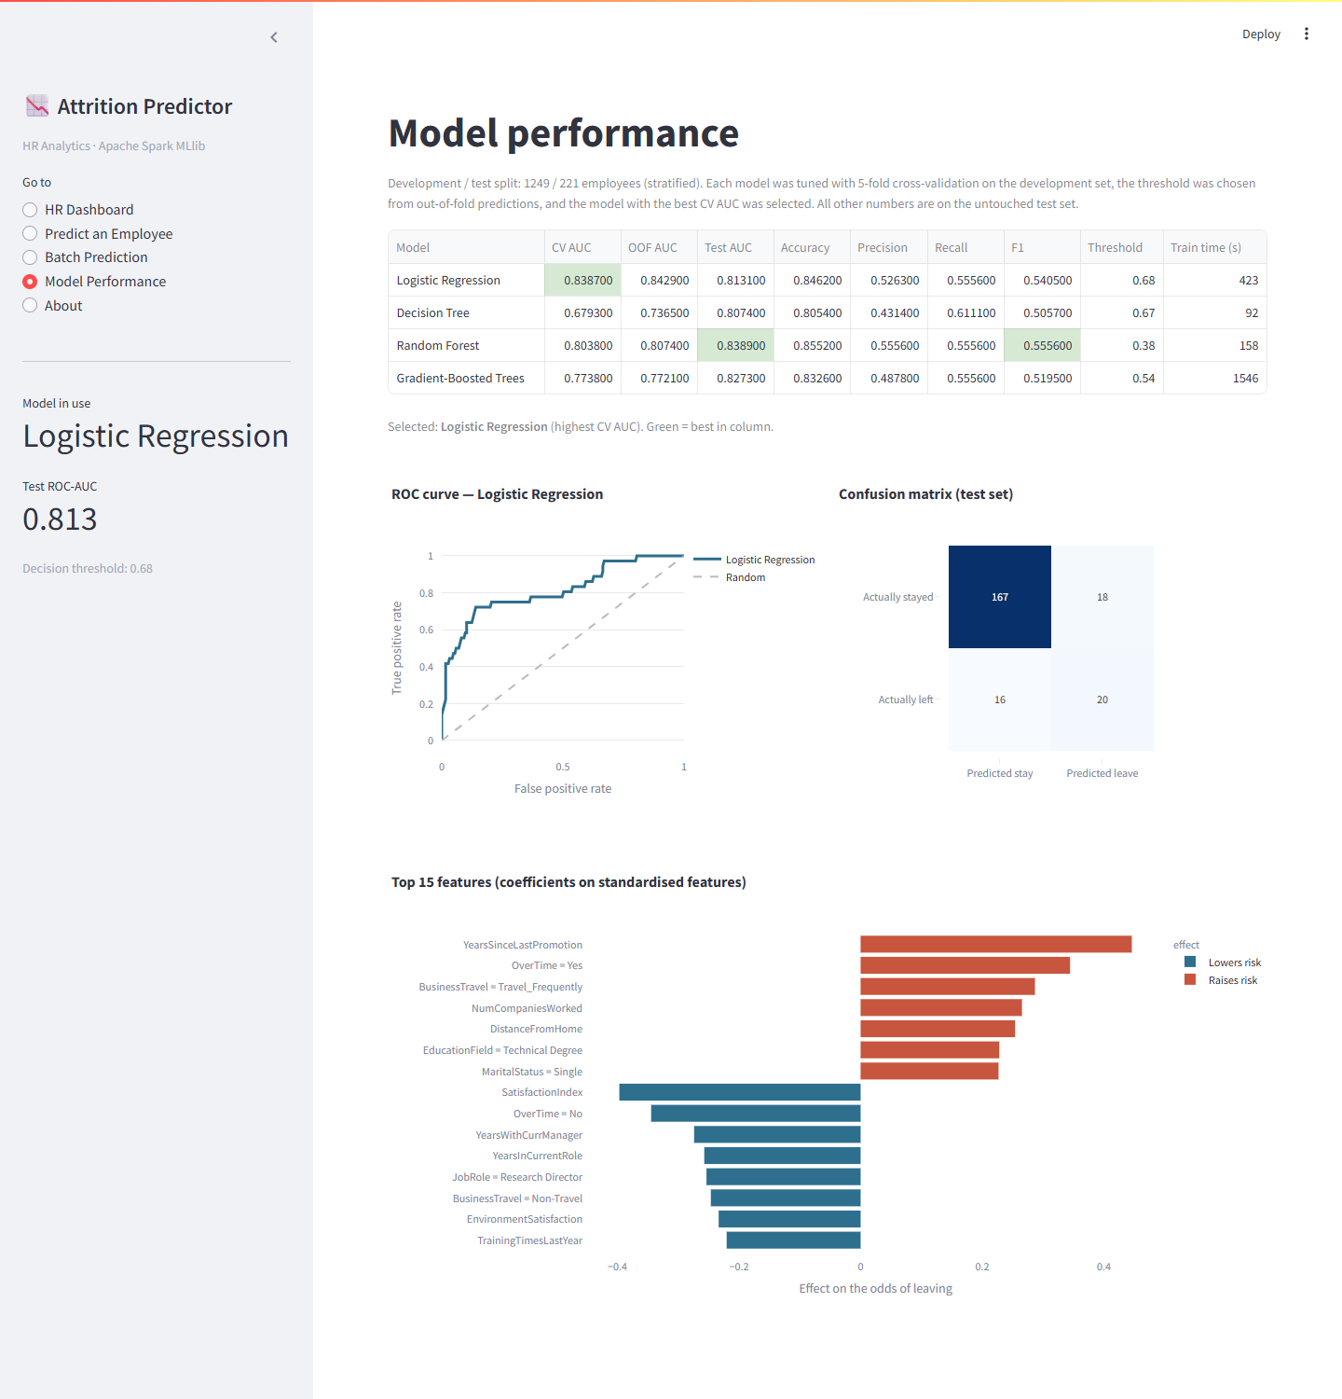
Web Application — Batch Scoring & Model Performance
Batch prediction: upload CSV → risk bands → download results
Model performance page: comparison, ROC, confusion matrix

Slide 18
Business Insights & Recommendations
Finding (from Spark analysis) | Recommended HR action
Overtime workers leave at 30.5% vs 10.4% | Track overtime hours; rebalance workload or add headcount
First two years at the company: 34.9% attrition | Structured onboarding, buddy programme, 30/60/90-day check-ins
Income under 3k: 28.6%; job level 1: 26.3% | Benchmark entry-level pay; publish progression paths from level 1
No stock options: 24.4% attrition | Stock options or retention bonus for high performers
Frequent travellers: 24.9% | Rotate travel duties; travel allowance or remote options
Low job satisfaction: 22.8%; bad work-life balance: 31.3% | Pulse surveys, stay interviews, flexible hours
Sales Representatives: 39.8% | Targeted retention plan: incentives, coaching, career path

Slide 19
Conclusion & Future Scope
Conclusion
Future scope
• Built a complete, working attrition prediction system on Apache Spark — from Spark SQL analysis to a deployed web app.
• Logistic Regression selected: test ROC-AUC 0.813, recall 56%, F1 54%.
• Overtime, income / level, tenure, stock options, travel and satisfaction drive attrition — most are actionable.
• Every prediction comes with its drivers and a suggested HR action.
• The same pipeline runs unchanged on ~735k rows — ready for real big-data volumes.
• All six objectives met.
• Train on an organisation's own HR data with monthly snapshots (trends, not one snapshot)
• Join attendance, leave, survey and performance data in Spark
• Deploy on a Spark cluster (Databricks / EMR) with scheduled retraining and drift monitoring
• SHAP explanations to capture interactions between factors
• Fairness audit across gender and age before real use
• Survival analysis: predict when an employee may leave

Slide 20
GitHub Repository & How to Run
github.com/varunmundhada/employee-attrition-prediction
Folder / file | Contents
src/ | config, Spark session, preprocessing, EDA, training, prediction, scalability benchmark
app/streamlit_app.py | Web application: dashboard, single and batch prediction, model performance
models/ | Saved Spark PipelineModel, metrics.json, eda_summary.json
reports/figures/ | All generated charts
tests/ | pytest tests for cleaning, split and predictor
report/ · ppt/ | LaTeX project report (SIT format) and this presentation
Run it
setup.bat — create venv, install packages
run_pipeline.bat — EDA + training
run_app.bat — open http://localhost:8501
Or manually
pip install -r requirements.txt
python -m src.eda
python -m src.train
streamlit run app/streamlit_app.py

Slide 21
References
1. D. G. Allen, P. C. Bryant and J. M. Vardaman, "Retaining talent: Replacing misconceptions with evidence-based strategies," Academy of Management Perspectives, vol. 24, no. 2, pp. 48–64, 2010.
2. V. V. Saradhi and G. K. Palshikar, "Employee churn prediction," Expert Systems with Applications, vol. 38, no. 3, pp. 1999–2006, 2011.
3. D. Alao and A. B. Adeyemo, "Analyzing employee attrition using decision tree algorithms," CISDIAR Journal, vol. 4, no. 1, pp. 17–28, 2013.
4. R. Punnoose and P. Ajit, "Prediction of employee turnover in organizations using machine learning algorithms," IJARAI, vol. 5, no. 9, 2016.
5. Y. Zhao et al., "Employee turnover prediction with machine learning: A reliable approach," IntelliSys 2018, AISC vol. 869, Springer, 2019.
6. F. Fallucchi et al., "Predicting employee attrition using machine learning techniques," Computers, vol. 9, no. 4, p. 86, 2020.
7. N. B. Yahia, J. Hlel and R. Colomo-Palacios, "From big data to deep data to support people analytics for employee attrition prediction," IEEE Access, vol. 9, 2021.
8. M. Zaharia et al., "Apache Spark: A unified engine for big data processing," Communications of the ACM, vol. 59, no. 11, 2016.
9. X. Meng et al., "MLlib: Machine learning in Apache Spark," JMLR, vol. 17, no. 34, 2016.
10. IBM, "IBM HR Analytics Employee Attrition & Performance," Kaggle dataset.

Slide 22
Thank You…..

