Slide 1
Design-Based KPI Estimation and Survey-Weighted Machine Learning for Undiagnosed Diabetes Screening on NHANES 2017-2018
Varun Mundhada | PRN 23070521184
B.Tech CSE, Semester VII | Healthcare Analytics, CA3 Mini Project
Symbiosis Institute of Technology, Nagpur
Code: https://github.com/varunmundhada/nhanes-healthcare-analytics

Slide 2
Problem: disease that has never been diagnosed
• Hospital records, claims and registries only see people who reached care
• Someone with undetected diabetes or hypertension appears in none of them
• NHANES interviews and physically examines a national US sample, so it can measure undiagnosed disease
• Course brief: build a three-tier KPI dashboard (executive, tactical, operational) with rates per 100,000
• Our question: how large is the diagnosis gap, who does it affect, and can simple non-lab information find these people?
Varun Mundhada | PRN 23070521184 | Healthcare Analytics | 2

Slide 3
Objectives and contributions
• Survey-weighted pipeline: 612 KPI estimates with valid 95% confidence intervals
• Income inequality with the concentration index (pooled and within age bands)
• Three-tier Streamlit dashboard across three domains
- Utilisation and patient experience, chronic disease surveillance, access and capacity
• Screening models for undiagnosed diabetes: LR, RF, gradient boosting, MLP vs the ADA risk score
• Comparison with 7 published models; 26 references (20 from 2021 or later)
Varun Mundhada | PRN 23070521184 | Healthcare Analytics | 3

Slide 4
Dataset: NHANES 2017-2018 (CDC / NCHS)
• 11 public-use files: DEMO, GHB, BPXO, BMX, DIQ, BPQ, MCQ, HUQ, HIQ, DPQ, RXQ_RX
• Merged on SEQN: 9,254 people, no duplicates
• Stratified multistage sample: 15 strata, 30 PSUs, design degrees of freedom = 15
• Weights: WTMEC2YR for exam/lab indicators, WTINT2YR for interview-only indicators
• 17 binary indicators for adults 18+; codes 7/9 (refused, don't know) set to missing
• No geography in public files, so the state map uses CDC PLACES (separate, model-based)
Domain | Example indicators
Utilisation | Fair/poor health, admitted 12m, 4+ visits
Chronic disease | Diabetes (HbA1c), undiagnosed DM/HTN, obesity, PHQ-9
Access | Uninsured, usual source of care, polypharmacy
Varun Mundhada | PRN 23070521184 | Healthcare Analytics | 4

Slide 5
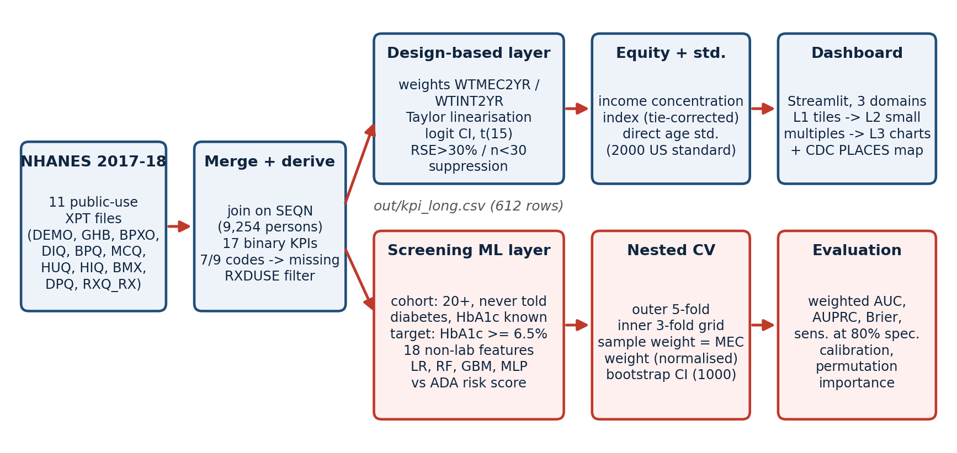
System architecture
Varun Mundhada | PRN 23070521184 | Healthcare Analytics | 5

Slide 6
Design-based estimation methodology
• Weighted prevalence: p = sum(w y) / sum(w)
• Taylor-linearised variance over strata and PSUs (with-replacement approximation)
• Logit-scale 95% CI with t(0.975, 15) = 2.131 instead of 1.96
• Suppress a cell if RSE > 30% or n < 30 (NCHS standard): 53 of 612 cells suppressed
• Concentration index C = (2 / mu) cov_w(y, R), tie-corrected rank for top-coded income; Erreygers E = 4 mu C
• Direct age standardisation to the US 2000 standard population (8 adult groups)
Varun Mundhada | PRN 23070521184 | Healthcare Analytics | 6

Slide 7
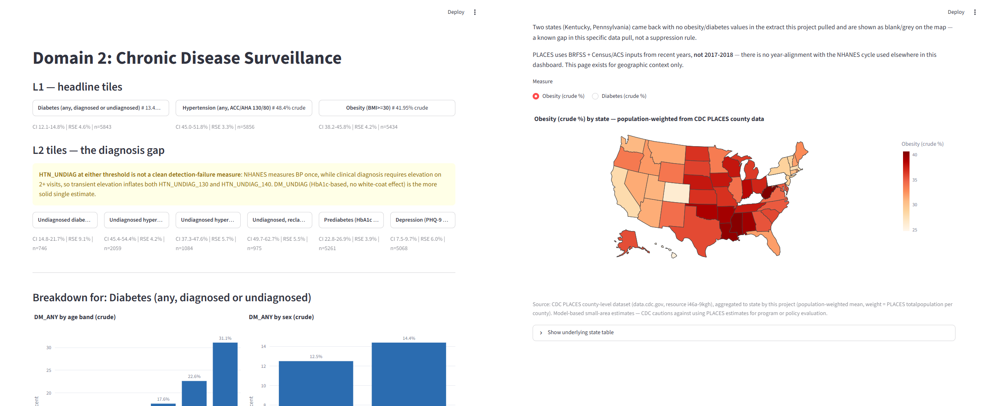
Three-tier dashboard (Streamlit)
L1 tiles with CI, RSE and n -> L2 breakdowns by age, sex, race, income -> L3 analytical charts. Suppressed cells shown grey, never as zero.
Varun Mundhada | PRN 23070521184 | Healthcare Analytics | 7

Slide 8
Key results: the diagnosis gap
Indicator (adults 18+) | % | 95% CI | n
Any diabetes | 13.4 | 12.1-14.8 | 5,843
Undiagnosed diabetes (of HbA1c >= 6.5%) | 18.0 | 14.8-21.7 | 746
Undiagnosed hypertension, 130/80 | 49.9 | 45.4-54.4 | 2,059
Obesity (BMI >= 30) | 42.0 | 38.2-45.8 | 5,434
Uninsured | 13.9 | 10.3-18.5 | 5,837
Fair/poor self-rated health | 18.6 | 16.6-20.8 | 5,849
• About 4.2 million US adults had undiagnosed diabetes
• Borderline answers counted as undiagnosed: 23.4%
• Hypertension gap is inflated by single-visit BP, so diabetes anchors the finding
Varun Mundhada | PRN 23070521184 | Healthcare Analytics | 8

Slide 9
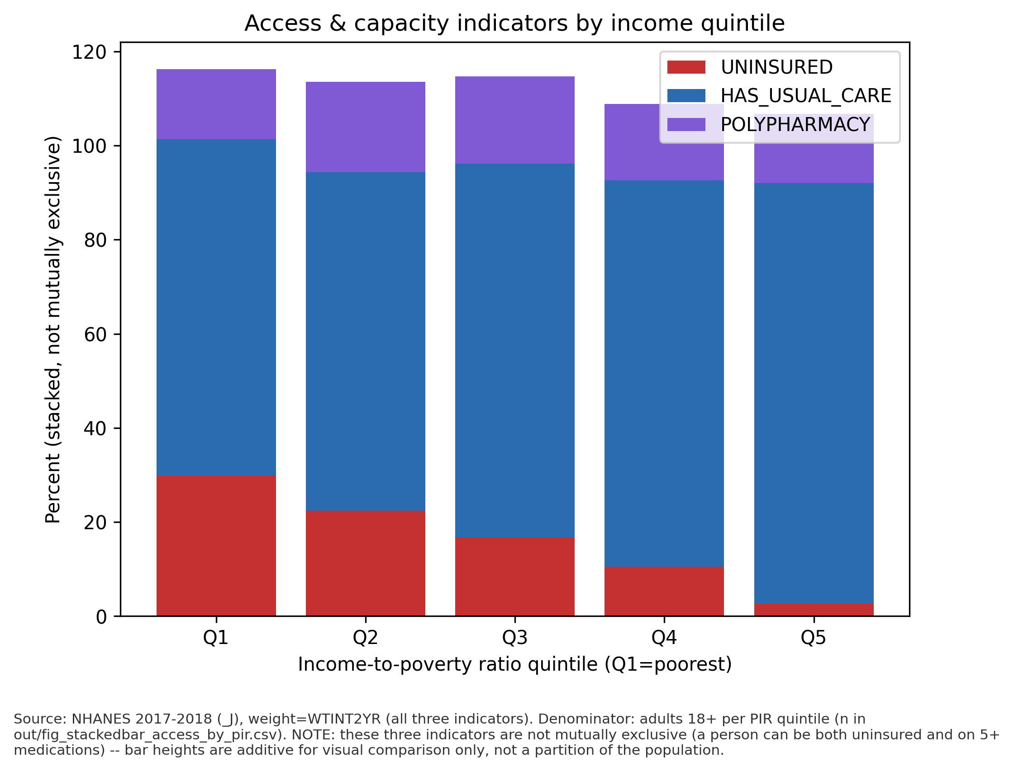
Who is affected: income inequality
• Uninsured: C = -0.42 (E = -0.24), strongly concentrated among the poor
• Steeper within age bands (-0.39 to -0.53), so not a Medicare effect
• Undiagnosed diabetes: C = -0.01, flat
• Insurance closes the access gap, but screening must reach every income group
Varun Mundhada | PRN 23070521184 | Healthcare Analytics | 9

Slide 10
Validation against published NCHS estimates
Indicator | This study (age-std.) | Published | Source
Obesity | 41.8% | 42.4% | Hales et al., Data Brief 360
Hypertension | 45.0% | 45.4% | Ostchega et al., Data Brief 364
Any diabetes | 13.5% | 13.2% (12.0-14.5) | CDC National Diabetes Statistics Report
• Hypertension match may hide offsetting definitions (theirs counts medication users)
• Diabetes not lower despite omitting fasting glucose: an open question we report, not explain away
Varun Mundhada | PRN 23070521184 | Healthcare Analytics | 10

Slide 11
Screening model: setup and hyperparameters
• Cohort: adults 20+, never told diabetes, HbA1c known: n = 4,051, 150 cases (3.7%)
• Target: HbA1c >= 6.5% (undiagnosed diabetes); 18 non-lab features
• Nested CV: 5 outer folds, 3-fold inner grid search on weighted AUC; MEC weights in fit and evaluation
• Baseline: adapted ADA risk score (5 of 7 items, max 9, cut-off >= 5)
Model | Search space
Logistic regression | C in {0.01, 0.1, 1, 10}, L2, balanced classes
Random forest | 500 trees; depth in {4, 8, none}; min leaf in {5, 20}
Gradient boosting | lr in {0.03, 0.1}; depth in {2, 3}; L2 in {0, 1}
MLP | hidden (16) or (32,16); alpha in {0.001, 0.1}; Adam
Varun Mundhada | PRN 23070521184 | Healthcare Analytics | 11

Slide 12
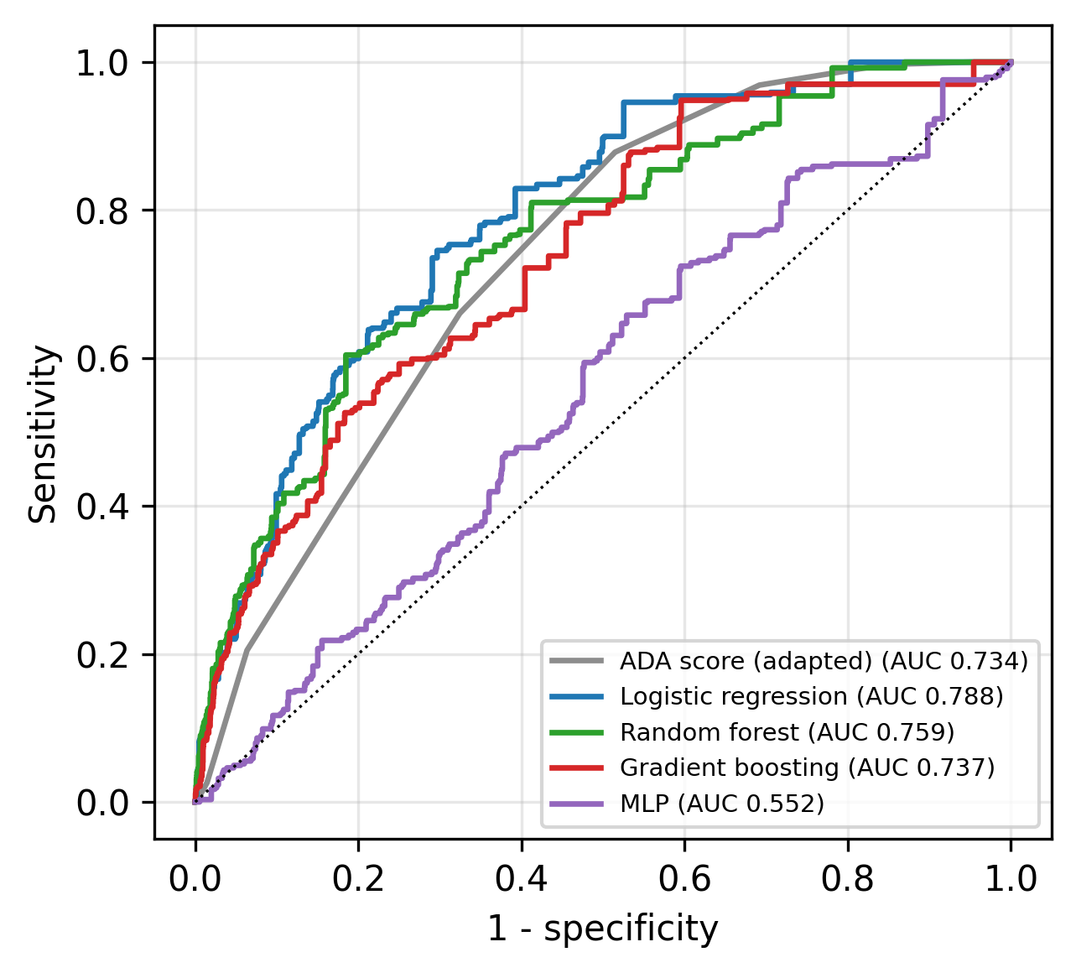
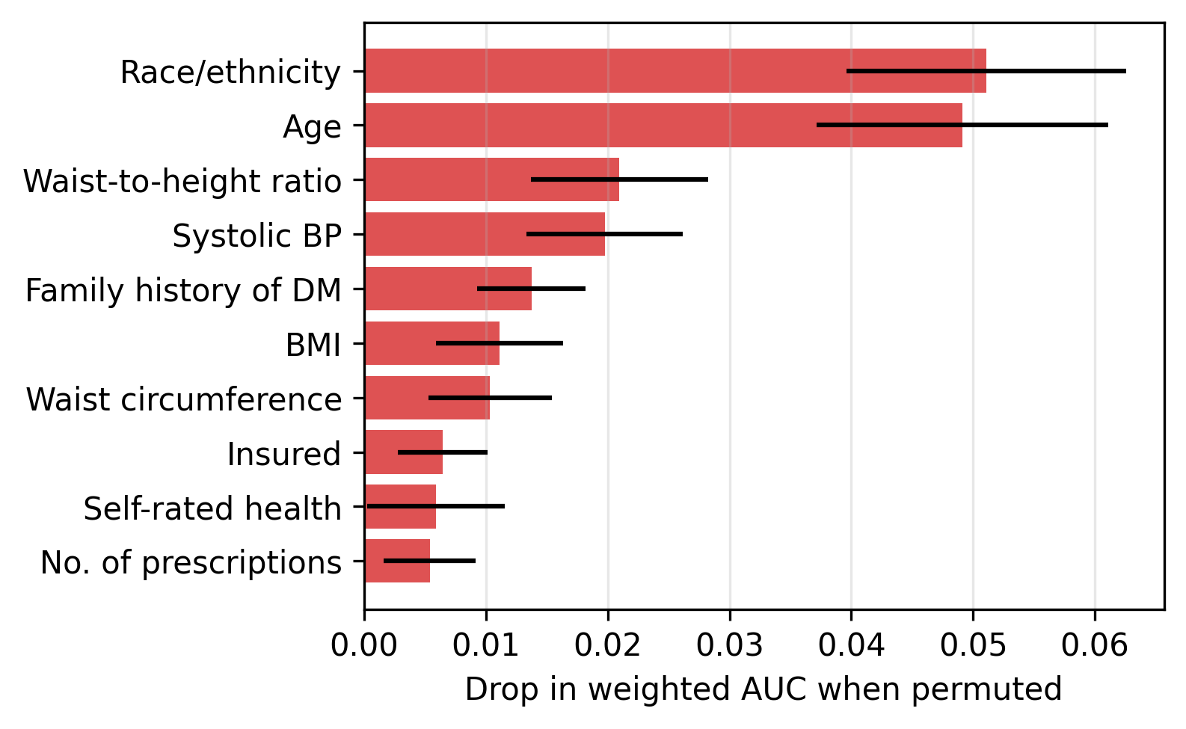
Screening results
Model | Pooled weighted AUC (95% CI) | Sens @ 80% spec
Logistic regression | 0.788 (0.732-0.841) | 0.62
Random forest | 0.759 (0.691-0.820) | 0.58
Gradient boosting | 0.737 (0.673-0.804) | 0.53
ADA score (adapted) | 0.734 (0.689-0.775) | 0.45
MLP (unweighted) | 0.552 (0.474-0.628) | 0.21
LR gain over ADA: +0.057 (95% CI -0.007 to +0.114), not significant with 150 cases
Varun Mundhada | PRN 23070521184 | Healthcare Analytics | 12

Slide 13
Comparison with published models
Study | Data / outcome | Best reported AUC
De Silva 2021 | NHANES, undiagnosed T2D | LR 0.757; ADA 0.737
Choi 2023 | KNHANES, undiagnosed DM | LightGBM 0.819
Qin 2022 | NHANES, fasting glucose | CatBoost 0.83
Riveros Perez 2025 | NHANES, self-reported T2D | XGBoost 0.817
Liu 2025 | NHANES 1999-2020, undiagnosed | AutoML 0.909
This work (weighted) | NHANES 2017-18, undiagnosed | LR 0.788; ADA 0.734
• Our ADA AUC matches De Silva et al. (0.734 vs 0.737); like them, no significant ML gain
• None of the benchmarks used survey weights, so their AUCs describe the sample, not the US population
Varun Mundhada | PRN 23070521184 | Healthcare Analytics | 13

Slide 14
Limitations, conclusion and code
• Limitations: cross-sectional; HbA1c-only diabetes; single-visit BP; no public geography; ML bootstrap ignores clustering
• Two data bugs found and fixed (prescription placeholder row, COPD variable name)
• 18.0% of adults with diabetes by HbA1c are undiagnosed, and the gap is not income-graded
• A weighted logistic regression on 18 non-lab inputs reaches AUC 0.788 vs 0.734 for the ADA score
• Next: add fasting glucose, pool 2017-2023 cycles, validate on 2021-2023
• Code and data pipeline: https://github.com/varunmundhada/nhanes-healthcare-analytics
Varun Mundhada | PRN 23070521184 | Healthcare Analytics | 14

