Slide 1
Assignment 2:
Varun Muniganti
DS-598-51 : Low code No code
1365299

Slide 2
Business Problem
Which factors contribute to customer satisfaction and dissatisfaction?
Introduction:
Airlines compete with each other to provide the best service.
Keeping passengers happy is very important for their success.
Key Problems in Passenger Satisfaction and Dissatisfaction:
Flight Delays – Passengers don’t like waiting for long hours.
Service Quality – Good staff behavior and clean planes matter a lot.
Seat Comfort & Travel Class – Business class passengers may have a different experience than economy class passengers.
Flight Distance & Purpose – Business and holiday travelers may have different needs.
Loyal Customers vs. New Passengers – Some passengers fly often, while others travel rarely. Understanding them helps improve service.
Why This Matters?
Airlines can use this study to improve their service, increase customer satisfaction, and make better business decisions.
Knowing what makes passengers happy can help airlines gain more loyal customers.

Slide 3
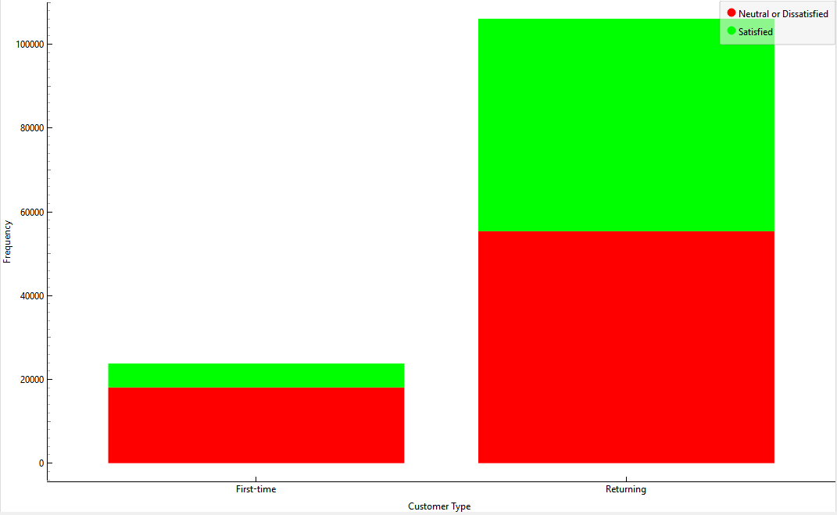
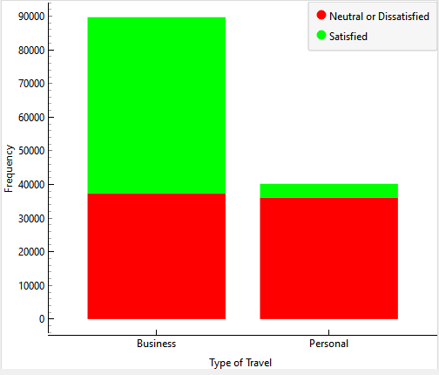
Which percentage of airline passengers are satisfied? Does it vary by customer type? What about the kind of travel?
Airline Passengers Satisfaction
Less than half of the passengers (about 44%) are satisfied, while the majority (56%) are neutral or dissatisfied.
More passengers had an average or bad experience rather than a good one.
The difference between the two groups suggests that there’s room for improvement in customer satisfaction.
Satisfaction by Customer Type (First-Time vs. Returning Passengers):
47.81 % of repeat traveling customers are satisfied and customers who are traveling for the first time are 23.97 % satisfied.
Returning passengers have a much higher satisfaction rate than first-time passengers.
This shows that returning customers have more trust in airline than the first-time traveling customers due to better loyalty services.
Satisfaction by Travel Type (Business vs. Personal):
58.37 % of customers traveling in business are satisfied, whereas 10.13 % of customers traveling in personal are dissatisfied.
This shows personal travelers have a much lower satisfaction rate than business travelers.
This suggests that airlines provide better service for business travelers, while personal travelers may not receive the same level of attention.

Slide 4
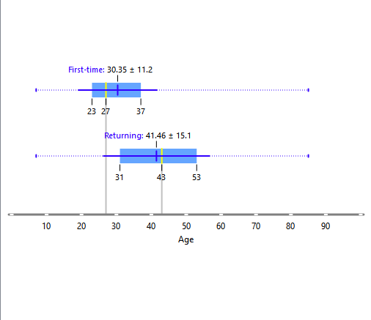
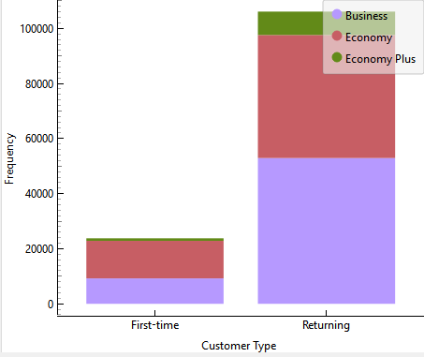
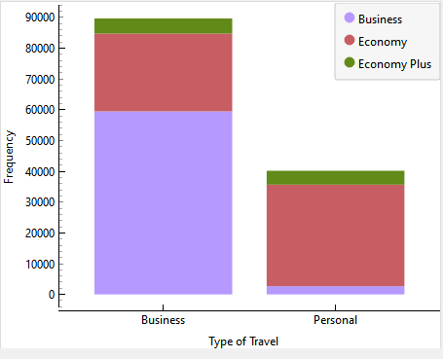
What is the customer profile for a repeating airline passenger?
Customer profile for a repeating airline passenger:
Customers between 31 to 53 years old are returning customers.
The average age of returning passengers is around 43 years.
Most returning passengers travel in Business or Economy class.
A large portion of returning passengers are business travelers.
Some return for personal travel, but the majority are flying for work.
Business travelers are more loyal to the airline than the personal travelers.

Slide 5
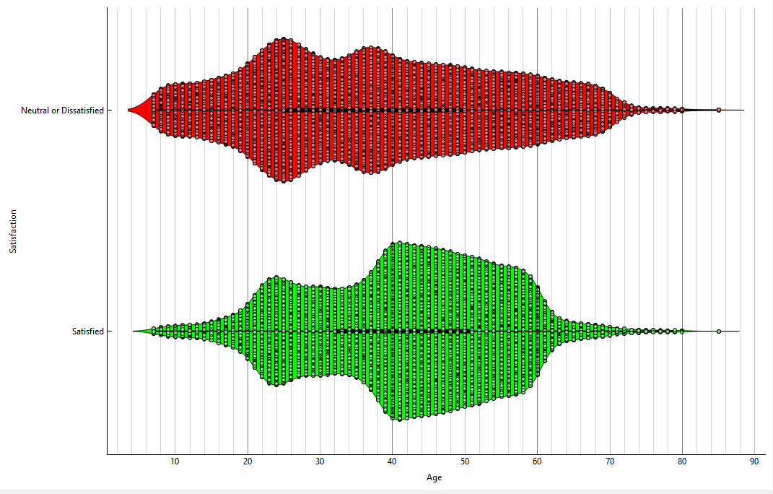
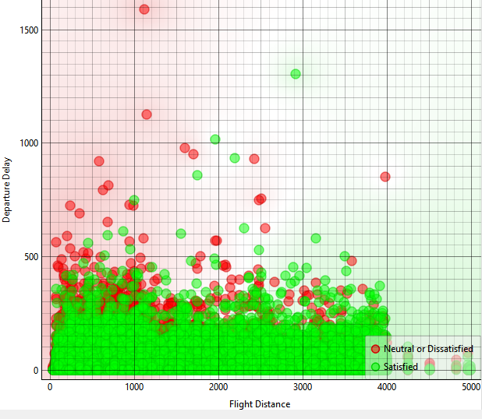
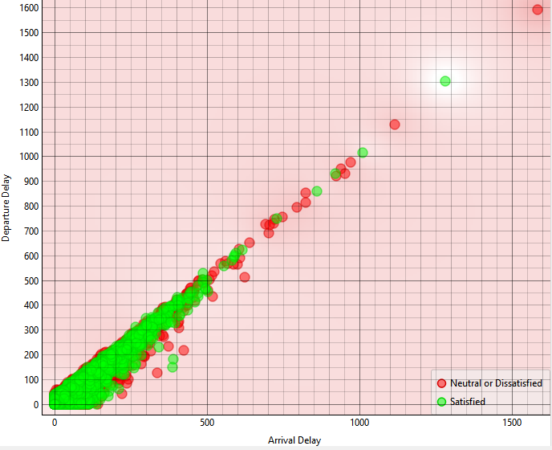
Does flight distance affect customer preferences or flight patterns?
Age and Satisfaction Patterns
Younger passengers (20-40 years) have both satisfied and dissatisfied groups, but more dissatisfaction is seen in younger travelers.
Older passengers (40-60 years) are more likely to be satisfied, meaning they may have different expectations or experiences.
2. Impact of Flight Distance on Satisfaction
Shorter flights (less than 2000 km) have a mix of satisfied and dissatisfied passengers.
As flight distance increases beyond 3000 km, satisfaction improves, with more points appearing.
This suggests longer flights may offer better services, comfort, or perks, leading to higher satisfaction.
3. Impact of Delays on Satisfaction
Departure and arrival delays strongly impact satisfaction—flights with high delays (more than 500 minutes) show more dissatisfaction (red).
Shorter delays (under 200 minutes) still have a mix, but more passengers remain satisfied.
Dissatisfaction is highest when both departure and arrival delays are long, showing that timely service is critical.

Slide 6
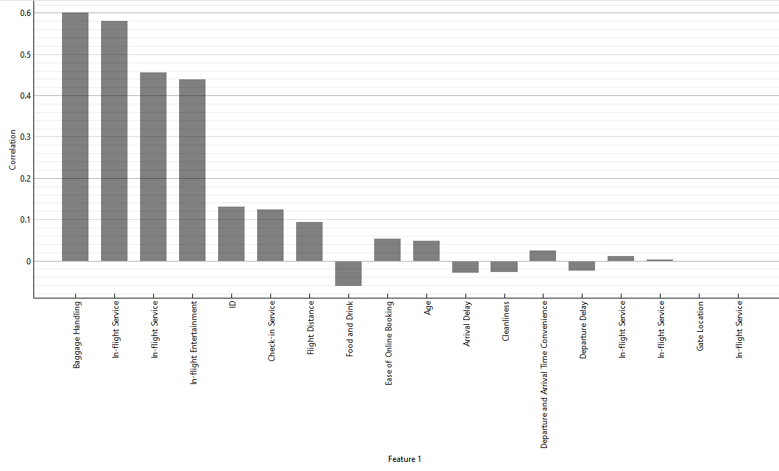
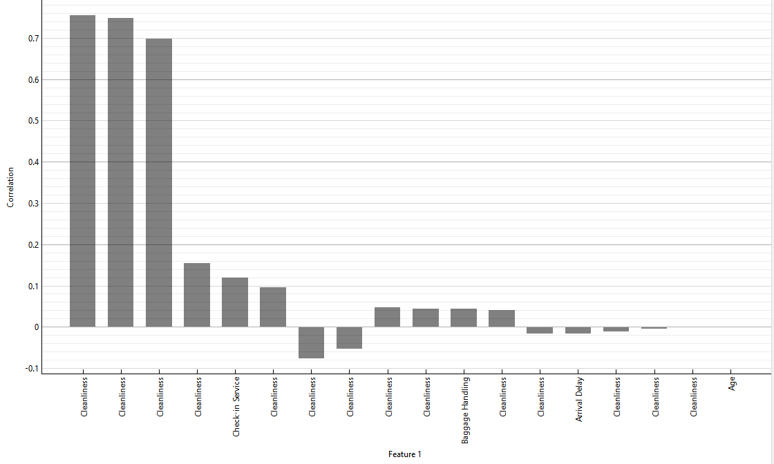
Which factors contribute to customer satisfaction the most? What about dissatisfaction?
Key Factors Leading to Customer Dissatisfaction:
Poor Food Quality and Lack of Cleanliness are major reasons for passenger complaints.
Uncomfortable Seats and Limited In-Flight Entertainment contribute to dissatisfaction.
Complicated Check-in and Online Booking Issues create a frustrating experience for travelers.
Passengers who rate seat comfort and cleanliness below average (around 3 or lower) are often dissatisfied.
Flight Delays (departure and arrival) significantly increase frustration and lower satisfaction ratings.
Key Factors Leading to Customer Satisfaction:
Smooth Baggage handling and In-flight services play big roles in making passengers happy.
Entertainment options (movies, music, WiFi) are key to keeping customers satisfied, especially on long flights.
40-45 years old customers are mostly satisfied.
Check-in services and Food quality impact moderately on satisfaction.

Slide 7
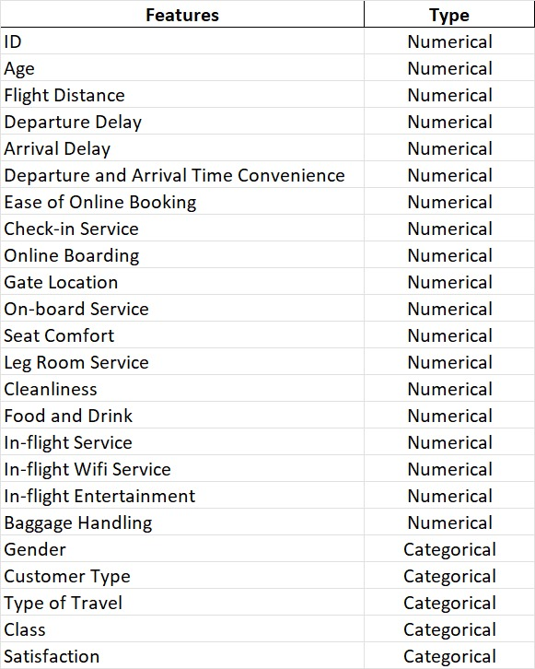
Data Dictionary
Name | Mean | Mode | Mode | Median | Dispersion | Min | Max | Missing
ID | 64940.5 | 1 | 1 | 64940.5 | 0.58 | 1 | 129880 | 0 (0%)
Age | 39.43 | 39 | 39 | 40 | 0.38 | 7 | 85 | 0 (0%)
Flight Distance | 1190.32 | 337 | 337 | 844 | 0.84 | 31 | 4983 | 0 (0%)
Departure Delay | 14.71 | 0 | 0 | 0 | 2.59 | 0 | 1592 | 0 (0%)
Arrival Delay | 15.09 | 0 | 0 | 0 | 2.55 | 0 | 1584 | 0 (0%)
Departure and Arrival Time Convenience | 3.06 | 4 | 4 | 3 | 0.5 | 0 | 5 | 0 (0%)
Ease of Online Booking | 2.76 | 3 | 3 | 3 | 0.51 | 0 | 5 | 0 (0%)
Check-in Service | 3.31 | 4 | 4 | 3 | 0.38 | 0 | 5 | 0 (0%)
Online Boarding | 3.25 | 4 | 4 | 3 | 0.42 | 0 | 5 | 0 (0%)
Gate Location | 2.98 | 3 | 3 | 3 | 0.43 | 0 | 5 | 0 (0%)
On-board Service | 3.38 | 4 | 4 | 4 | 0.38 | 0 | 5 | 0 (0%)
Seat Comfort | 3.44 | 4 | 4 | 4 | 0.38 | 0 | 5 | 0 (0%)
Leg Room Service | 3.35 | 4 | 4 | 4 | 0.39 | 0 | 5 | 0 (0%)
Cleanliness | 3.29 | 4 | 4 | 3 | 0.4 | 0 | 5 | 0 (0%)
Food and Drink | 3.2 | 4 | 4 | 3 | 0.41 | 0 | 5 | 0 (0%)
In-flight Service | 3.64 | 4 | 4 | 4 | 0.32 | 0 | 5 | 0 (0%)
In-flight Wifi Service | 2.73 | 2 | 2 | 3 | 0.49 | 0 | 5 | 0 (0%)
In-flight Entertainment | 3.36 | 4 | 4 | 4 | 0.4 | 0 | 5 | 0 (0%)
Baggage Handling | 3.63 | 4 | 4 | 4 | 0.32 | 1 | 5 | 0 (0%)
Gender | Female |  |  |  |  |  |  | 0 (0%)
Customer Type | Returning |  |  |  |  |  |  | 0 (0%)
Type of Travel | Business |  |  |  |  |  |  | 0 (0%)
Class | Business |  |  |  |  |  |  | 0 (0%)
Satisfaction | Neutral or Dissatisfied |  |  |  |  |  |  | 0 (0%)

Slide 8
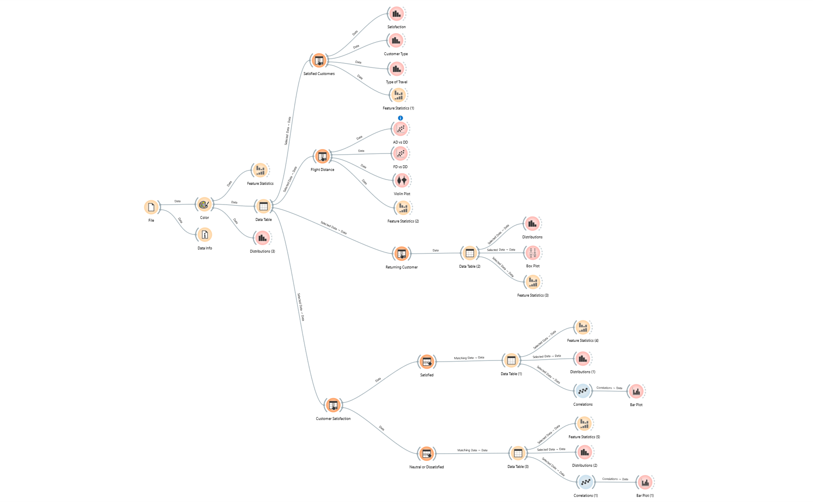
Orange Workflow

Slide 9
Final Observations
Less than 50% of passengers are satisfied, with first-time and personal travelers showing lower satisfaction.
Returning and business travelers report higher satisfaction, likely due to better services and familiarity.
Long-haul flights (above 2000 km) have better satisfaction, while short-haul flights face more complaints due to limited services and delays.
Delays (departure & arrival) are a major cause of dissatisfaction, especially for short-distance flights.
Key satisfaction drivers include baggage handling, in-flight service, entertainment, and cleanliness.
Dissatisfaction is mainly caused by delays, baggage issues, poor food quality, and uncomfortable seating.
Airlines should focus on improving short-haul flight experience, minimizing delays, and enhancing economy-class comfort.

