Slide 1
Today in Cryptography (5830)
Hybrid encryption recap
OpenPGP standard
TextSecure
Katz-Lindell Chapter 10.3 (Hybrid Encryption)
RFC 4880 (OpenPGP standard)
Notes:
We develop pioneering leaders for the digital age.

Slide 2
Application-layer crypto
So far focused on TLS as running example
Transport Layer Security
Provides network socket style stream interface
What about if an application wants to encrypt discrete messages (as opposed to stream)?
Email
Text messages
Etc.

Slide 3

Email encryption
Encrypted, signed message
Sender
Receiver
pk_{A} , sk_{A}
pk_{B} , sk_{B}
Message may be large (body of email, PDF of attachments)
Desire authenticity and confidentiality
Public-keys delivered out-of-band
Websites, key parties, key directory servers

Slide 4
Example hybrid encryption
Enc(X,M):
K1 || K2 = SHA256(g^{xr})
M1
M2
M3
K2
g^{r}
E_{K1}
E_{K1}
E_{K1}
HMAC
C1
C2
C3
C_{kem}
C
T

Slide 5
Email encryption
Ctxt
Sender
Receiver
pk_{A} , sk_{A}
pk_{B} , sk_{B}
To digitally sign, let M = Msg || Sign(sk_{A} , Msg)
Ctxt = Encrypt(pk_{B} , M)

Slide 6
PGP history
Phil Zimmerman released “Pretty Good Privacy” in 1991 on a USENET post marked as “US only”
1993: Criminal investigation by US government for munitions export without a license.
Printed PGP source code into a book. First amendment gambit

Slide 7
OpenPGP overview
Standard for PGP is RFC 4880
Key encapsulation mechanism:
RSA PKCS#1 v1.5 encryption
ElGamal over finite field or elliptic curve
Digital signatures:
RSA PKCS#1 v1.5 signatures
DSA
Symmetric encryption:
Password-based key derivations using iterated hashing
CFB mode using block cipher

Slide 8
OpenPGP overview
Security problems:
Padding oracle attacks against CFB & PKCS#1 v1.5
http://www.ssi.gouv.fr/uploads/2015/05/format-Oracles-on-OpenPGP.pdf
Attacks against home-brewed integrity checks (modification detection check, MDC)
Subject lines always in the clear
Usability problems:
Users must manage their own keys
Copying private keys to each device
“Why Johnny Can’t Encrypt” http://www.gaudior.net/alma/johnny.pdf
90 minutes to send encrypted email, 66% failure rate

Slide 9
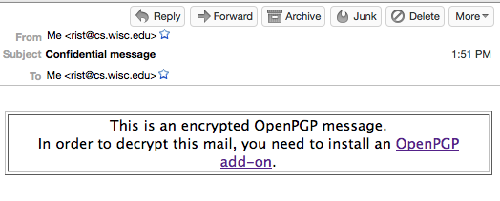

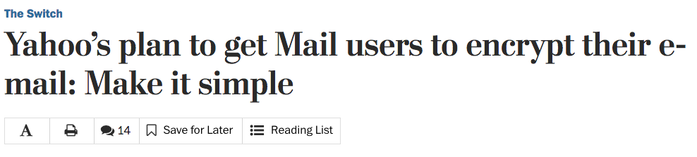

Slide 10

Messaging encryption
Encrypted/Signed SMS or IM
Sender
Receiver
pk_{A} , sk_{A}
pk_{B} , sk_{B}
End-to-end encrypted messaging is a big topic
TextSecure is protocol adopted by WhatsApp (~1 billion users)

Slide 11
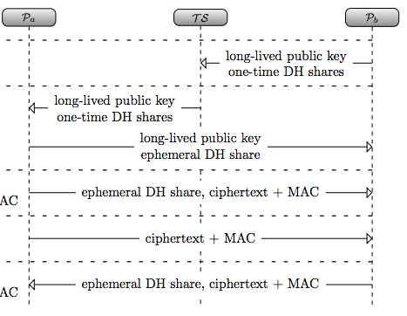
TextSecure
Encrypted/Signed SMS or IM
Sender
Receiver
pk_{A} , sk_{A}
pk_{B} , sk_{B}
https://eprint.iacr.org/2014/904.pdf

Slide 12
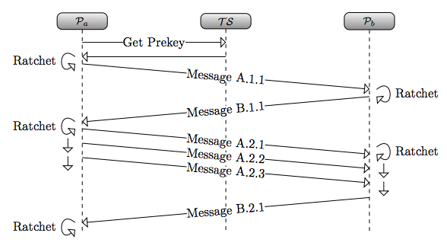
TextSecure
Encrypted/Signed SMS or IM
Sender
Receiver
pk_{A} , sk_{A}
pk_{B} , sk_{B}
https://eprint.iacr.org/2014/904.pdf

Slide 13
Summary
Hybrid encryption uses combination of asymmetric and symmetric cryptography
Key encapsulation mechanisms (KEM) based on secure PKE, (elliptic curve) Diffie-Hellman
Use an authenticated encryption scheme for data encapsulation mechanism (DEM)
PGP is historical example (and still somewhat widely used)
End-to-end messaging for IM/chat hotter topic, now widely deployed

Slide 14
Hybrid encryption (KEM/DEM)
pk_{B}
K
KEM
Sym Enc
R
K, C_{kem}
Msg
C_{dem}
KEM = key encapsulation mechanism
Public-key primitive
DEM = data encapsulation mechanism
One-time secure authenticated encryption
HybEnc(pk, M )
Choose randomness R
K, C_{kem} <- KEM(pk,R)
C_{dem} <- Enc(K,M)
Return C_{kem} , C_{dem}
HybDec(sk, C_{kem} , C_{dem} )
K <- KEM⁻¹(sk, C_{kem})
M <- Dec(K, C_{dem})
Return M

Slide 15
KEM from PKE
pk_{B}
KEM
KEM(pk, R)
C_{kem} <- PKE-Enc(pk,R)
Return H(R), C_{kem}
R
K, C_{kem}
KEM = key encapsulation mechanism
Public-key primitive

Slide 16
ElGamal encryption
Kg outputs pk = (g,X =g^{x}) and sk = (g,x)
g is generator for group of order prime p
Enc((g,X), M, R )
r = R mod p
C1 = g^{r}
C2 = X^{r} * M
Return C1 , C2
Dec((g,x), C1, C2 ):
Return C2 * C1^{-x}
This is only at most chosen-plaintext attack secure. CCA attacks?

Slide 17
ElGamal KEM
Kg outputs pk = (g,X =g^{x}) and sk = (g,x)
g is generator for group of order prime p
EG-KEM((g,X), R )
r = R mod p
C_{kem} = g^{r}
K = X^{r}
Return H(K) , C_{kem}
Dec((g,x), C_{kem} ):
Return H(C_{kem})
x
Secure if computational Diffie-Hellman assumption holds in group

