Slide 1
Today in Cryptography (5830)
Summary of crypto we’ve seen
Crypto backdoors
Notes:
We develop pioneering leaders for the digital age.

Slide 2
Some basic primitives
Symmetric cryptography (shared key K)
encryption & decryption using K
message authentication using K
pseudorandom functions (PRF)
Public-key cryptography (public key pk, secret key sk)
encrypt with pk and decrypt with sk
digitally sign using sk and verify with pk
Hash functions (no keys)
used to “compress” messages in a secure way

Slide 3

TLS handshake for RSA transport
Client
Server
ClientHello, MaxVer, Nc, Ciphers/CompMethods
Pick random Nc
ServerHello, Ver, Ns, SessionID, Cipher/CompMethod
Pick random Ns
Check CERT
using CA public
verification key
CERT = (pk of bank, signature over it)
C
Pick random PMS
C <- E(pk,PMS)
PMS <- D(sk,C)
ChangeCipherSpec,
{ Finished, PRF(MS, “Client finished” || H(transcript)) }
ChangeCipherSpec,
{ Finished, PRF(MS, “Server finished” || H(transcript’)) }
Bracket notation
means contents
encrypted
MS <- PRF(PMS, “master secret” || Nc || Ns )

Slide 4
Primitive | Use cases / examples | Security goals | Good schemes | Bad schemes
Block ciphers | Building block for symmetric encryption | Indistinguishable from random permutation | AES, 3DES | DES, Skipjack
Pseudorandom Functions (PRFs) / Message authentication codes (MACs) | Authenticating data with shared secret key, key derivation | Indistinguishable from random function | HMAC w/ good hash function OMAC, CMAC, PMAC | CBC-MAC without prefix-free encoding
Symmetric encryption (length-extending, authenticated encryption) | Main mechanism for encrypting data; TLS record layer, encrypting data at rest | Message confidentiality and associated data + ciphertext authenticity | Encrypt-then-MAC GCM OCB | Encryption only modes: CTR mode, CBC mode, ECB mode, RC4
Hash functions | Key derivation, PW hashing, digital signatures, HMAC | Behave like a public random function (implies coll resist, one-wayness, etc.) | SHA-256 SHA-3 | MD4, MD5, SHA-1
Password-based key derivation | Password hashing, PW-based encryption | No shortcut attacks | PBKDF2, scrypt, bcrypt, argon2 | Plain hash function

Slide 5
Primitive | Use cases / examples | Security goals | Good schemes | Bad schemes
RSA PKE | Encrypt symmetric key | No partial info on messages leaked to active attacker | RSA-OAEP w/ 2048 bit moduli | RSA-PKCS#1 v1.5, “raw” RSA < 2048 bit N
ECC PKE | Encrypt symmetric key | No partial info on messages leaked to active attacker |  | ElGamal by itself
Hybrid encryption | Encrypt data efficiently using recipient public key | No partial information on messages leaked; attacker can’t maul ciphertext | ECIES RSA-OAEP w/ one-time Encrypt-then-MAC scheme | Raw RSA kem, bad sym encryption (e.g., CBC mode)
Digital signatures | Authenticated key exchange, code signing | Unforgeability under chosen message attacks | ECDSA, RSA PSS | RSA-PKCS#1 v1.5
Diffie-Hellman key exchange | Establishing secure channel | Attacker can’t recover derived session key | ECC DH, Finite field DH | << 256 bit ECC groups, << 2048 bit FF groups

Slide 6
Cryptographic backdoors
Long debate over whether average citizens should have access to strong crypto
“Crypto wars” of 1990s: export restrictions that treat crypto software as munitions
Overt and surreptitious backdoors seen as backup plan by governments

Slide 7
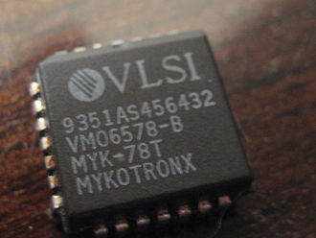
Overt backdoors
Clipper chip
NSA hardware for encrypting telecommunications
Each chip had secret key, this was given to (escrowed with) NSA at manufacture time
Significant backlash
“The Risks of Key Recovery, Key Escrow, and Trusted Third-Party Encryption” by Abelson et al.

Slide 8
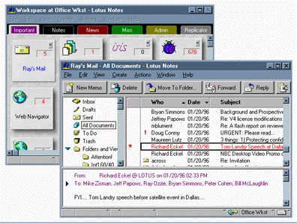
Overt backdoors
Export controls required only 40-bit keys for international software
Lotus Notes “Differential Workfactor Cryptography”
64 bit symmetric key K
C1 = RSA-Enc(pk_{NSA} , top24(K) )
C2 = Enc(K, data)

Slide 9
Surreptitious backdoors
Secretly weaken / sabotage cryptographic systems
Usually done to dovetail with interception capabilities

Slide 10
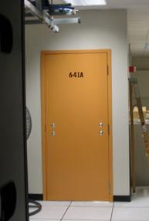
AT&T Wiretap case
Mark Klein discloses potential wiretapping activities by NSA at San Francisco AT&T office
Fiber optic splitter on major trunk line for Internet communications
Electronic voice and data communications copied to “secret room”
Narus STA 6400 device

Slide 11
Preventing intercept
End-to-end encryption (TLS, SSH)
What does this protect? What does it leak?
What can go wrong?
Interception gear
Other major backbone
IP:
1.2.3.4
AT&T network
IP:
5.6.7.8

Slide 12
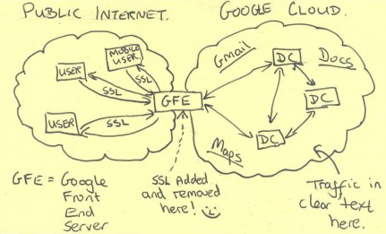
End-run around HTTPS
HTTPS terminated at edge of Google networks
Internal data center-to-data center communications on privately leased lines
No encryption up until summer 2013

Slide 13
Sabotaging TLS
NIST’s Dual EC pseudorandom number generator (PRNG) apparently backdoored
Mandated public parameters are public key
There exists a secret key, the trapdoor
One output of PRNG + trapdoor reveals next state of PRNG, and prediction of future outputs
State 1
State 2
…
trapdoor
Output 1
Output 2

Slide 14
TLS handshake for RSA transport
Bank customer
Bank
ClientHello, MaxVer, Nc, Ciphers/CompMethods
Pick random Nc
ServerHello, Ver, Ns, SessionID, Cipher/CompMethod
Pick random Ns
Check CERT
using CA public
verification key
CERT = (pk of bank, signature over it)
C
Pick random PMS
C <- E(pk,PMS)
PMS <- D(sk,C)
Say client is using Dual EC for randomness generation
What is vulnerable?
RSA BSAFE library: 2.4 seconds to recover PMS
Windows: 60 minutes
OpenSSL: never (bug in code!)
See
http://dualec.org/

Slide 15
Preventing intercept
End-to-end encryption (TLS, SSH)
What does this protect? What does it leak?
What can go wrong?
Interception gear
Other major backbone
IP:
1.2.3.4
AT&T network
IP:
5.6.7.8

Slide 16
Hiding “metadata” such as connectivity is even harder
IP addresses are required to route communication, yet not encrypted by normal end-to-end encryption
1.2.3.4 talked to 5.6.7.8 over HTTPs
How can we hide connectivity information?

Slide 17

Anonymization systems
Single-hop proxy services
JonDonym, anonymous remailers (MixMaster, MixMinion), many more…
Anonymizer.com

Slide 18
Tor (The Onion Router)
Interception gear
Other major backbone
IP:
1.2.3.4
AT&T network
IP:
5.6.7.8
Other major backbone
Tor Node
Tor Node
Tor Node
7.8.9.1
9.1.1.2
8.9.1.1

Slide 19
IP:
1.2.3.4
7.8.9.1
8.9.1.1
9.1.1.2
IP:
5.6.7.8
Onion routing: the basic idea
Src:
9.1.1.2
Dest:
5.6.7.8
HTTP packet
Src:
8.9.1.1
Dest:
9.1.1.2
Encrypted to 9.1.1.2
Src:
8.9.1.1
Dest:
9.1.1.2
Encrypted to 8.9.1.1
Src:
7.8.9.1
Dest:
8.9.1.1
Encrypted to 7.8.9.1
Tor implements more complex version of this basic idea

Slide 20
What does adversary see?
Src:
9.1.1.2
Dest:
5.6.7.8
HTTP packet
Interception gear
Other major backbone
IP:
1.2.3.4
AT&T network
IP:
5.6.7.8
Other major backbone
Tor Node
Tor Node
Tor Node
Tor obfuscates who talked to who, need end-to-end encryption (e.g., HTTPS) to protect payload
7.8.9.1
9.1.1.2
8.9.1.1

