Slide 1
Today in Cryptography (5830)
Random number generators
Pseudorandom number generators
Notes:
We develop pioneering leaders for the digital age.

Slide 2
Winding down semester
Presentations next Thursday
Final exam will be take home to be completed individually.
Given out Thursday
Due at end of finals (May 24)

Slide 3

TLS handshake for RSA transport
Client
Server
ClientHello, MaxVer, Nc, Ciphers/CompMethods
Pick random Nc
ServerHello, Ver, Ns, SessionID, Cipher/CompMethod
Pick random Ns
Check CERT
using CA public
verification key
CERT = (pk of bank, signature over it)
C
Pick random PMS
C <- E(pk,PMS)
PMS <- D(sk,C)
ChangeCipherSpec,
{ Finished, PRF(MS, “Client finished” || H(transcript)) }
ChangeCipherSpec,
{ Finished, PRF(MS, “Server finished” || H(transcript’)) }
Bracket notation
means contents
encrypted
MS <- PRF(PMS, “master secret” || Nc || Ns )

Slide 4

Random number generator (RNG)
R
MD_Update(&m,buf,j);
….
MD_Update(&m,buf,j); /* purify complains */
These lines of code commented out from OpenSSL random number generator code (md_rand.c) to address complaints by security tools Purify and Valgrind
Only the PID was used as input to RNG.
It took a ~2 years for the bug to be (publicly) discovered!
Random number generators are hard to get right:
[Wagner, Goldberg 1996]
[Gutterman, Malkhi 2006]
Flaws so that R ends up:
[Gutterman, Pinkas, Reinman 2006]
[Dorrendorf, Gutterman, Pinkas 2007]
Repeated
Exposed to attackers
Predictable
[Woolley et al. 2007]
[Bello 2008]
[Mueller 2008]
[Abeni et al. 2008]
[Yilek et al. 2009]
Debian OpenSSL bug lead to small set of possible R

Slide 5
Cryptographically strong randomness
Must be maximally unpredictable from adversary’s perspective
This means (computationally) indistinguishable from uniform bit string of same length
“True” randomness vs. cryptographic randomness

Slide 6
RNG pipelines
Entropy gathering
Extracting from measrements a cryptographically strong value called seed
Using seed to deterministically produce pseudorandom values
Seed (256 bits)
M1
M2
M3
…
Measurements of
unpredictable events
S
R1, R2, …
Extract
Stretch

Slide 7
Entropy sources
Timing and description of various events
keyboard presses and timing
file/network interrupts
mouse movements
Hardware RNGs
Intel RNG has custom hardware for generating unpredictable bits using thermal noise
Health tests

Slide 8
Intel RNG system
512 bits collected per go
Seed (256 bits)
High entropy bits from hardware entropy source
b1
b2
b3
…
S
R1, R2, …
64-bit values, one per RDRAND call
AES-CBC based
extractor
AES-CTR
based PRNG
Health tests
(heuristics to see if entropy is close to 0.5)
Can fail tests,
outputs 0 if so
Good writeup: http://eprint.iacr.org/2014/504.pdf

Slide 9
AES CBC MAC as an extractor
Entropy measurements
b1
b2
…
K1 = AES(0,1)
S1 || S2
b1b2…
b129…
b257..
E_{K1}
E_{K1}
E_{K1}
S1
Repeat process of collecting entropy values and CBC-MACing to get S2

Slide 10
Intel RNG system
512 bits collected per go
Seed (256 bits)
High entropy bits from hardware entropy source
b1
b2
b3
…
S
R1, R2, …
64-bit values, one per RDRAND call
AES-CBC based
extractor
AES-CTR
based PRNG
Health tests
(heuristics to see if entropy is close to 0.5)
Can fail tests,
outputs 0 if so
Good writeup: http://eprint.iacr.org/2014/504.pdf

Slide 11
AES CTR mode as PRG
Seed (128 bits)
AES-CTR(S) -> R1, R2, R3…
S
R1, R2, …
0
1
2
E_{S}
E_{S}
E_{S}
R1
R2
R3

Slide 12
AES CTR mode in Intel RNG
Seed (256 bits)
AES-CTR(K,IV,S) -> R1, K’, IV’
S
R1
S = S1 || S2 (128 bits each)
IV
IV + 1
IV + 2
E_{K}
E_{K}
E_{K}
R1
R2
R3
R1 output to caller
of instruction
S1
S2
K’
IV’

Slide 13
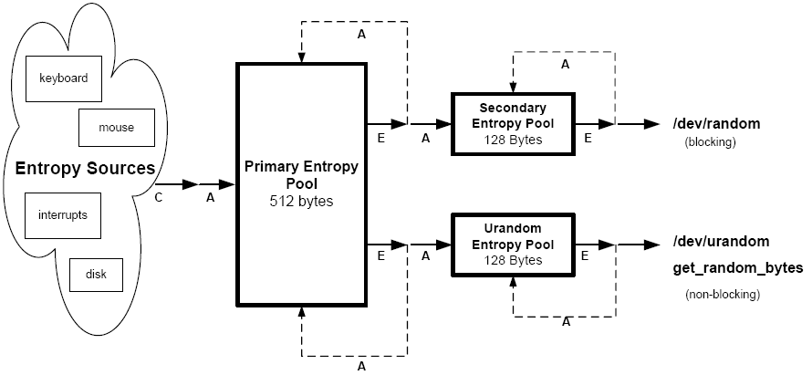
Linux /dev/(u)random
Linux random number generator (2500 lines of undocumented code)
Diagram from [Gutterman, Pinkas, Reinman 2006]
Applications like TLS take randomness from /dev/random
They then maintain an internal pool of random bits

Slide 14

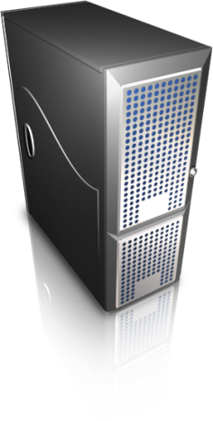
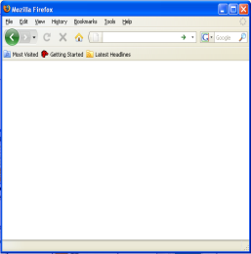

Virtual machines and secure browsing
“Protect Against Adware and Spyware: Users protect their PCs against adware, spyware and other malware while browsing the Internet with Firefox in a virtual machine.”
[http://www.vmware.com/company/news/releases/player.html]
http://www.freesoftware.com/
browser exploit
Clean
snapshot
of VM with
browser
running
Virtual machine compromised, but not host OS
Resetting to snapshot removes malware

Slide 15

Virtual machine resets lead to RNG failures
[R., Yilek – NDSS ‘10]
https://www.mybank.com/
TLS session
key transport
https://www.randomsite.com/
To-be-used randomness captured in snapshot!
TLS session
key transport
Older versions of Firefox, Chrome
allow session compromise attacks
Apache mod_ssl TLS server:
server’s secret DSA key can be stolen!

Slide 16

https://www.mybank.com/
TLS session
key transport
A logical timeline of events
User snapshots VM
User requests
https page
User launches
browser in VM
TLS key
transport
client
Snapshot later run.
Randomness used by TLS
key transport
Randomness gathered by browser random number generator (RNG)
RSA PKCS#1
(N,e)
A second run from snapshot
leads to same secret key being
sent to (different) server
C
C sent to server

Slide 17
Problem with Windows and Linux
We showed that Linux /dev/(u)random and Windows system RNG are also vulnerable to resets
Changes have been made to Windows to fix
http://pages.cs.wisc.edu/~ace/papers/not-so-random.pdf

Slide 18
Using RNGs
Rule of thumb: more entropy is better
In consuming applications:
Call cryptographically strong RNG such as /dev/urandom or Intel RDRAND
Mix in local entropy if you have any
Hash it all together with cryptographic hash function to derive randomness to use
Minimize time between collection and use
If efficiency is problem, use your own PRG seeded with above

