Slide 1
Today in Cryptography (5830)
Elliptic curve cryptography
Based in part on slides from Martin R. Albrecht and Kenny Paterson
Notes:
We develop pioneering leaders for the digital age.

Slide 2
Asymmetric crypto so far
RSA
Work in Z_{N} for large composite N = pq
RSA assumption: given Xe mod N can’t recover X without secret key d
Discrete log problem (DLP)
Worked in prime-order subgroup of Z_{p} for prime p. g is a generator of subgroup. q is size of subgroup
Discrete log assumption: given g^{x} mod p can’t recover x
*
*

Slide 3
Comparison
Security level | RSA (log N) | DLP in finite field (log p) | DLP subgroup size (log q)
80 | 1024 | 1024 | 160
112 | 2048 | 2048 | 224
128 | 3072 | 3072 | 256
256 | 15360 | 15360 | 512
Exponentiation time performance scales with O(n³) for bit length n numbers
Numerical estimates from best attack times using best known algorithms runtimes

Slide 4
Finite fields
Finite field is a finite set with basic operations:
Addition, subtraction, multiplication, division
Integers modulo prime p is a field.
Notated F_{p} or GF(p) .
The set is {0,1,…,p-1}
Addition is a + b mod p
Multiplication is ab mod p .
We’ve been using this implicitly, just making it explicit. We use them for elliptic curves

Slide 5
Elliptic curves
Are discrete log based systems. They use a new kind of group defined relative to a finite field. We will only need curves over F_{p}
Independently suggested for cryptographic applications by Victor Miller and Neal Koblitz in 1985
They are now the go-to state-of-art in practice

Slide 6
Comparison
Security level | RSA size (log N) | DLP in finite field (log p) | DLP subgroup size (log q) | ECC group size (log q)
80 | 1024 | 1024 | 160 | 160
112 | 2048 | 2048 | 224 | 224
128 | 3072 | 3072 | 256 | 256
256 | 15360 | 15360 | 512 | 512
ECC has smallest representations and fastest performance of all asymptotic primitives we will see

Slide 7
Elliptic curves
An elliptic curve is set of x,y points in F_{p} defined by an equation
E = {(x, y) | y ² = x³ + ax + b mod p}
a,b are fixed values also from F_{p}
Plus one special point O called the “point at infinity”
Technical condition: 4a³ + 27b² ≠ 0
Otherwise curve is not non-singular

Slide 8
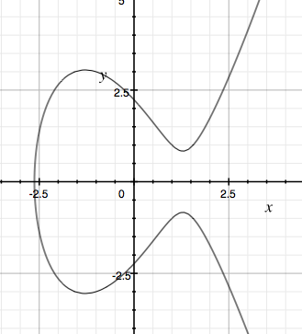
y² = x³ - 5x + 5

Slide 9
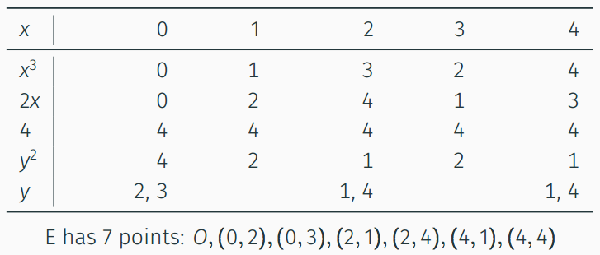
Elliptic curves
Example: y ² = x³ + 2x + 4 mod 5 (i.e., over F₅)

Slide 10
Elliptic curves as groups
Recall that a group is a set G along with an operation * such that (s.t.) for all a,b,c in G:
Closure: a*b in G
Associativity: (a*b)*c = a*(b*c)
Identity: exists 1 in G s.t. 1*a = a*1 = a
Inverses: for all a in G, there exists a⁻¹ in G s.t. a*a⁻¹ = 1
Abelian groups: a*b = b*c

Slide 11
Elliptic curve group operation
The operation * is called “point addition” and we usually denote this P + Q for P,Q in E
What does it mean to “add” two points
P = (x1,y1) and Q = (x2,y2)?

Slide 12
Elliptic curve group operation
Let O be the identity for the group
P+O = O + P = P for any point
Let P⁻¹ be (x,-y) for P = (x,y)
By definition P + P⁻¹ = O
O ⁻¹ = O
P + Q has geometric interpretation

Slide 13
P
Q
R
-R
y² = x³ - 5x + 5

Slide 14
Elliptic curve group operation
Let O be the identity for the group
P+O = O + P = P for any point
Let P⁻¹ be (x,-y) for P = (x,y)
By definition P + P⁻¹ = O
O ⁻¹ = O
P + Q has geometric interpretation
P + Q + R = O

Slide 15
-R’
P’
R’
y² = x³ - 5x + 5

Slide 16
Elliptic curve group operation
Let O be the identity for the group
P+O = O + P = P for any point
Let P⁻¹ be (x,-y) for P = (x,y)
By definition P + P⁻¹ = O
O ⁻¹ = O
P + Q has geometric interpretation
P + Q + R = O
P’ + P’ = -R’
Over finite fields same, but calculate algebraically

Slide 17
Elliptic curve group operation (over F_{p})
Adding P = (x1,y1) , Q = (x2,y2):
Slope is D = (y2-y1) / (x2-x1) mod p
Line through P,Q is
y = D(x-x1) + y1 mod p
Substitute in to curve equation:
(D(x-x1) + y1)² = x³ + ax + b mod p
Only three values of x satisfy equation: x1,x2 and
x3 = D² - x1 - x2 mod p
So: y3 = D(x3-x1) + y1 mod p
Above only works for x1 ≠ x2. Similar calculation though for P + P case

Slide 18
Elliptic curve group operation (over F_{p})
P + Q for P = (x1,y1) Q = (x2,y2)
If P = O then return Q
If Q = O then return P
If x1 = x2 and y1 = -y2 then return O
If x1 = x2 then D = (3x1² + a)/(2y1) mod p
Else D = (y2-y1) / (x2-x1) mod p
x3 = D² - x1 - x2 mod p
y3 = D(x2-x1) + y1 mod p
Return (x3,-y3)

Slide 19
Elliptic curve group operation (over F_{p})
Amazingly, point addition is a group operation
Closure: P + Q on curve for all P, Q
Associativity: P + (Q + Z) = (P + Q) + Z
Abelian: P + Q = Q + P
Scalar multiplication nP is just adding P to itself n times
This is analogous to “exponentiation” in Z_{p}
Can compute with double and add algorithm (same as square and multiply)
Can pick generator P that defines cyclic subgroup of E
{ 0P, 1P, 2P, 3P,…, qP } = all points of interest on curve
(choose so q is big prime)
*

Slide 20
Building elliptic curve groups
How do we find suitable curves?
Pick large prime p
Pick values for a and b to define
y ² = x³ + ax + b mod p
Determine size of group, see if it is prime
There are efficient algorithms for all this
Short, better answer: Use predefined ones
NIST curves
Curve25519

Slide 21


Elliptic curve DH
X
Pick random x from Z_{q}
X = xP
Y
Pick random y from Z_{|G|}
Y = g^{y}
K = H(xY)
K = H(yX)
X
Pick random x from Z_{|G|}
X = g^{x}
Y
Pick random y from Z_{|G|}
Y = g^{y}
K = H(Y^{x})
K = H(X^{y})

Slide 22
Elliptic curve DLP
Given xP compute x
Same as g^{x} compute x, just different group!
Best known algorithm against well-chosen ECC group version runs in time q^{0.5}

Slide 23
Summary
Elliptic curves are specially constructed groups where DLP is conjectured to be hard
These are faster than RSA or DLP over Z_{p}
Being used increasingly in practice
EC-DSA (bitcoin)
TLS EC-DHE (elliptic curve ephemeral DH)
*

