Slide 1
Today in Cryptography (5830)
TLS Overview
Public-key encryption
Key transport
Notes:
We develop pioneering leaders for the digital age.

Slide 2
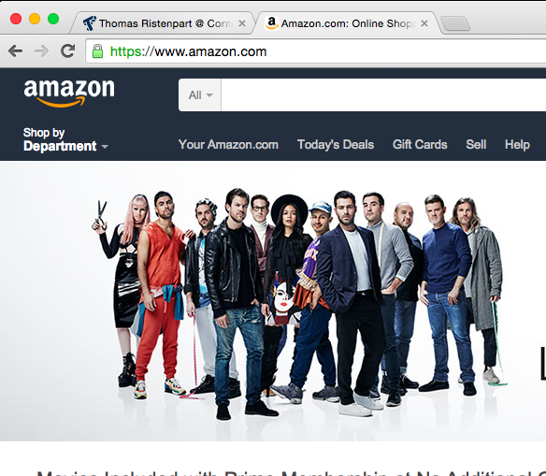

Slide 3

Internet protocol stack
Application | HTTP, FTP, SMTP, SSH, etc.
Transport | TCP, UDP
Network | IP, ICMP, IGMP
Link | 802x (802.11, Ethernet)
Application
Transport
Network
Link
Application
Transport
Network
Link
Network
Link

Slide 4
TLS sits between application and TCP
user data
Application
TLS
TCP
IP
Ethernet
Appl hdr
user data
TLS hdr
Appl hdr
user data
TLS message
TCP hdr
TLS hdr
Appl hdr
user data
TCP segment
IP hdr
TCP hdr
TLS hdr
Appl hdr
user data
IP datagram

Slide 5
Places TLS is used
HTTPS
HTTP messages but over TLS, not TCP
Email connections
When getting information from your email server (not the email contents themselves)
Virtual private networks (VPNs)
Tunnel other internet connections over a TLS connection

Slide 6


How does TLS work (high level)?
https://amazon.com
Step 1:
Key exchange
protocol to
share secret K
K
K
Step 2:
Send data via
secure
channel
The secure channel is implemented via our now familiar symmetric encryption primitives
Goals of handshake:
Negotiate version
Negotiate parameters (crypto to use)
Authenticate server (Is server actually Amazon.com?)
Digital signatures and certificates
Establish shared secret
Asymmetric encryption primitives

Slide 7

A short history of TLS
How many
cryptographers
involved?
SSL ver 2
SSL ver 2.0 designed by Hickman at Netscape
1994
Wagner, Goldberg break SSL ver 2
1995
SSL ver 3
Freier, Karlton, Kocher design SSL ver 3.0
Bleichenbacher breaks RSA PKCS #1 encryption,
used in SSL ver 3
1998
1999
TLS ver 1 released as IETF standard,
based on SSL 3, many cryptographers involved
TLS ver 1.0
2001
Vaudenay, Klima et al. padding attacks
2002
Rogaway IV re-use insecurity
2003
Brumley, Boneh remote timing attacks
2006
TLS ver 1.1 released as standard
TLS ver 1.1
…
(more attacks and fixes)

Slide 8
TLS handshake for RSA transport
Client
Server
ClientHello, MaxVer, Nc, Ciphers/CompMethods
Pick random Nc
ServerHello, Ver, Ns, SessionID, Cipher/CompMethod
Pick random Ns
Check CERT
using CA public
verification key
CERT = (pk of bank, signature over it)
C
Pick random PMS
C <- E(pk,PMS)
PMS <- D(sk,C)
ChangeCipherSpec,
{ Finished, PRF(MS, “Client finished” || H(transcript)) }
ChangeCipherSpec,
{ Finished, PRF(MS, “Server finished” || H(transcript’)) }
Bracket notation
means contents
encrypted
MS <- PRF(PMS, “master secret” || Nc || Ns )

Slide 9
Trapdoor functions
easy given pk
X
f_{pk}(X)
hard given pk
easy given sk

Slide 10
TLS handshake for Diffie-Hellman Key Exchange
Client
Server
ClientHello, MaxVer, Nc, Ciphers/CompMethods
Pick random Nc
Check CERT
using CA public
verification key
Check σ
ServerHello, Ver, Ns, SessionID, Cipher/CompMethod
Pick random Ns
CERT = (pk_{s} , signature over it)
Pick random x
X = g^{x}
p , g , X , σ = Sign(sk_{s}, p || g || X)
Pick random y
Y = g^{y}
Y
PMS = g^{xy}
ChangeCipherSpec,
{ Finished, PRF(MS, “Client finished” || H(transcript)) }
PMS = g^{xy}
ChangeCipherSpec,
{ Finished, PRF(MS, “Server finished” || H(transcript’)) }
Bracket notation
means contents
encrypted
MS <- PRF(PMS, “master secret” || Nc || Ns )

Slide 11
One-way functions
easy given x
x
X = g^{x}
hard given X

Slide 12
TLS Key derivation & use
MS <- PRF(PMS, “master secret” || Nc || Ns )
K1,K2 <- PRF(MS, “key expansion” || Ns || Nc )
PRF(secret, message) = HMAC-HASH(secret, A(1) + seed) +
HMAC-HASH(secret, A(2) + seed) +
HMAC-HASH(secret, A(3) + seed) + ...
Where A(0) = seed and A(i) = HMAC_hash(secret, A(i-1))
This mess
replaced
with HKDF
in 1.3
C1 <- AEnc(K1,Message)
C1
Message <- ADec(K1,C1)
C2
C2 <- AEnc(K2,Message’)
Message’ <- ADec(K2,C2)

Slide 13
TLS 1.2 record protocol: MAC-Encode-Encrypt (MEE)
Padding is not MAC’d.
Implementations must
handle padding checks
very carefully.
SQN +
comp method
Payload
MAC
Payload
MAC tag
Padding
Enc
Header
Ciphertext
MAC
HMAC-MD5, HMAC-SHA1, HMAC-SHA256
Encrypt
CBC-AES128, CBC-AES256, CBC-3DES, RC4-128

Slide 14
Record layer details
Fragmentation
Maximum TLS ciphertext handles 2¹⁴ bytes of message data
Split longer requested submission into multiple chunks
Sequence numbers keep track of count of chunks sent in each direction
Compression methods
Generally a bad idea to use (why?)

