Slide 1
Today in Cryptography (5830)
Public-key encryption
The RSA permutation
PKCS#1 RSA encryption
References:
RSA discussed in many textbooks. See Katz & Lindell Sec. 8.1, 8.2
PKCS#1 encryption defined in PKCS#1 v1.5 standard.
Notes:
We develop pioneering leaders for the digital age.

Slide 2

TLS handshake for RSA transport
Client
Server
ClientHello, MaxVer, Nc, Ciphers/CompMethods
Pick random Nc
ServerHello, Ver, Ns, SessionID, Cipher/CompMethod
Pick random Ns
Check CERT
using CA public
verification key
CERT = (pk of bank, signature over it)
C
Pick random PMS
C <- E(pk,PMS)
PMS <- D(sk,C)
ChangeCipherSpec,
{ Finished, PRF(MS, “Client finished” || H(transcript)) }
ChangeCipherSpec,
{ Finished, PRF(MS, “Server finished” || H(transcript’)) }
Bracket notation
means contents
encrypted
MS <- PRF(PMS, “master secret” || Nc || Ns )

Slide 3
Trapdoor functions
easy given pk
X
f_{pk}(X)
hard given pk
easy given sk

Slide 4
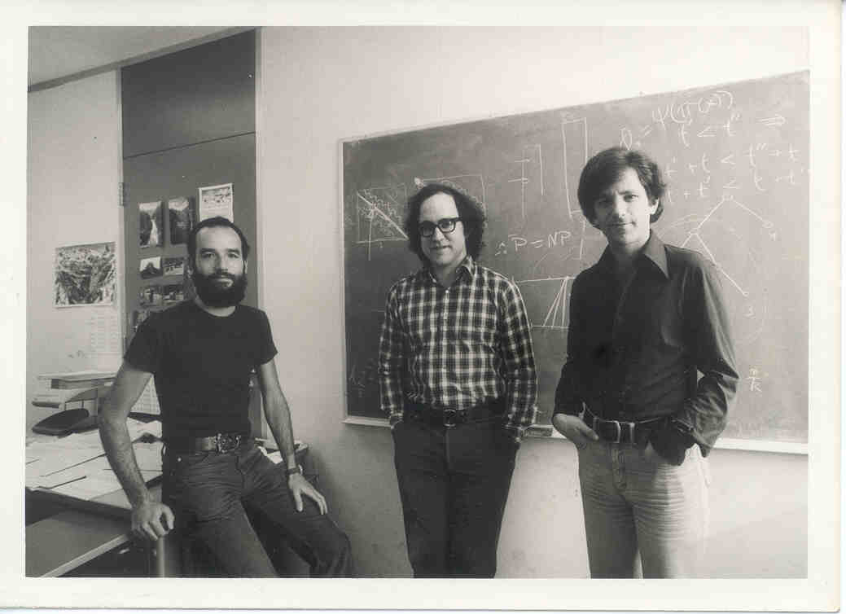
The RSA trapdoor function
Rivest, Shamir, Adleman 1978
Garnered them a Turing award

Slide 5
RSA math
p and q be large prime numbers
N = pq
N is called the modulus
p = 7, q = 13, gives
N = 91
p = 17, q = 53, gives
N = 901

Slide 6
RSA math
p and q be large prime numbers
N = pq
N is called the modulus
Z_{N} = {0,1,2,3,…, N-1}
Z_{N} = { i | gcd(i,N) = 1 and i < N}
*
gcd(X,Y) = 1 if greatest common divisor of X,Y is 1

Slide 7
RSA math
Z_{N} = { i | gcd(i,N) = 1 }
*
N = 13
Z₁₃ = { 1,2,3,4,5,6,7,8,9,10,11,12 }
*
N = 15
Z₁₅ = { 1,2,4,7,8,11,13,14 }
*
The size of a set S is denoted by |S|
Def. φ(N) = |Z_{N}| (This is Euler’s totient function)
*
φ(13) =
12
Z_{φ(15)} = Z₈ = { 1,3,5,7 }
*
*
φ(15) =
8

Slide 8
RSA math
Z_{N} = { i | gcd(i,N) = 1 }
*
Z_{N} is a group under modular multiplication
*
Fact. For any a,N with N > 0, there exists unique q,r
such that
a = Nq + r and 0 ≤ r < N
17 mod 15 = 2
Def. a mod N = r Z_{N}
105 mod 15 = 0
Def. a b (mod N) iff (a mod N) = (b mod N)

Slide 9
RSA math
Z_{N} = { i | gcd(i,N) = 1 }
*
Z_{N} is a group under modular multiplication
*
Z₁₅ = { 1,2,4,7,8,11,13,14 }
*
2•7 14 (mod 15)
4•8 2 (mod 15)
Closure: for any a,b Z_{N} a•b mod N Z_{N}
*
*
Def. a^{i} mod N = a•a•a•…•a mod N
i times

Slide 10
Some needed algorithms
Algorithm | Running time (n = log N)
Modular multiplication ab mod N | O(n²)
Modular exponentation a^{i} mod N | O(n³)
Modular inverse a⁻¹ mod N | O(n²)

Slide 11
Textbook exponentiation
Let G be a group.
How do we compute h^{x} for any h G?
Exp(h,x)
X’ = h
For i = 2 to x do
X’ = X’*h
Return X’
SqrAndMulExp(h,x)
b_{k},…,b₀ = x
f = 1
For i = k down to 0 do
f = f²
If b_{i} = 1 then
f = f*h
Return f
Requires time O(|G|) in
worst case.
Requires time O(k) multiplies and
squares in worst case.

Slide 12
SqrAndMulExp(h,x)
b_{k},…,b₀ = x
f = 1
For i = k down to 0 do
f = f²
If b_{i} = 1 then
f = f*h
Return f
h¹¹ = h⁸⁺²⁺¹ = h⁸ • h² • h
b₃ = 1
f₃ = 1 • h
Don’t implement this algorithm:
side-channel attacks
b₂ = 0
f₂ = h²
b₁ = 1
f₁ = (h²)² • h
b₁ = 1
f₀ = (h⁴ • h)² • h
= h⁸ • h² • h

Slide 13
RSA math
Z_{N} = { i | gcd(i,N) = 1 }
*
Claim: Suppose e,d Z_{φ(N)} satisfying ed mod φ(N) = 1
then for any x Z_{N} we have that
(x^{e})^{d} mod N = x
*
*
(x^{e})^{d} mod N = x^{(ed mod φ(N))} mod N
= x¹ mod N
= x mod N
First equality is
by Euler’s Theorem

Slide 14
RSA math
Z_{N} = { i | gcd(i,N) = 1 }
*
Claim: Suppose e,d Z_{φ(N)} satisfying ed mod φ(N) = 1
then for any x Z_{N} we have that
(x^{e})^{d} mod N = x
*
*
Z₁₅ = { 1,2,4,7,8,11,13,14 }
Z_{φ(15)} = { 1,3,5,7 }
*
*
e = 3 , d = 3 gives ed mod 8 = 1
x | 1 | 2 | 4 | 7 | 8 | 11 | 13 | 14
x³ mod 15 | 1 | 8 | 4 | 13 | 2 | 11 | 7 | 14
y³ mod 15 | 1 | 2 | 4 | 7 | 8 | 11 | 13 | 14

Slide 15
The RSA trapdoor permutation
pk = (N,e)
sk = (N,d)
with ed mod φ(N) = 1
f_{N,e}(x) = x^{e} mod N
g_{N,d}(y) = y^{d} mod N
easy given N,e
X
f_{pk}(X)
hard given N,e
easy given N,d

Slide 16
The RSA trapdoor permutation
pk = (N,e)
sk = (N,d)
with ed mod φ(N) = 1
f_{N,e}(x) = x^{e} mod N
g_{N,d}(y) = y^{d} mod N
But how do we find suitable N,e,d ?
If p,q distinct primes and N = pq then φ(N) = (p-1)(q-1)
Why?
φ(N) = |{1,…,N-1}| - |{ip : 1 ≤ i ≤ q-1}| - |{iq : 1 ≤ i ≤ p-1}|
= N-1 - (q-1) - (p-1)
= pq – p – q + 1
= (p-1)(q-1)

Slide 17
The RSA trapdoor permutation
pk = (N,e)
sk = (N,d)
with ed mod φ(N) = 1
f_{N,e}(x) = x^{e} mod N
g_{N,d}(y) = y^{d} mod N
But how do we find suitable N,e,d ?
If p,q distinct primes and N = pq then φ(N) = (p-1)(q-1)
Given φ(N), choose e Z_{φ(N)} and calculate
d = e⁻¹ mod φ(N)
*
How to find suitable p,q prime?
Choose random numbers and test primality

Slide 18
Summary
Find 2 large primes p, q . Let N = pq
random integers + primality testing
Choose e (usually 65,537)
Compute d using φ(N) = (p-1)(q-1)
pk = (N,e) and sk = (N,d)
Often store p,q with sk to use Chinese Remainder Theorem

Slide 19
Public-key encryption
key generation
Kg
R_{k}
pk
sk
R
Enc
Dec
M or
error
C
C
M
C is a ciphertext
Correctness: D( sk , E(pk,M,R) ) = M with probability 1 over randomness used

Slide 20
PKCS #1 RSA encryption
Kg outputs (N,e),(N,d) where |N|₈ = n
Let B = {0,1}⁸ / {00} be set of all bytes except 00
Want to encrypt messages of length |M|₈ = m
(N,e)
Enc((N,e), M, R)
pad = first n - m - 3 bytes from R that
are in B
X = 00 || 02 || pad || 00 || M
Return Xe mod N
R
Enc
C
M
(N,d)
Dec((N,d), C )
X = C^{d} mod N ; aa||bb||w = X
If (aa ≠ 00) or (bb ≠ 02) or (00 w)
Return error
pad || 00 || M = w
Return M
Dec
M or
error
C

Slide 21
Hybrid encryption
Kg outputs (pk,sk)
pk
Enc(pk, M, R)
K||R1||R2 = R
C1 = Enc(pk,K,R1)
C2 = Enc(K,M,R2)
Return (C1,C2)
R
Enc
C
M
sk
Dec(sk, (C1,C2) )
K = Dec(sk,C1)
M = Dec(K,C2)
Return M
Dec
M or
error
C

Slide 22
TLS handshake for RSA transport
Bank customer
Bank
ClientHello, MaxVer, Nc, Ciphers/CompMethods
Pick random Nc
ServerHello, Ver, Ns, SessionID, Cipher/CompMethod
Pick random Ns
Check CERT
using CA public
verification key
CERT = (pk of bank, signature over it)
C
Pick random PMS
C <- E(pk,PMS)
PMS <- D(sk,C)
ChangeCipherSpec,
{ Finished, PRF(MS, “Client finished” || H(transcript)) }
ChangeCipherSpec,
{ Finished, PRF(MS, “Server finished” || H(transcript’)) }
Bracket notation
means contents
encrypted
MS <- PRF(PS, “master secret” || Nc || Ns )

Slide 23
Security of RSA PKCS#1
Passive adversary sees (N,e),C
Attacker would like to invert C
Possible attacks?

Slide 24
Learning p,q from N is
the factoring problem
We don’t know if inverse is true, whether inverting RSA implies ability to factor

Slide 25
Factoring composites
What is p,q for N = 901?
Factor(N):
for i = 2 , … , sqrt(N) do
if N mod i = 0 then
p = i
q = N / p
Return (p,q)
Woops… we can always factor
But not always efficiently:
Run time is sqrt(N)
O(sqrt(N)) = O(e^{0.5 ln(N)})

Slide 26
Factoring composites
Algorithm | Time to factor N
Naïve | O(e^{0.5 ln(N)})
Quadratic sieve (QS) | O(e^{c} ) c = d (ln N)^{1/2} (ln ln N)^{1/2}
Number Field Sieve (NFS) | O(e^{c} ) c = 1.92 (ln N)^{1/3} (ln ln N)^{2/3}

Slide 27
Factoring records
Challenge | Year | Algorithm | Time
RSA-400 | 1993 | QS | 830 MIPS years
RSA-478 | 1994 | QS | 5000 MIPS years
RSA-515 | 1999 | NFS | 8000 MIPS years
RSA-768 | 2009 | NFS | ~2.5 years
RSA-512 | 2015 | NFS | $75 on EC2 / 4 hours
RSA-x is an RSA challenge modulus of size x bits

Slide 28
Security of RSA PKCS#1
Passive adversary sees (N,e),C
Attacker would like to invert C
Possible attacks?
Pick |N| > 1024 and factoring will fail
Active attacks?

Slide 29

Bleichanbacher attack
C₁
I’ve just learned
some information
about C₁^{d} mod N
Dec((N,d), C )
X = C^{d} mod N ; aa||bb||w = X
If (aa ≠ 00) or (bb ≠ 02) or (00 w)
Return error
pad || 00 || M = w
Return M
padding error?
C₂
padding error?
…
We can take a target C and decrypt it using
a sequence of chosen ciphertexts C₁, … , C_{q}
where q ≈ 1 million
[Bardou et al. 2012] q = 9400 ciphertexts on average

Slide 30
Response to this attack
Ad-hoc fix: Don’t leak whether padding was wrong or not
This is harder than it looks (timing attacks, control-flow side channel attacks, etc.)
Better:
use chosen-ciphertext secure encryption
OAEP is common choice

Slide 31
Summary
RSA is example of trapdoor one-way function
Security conjectured. Relies on factoring being hard
RSA security scales somewhat poorly with size of primes
RSA PKCS#1 v1.5 is insecure due to padding oracle attacks. Don’t use it in new systems.
Use OAEP instead

Slide 32
TLS handshake for Diffie-Hellman Key Exchange
Client
Server
ClientHello, MaxVer, Nc, Ciphers/CompMethods
Pick random Nc
Check CERT
using CA public
verification key
Check σ
ServerHello, Ver, Ns, SessionID, Cipher/CompMethod
Pick random Ns
CERT = (pk_{s} , signature over it)
Pick random x
X = g^{x}
p , g , X , σ = Sign(sk_{s}, p || g || X)
Pick random y
Y = g^{y}
Y
PMS = g^{xy}
ChangeCipherSpec,
{ Finished, PRF(MS, “Client finished” || H(transcript)) }
PMS = g^{xy}
ChangeCipherSpec,
{ Finished, PRF(MS, “Server finished” || H(transcript’)) }
Bracket notation
means contents
encrypted
MS <- PRF(PMS, “master secret” || Nc || Ns )

Slide 33
Diffie-Hellman math
Let p be a large prime number
Fix the group G = Z_{p} = {1,2,3,…, p-1}
Then G is cyclic. This means one can give a
member g G , called the generator, such that
Example: p = 7. Is 2 or 3 a generator for Z₇ ?
*
G = { g⁰, g¹, g², … , g^{p-1} }
*
x | 0 | 1 | 2 | 3 | 4 | 5 | 6
2^{x} mod 7 | 1 | 2 | 4 | 1 | 2 | 4 | 1
3^{x} mod 7 | 1 | 3 | 2 | 6 | 4 | 5 | 1

Slide 34
Textbook exponentiation
Let G be cyclic group.
How do we compute h^{x} for any h G?
ModExp(h,x)
X’ = h
For i = 2 to x do
X’ = X’*h
Return X’
SqrAndMulExp(h,x)
b_{k},…,b₀ = x
f = 1
For i = k down to 0 do
f = f² mod N
If b_{i} = 1 then
f = f*h
Return f
Requires time O(|G|) in
worst case.
Requires time O(k) multiplies and
squares in worst case.

Slide 35
SqrAndMulExp(h,x)
b_{k},…,b₀ = x
f = 1
For i = k down to 0 do
f = f² mod N
If b_{i} = 1 then
f = f*h
Return f
h¹¹ = h⁸⁺²⁺¹ = h⁸ • h² • h
b₃ = 1
f₃ = 1 • h
b₂ = 0
f₂ = h²
b₁ = 1
f₁ = (h²)² • h
b₁ = 1
f₀ = (h⁴ • h)² • h
= h⁸ • h² • h

Slide 36
The discrete log problem
Fix a cyclic group G with generator g
Pick x at random from Z_{|G|}
Give adversary g, X = g^{x} . Adversary’s goal is to compute x
easy
x
g^{x}
hard

Slide 37
The discrete log problem
Fix a cyclic group G with generator g
Pick x at random from Z_{|G|}
Give adversary g, X = g^{x} . Adversary’s goal is to compute x
Very slow for large groups!
O(|G|)
Baby-step giant-step is better:
O(|G|^{0.5})
Nothing faster is known for some
groups.
A(X):
for i = 2 , … , |G|-1 do
if X = g^{i} then
Return i

Slide 38

Diffie-Hellman Key Exchange
X
Pick random x from Z_{|G|}
X = g^{x}
Y
Pick random y from Z_{|G|}
Y = g^{y}
K = H(Y^{x})
K = H(X^{y})
Get the same key. Why?
Y^{x} = g^{yx} = g^{xy} = X^{y}
What type of security does this protocol provide?

Slide 39
Computational Diffie-Hellman Problem
Fix a cyclic group G with generator g
Pick x,y both at random Z_{|G|}
Give adversary g, X = g^{x} , Y = g^{y}.
Adversary must compute g^{xy}
For most groups, best known algorithm finds
discrete log of X or Y.
But we have no proof that this is best approach.

Slide 40
TLS handshake for Diffie-Hellman Key Exchange
Client
Server
ClientHello, MaxVer, Nc, Ciphers/CompMethods
Pick random Nc
Check CERT
using CA public
verification key
Check σ
ServerHello, Ver, Ns, SessionID, Cipher/CompMethod
Pick random Ns
CERT = (pk_{s} , signature over it)
Pick random x
X = g^{x}
p , g , X , σ = Sign(sk_{s}, p || g || X)
Pick random y
Y = g^{y}
Y
PMS = g^{xy}
ChangeCipherSpec,
{ Finished, PRF(MS, “Client finished” || H(transcript)) }
PMS = g^{xy}
ChangeCipherSpec,
{ Finished, PRF(MS, “Server finished” || H(transcript’)) }
Bracket notation
means contents
encrypted
MS <- PRF(PMS, “master secret” || Nc || Ns )

