Slide 1
Today in Cryptography (5830)
Digital signatures
RSA signatures and full domain hash
Schnorr signatures, DSA
PKI
Notes:
We develop pioneering leaders for the digital age.

Slide 2

TLS handshake for RSA transport
Client
Server
ClientHello, MaxVer, Nc, Ciphers/CompMethods
Pick random Nc
ServerHello, Ver, Ns, SessionID, Cipher/CompMethod
Pick random Ns
Check CERT
using CA public
verification key
CERT = (pk of bank, signature over it)
C
Pick random PMS
C <- E(pk,PMS)
PMS <- D(sk,C)
ChangeCipherSpec,
{ Finished, PRF(MS, “Client finished” || H(transcript)) }
ChangeCipherSpec,
{ Finished, PRF(MS, “Server finished” || H(transcript’)) }
Bracket notation
means contents
encrypted
MS <- PRF(PMS, “master secret” || Nc || Ns )

Slide 3

Digital signatures
Msg, S
sk
pk
Sender
Receiver
Two algorithms:
Key generation outputs (pk,sk)
Sign (sk,Msg) outputs a signature S (may be randomized)
Verify(pk,Msg,S) outputs 0/1 (invalid / valid)
Correctness: Verify(pk,Msg,Sign(sk,Msg)) = 1 always
Security: No computationally efficient attacker can forge signatures for a new message even when attacker gets
(Msg₁ , S₁ ) , (Msg₂ , S₂ ), … , (Msg_{q} , S_{q})
for messages of his choosing and reasonably large q.

Slide 4
Digital signatures
key generation
Kg
R_{k}
sk
pk
R
Sign
M
Ver
S
0 / 1
M
S
Anyone with public key can verify a signature
Only holder of secret key should be able to generate a signature

Slide 5
Digital signatures
Msg, T
sk
pk
Sender
Receiver
“Raw” RSA as a signature scheme:
Key generation gives (N,e) , (N,d)
Sign((N,d),M) = M^{d} mod N
Verify((N,e),M,S) checks if S^{e} mod N = M
Secure?
No!

Slide 6
PKCS #1 RSA signing
Kg outputs (N,e),(N,d) where |N|₈ = n
Let B = {0,1}⁸ / {00} be set of all bytes except 00
Want to encrypt messages of length |M|₈ = m
(N,d)
Sign((N,d), M , R)
pad = first n - m - 2 bytes from R that
are in B
Y = 00 || 01 || pad || 00 || H(M)
Return Y^{d} mod N
M
Sign
S
R
pk
Verify((N,e), M, S )
Y = Ce mod N ; aa||bb||w = Y
If (aa ≠ 00) or (bb ≠ 01) or (00 w)
Return error
pad || 00 || h = w
Return H(M) = h
M
Ver
0 / 1
S

Slide 7
Digital signature security
Padding oracle attacks that work against RSA PKCS#1 v1.5 decryption work against similar implementations of signing

Slide 8
Full Domain Hash RSA
Kg outputs pk = (N,e) , sk = (N,d)
H is a hash function
(N,d)
Sign((N,d), M )
X = 00 || H(1||M) || … || H(k||M)
S = X^{d} mod N
Return S
Sign
M
S
pk
Ver((N,e), M, S )
X = S^{e} mod N
X’ = 00 || H(1||M) || … || H(k||M)
If X = X’ then
Return 1
Return 0
M
Ver
0 / 1
S

Slide 9
Schnorr signatures
Choose prime q and we’ll work in multiplicative group Z_{q}
sk = k chosen in Z_{q} pk = g^{k}
*
Sign(k, M )
R = g^{r} ; e = H(M || R) ; s = r - xe
Return (s,e)
Ver(pk = g^{k}, M, (s,e) )
R_{v} = g^{s} * pk^{e} ; e_{v} = H(M || R_{v})
If e_{v} = e then Return 1
Return 0

Slide 10
DSA (digital signature algorithm)
Choose prime q and p s.t. p-1 | q . Set g = h^{(p-1)/q} mod p
sk = k chosen in Z_{q} pk = g^{k}
Sign(k, M )
r <-$ Z_{q} until R = (g^{r} mod p ) mod q ≠ 0
s <- k⁻¹( H(M) + k R ) mod q (start over if s = 0)
Return (R,s)
Ver(pk = g^{k}, M, (R,s) )
If R,s not in Z_{q}
w <- s⁻¹ mod q ; u1 = H(m) * w mod q
u2 = R*w mod q ; v = (g^{u1} pk^{u2} mod p) mod q
If v = R then Return 1
Return 0

Slide 11
TLS handshake for RSA transport
Client
Server
ClientHello, MaxVer, Nc, Ciphers/CompMethods
Pick random Nc
ServerHello, Ver, Ns, SessionID, Cipher/CompMethod
Pick random Ns
Check CERT
using CA public
verification key
CERT = (pk of server, signature over it)
C
Pick random PMS
C <- E(pk,PMS)
PMS <- D(sk,C)
ChangeCipherSpec,
{ Finished, PRF(MS, “Client finished” || H(transcript)) }
ChangeCipherSpec,
{ Finished, PRF(MS, “Server finished” || H(transcript’)) }
Bracket notation
means contents
encrypted
MS <- PRF(PMS, “master secret” || Nc || Ns )

Slide 12


Certificate Authorities and Public-key Infrastructure
(pk,sk)
Give me a certificate
for pk’, please
pk
M = (pk’,data)
S = Sign(sk,M)
S
http://amazon.com
pk’, data, S
M = (pk’,data)
If Ver(pk,M,S) then
trust pk’
(pk’,sk’)
This prevents man-in-the-middle (MitM)
attacks

Slide 13
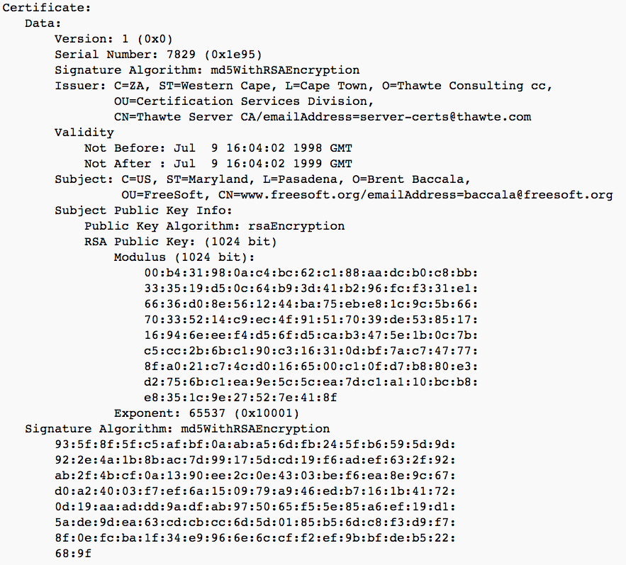

Slide 14
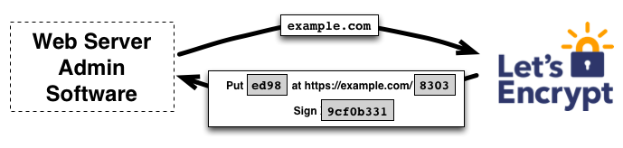
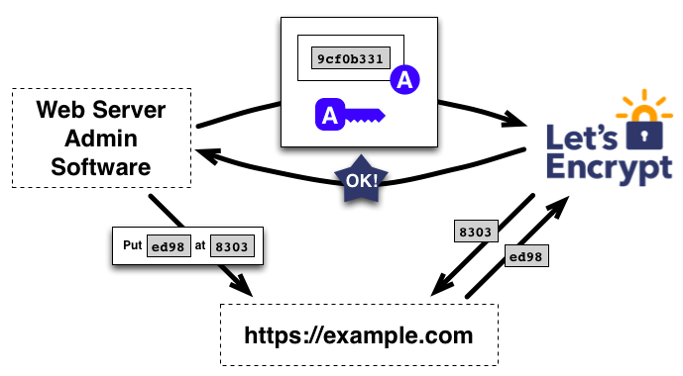
Free CAs

Slide 15
Revocation
Certificates must often be revoked
Short expirations
CRLs (Certificate revocation lists)
OCSP (online certificate status protocol)

Slide 16
The Web PKI Ecosystem
http://conferences.sigcomm.org/imc/2013/papers/imc257-durumericAemb.pdf
~1800 CAs that can sign any domain controlled by 683 organizations

Slide 17
