Slide 1
Today in Cryptography (5830)
Digital signatures
Schnorr signatures, DSA
PKI
Katz-Lindell Chapter 12
Various PKI sources available on web (some references within slides)
Notes:
We develop pioneering leaders for the digital age.

Slide 2
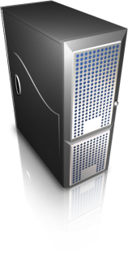
TLS handshake for Diffie-Hellman Key Exchange
Client
Server
ClientHello, MaxVer, Nc, Ciphers/CompMethods
Pick random Nc
Check CERT
using CA public
verification key
Check σ
ServerHello, Ver, Ns, SessionID, Cipher/CompMethod
Pick random Ns
CERT = (pk_{s} , signature over it)
Pick random x
X = g^{x}
p , g , X , σ = Sign(sk_{s}, p || g || X)
Pick random y
Y = g^{y}
Y
PMS = g^{xy}
ChangeCipherSpec,
{ Finished, PRF(MS, “Client finished” || H(transcript)) }
PMS = g^{xy}
ChangeCipherSpec,
{ Finished, PRF(MS, “Server finished” || H(transcript’)) }
Bracket notation
means contents
encrypted
MS <- PRF(PMS, “master secret” || Nc || Ns )

Slide 3

Digital signatures
Msg, S
sk
pk
Sender
Receiver
Two algorithms:
Key generation outputs (pk,sk)
Sign (sk,Msg) outputs a signature S (may be randomized)
Verify(pk,Msg,S) outputs 0/1 (invalid / valid)
Correctness: Verify(pk,Msg,Sign(sk,Msg)) = 1 always
Security: No computationally efficient attacker can forge signatures for a new message even when attacker gets
(Msg₁ , S₁ ) , (Msg₂ , S₂ ), … , (Msg_{q} , S_{q})
for messages of his choosing and reasonably large q.

Slide 4
Underlying groups
Let p be a large prime number
Let q be a prime such that q divides p-1
Example: p = 2q + 1 (so-called safe prime p)
Fix the group G = Z_{p} = {1,2,3,…, p-1}
Let g be generator of sub-group of order q:
How to pick g?
g = h^{(p-1)/q} mod p for some h and check g ≠ 1 mod p
If so, try repeat with another h. Usually use h = 2
*
{ g⁰, g¹, g², … , g^{q-1} } subset of G

Slide 5
Schnorr signatures
p,q,g specified
sk = x chosen randomly from Z_{q} pk = X = g^{x}
Sign(x, M )
r <-$ Z_{q}
R = g^{r} ; c = H(M || R) ; z = r + cx mod q
Return (R,z)
Ver(X, M, (R,z) )
c = H(M || R)
If g^{z} = RX^{c} then Return 1
Return 0
Correctness?
g^{z} = g^{r + cx} = g^{r}g^{xc} = RX^{c}

Slide 6
Security of Schnorr signatures
Assume an adversary that can output forgery (M,(R,z))
Then to be valid:
g^{z} = RX^{c} implies z = r + cx
for c = H(M || R) .
Assume c is random (H is random oracle)
Imagine we can run adversary twice but force forgery to be on same R, different c .
In second execution, getting (M’,(R,z’))
Then success second time around gives:
g^{z’} = RX^{c’} implies z’ = r + c’x
But now can compute z - z’ / (c - c’) = x the secret key

Slide 7
Fragility of Schnorr
Repeat randomness failure:
Sign two messages M ≠ M’ and reuse random
Sign(x,M) -> (R,z)
Sign(x,M’) -> (R,z’)
Then: x = (z - z’) / ( H(M||R) - H(M’||R) )
If r is predictable, can recover secret as well
Can improve security by “hedging”:
choose r = H( x || M || randomness )

Slide 8
DSA (digital signature algorithm)
p,q,g specified
sk = x chosen randomly from Z_{q} pk = X = g^{x}
Sign(x, M )
r <-$ Z_{q} ; R = (g^{r} mod p) mod q
z = r ⁻¹ ( H(M) + x R ) mod q
Return (R,z)
Ver(X, M, (R,z) )
w = z⁻¹ mod q
u1 = H(m) * w mod q
u2 = R*w mod q
If R = (g^{u1} X^{u2} mod p) mod q
then Return 1
Else Return 0
Correctness?
g^{u1} X^{u2} = g^{H(M) w} g^{x R w} = g^{(H(M)+xR) w}
= g^{(H(M)+xR) (H(M)+xR) r} = g^{r}
-1

Slide 9
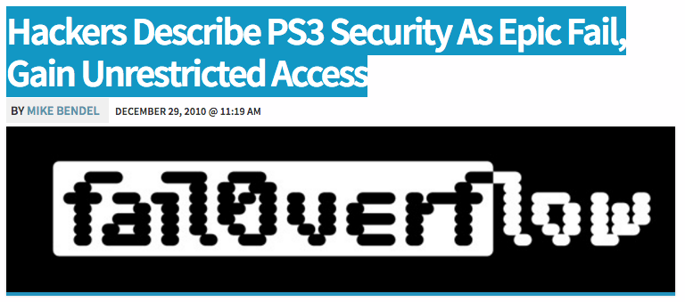

Slide 10
Digital signature schemes
 | Problems? | Proofs? | Uses
RSA PKCS#1 v1.5 | Bleichanbacher attacks |  | TLS, Certificates, XML
RSA PSS (PKCS#1 v2) |  | Security reduces to hardness of inverting RSA
Schnorr | Randomness fragility | Security reduces to discrete log problem
DSA | Randomness fragility | No security reduction | Bitcoin (ECC version), TLS, SSH, elsewhere

Slide 11


Certificate Authorities and Public-key Infrastructure
(pk,sk)
Give me a certificate
for pk’, please
pk
M = (pk’,data)
S = Sign(sk,M)
S
http://amazon.com
pk’, data, S
M = (pk’,data)
If Ver(pk,M,S) then
trust pk’
(pk’,sk’)
This prevents man-in-the-middle (MitM)
attacks

Slide 12
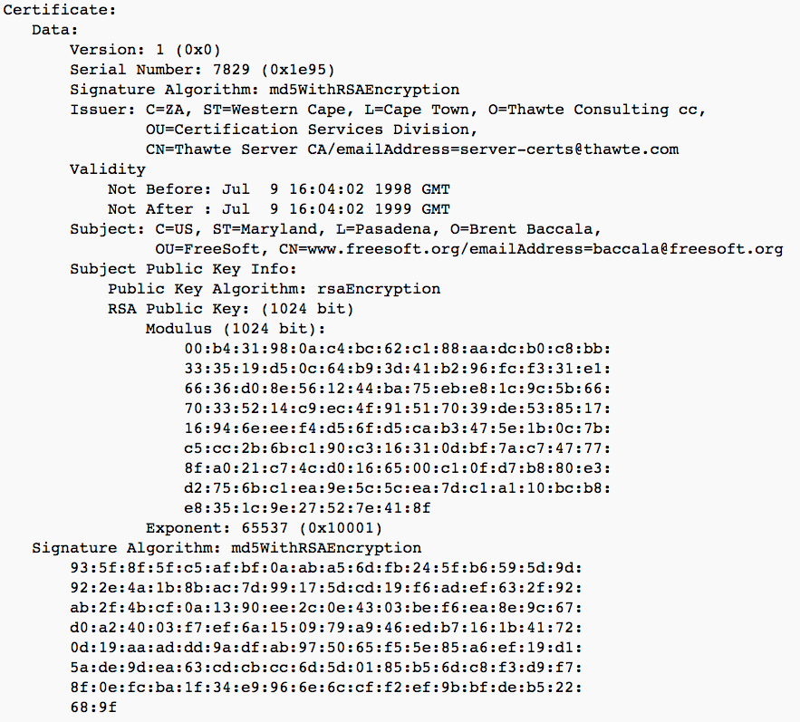

Slide 13
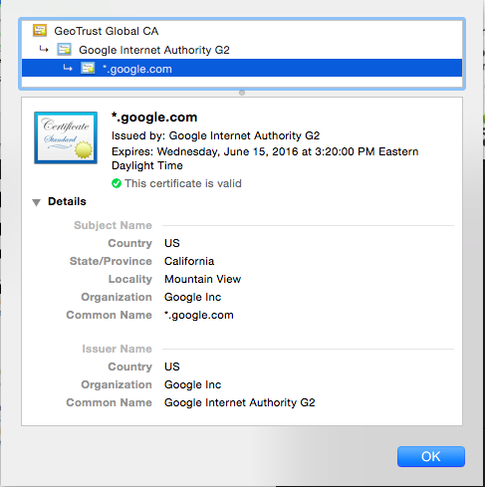
Certificate chains

Slide 14
Identity checks?
CA’s must check that requestor of cert is who they say they are
Domain validated
Prove ownership of domain
Extended validation
Establish legal identity of requestor
Physical presence of website owner
Confirm ownership of domain
Etc.

Slide 15
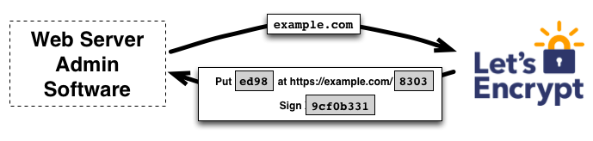
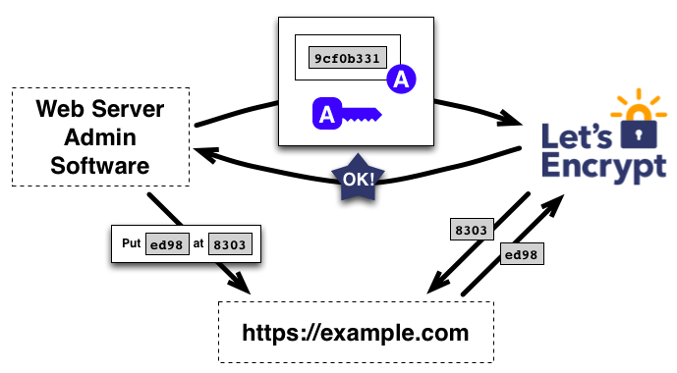
Free CAs

Slide 16
Revocation
Certificates must often be revoked
Short expirations
CRLs (Certificate revocation lists)
OCSP (online certificate status protocol)
Client queries CA to check on validity of cert
privacy concerns, performance / scalability issues
Stapling: server periodically gets fresh, time-stamped OCSP signature from CA. Sends to clients

Slide 17
The Web PKI Ecosystem
http://conferences.sigcomm.org/imc/2013/papers/imc257-durumericAemb.pdf
~1800 CAs that can sign any domain controlled by 683 organizations

Slide 18
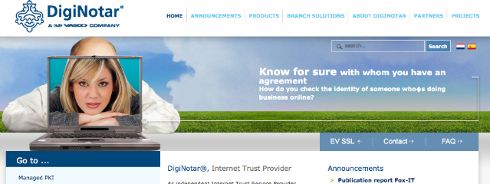

https://nakedsecurity.sophos.com/2011/03/24/fraudulent-certificates-issued-by-comodo-is-it-time-to-rethink-who-we-trust/
https://technet.microsoft.com/library/security/2524375

Slide 19
Certificate/public-key pinning
Client knows what cert/pk to expect, rejects otherwise
Pre-install some keys
HPKP (HTTP Public Key Pinning)
HTTP header that allows servers to set a hash of public key they will use
Public-Key-Pins:
pin-sha256="d6qzRu9zOECb90Uez27xWltNsj0e1Md7GkYYkVoZWmM=";
pin-sha256="LPJNul+wow4m6DsqxbninhsWHlwfp0JecwQzYpOLmCQ=";
max-age=259200
https://developers.google.com/web/updates/2015/09/HPKP-reporting-with-chrome-46?hl=en

Slide 20
Certificate transparency
Force CAs to log the certificates they sign in a public tamper-evident register
Experimental IETF standard
Google has been pushing this
Chrome requires it for “extra validation” certs
DigiCert has implemented

Slide 21
Summary
Web PKI relies on various trust assumptions
Can be undermined in many ways
Digital signature schemes power PKI and verifying identities:
unforgeability under chosen message attack
RSA based schemes PKCS#1 1.5 and 2.0
Schnorr, DSA based on discrete log problem

