Slide 1
PROJECT PRESENTATION
Adaptive Context-Aware
Multi-Objective Flight
Decision Algorithm
TEAM MATES:
DEEPIKA REDDY –CB.SC.U4AIE24215
G.VARSHINI -CB.SC.U4AIE24216
JOVIKA NB – CB.SC.U4AIE24223
P POOJITHA –CB.SC.U4AIE24237
POTNURU VARUN – CB.SC.UAAIE24244
Context detection • Adaptive priorities • Obstacle-aware navigation
22AIE448 | Introduction to Data Driven Control of Drones
Team project •
01

Slide 2
01 / OVERVIEW
A drone should choose how to fly — not only where to fly.
ACMFDS translates changing mission conditions into explainable flight decisions.
FROM INPUTS TO MOVEMENT
THE CORE IDEA
01
Mission inputs
Battery • wind • goal • duration
Re-evaluate the mission
as conditions change.
02
Decision layer
Context • effective weights • action
The simulation exposes the inputs, selected context, objective priorities and route-safety outcome so a reviewer can inspect why the drone behaves differently.
03
Route & safety
Check clearance • accept / stop
04
Simulation output
Drone position • status • telemetry
VISIBLE
ADAPTIVE
TESTABLE
Design principle: UI controls and displayed telemetry must reflect the same simulation state.
ACMFDS / PYTHON SIMULATION PROTOTYPE
02

Slide 3
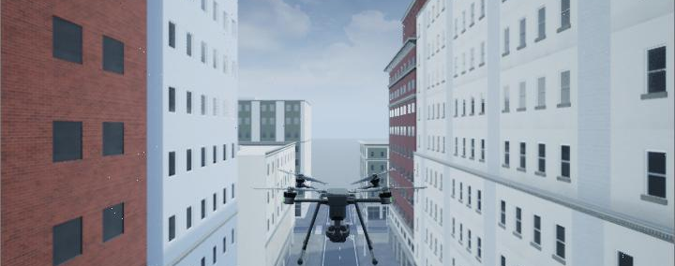
02 / PROBLEM
Why context-aware flight decisions matter
The problem is a changing environment with competing objectives and a need for observable, defensible behavior.
01
Changing environment
02
Conflicting objectives
03
Limited explainability
A moving obstacle can make a previously clear corridor unsafe.
A short route may be fast but unsafe; a detour may be safer but cost more time and energy.
A mode label alone does not prove that the drone followed a safe route.
PROJECT PROBLEM
How can a UAV simulation reassess its context and select a safe, efficient action when mission conditions change?
Illustrative city-flight environment supplied as a visual reference.
ACMFDS / PYTHON SIMULATION PROTOTYPE
03

Slide 4
03 / OBJECTIVES
What ACMFDS is designed to demonstrate
The project combines configurable mission inputs, rule-based context detection and route-safety checks in a visible simulation.
ENERGY
Conserve battery where mission conditions require it.
OPERATOR CONTROLS
• Battery level
• Wind speed
• Mission duration
• Destination coordinates (X / Z)
• Static and moving obstacle scenario
SAFETY
Avoid unacceptable obstacle clearance.
TIME
Account for mission duration and travel time.
TRACKING
Stay close to the selected route / reference.
VISIBLE OUTPUTS
• Current context and target speed
• Effective objective weights
• Direct-route status and clearance
• Mission timer, state and outcome
MISSION
Make progress toward the configurable goal.
Scope note: this is a software simulation, not a physical flight controller.
ACMFDS / PYTHON SIMULATION PROTOTYPE
04

Slide 5
05 / ARCHITECTURE
System architecture: separate the visuals from the decisions
The front end sends operator settings; the simulation backend owns the state and decides what movement is allowed.
OPERATOR UI
SIMULATION STATE
CONTEXT LAYER
DECISION LAYER
Battery • wind • goal
Duration • controls
Config • vehicle state
Obstacle state
Battery / wind /
clearance classification
Action selection • objective weights
PATH PLANNER
SIMULATED MOTION
TELEMETRY / VIEW
Direct-line check now;
search + detour is next.
Update position, timer
and simplified battery.
Render trajectory, context,
clearance and mission result.
Safety rule: route geometry and obstacle positions—not a decorative distance label—must determine whether a route is feasible.
ACMFDS / PYTHON SIMULATION PROTOTYPE
06

Slide 6
06 / DECISION LAYER
Context detection selects a transparent operating mode
The current prototype uses explicit threshold rules with low battery taking precedence over other contexts.
PRECEDENCE
1
LOW BATTERY
2
OBSTACLE NEARBY
3
HIGH WIND
4
NORMAL
Battery ≤ 20%
Clearance ≤ 5 m
Wind ≥ 10 m/s
Otherwise
PROTOTYPE OUTPUTS BY CONTEXT
CONTEXT
TARGET SPEED
CURRENT RESPONSE
Normal
4.0 m/s
Follow direct route if the safety check passes.
High wind
3.0 m/s
Use a reduced target speed in the prototype.
Obstacle nearby
2.5 m/s
If direct route is blocked, stop; detour planner not yet implemented.
Low battery
2.0 m/s
Energy-priority weights are displayed; no return-to-home logic yet.
Thresholds and speeds are software configuration values, not validated aircraft limits.
ACMFDS / PYTHON SIMULATION PROTOTYPE
07

Slide 7
07 / MULTI-OBJECTIVE MODEL
The decision model balances five objectives
Target formulation: evaluate each feasible candidate path using context-dependent weights and comparable cost terms.
C(P) = wE·E(P) + wS·S(P) + wT·T(P) + wR·R(P) + wM·M(P)
Lower cost is preferred among feasible routes.
E
ENERGY
S
SAFETY
T
TIME
R
TRACKING
M
MISSION
Estimated energy / battery cost
Obstacle exposure and clearance risk
Estimated travel time / deadline pressure
Deviation from a reference path
Progress and goal-fulfilment cost
CURRENT PROTOTYPE
NEXT MILESTONE
Rule table changes the displayed weights by context.
Use weights inside route-cost evaluation and candidate ranking.
Cost terms must be normalized / scaled consistently before their weighted sum is meaningful.
ACMFDS / PYTHON SIMULATION PROTOTYPE
08

Slide 8
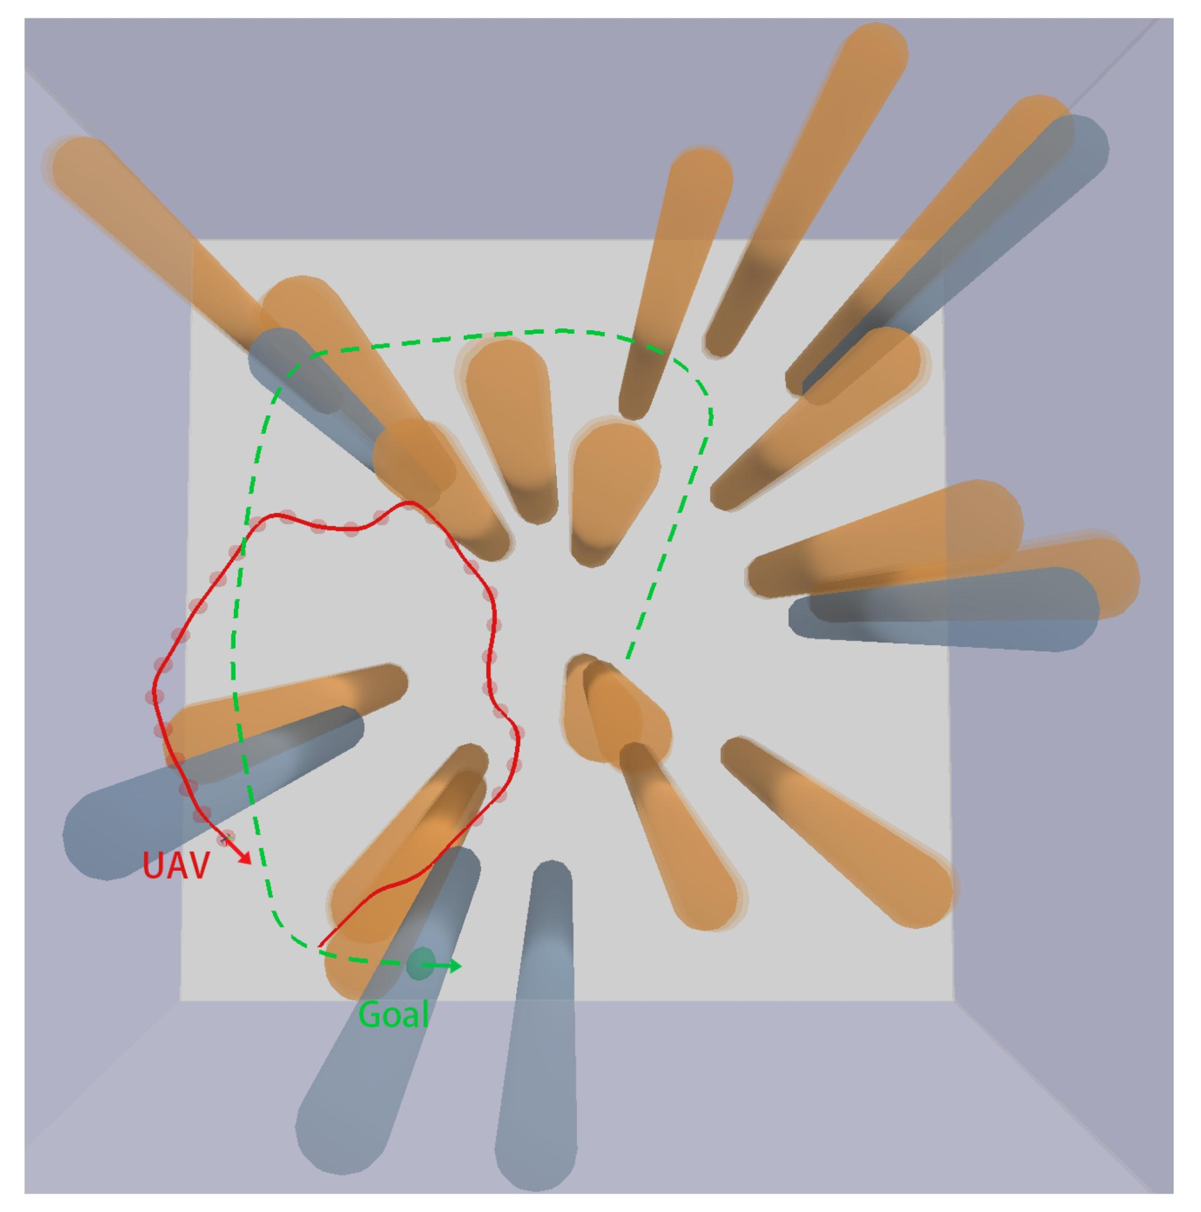
08 / NAVIGATION AND SAFETY
A route is accepted only when its geometry is safe
The supplied sketch communicates the target behavior: visible trajectory choices around obstacles.
ROUTE-SAFETY PIPELINE
01
Build direct segment
Connect current position to the adjustable goal.
02
Check obstacle footprints
Inflate obstacle footprint by drone radius + safety margin.
03
Accept or reject
Clear route → proceed; blocked route → safe stop.
04
Planned extension
Search feasible detours, score cost, choose best safe candidate.
Current behavior: direct-route gate + stop when blocked; no detour search yet.
USER-SUPPLIED PATH-PLANNING REFERENCE
ACMFDS / PYTHON SIMULATION PROTOTYPE
09

Slide 9
09 / SIMULATION LOOP
The control loop makes decisions observable
The prototype updates a moving obstacle, recomputes context and clearance, then either advances along a clear direct route or stops.
01
02
03
04
05
06
INPUT
ENVIRONMENT
PERCEPTION
DECISION
SAFETY GATE
UPDATE
Battery / wind
mission settings
Move obstacle(s)
update geometry
Nearest clearance
direct-line check
Context / weights
target speed
Clear? proceed
blocked? stop
Position / timer
battery / telemetry
Fixed-step simulation loop
SIMULATED PHYSICS
VISIBILITY
Battery drain and wind response are simplified demonstrator models, not calibrated vehicle dynamics.
Every run should log context, action, route status, clearance, elapsed time and final outcome.
ACMFDS / PYTHON SIMULATION PROTOTYPE
10

Slide 10
11 / STATUS AND NEXT STEPS
Prototype status: baseline built; planner still pending
The current deliverable is a software-only interactive prototype; the complete adaptive planner remains future work.
IN THE CURRENT PYTHON PROTOTYPE
• Ursina 3D scene with grid, simple buildings and drone geometry
• Four static obstacles plus one oscillating moving obstacle
• On-screen controls for battery, wind, mission duration and goal X/Z
• Context labels, target-speed rules and context-specific weight display
• Direct-route clearance check, simple movement and stop when blocked
MILESTONES
1
Separate modules
2
safety tests
3
Weighted cost
4
Results + report
TEAM | Deepika Reddy • Gade Varshini • Jovika N B • Poojitha P • Potnuru Varun
Simulation only — no physical aircraft, sensors or flight-controller integration is claimed.
ACMFDS / PYTHON SIMULATION PROTOTYPE
12

