Slide 1
PREDICTING COLLISION SEVERITY
VARUN PATEL

Slide 2
PREDCITING COLLISION IS VALUABLE FOR TRAFFIC DEPARTMENT
PAST DATA CAN BE ANALYZED BASED ON DIFFERENT PARAMETERS. SO THAT WE CAN GET INSIGIHTS ON CAUSES OF ACCIDENT.
FUTURE POSSIBILITIES OF ACCIDENTS CAN BE AVOIDED BY ANALYZING DIFFERENT PARAMETERS LIKE WEATHER CONDITION, LIGHT CONDITION AND ROAD CONDITION

Slide 3
DATA ACQUISITION AND CLEANING
Data is provided by courser
Dataset has accident records of Seattle.
Dataset contains 194673 rows and 38 columns
Models are trained on 116217 rows and 10 columns.
Test set contains 29055 rows.

Slide 4
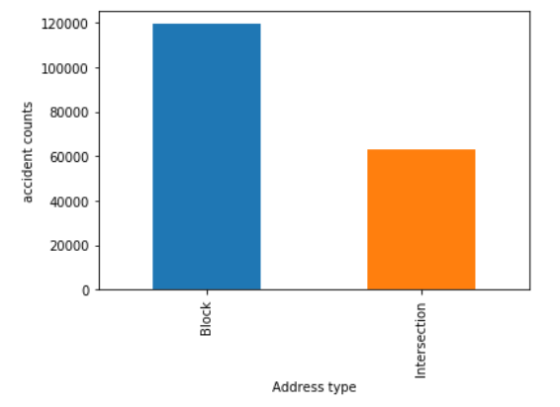
COLLISION PER ADDRESS TYPES
There are approx. 120000 collision where address type is block
Approx 60000 incident have intersection as their address type

Slide 5
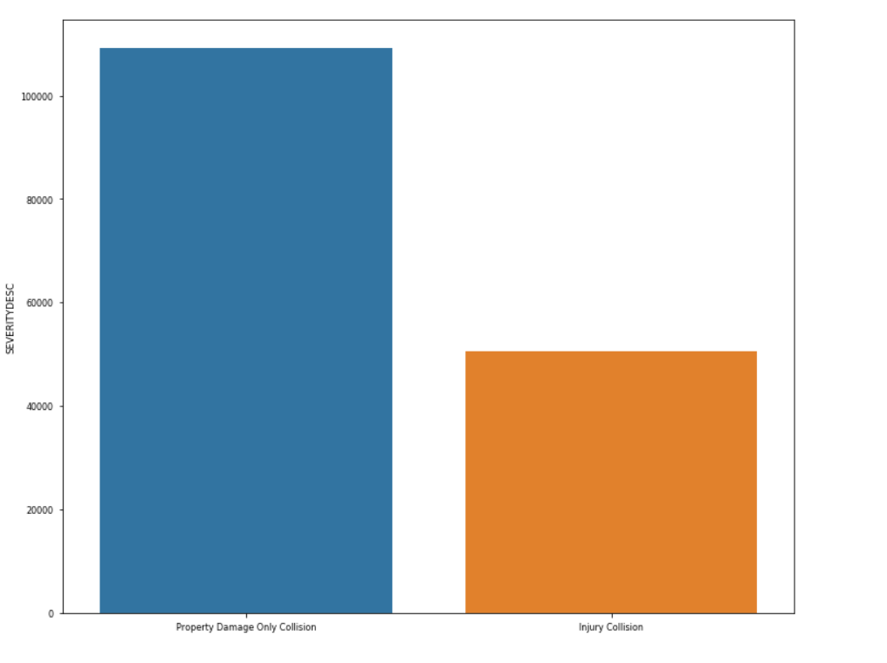
Damage Graph
Over 100000 cases have property damage only
Close about 45000 have caused injuries.

Slide 6
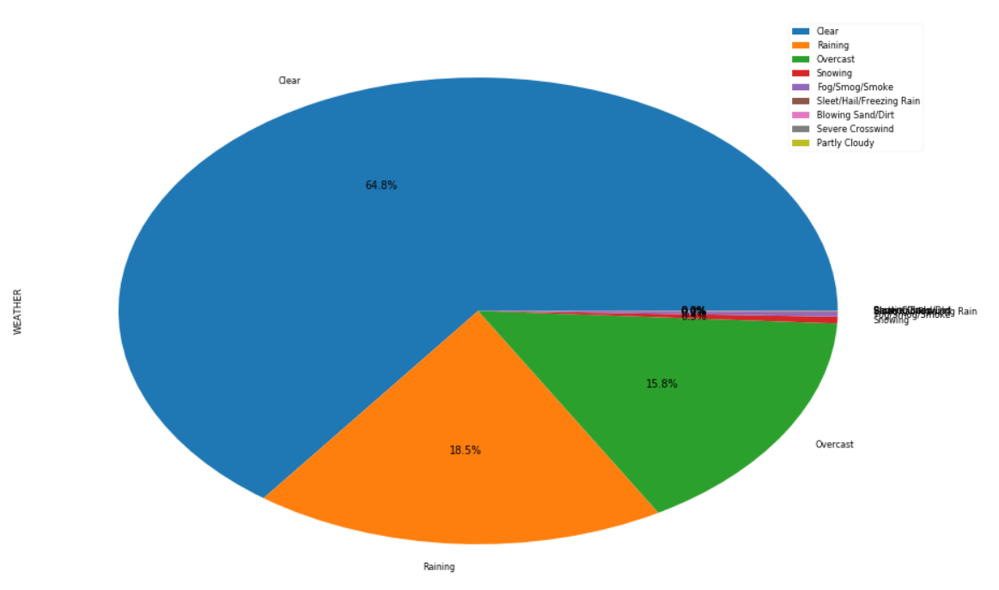
Collision probability based on Weather
Over 100000 cases have property damage only
Close about 45000 have caused injuries.

Slide 7
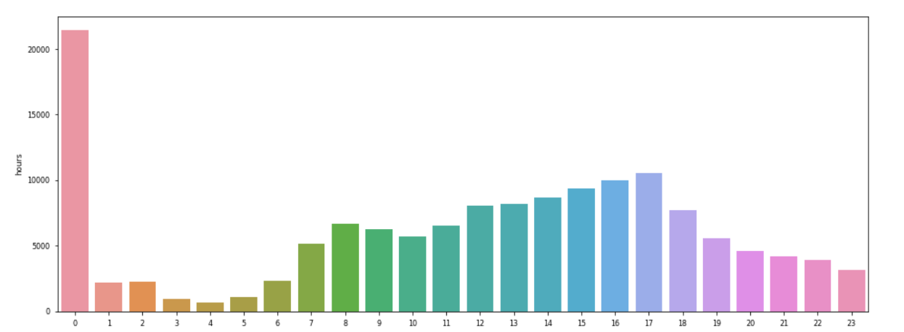
Time vs collision count graph
Approx 21000 cases have occurred at midnight
Other peaks in number of accident is at 3:00 to 5:00 pm

Slide 8
Accuracy score And F1-Score comparision
 | ACCURACY SCORE | F1-SCORE
LOGISTIC REGRESSION | 0.70 | 0.66
K-NEAREST NEIGHBOUR | 0.71 | 0.68
DECISION TREE | 0.72 | 0.68

Slide 9
THANK YOU

