Slide 1
Ariia
An Electronic health records system

Slide 2
IT-314 Software Engineering Team 7
Aman Agarwal
Rutva Sutaria
Madhuri Jain
Divyaraj Masani
Vinayak Pande
Hemil Shah
Rajvi Dhimar
Gaurav Maheshwari
Varun Pidyar
Karan Deep Singh
Instructor: Asim Banerjee
Mentor: Divyesh Tailor

Slide 3
Ariia
Ariia is a system which allows the employees of Hi-Tech hospital to record the medical records of their patients for future use.
It also allows for the video of the Surgery to be recorded and stored for further analysis and future viewing by the doctor.

Slide 4
Why this project?
The existing system is not digital and requires the storing of data in physical copies. As such there is no central repository of the records of their patients.
The present system has no way of recording and indexing the Surgery videos.
This project will allow for the simplification of the record-keeping of the patients and help in future monitoring and diagnosis of the said patients. It will also allow for the videos to be available for later viewing which can help the doctor.

Slide 5
Users
Doctor
Medical Officer
Nurse
Receptionist
Pathologist

Slide 6
Features: Receptionist
Session Based Login
Creating a New Patient Profile
Searching and Updating Patient Profile
Entering Physical Details.

Slide 7
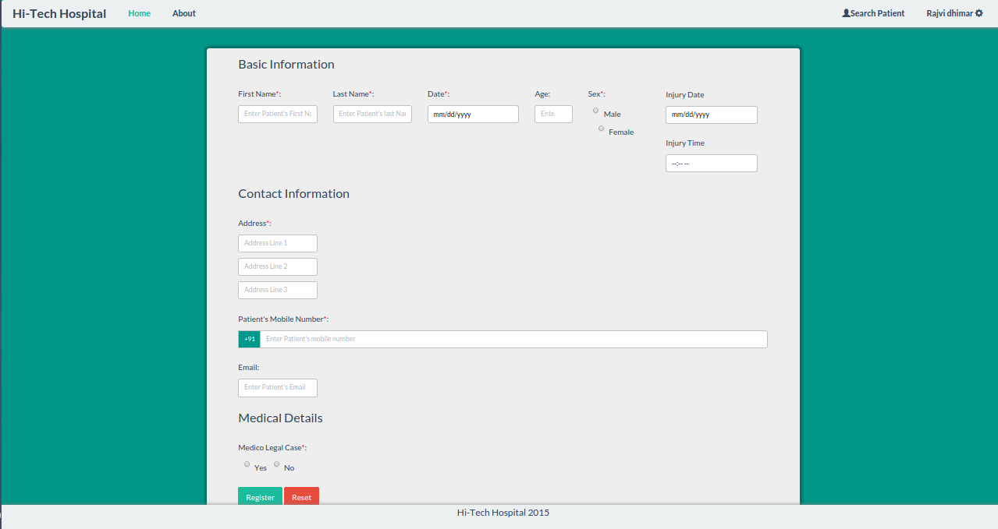

Slide 8
Features: Doctor
Digitizing Past History.
Viewing Past History
Access Control.
Storing the Present Observations for future use.
Downloading the Prescriptions for Patient’s use.
Viewing the recorded Videos
View and comment on Lab Reports

Slide 9
Features: Nurse
Inserting the details about Daily Observation
Viewing Past History
Session Based Login

Slide 10
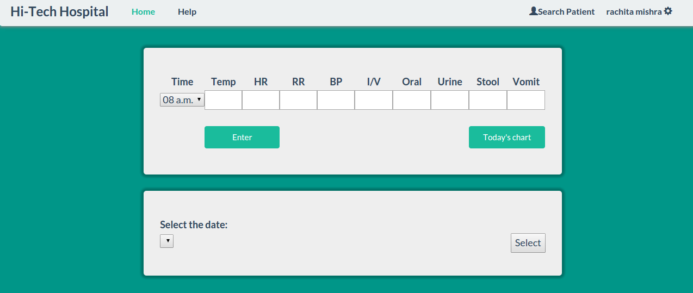

Slide 11
Features: Medical Officer
Viewing Past History
Access Control.
Storing the Present Observations for future use.
Filling up the discharge card

Slide 12
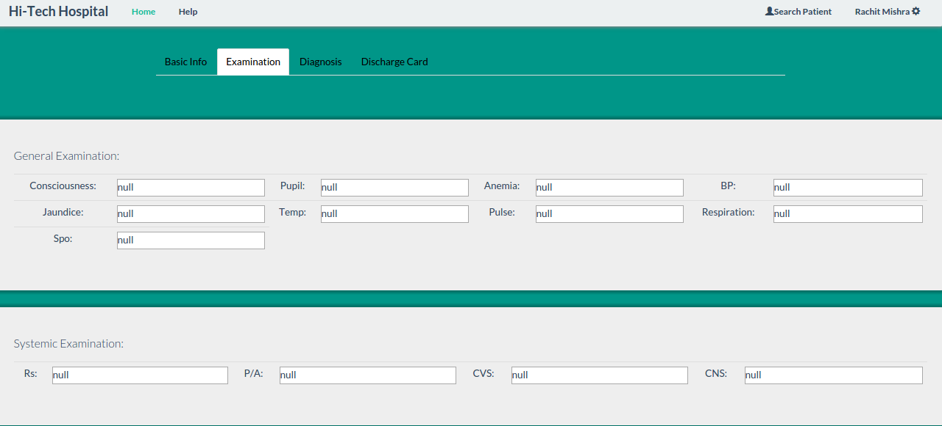

Slide 13
Features: Pathologist
Session Based Login
Search for a Patient
Upload Reports

Slide 14
SDLC
Iterative Model was chosen
Our project had multiple components
Functionalities were iteratively designed, implemented and tested.

Slide 15
Our Approach
The final project was decided on the basis of a feasibility study and analysis of the candidate ideas which we had.
Choosing the Incremental Model as our SDLC allowed us to make changes in the design of the system and implementation of the same as and when we continued to add features.
The process of project development was documented thoroughly so that progress could be mapped, retraced and understood if necessary.
Test Plans were decided upon before the Designing of the system so that it allowed for the nullification of the foreseeable loopholes in our system,.

Slide 16
Deviations
Deadlines Deviations
Requirements Deviations
Design Deviations

Slide 17
Lessons Learnt
In order to develop large scale projects aspects like documentation format and standards should have been decided from the onset of the project
Version control system should have been used more extensively.
Proper research of technologies and the objective selection of the best suited one.
Requirement phase should have been more though out and organized.

Slide 18
Future Scope
The Database can be made more intelligent which predicts and recommends symptoms by analyzing past history of the patient.
The system can be extended to link multiple hospitals and facilitate the recording of their patient’s histories.
The Video software can be made to have more features such as scaling, zooming etc.

