Slide 1
Task Assignment Presentation
Varun Srinivas Posimsetty
M.Sc. Integrated Circuit Design (TUM & NTU)
Interview for: Junior Scientist – Edge-AI Accelerators

Slide 2
Presentation Overview
Task 1 : Hardware Design – The MAC Unit (Compute Core)
Task 2 : System Integration – Memory Mapped Interface
Task 3 : Processor Microarchitecture

Slide 3
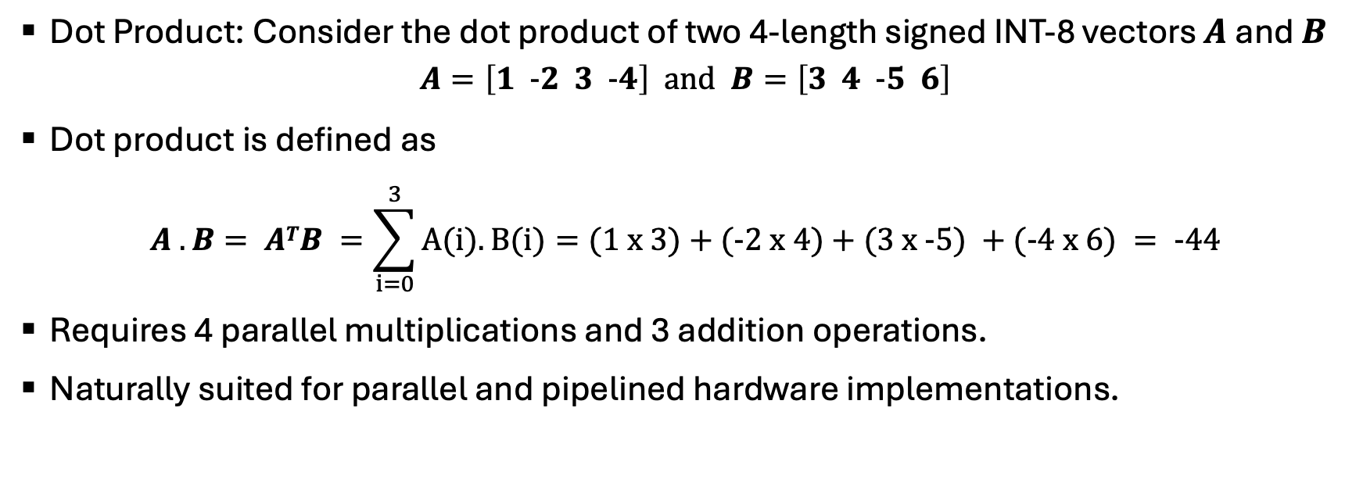
Task 1 : Hardware Design – The MAC Unit (Compute Core)
Dot Product: Consider the dot product of two 4-length signed INT-8 vectors $A$ and $B$
$$A=\left[1 -2 3 -4\right] and B=\left[3 4 -5 6\right]$$
Dot product is defined as
$$A .B= ATB =\sum_{i=0}^{3}{A(i).B(i)}=(1 x 3)+(-2 x 4)+(3 x -5) +(-4 x 6) = -44$$
Requires 4 parallel multiplications and 3 addition operations.
Naturally suited for parallel and pipelined hardware implementations.

Slide 4
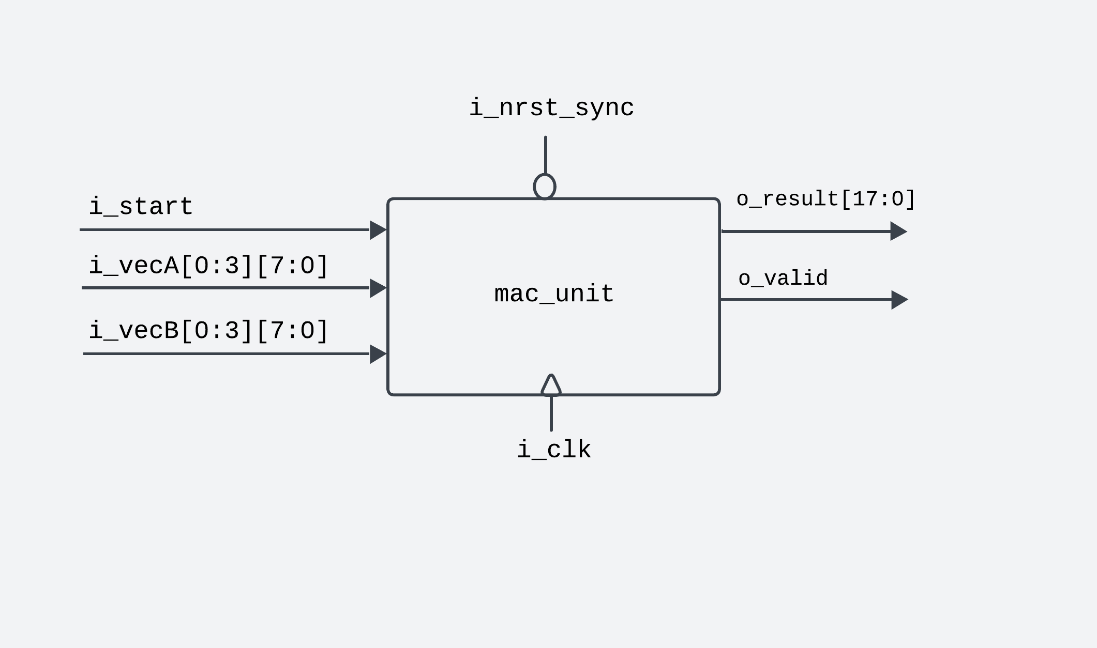
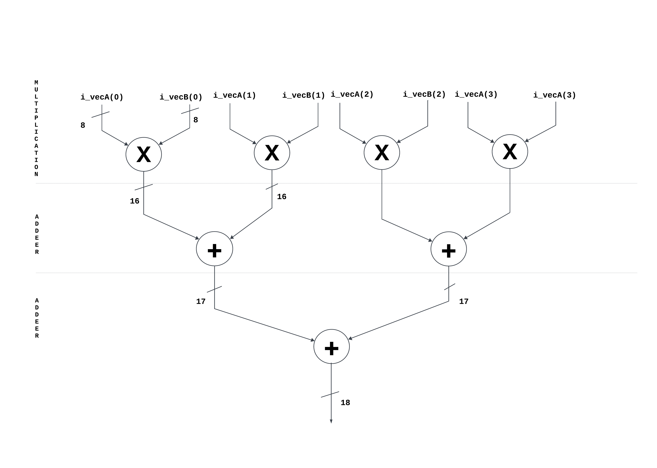
MAC Unit Datapath & Pipelined Architecture
Figure 1: mac_unit interface block diagram
Figure 2: MAC Unit Datapath

Slide 5
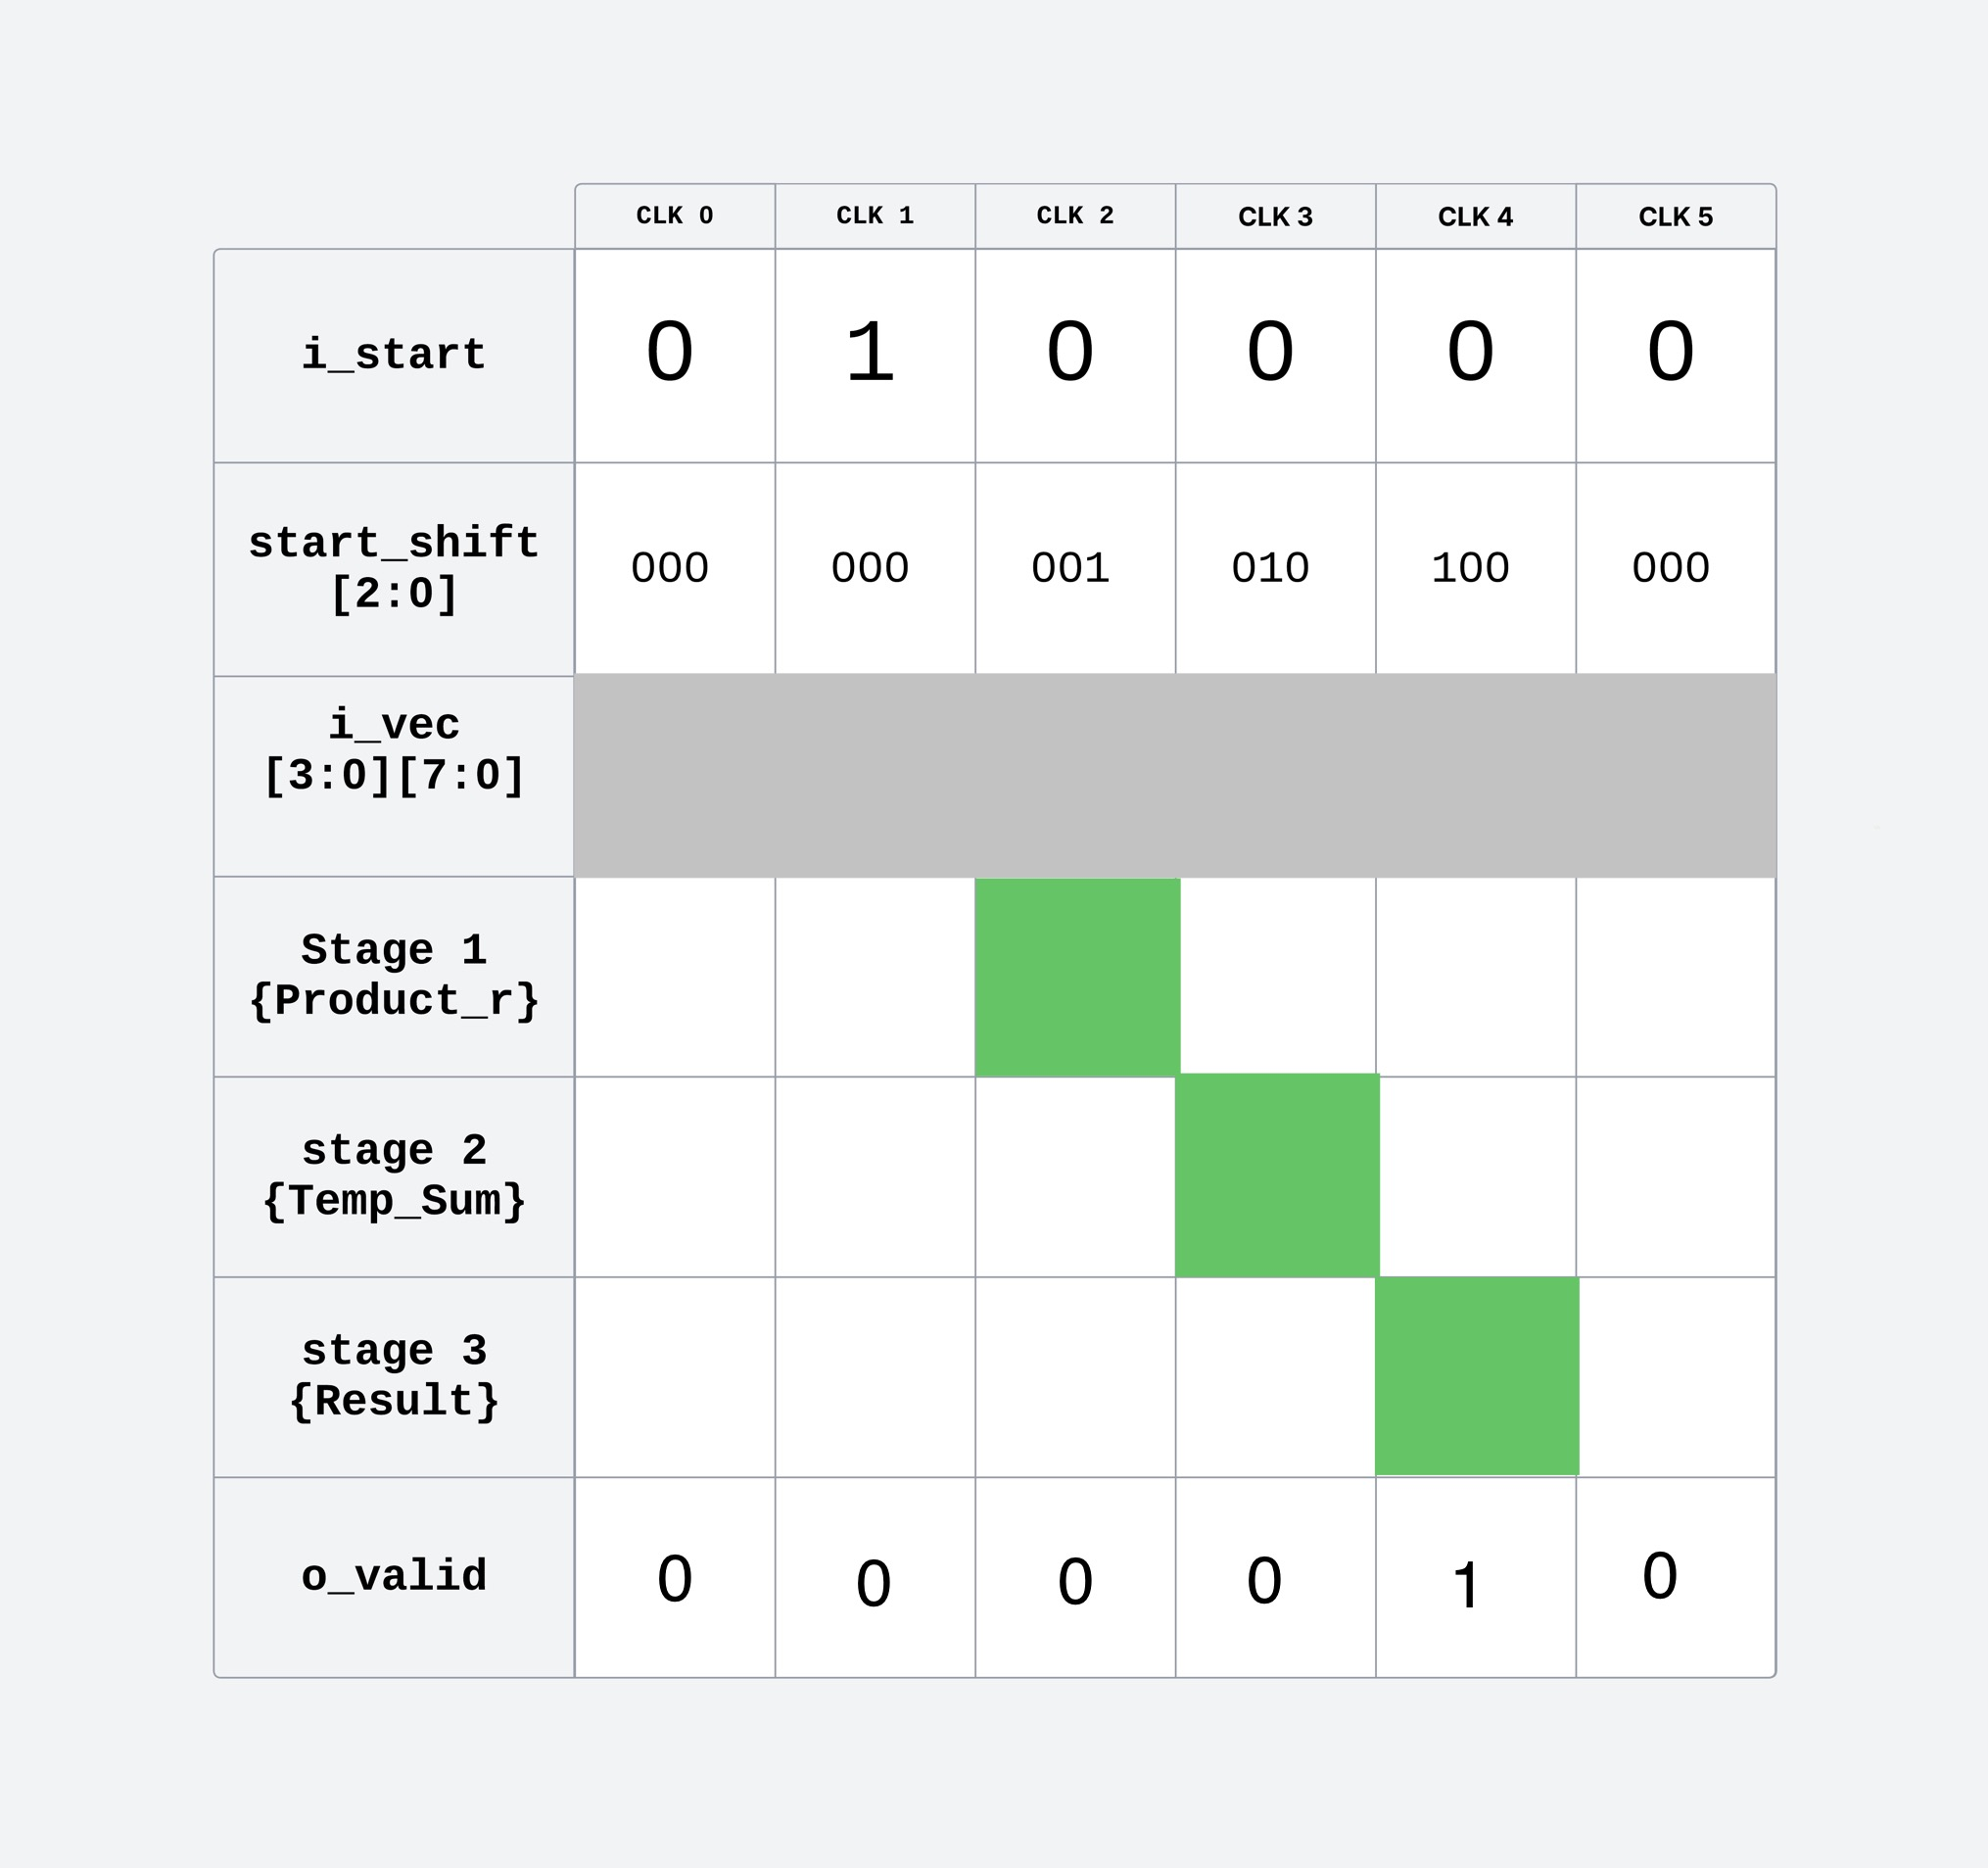
Pipeline Control and Timing
Pulse-Triggered Execution: A single-cycle i_start launches the 3-stage pipeline.
Delay-Matched Control: Control signals are register-aligned with datapath stages.
Deterministic Output: o_valid asserts the 18-bit output.
Figure 3: MAC Unit Pipeline Data Flow

Slide 6
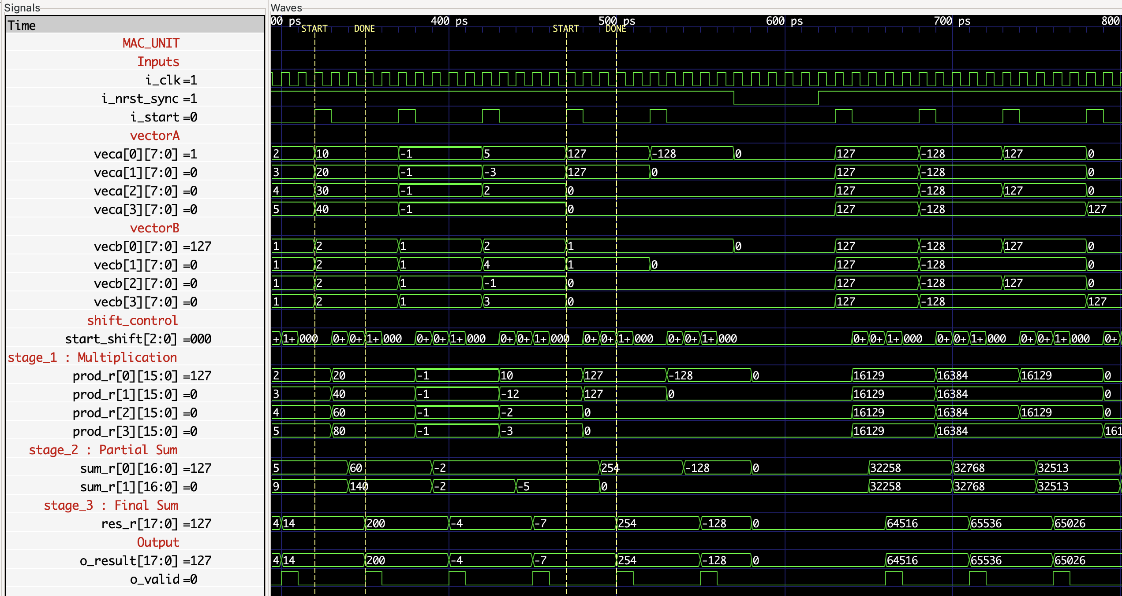
Verification – Waveform Analysis
Figure 4: MAC Unit Output Waveform

Slide 7
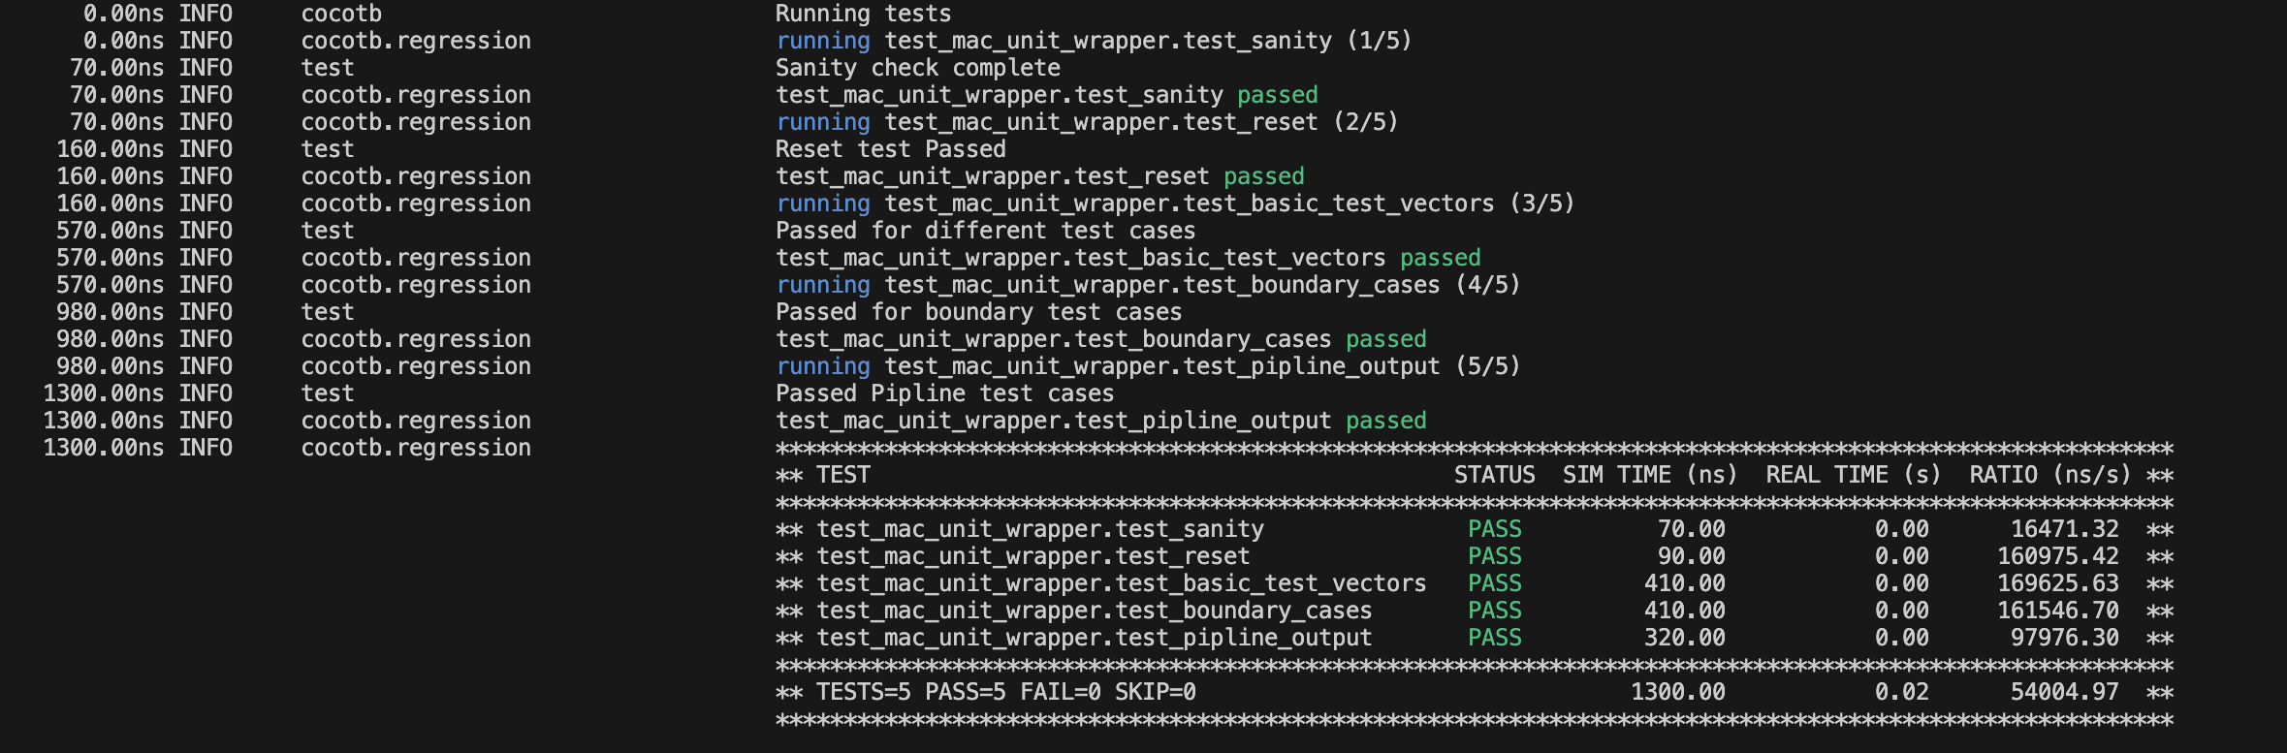
Verification – cocotb (Python-Based)
Figure 5: cocotb Console Log – MAC Unit Functional Verification

Slide 8
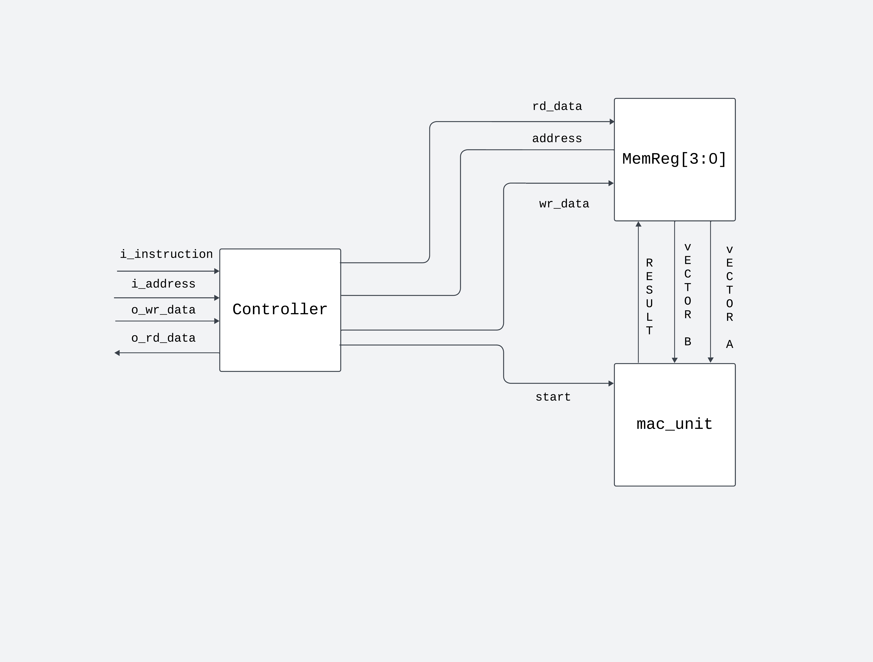
Task 2 : System Integration – Memory Mapped Interface
Unified Top-Level: Integrates the MAC compute core with a Register-Mapped Memory Interface.
Dual-Strategy: Built to support both "Stalled" (safety-first) and "Streaming" (performance-first) control logic.
Modular Design: Allows for easy swapping between 'Stalled' and 'Streaming' control logic.
Figure 6: Data Flow Diagram Top Module

Slide 9
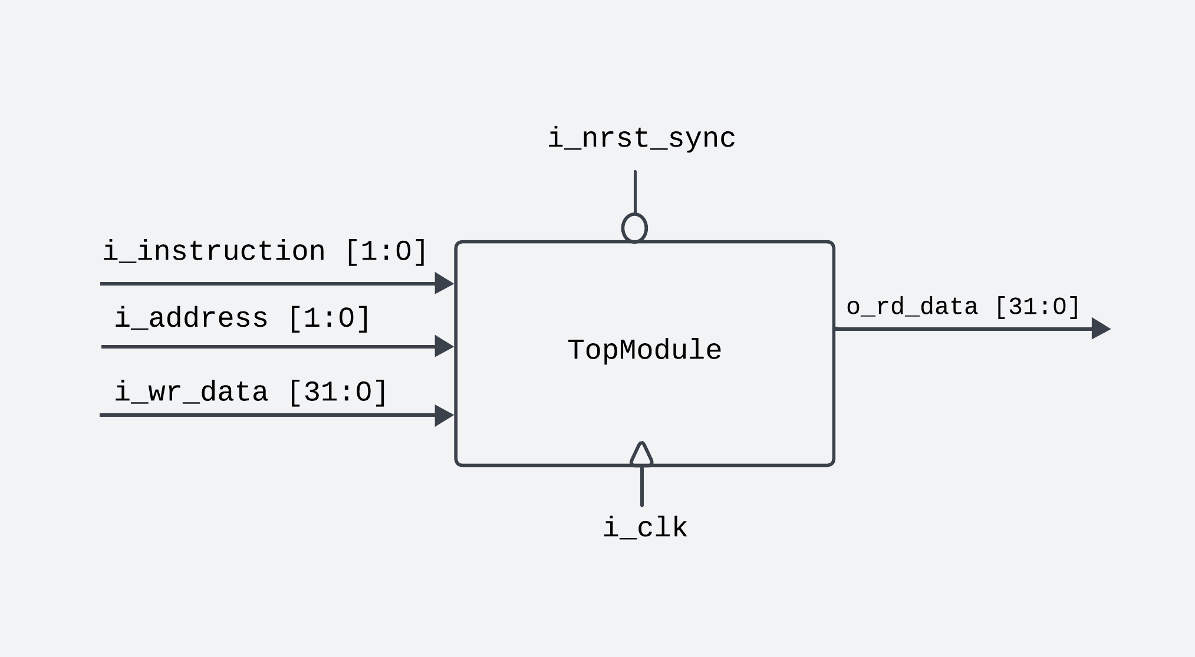
Top Module Architecture & Register Map
Figure 7: Top Module Block Diagram
Figure 8: Register Mapping of Memory

Slide 10
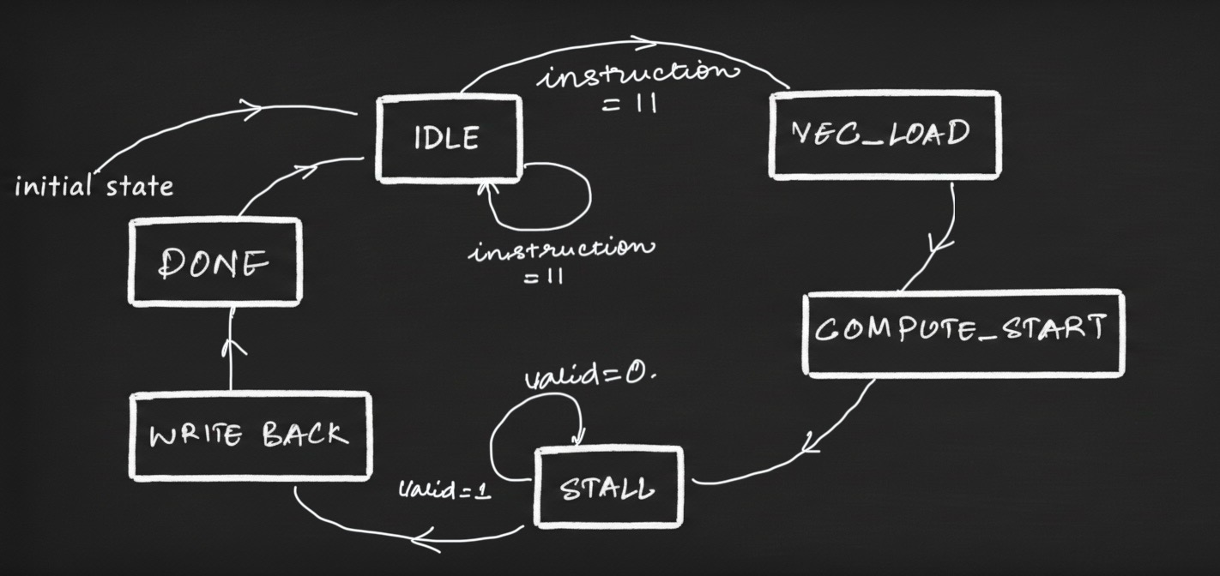
Control Strategy 1 : Stalled Approach
Sequential Locking: Prevents a new memory read or write while a calculation is in progress to avoid a data hazard.
Deterministic FSM: A simple, robust state machine that ensures the CPU only reads valid, finished results.
Figure 9: Stalled Implementation FSM

Slide 11
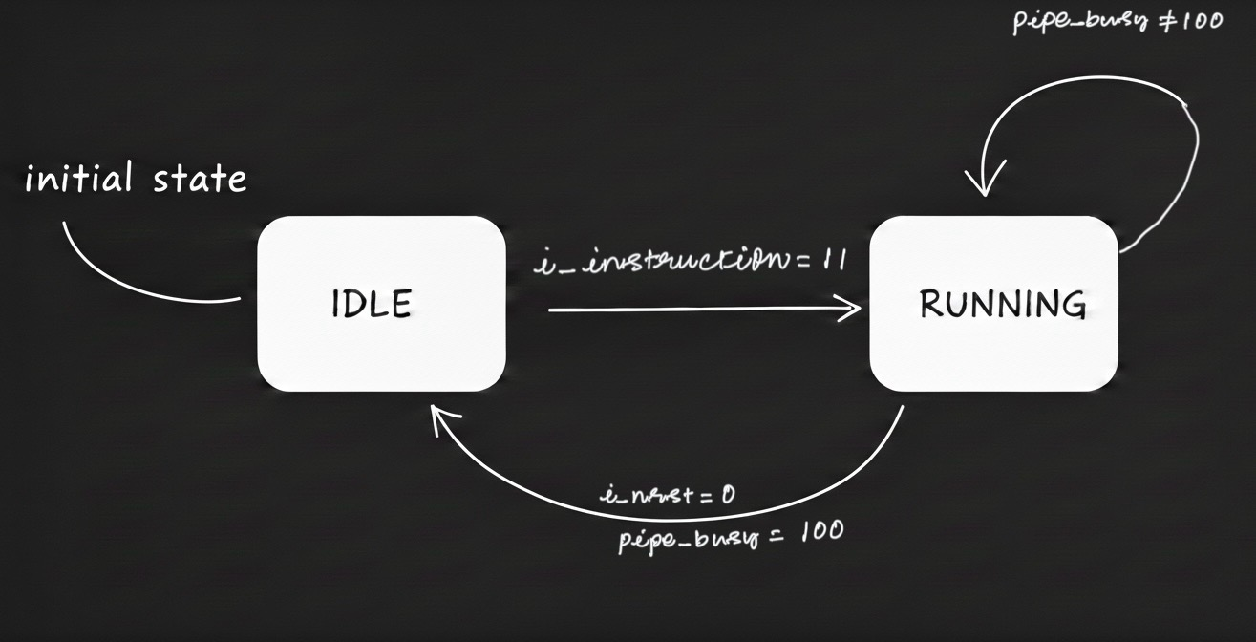
Control Strategy 2 : Streaming (Fully Pipelined)
Throughput Optimized: Removes FSM wait-states, allowing the MAC unit to produce one result per clock cycle.
Data-In-Flight Management: Logic allows the memory interface to accept new inputs while previous results are being computed.
Figure 10: Streaming Implementation FSM

Slide 12
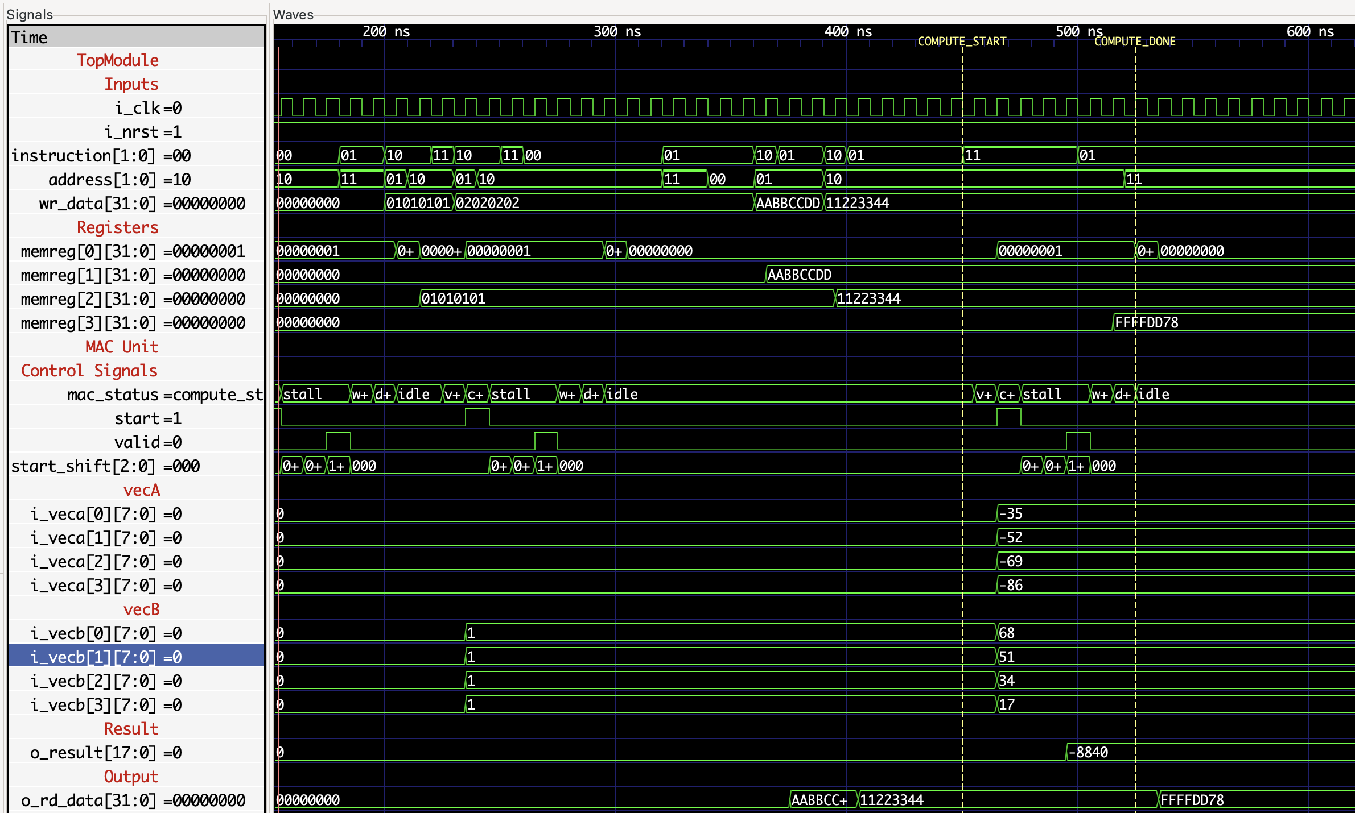
Verification : Stalled Approach Waveform Analysis
Figure 11: Stalled Implementation Waveform

Slide 13
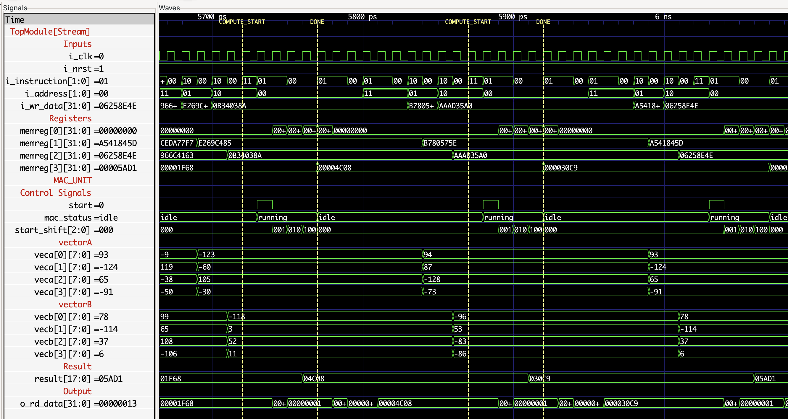
Verification : Streaming (Fully Pipelined) Waveform Analysis
Figure 12: Streaming Implementation Waveform

Slide 14
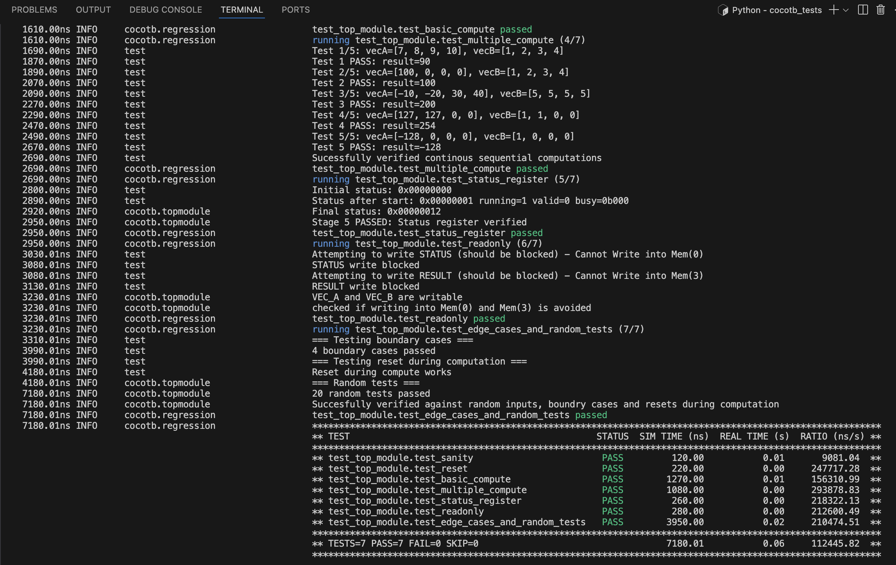
Verification : Streaming (Fully Pipelined) cocotb (Python Based)
Figure 13: cocotb Console Log – Top Module Functional Verification

Slide 15
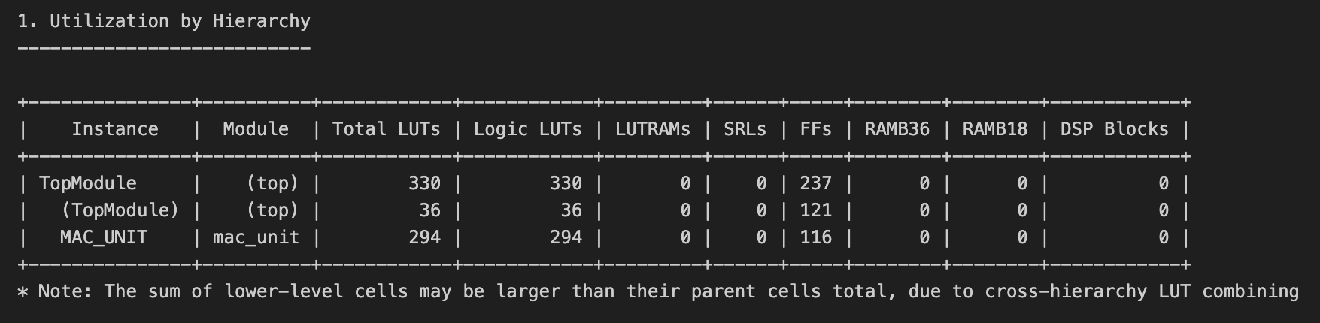
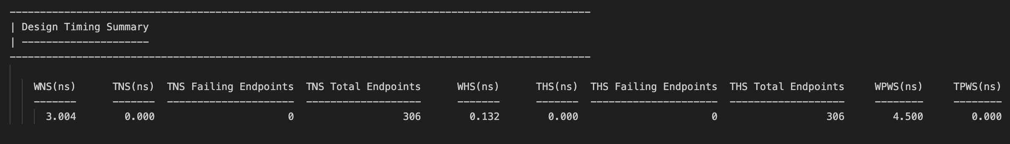
Implementation Results
Figure 14: Resource Utilization – Streaming Implementation
Figure 15: Timing Summary – Streaming Implementation

Slide 16
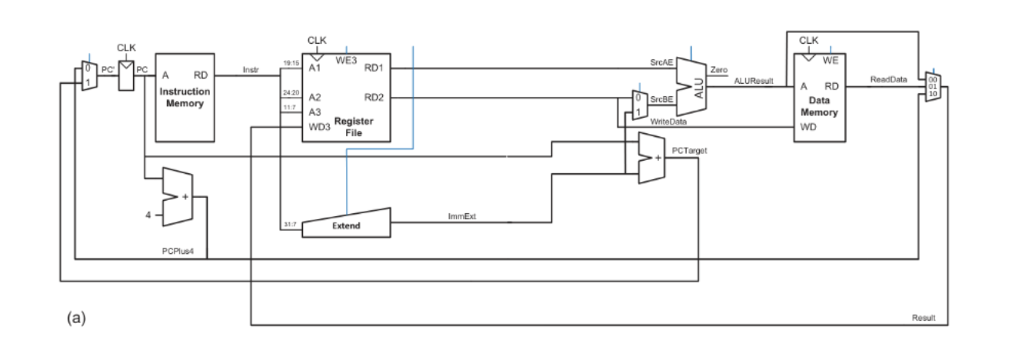
Task 3 : Processor Microarchitectures (Serial Architecture)
Single-Cycle Execution Path: Processes a complete instruction from Fetch to Write-Back within one clock period.
Longest Path Timing Constraint: The clock frequency is limited by the total accumulated delay of all combinatorial logic blocks.
Figure 16: Serial Architecture

Slide 17
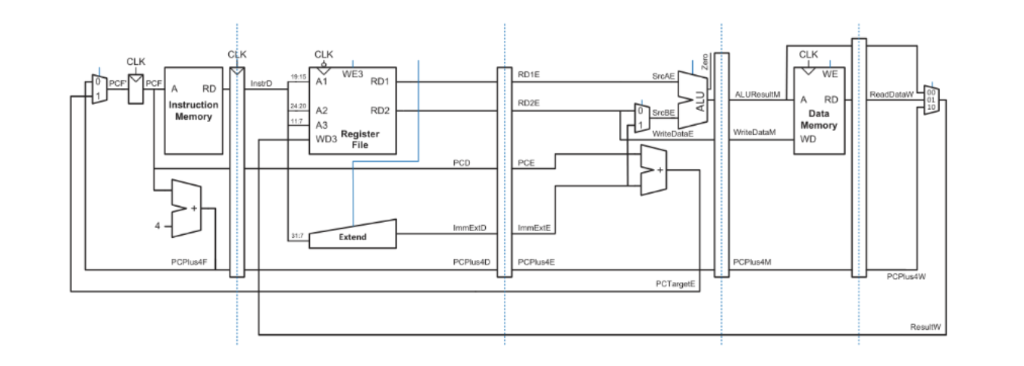
Task 3 : Processor Microarchitectures (Pipelined Architecture)
Parallelism: It overlaps multiple instructions across distinct hardware stages to maximize resource utilization.
Enhanced Throughput: Breaks the critical path into smaller segments, enabling a higher clock frequency.
Figure 17: Pipelined Architecture

Slide 18
THANK YOU
varunposimsetty@gmail.com | github.com/varunposimsetty

