Slide 1



Slide 2
Understand ASP.NET Form Structure
Identify key inputs needed for form request
Identify Event target which initiates form request on server side
Post Form with inputs
Retrieve HTML page with form output from server
Process HTML output to retrieve data
Analyze Data
1
2
3
4
5
6
7
Performed a manual test form submission and monitored output using Chrome Developer Tools
Key Form Inputs identified as From Month, From Date, From Year, To Month, To Date, and To year
‘btnGO’ is the event target on the page that initiates form request
Post form in a loop of 1-month increment (server has a limit of 3 months max)
Retrieve HTML page with form output from server
Use Beautiful Soup, and Python regex search to get offense data, offense location, offense type, and case details
Perform Exploratory Data Analysis Using Pandas and Answer Questions
General Steps
How I applied it
To Bellingham Police Activity Detail Report

Slide 3
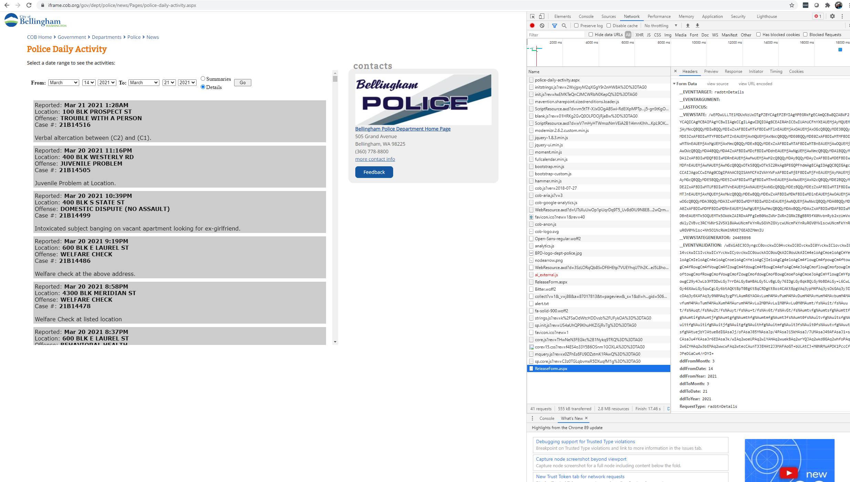
3
1
2

Slide 4
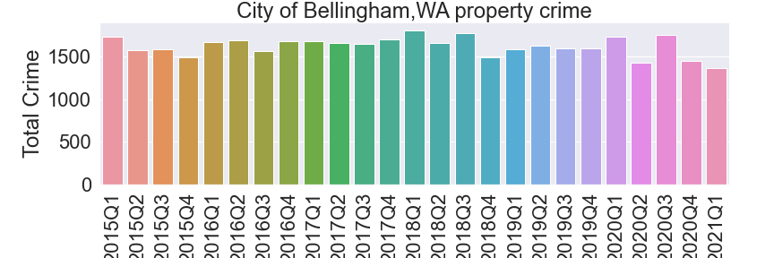
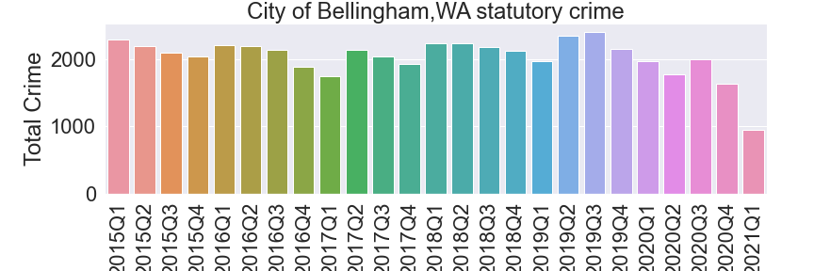
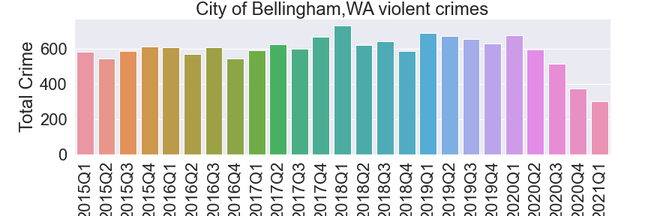
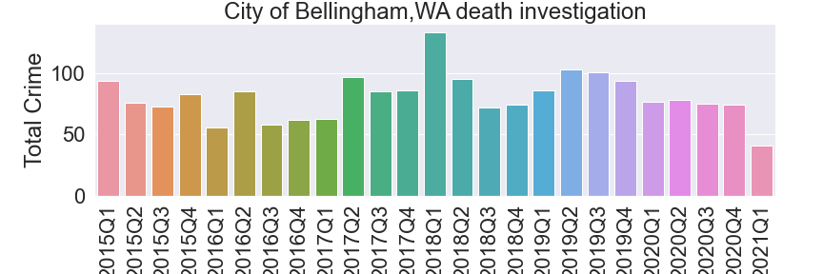
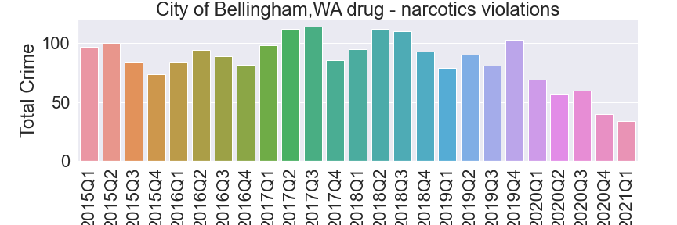
COV-2 related shutdown
Slight reduction in property crimes
Significant reduction in violent crimes
Large reduction in drug-narcotics crimes
Slight reduction in statutory crime
Minimal reduction in death investigations

