Slide 1

Designing
Arithmetic Building Blocks

Slide 2

TEAM OF PRESENTERS:
Anirudh Santhosh 20BAC10003
Yashraj Karwa 20BAC10006
Nibedita Rakshit 20BAC10024
Varun Ram S 20BAC10038

Slide 3

TABLE OF CONTENTS
Data Paths
Ripple Carry Adders
Full Adder and Half Adder
Carry Look Ahead Adder using CMOS
High Speed Adder or Carry Skip
Multipliers & Design Stages
Divider Overview
Barrel Shifter
Cross Bar Switch and Multiplexer
Speed and Area

Slide 4
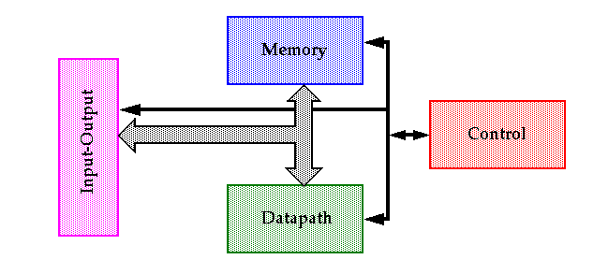
DATA PATHS
A datapath is a collection of functional units,such as adders, multipliers,ALU etc. that perform data processing operations.
Data is generally passed via busses.
A control path is used to control the flow of simple datapaths.
The speed of these elements often dominates the overall system performance so optimization techniques are important.

Slide 5
RIPPLE CARRY ADDER
A3
B3
A2
B2
A1
B1
A0
B0
C3
C2
C1
C0
Cin
FULL ADDER 4
FULL ADDER 3
FULL ADDER 2
FULL ADDER 1
S3
S2
S1
S0
A structure of multiple full adders is cascaded in a manner to gives the results of the addition of an n bit binary sequence.
The carry-out of one stage is fed directly to the carry-in of the next stage.
This adder is called ripple carry because each carry bits get rippled into the next stage.
So there will be a delay to get the result with using of this carry adder.

Slide 6
A3
B3
A2
B2
A1
B1
A0
B0
C3
C2
C1
C0
Cin
FULL ADDER 4
FULL ADDER 3
FULL ADDER 2
FULL ADDER 1
S3
S2
S1
S0

Slide 7
FULL ADDER
Note: Adding using a full adder leads to propagation
delay
A3 B3 A2 B2 A1 B1
C1
C0
FULL ADDER 3
FULL ADDER 2
FULL ADDER 1
Cin
C2
S3 S2 S1

Slide 8
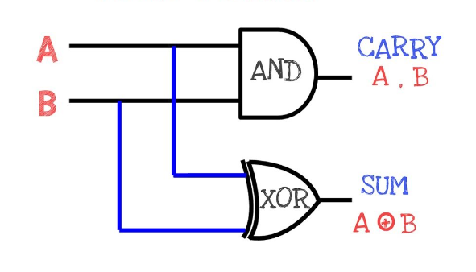
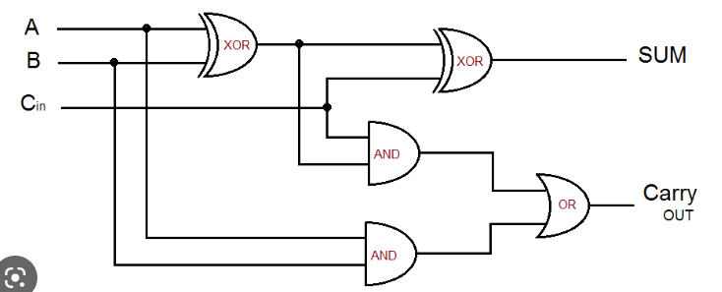
FULL ADDER AND HALF ADDER

Slide 9
CARRY LOOK AHEAD ADDER
Carry look ahead adder is faster in operational speed compared to full adder.
By full adder when we have parallel adders it takes propagation delay to have output.
In carry look ahead adder the output carry of each is not dependent on the previous output and is generated at same time.
We will be trying to make each carry dependent on the first carry so that all can be generated simultaneously.

Slide 10
A3
B3
A2
B2
A1
B1
A0
B0
C3
C2
C1
C0
Cin
FULL ADDER 4
FULL ADDER 3
FULL ADDER 2
FULL ADDER 1
S3
S2
S1
S0
C1= A1. B1 + (B1 xor A1) . C0
Lets generalize:
Ci= Ai. Bi + (Bi xor Ai) . Ci-1
Carry generator
Carry propagator
Ci= Gi + Pi . Ci-1

Slide 12
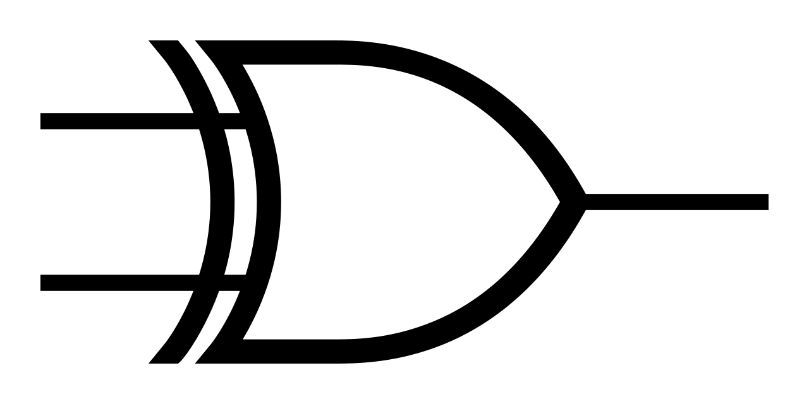
S0= (A0 xor B0) xor (Cin)
S1= (A1 xor B1) xor (C0)
G3
P3
C
L
A
L
O
G
I
C
C3
C3
G2
P2
C2
S3
P3
G2
C1
S2
P2
P1
C0
S1
G0
P1
P0
P0
Cin
S0

Slide 13
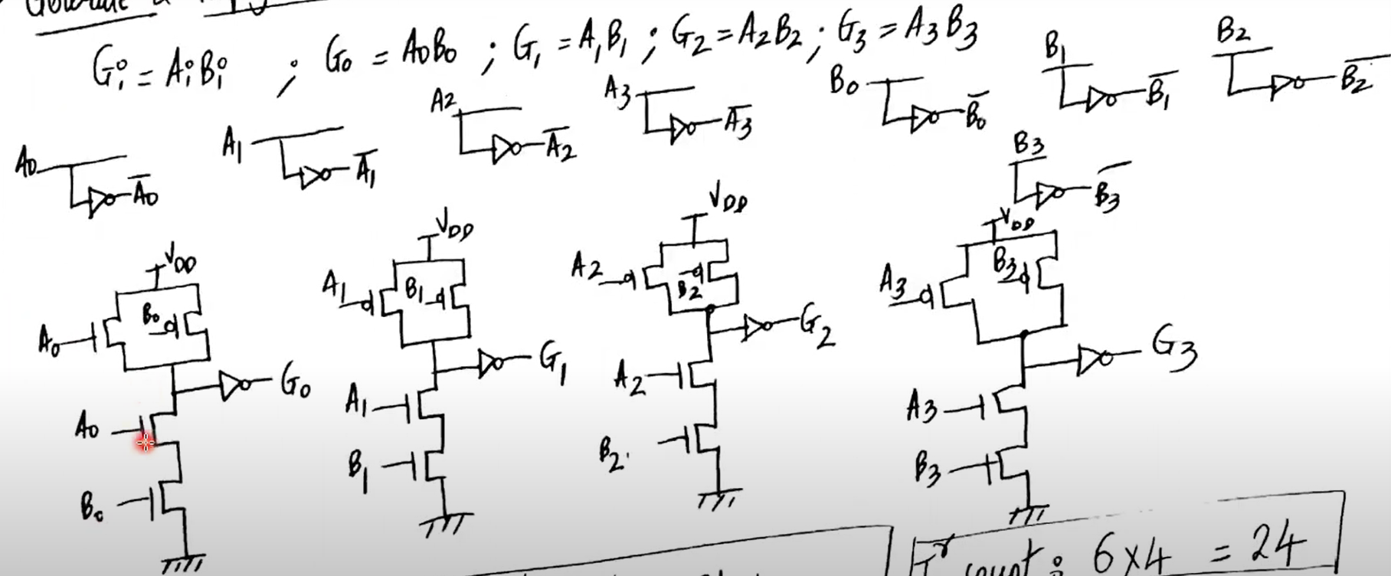
CARRY LOOK AHEAD ADDER USING CMOS
Total Transistors count = 24 (6*4)

Slide 14
Gi=Ai. Bi

Slide 15
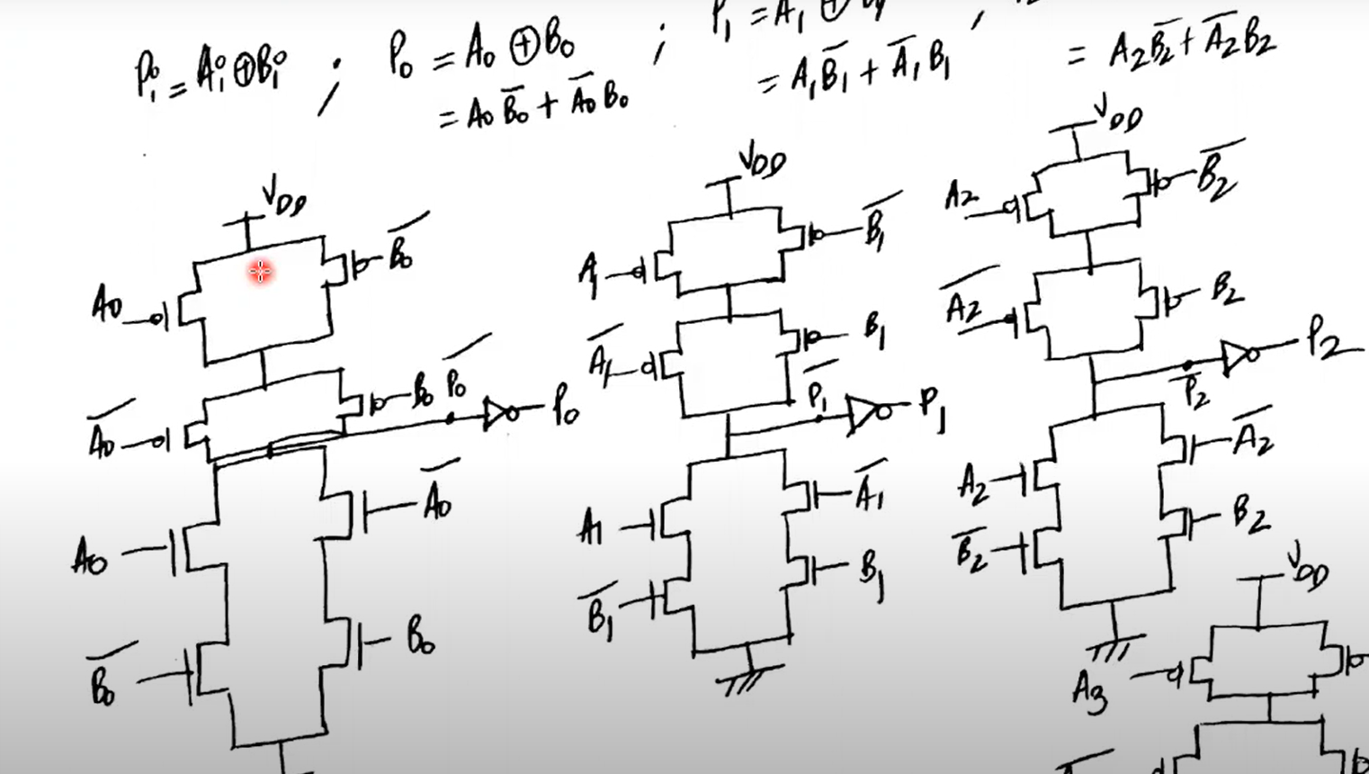
Total Transistors count = 56 (14*4)

Slide 16
Pi=Ai xor Bi

Slide 17
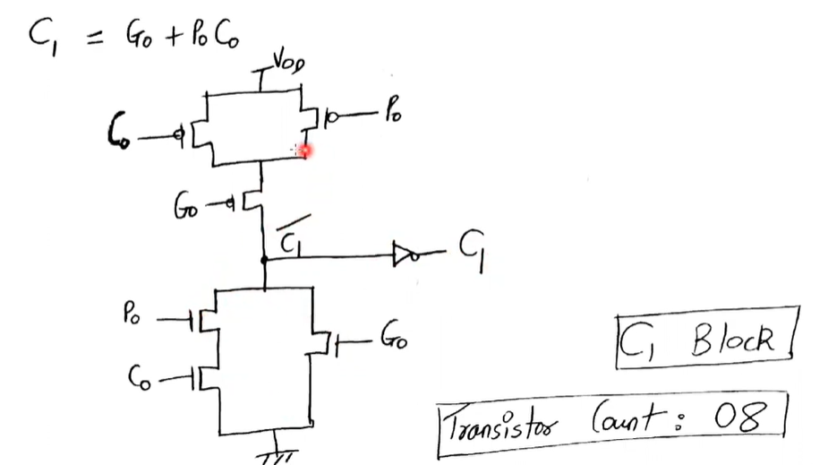

Slide 18
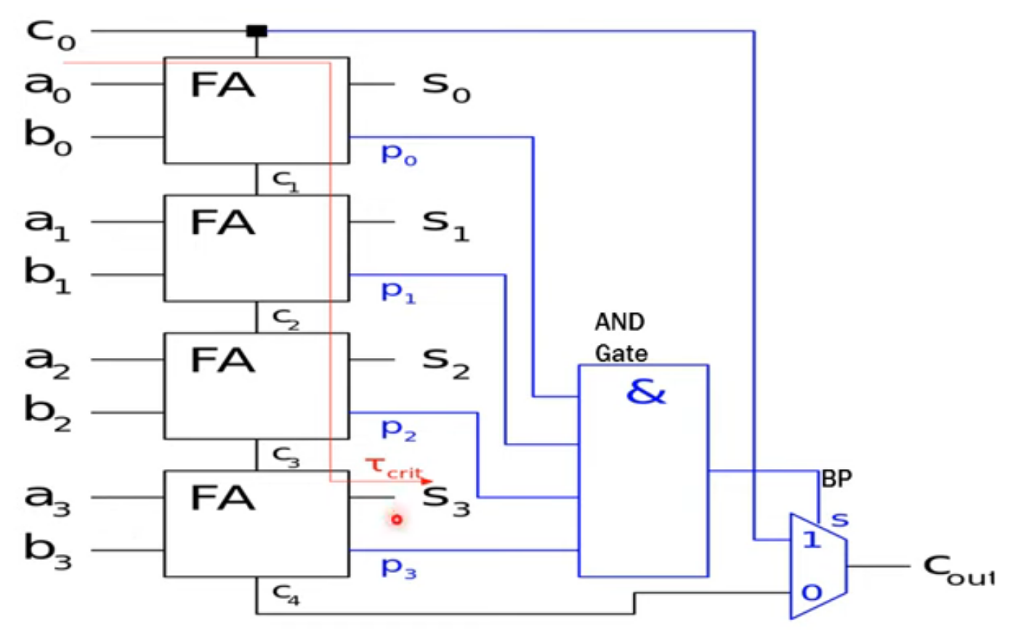
HIGH SPEED ADDER OR CARRY SKIP

Slide 19
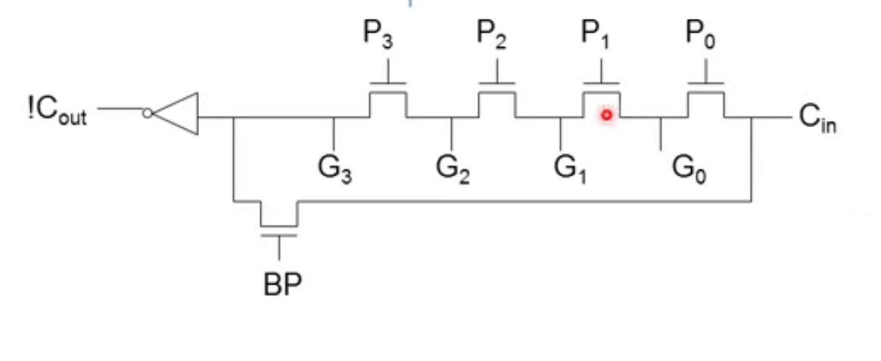
HIGH SPEED USING NMOS

Slide 20
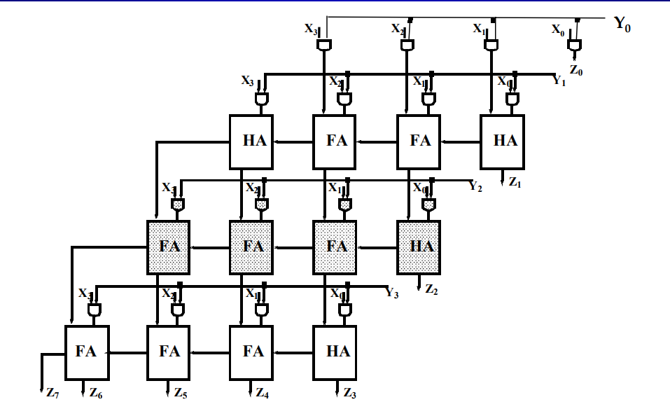
MULTIPLIERS
Array Multiplier
For Unsigned Binary Integers
4 inputs and 4 outputs per unit
Partial products, one for each bit in multiplier (each bit needs just one AND gate)

Slide 21
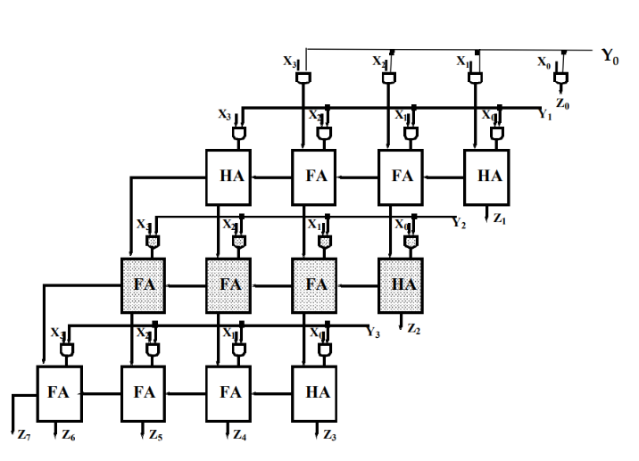
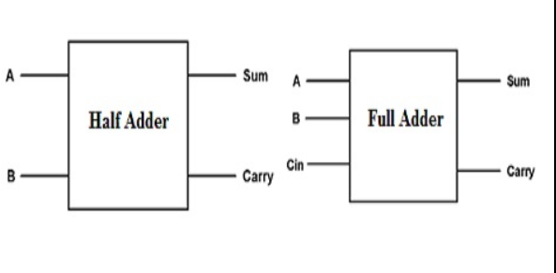
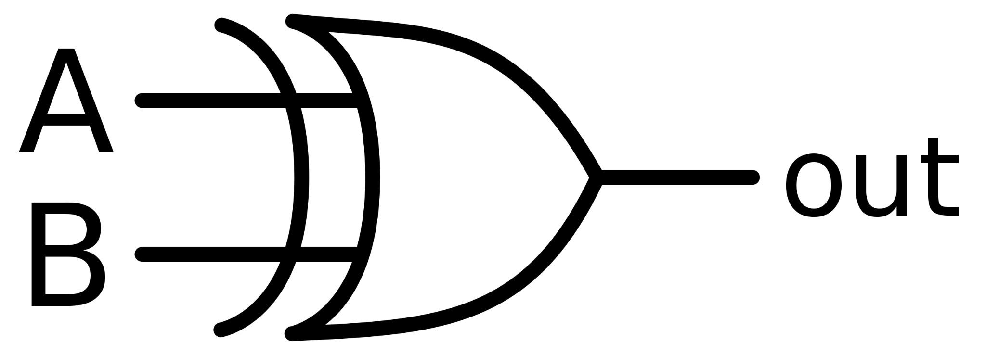
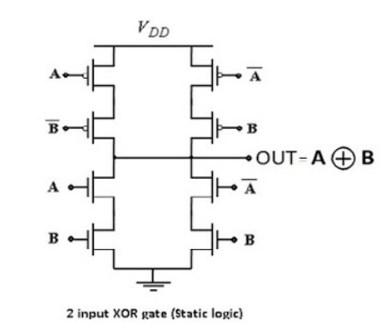
DESIGN STAGES OF ARRAY MULTIPLIER
.
ARRAY MULTIPLIER
HALF ADDERS & FULL ADDERS
XOR &
AND GATES
CMOS LOGIC

Slide 22
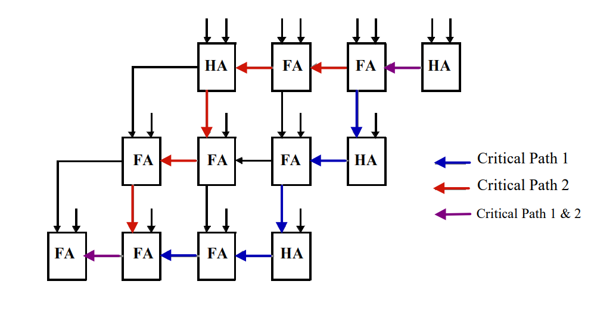
MXN MULTIPLIER
.

Slide 23
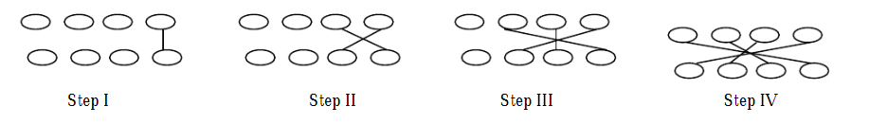
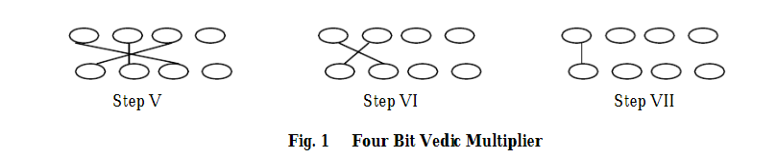

RECENT RESEARCH: VEDIC MULTIPLIER
This is the diagrammatic representation:

Slide 24
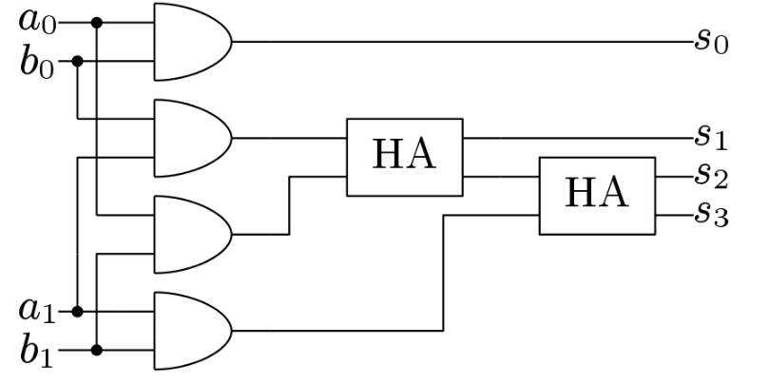
VEDIC MULTIPLIER FOR 2 BIT DATA WIDTH
.

Slide 25
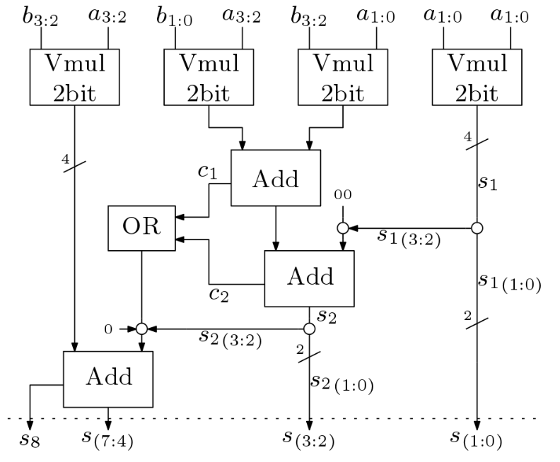
4 BIT VEDIC MULTIPLIER
.

Slide 26
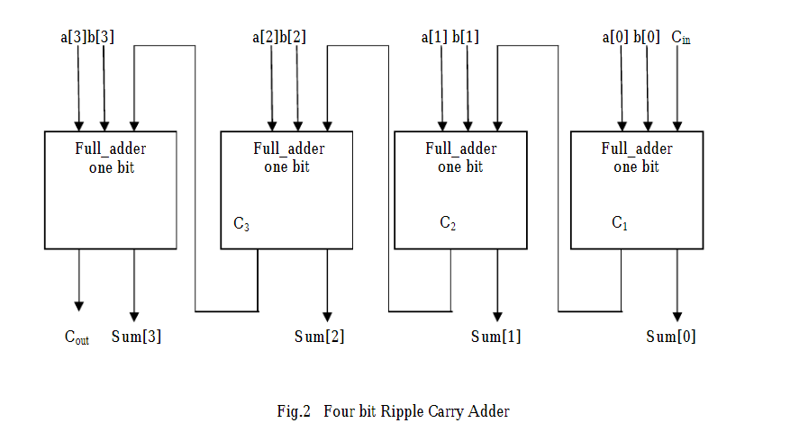
VEDIC MULTIPLIER PROPOSED ALGORITHM
Ripple Carry Adder is one of the digital adder [5, 6] used in many logic circuits. In this adder circuit the carry and sum bits are produced alongside, in which the carry-out of each full adder is the carry in of the following next most significant full adder.
It is called a ripple carry adder because each carry bit gets rippled into the next stage
Citation: Design, implementation & performance of vedic multiplier for different bit lengths
V Sharma, A Kumar - International Journal of Innovative Research in …, 2017

Slide 27
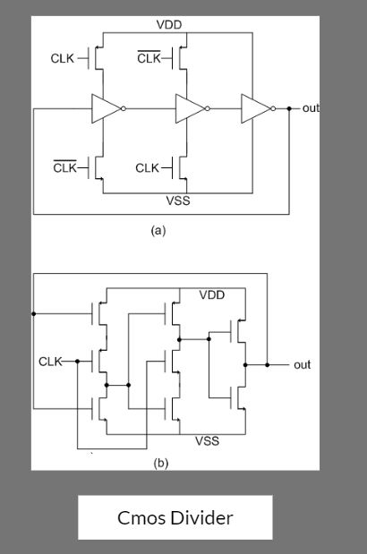
DIVIDERS
Dividers are important building blocks in VLSI circuits, used to divide an input signal frequency by a specific factor.
In general, the architecture of dividers in VLSI depends on the specific requirements of the application, such as frequency division ratio, power consumption, and speed. The choice of architecture will also depend on the available technology and the design constraints of the system.

Slide 28

BARREL SHIFTER
Description:
A barrel shifter is a digital circuit that can shift binary data by a specified number of positions to the left or right.
Architecture:
Crossbar
Multiplexer (Mux)
Barrel shifters are essential building blocks in digital circuits

Slide 29
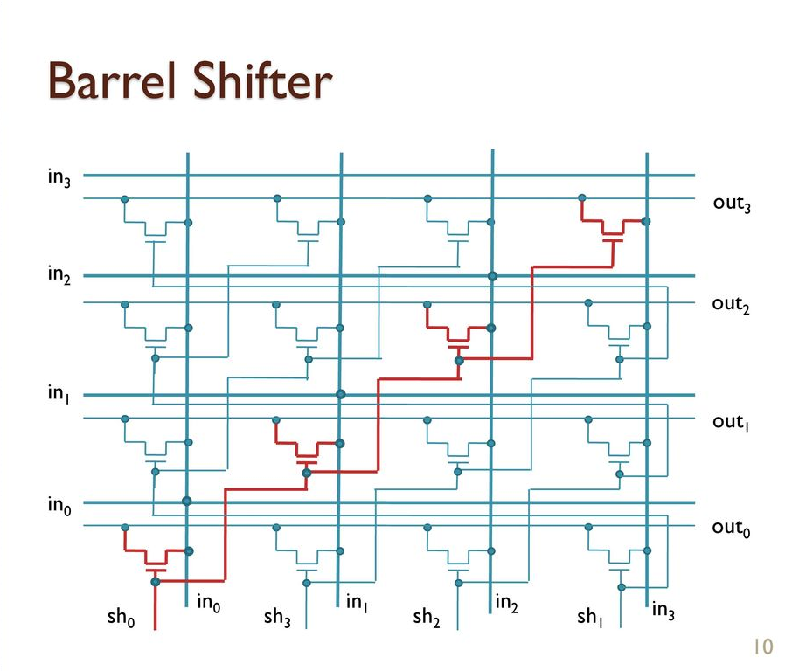
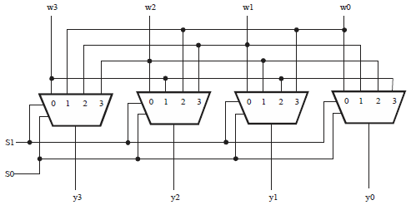
CROSS BAR SWITCH
MULTIPLEXER
(Crossbar)

Slide 30
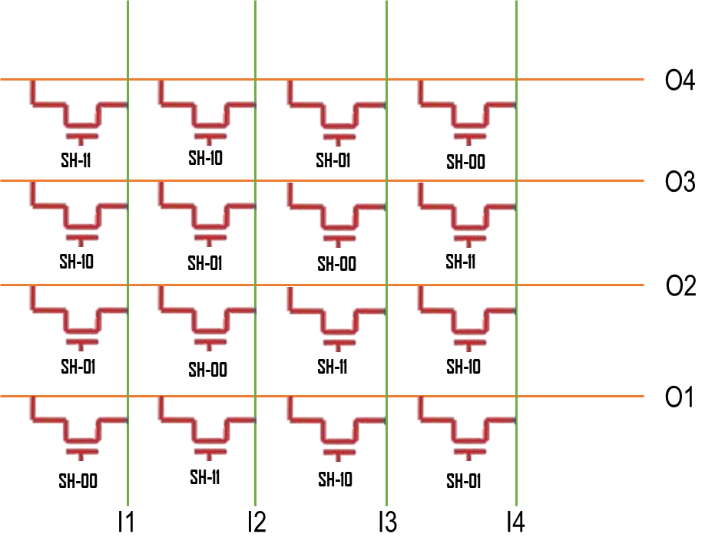
Example
Bit-stream: 1001
Cross bar:
Shift | O1 | O2 | O3 | O4
0 - (00) | I1 - (1) | I2 - (0) | I3 - (0) | I4 - (1)
1 - (01) | I4 - (1) | I1 - (1) | I2 - (0) | I3 - (0)
2 - (10) | I3 - (0) | I4 - (1) | I1 - (1) | I2 - (0)
3 - (11) | I2 - (0) | I3 - (0) | I4 - (1) | I1 - (1)

Slide 31
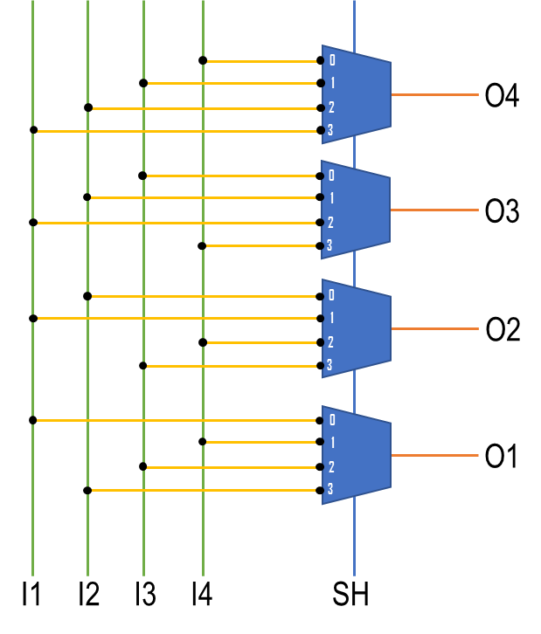
EXAMPLE
Bit-stream: 1001
MUX:

Slide 32
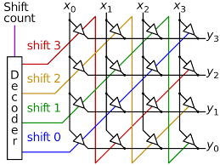
CROSSBAR SWITCH
A crossbar is a direct interconnect that can switch between inputs and outputs in a single cycle.
Low Latency: The direct interconnect of the crossbar switch provides low latency shifting operation.
Scalability: The crossbar switch can be easily scaled up to support larger word sizes without increasing latency.
Fault Tolerance: The crossbar switch can be designed to be fault-tolerant by adding redundancy and voting circuits.

Slide 33
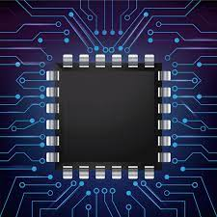
MULTIPLEXER
A mux-based design is simpler and more power-efficient than a crossbar.
Lower Power: They consume less power because they use fewer transistors. This makes them a better choice for power-sensitive applications.
Simplicity: It is a simpler to implement design. This is because a mux requires fewer components and less routing.
Area Efficiency: They have a smaller area footprint for small to medium-sized word widths. This is because the number of transistors in a mux grows logarithmically with the number of inputs and outputs.

Slide 34
SPEED AND AREA
Speed: Speed refers to how quickly a circuit can perform its intended function. Faster circuits are generally more desirable, but achieving higher speed often comes at the cost of increased power consumption, complexity, and area.
Area: Area refers to the amount of physical space that a circuit occupies on a chip. However, reducing the area of a circuit often comes at the cost of reduced functionality, increased complexity, and decreased speed.
GPS Receiver: A GPS receiver is a device that receives and processes signals from satellites to determine a user's location. In this case, area might be prioritized over speed because the receiver needs to be small enough to fit in a handheld device. This might mean using smaller transistors or simplifying the design to reduce the number of circuits, even if it makes the receiver slower.
Image Processing: Image processing circuits are used in cameras and other devices to process images and video. In this case, speed might be prioritized over area because the circuits need to be able to process large amounts of data quickly. This might mean using more complex design techniques or more powerful transistors, even if it makes the circuit larger.
Audio Amplifier: An audio amplifier is a circuit that increases the power of an audio signal to drive speakers or headphones. In this case, both speed and area might be important, depending on the specific requirements of the application. For example, a portable audio amplifier might need to be small and energy-efficient, but also powerful enough to drive high-quality headphones.

Slide 35
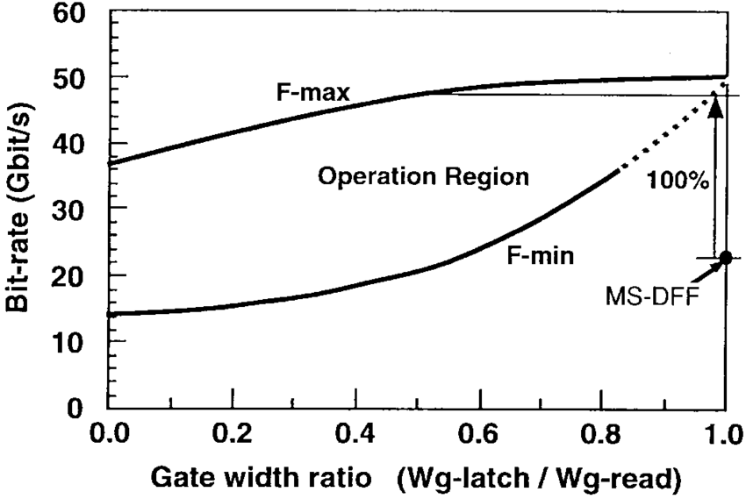
SPEED AND AREA

Slide 36
THANK YOU!!!
.

