Slide 1

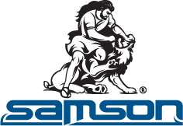
Presented by:
Varun Yashwant Rasalkar 1921452
LEAN IMPLEMENTATIONS
AT
SAMSON ROPES TECHNOLOGIES

Slide 2
SAMSON ROPE TECHNOLOGIES
Established in ​1884
Website: https://www.samsonrope.com
Headquarter: Ferndale, Washington
Sector: Industrial Ropes
SAMSON BUSINESS SYSTEM
STRATEGY
GOVERNANCE
PROCESSES
PEOPLE
CULTURE
PERFORMANCE
MISSION AND VISION
Our vision is to enhance our customers' operations by delivering safer, smarter, and more reliable synthetic rope systems and services. We do this by first listening to better understand your challenges and needs. Actively engaging with all of our customers leads to more focused innovation, engineering, and service. After all, when you succeed, we succeed.
VALUE OUTCOME
SOCIETAL
IMPACT
RESOURES INPUTS
HOW VALUE IS CREATED AT SAMSON ROPE
TECHNOLOGIES
Ref: https://www.samsonrope.com

Slide 3
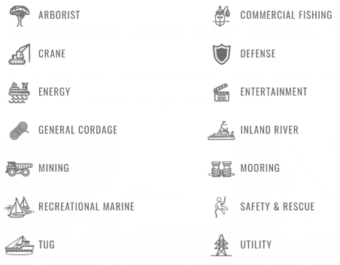
Samson Rope Technologies
Samson Rope's headquarters is in Ferndale, Washington. Samson Rope has a revenue of $100M, and 320 employees.
The manufacturing facilities of Samson Rope are ISO 9001:2015 certified utilizing LEAN manufacturing practices to ensure we provide the best-performing and highest-value ropes in the industry.
Products by Industry
Services
Engineering Services
Field Services
Icaria Service Program
Testing Services
Ref: https://www.samsonrope.com

Slide 4

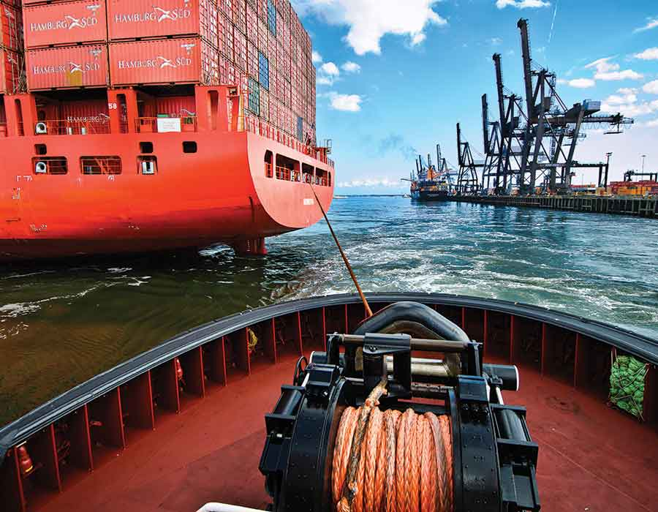
PRODUCT DESCRIPTION
LEAN IMPLEMENTATION
Quantum-12 is a lightweight, high-strength, floating rope that can grip on a capstan or H-bitt.
The patented DPXTM fiber technology provides superior abrasion and cut resistance, but with a higher coefficient of friction than other high modulus polyethylene ropes.
The 12-strand construction provides added flexibility, improved handling, and easy splicing.
The vivid green Samthane coating provides excellent visibility and additional abrasion resistance.
Lean concepts were applied to the Information flow system and Material flow system.
Product: Quantum 12 rope in application
Ref: https://www.samsonrope.com

Slide 5
MANUFACTURING PROCESSES OF ROPE INDUSTRY
Raw Material
Twisting process
Stranding process
Braiding process
Oven
Splicing and
packaging
Shipping
Ref: Korakot Yuvamitra, Jim Lee, and Kanjicai Dong, “Value Stream Mapping of Rope Manufacturing: A Case Study”, International Journal of Manufacturing Engineering, Hindawi

Slide 6
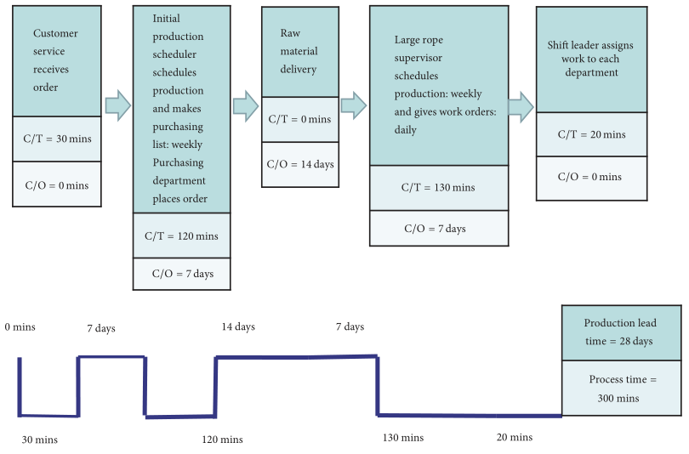
VALUE STREAM MAPPING
VALUE STREAM MAPPING OF PRODUCTION STAGES BEFORE LEAN
Ref: Korakot Yuvamitra, Jim Lee, and Kanjicai Dong, “Value Stream Mapping of Rope Manufacturing: A Case Study”, International Journal of Manufacturing Engineering, Hindawi

Slide 7
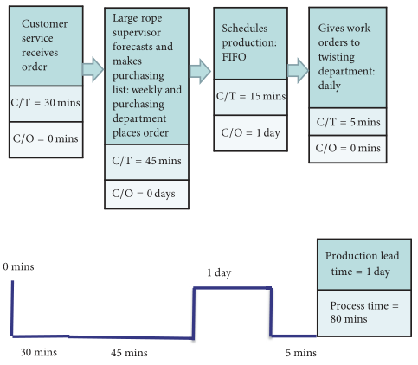
VALUE STREAM MAPPING OF PRODUCTION STAGES AFTER LEAN
Ref: Korakot Yuvamitra, Jim Lee, and Kanjicai Dong, “Value Stream Mapping of Rope Manufacturing: A Case Study”, International Journal of Manufacturing Engineering, Hindawi

Slide 8
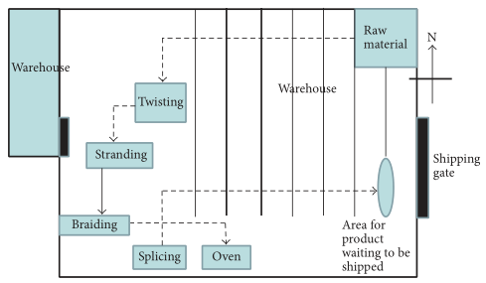
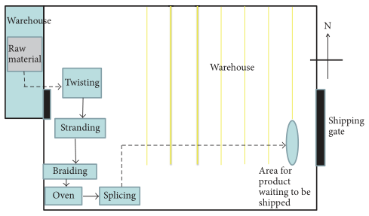
MATERIAL FLOW IN PLANT
Before LEAN
After LEAN
Ref: Korakot Yuvamitra, Jim Lee, and Kanjicai Dong, “Value Stream Mapping of Rope Manufacturing: A Case Study”, International Journal of Manufacturing Engineering, Hindawi

Slide 9
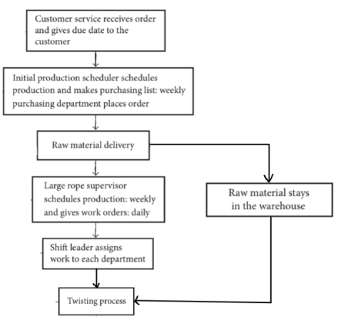
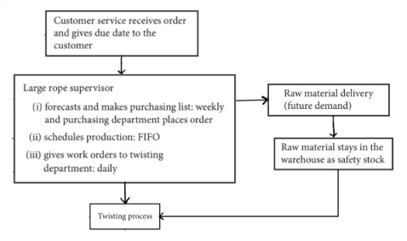
FLOW OF INFORMATION IN ORGANIZATION
Flow of information after receiving orders: Before LEAN
Flow of information after receiving orders: After LEAN
Ref: Korakot Yuvamitra, Jim Lee, and Kanjicai Dong, “Value Stream Mapping of Rope Manufacturing: A Case Study”, International Journal of Manufacturing Engineering, Hindawi

Slide 10
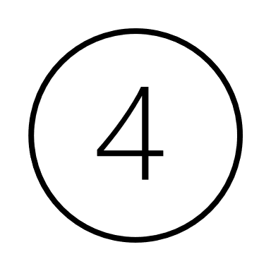

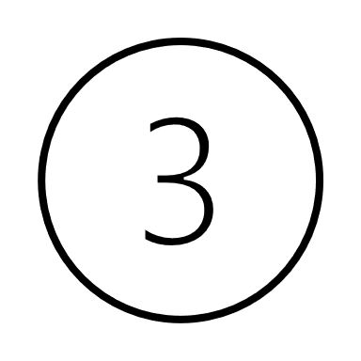

CONTINUOUS IMPROVEMENT AT ORGANIZATIONAL LEVEL
Solve the problems faced in controlling quality, and again start with a plan.
Plan strategically to complete orders in time.
Plan
Do
Check
Act
Check the quality of material used.
Check the quality of finished product.
Complete the manufacturing task in hand.
Ref: https://www.samsonrope.com/docs/default-source/default-document-library/sustainability-report.pdf?sfvrsn=4fd63e36_2

Slide 11
COMPANY TODAY
KEY PERFORMANCE INDICATORS (KIP)
“In keeping with our history of innovation, we continue to operate at the forefront of the synthetic rope industry. As your needs are evolving, so are we. We are continually inventing, refining, and optimizing our products to ensure we provide you with the highest quality products and comprehensive service you expect from us. We aren’t satisfied with status quo. Never have been. That’s why we continue to take product innovation and service to the next level to better serve.”
Eliminated all hazardous lifts in maintenance by installing lift assists.
Reduced job remake requests by 27% through increased awareness, employee training and error proofing measures.
Reduced employee travel by 64% in supply restock process by implementing a consumables VMI program.
After applying lean for the information flow, the processing time and waiting time are reduced by an estimated 68% and 88%, respectively.
For production processes, the material handling time is reduced by 33% due to revision of the plant layout.
The total cycle time from receiving customer order to shipping is reduced from 36 days to 9 days.
This is a reduction of 75% total time from the moment the customer places an order to the time it is shipped. Production lead time is the same.
Ref: Korakot Yuvamitra, Jim Lee, and Kanjicai Dong, “Value Stream Mapping of Rope Manufacturing: A Case Study”, International Journal of Manufacturing Engineering, Hindawi

Slide 12
REFERENCES
https://www.samsonrope.com
https://www.samsonrope.com/docs/default-source/default-document-library/sustainability-report.pdf?sfvrsn=4fd63e36_2
https://www.samsonrope.com/docs/default-source/brochures/rm_line_selection_guide_web.pdf?sfvrsn=5f36249d_10
Korakot Yuvamitra, Jim Lee, and Kanjicai Dong, “Value Stream Mapping of Rope Manufacturing: A Case Study”, International Journal of Manufacturing Engineering, Hindawi.

