Slide 1


Presented by:
Varun Yashwant Rasalkar 1921452
PSS
Lenovo Daas

Slide 2

Lenovo
Established in: ​1984
Website: https://www.lenovo.com/
Headquarter: Quarry Bay, Hong Kong
Industrial Sector: IT Solution
MISSION
Our culture defines us … it's our DNA. We call it the Lenovo Way and it's the values we share and the business practices we deploy. It's how we address our day-to-day commitments. The Lenovo Way is embodied in the statement: We do what we say and we own what we do.
Quality | Reliability | Efficiency | Security | Support
Lenovo is the only global technology provider offering wrist-to-cloud solutions, including mobile phones, tablets, PCs, and data centers. Because we own our manufacturing facilities around the world, we have greater control over both product quality and supply chain operations. Our scale and manufacturing efficiency enable us to drive the best quality, supply chain security, and manufacturing costs in the industry, which we pass on to the customer
$43B
Global technology
company
Customers in
160+
countries
226
On the global Fortune 500 list
52K
employees
Ref: https://www.lenovo.com/content/dam/lenovo/pcsd/north-america/en/solutions/services/flyers/lenovo-client-services-end-to-end-guide.pdf
Notes:
https://www.lenovo.com/content/dam/lenovo/pcsd/north-america/en/solutions/services/flyers/lenovo-client-services-end-to-end-guide.pdf

Slide 3






The DaaS Model
Hardware is owned by Lenovo Financial Services and refreshed on an industry best-practices schedule (3–4 years, depending on the equipment model)
Includes all enterprise-facing services under one contract, with a single point of accountability
Has a set refresh cycle that includes imaging and taking the equipment back while securely destroying it
Hardware, software, and services are all one monthly price without any up-front investment
Customers can flex up or down based on their device fleet
No significant setup fees up front
Ref: https://www.logically.com/solutions/services/managed-services/device-as-a-service
Notes:
Lenovo DaaS is a fully managed model that combines hardware, services, and software into a single configurable solution with a predictable, affordable periodic fee.
Lenovo DaaS allows you to select from tiered pricing models of popular, high-performing devices for your workforce. Lenovo DaaS combines devices and services, giving you greater flexibility.
Logically works with Lenovo and Intel to provide this solution exclusively to our Managed Services clients

Slide 4
SWOT Analysis
Traditional
PSS
 | Current situation |  | Future situation
 | Strengths | Weakness | Opportunities | Threats
A. Environmental dimension | -parts harvesting & reutilization | -Non recycled Electronic waste | -Manufacture energy efficient products -Reduce usage of non recyclable plastic | -Less motivation in consumers to upgrade
B. Socio-cultural dimension | -Good public relationship & sponsorship -employment growth -Well established brand name | -Product are fewer to choose -Less product diversity -Maintaining good relations with suppliers | -Increase brand awareness to attract new consumer & continue engage with old client -Diversity product range -Provide consumer configured hardware option | -Device malfunctioning before expected time period in the product life -Increased promotions by competitors
C. Economic dimension | -Less responsibility -less maintenance cost -Good quality product | -Too expensive devices -Consumer facing problem in after sales services | -Provide economic solutions for repair & service -Reselling after use can help in harvesting | -Constant technological development required trained workforce accordingly -labor cost increased - Avaibility of same technology with less price
D. technology, Feasibility | -online & offline marketplace for purchasing -free to do experimentations in design & technology -not consumer bounded | -Hardware technology is not feasible every time. -Limited Resources of Feedback For improvement | -Focus more in research and development -Adoption of future needs of consumer -Collaborating with suppliers in R & D | -New technological competitors
E .Legislation, Regulation, Public Infrastructure | -Term & condition for selling of product -price are regulated by vendor | -Regulation of pirated software cannot be controlled | -To provide sales and services under the relevant market regularization. | -Regulation on international trade keep changing
Notes:
This SWOT analysis matrix is generated as per our understanding of the PSS model and its implementation.

Slide 5
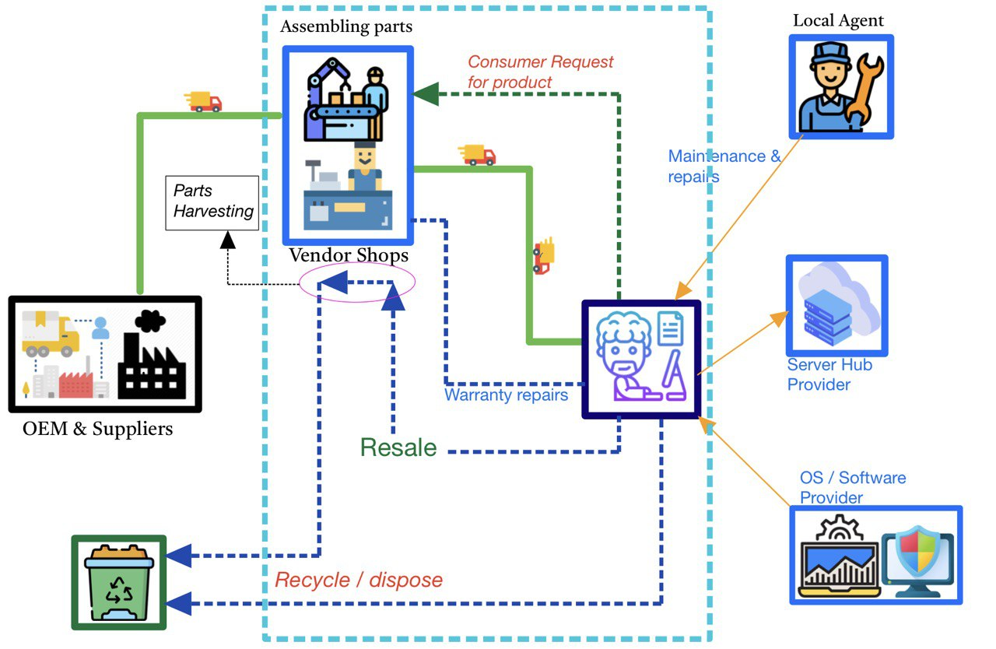
Traditional System map
Notes:
This system map is developed by understanding the nature of market by the group.
*End Users or Consumer: IT firms, Educational Institutions, Banks, manufacturing companies, etc.
*OEM & Suppliers: processor manufacturers, mother board manufacturers and producers of storage devices, optical drives, display screens, and other parts required to make laptops, servers, or desktop PCs.
*Explanation of the Traditional system map:
In the traditional system map as we understand, the end user directly buys devices from the market or directly from the vendor shops or online, and has to pay upfront for it, while also engaged in buying add on services of Operating System, Software, Server and cloud storage to store their work. Here the consumer is also busy in creating a safe theft proof workspace from cyber attacks. So, between all these activities the consumer who is a bank for example doesn’t have the need to go into the specific technical details. They are only concerned with the usage of the devices and software that will create value for them.
For the flow of material, as it is self evident from the map, the old fashioned way of buy-make-destroy is in use with some modification that some parts are harvested and reused in the supply chain and then are disposed.
In our case the vendor is LENOVO, who is only able to earn when their devices are sold.

Slide 6
Classification of the PSS
Device-as-a-Service provided by Lenovo is a subscription based business model where there are no upfront cost for the end user to pay.
In this model the devices are owned by Lenovo and the consumer pays a monthly fees for the service based on its capacity.
Lenovo also provides leasing option for large enterprises while it is subscription based for SME’s.
In recent years Lenovo pitched a new term of business called ‘pay per seat’ for it’s desktop PC’s.
Value mainly in product content
Product Service System
Value mainly in service content
Service Content (intangible)
Product Content (tangible)
Pure Product
A: Product Oriented
B: Use Oriented
C: Result Oriented
Pure service
3. Product lease
4.Product
renting/
Sharing
5.Product pooling
6.Activity
Management
7.Pay per
Service unit
8.Functional
result
1. Product related
2. Advice and consultancy
Ref: https://www.lenovo.com/us/en/landingpage/lenovo-financial-services/

Slide 7
Description of the PSS
Ref: https://www.lenovo.com/us/en/landingpage/lenovo-financial-services/
Notes:
In DaaS provided by Lenovo, the devices are owned by Lenovo during the phase of use as well as after the phase of use.
In this PSS system the equipment are installed at the consumer’s location, and the maintenance and repair services are provided by Lenovo technicians at their site.
Lenovo could involve with multiple consumers in parallel operations.
Payment methods are either fixed rate or pay per unit (pay per seat) or both depending on the scale of service required and size of the relative company.

Slide 8
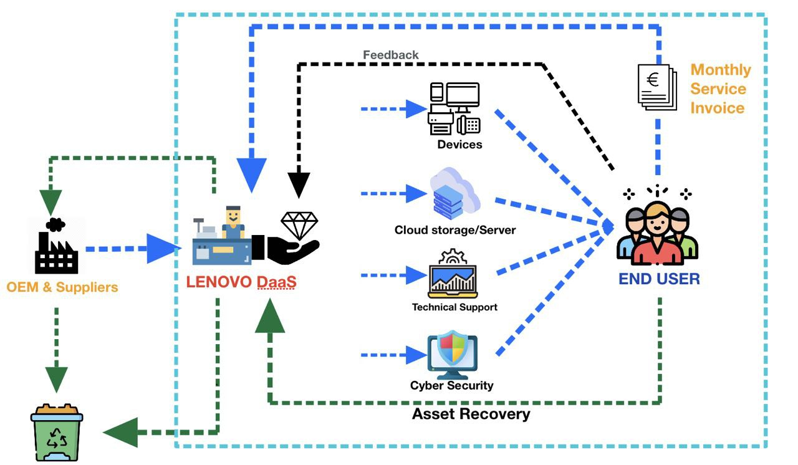
PSS System Map
Notes:
*This is the upgraded system map after applying PSS solutions. Here the devices are offered as a service and not owned by the consumers. The consumers are only focused on the use of devices and not owing these assets. With this improved system map, Lenovo collaborate with OEM (original equipment manufacturers) and suppliers (defined in previous system map) to manage and provide an end user’s IT solutions. In this system there are no upfront payments as compared to in the traditional system, but the end user only has to pay for the subscription of the service.
In this PSS system the relation between suppliers and Lenovo are same as in previous map, the difference is that the end user no longer has to hunt for a other service providers like for database/server provider, software and cyber security providers.
In this PSS solution Lenovo create a package deal and end users are free to make a choice.
This system offers a feedback flow from the consumer end which gives the window of opportunity for continuous improvement.
As far as the life cycle of devices is concerned, Lenovo will have the strength to control it and provide new updated technologies, maintenance/repairs, and even refurbish the devices. At the end of the subscription, all the assets are recovered and reused or diposed responsibly by Lenovo.
This system creates more complexity of product life cycle, which is beneficial for environment.

Slide 9
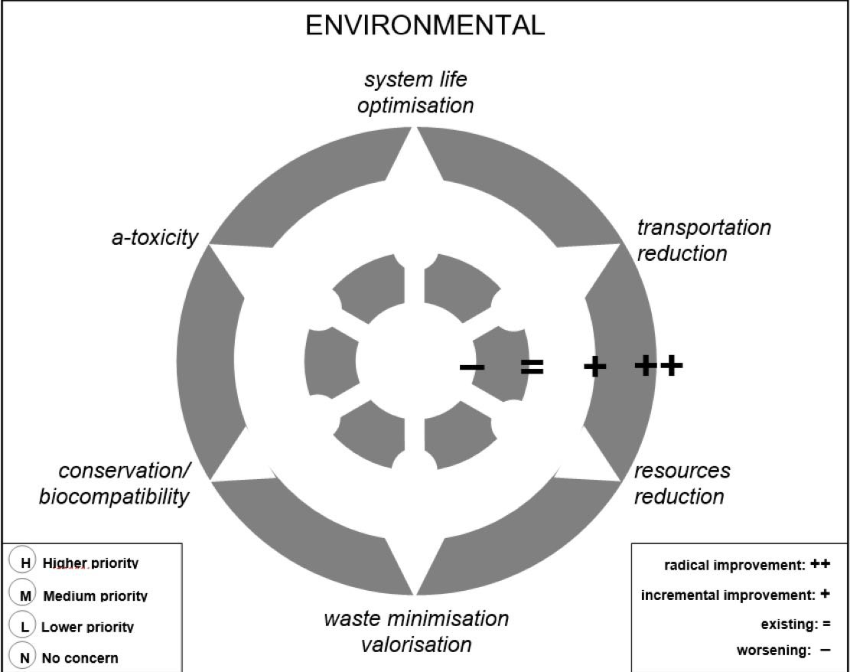
Screening : Environmental Criteria
Notes:
This Environmental Criteria is generated as per our understanding of the PSS model and its implementation.

Slide 10
Screening : Environmental Criteria
Notes:
This Environmental Criteria is generated as per our understanding of the PSS model and its implementation.

Slide 11
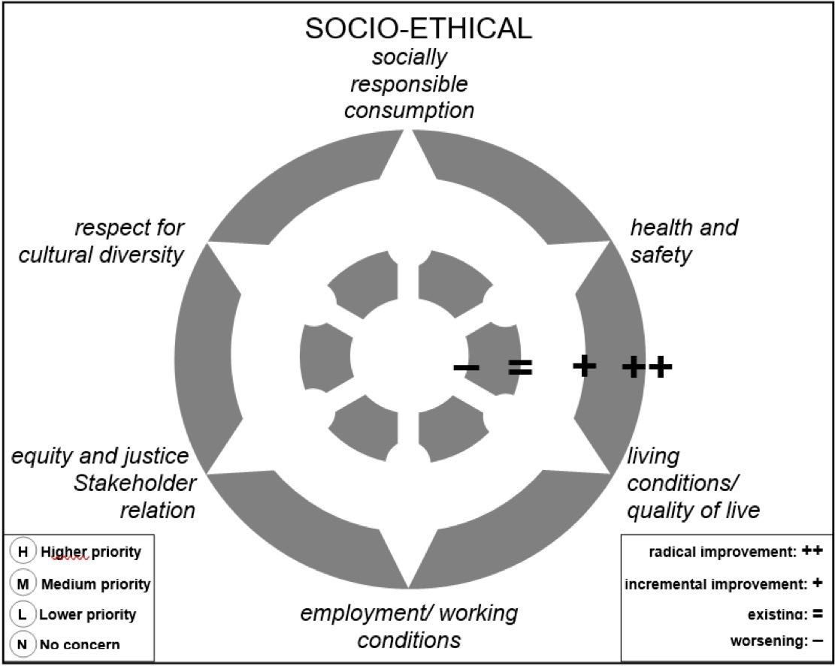
Screening : Socio-Cultural Criteria
Notes:
This Socio-Cultural Criteria is generated as per our understanding of the PSS model and its implementation.

Slide 12
Screening : Socio-Cultural Criteria
Notes:
This Socio-Cultural Criteria is generated as per our understanding of the PSS model and its implementation.

Slide 13
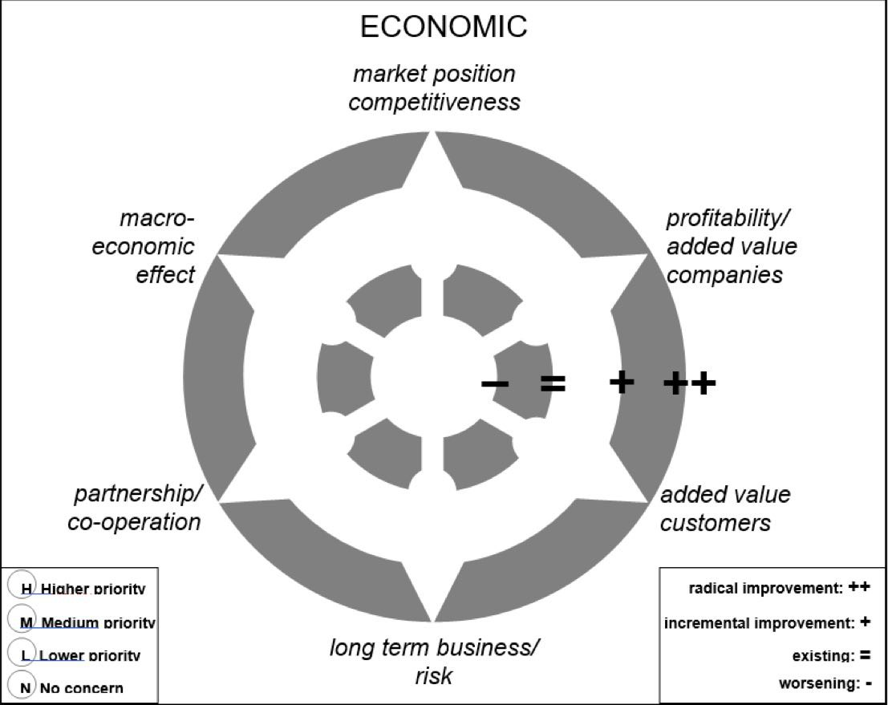
Screening : Economic Criteria
Notes:
This Economic Criteria is generated as per our understanding of the PSS model and its implementation.

Slide 14
Screening : Economic Criteria
Notes:
This Economic Criteria is generated as per our understanding of the PSS model and its implementation.

Slide 15
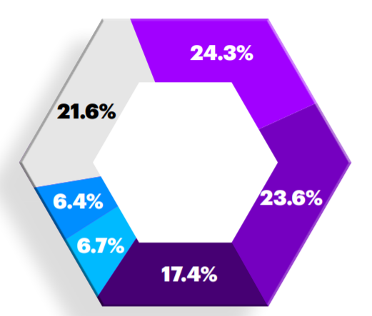
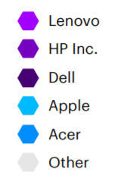
Competitors
DaaS is exploding in the market.
In PC Devices alone: in 2015, 0% of PC manufacturers offered DaaS as an option in the PC market. By 2019, DaaS as a product was offered by PC manufacturers with over 65% of market share.
Device as a Service (DaaS) Market to Surpass USD 190,163.86 Million by 2026 With Registering a CAGR of 55.8%. (CAGR-compound annual growth rate)
Ref: https://www.accenture.com/_acnmedia/PDF-128/Accenture-Device-As-A-Service-Business-Model.pdf#zoom=40
Notes:
In PC Devices alone: in 2015, 0% of PC manufacturers offered DaaS as an option in the PC market. By 2019, DaaS as a product was offered by PC manufacturers with over 65% of market share

Slide 16
Reference
https://www.lenovo.com/
https://www.lenovo.com/content/dam/lenovo/pcsd/north-america/en/solutions/services/flyers/lenovo-client-services-end-to-end-guide.pdf
https://www.accenture.com/_acnmedia/PDF-128/Accenture-Device-As-A-Service-Business-Model.pdf#zoom=40
https://www.logically.com/solutions/services/managed-services/device-as-a-service
https://www.data3.com/knowledge-centre/ebooks/unpacking-device-as-a-service/
https://www.lenovo.com/us/en/landingpage/lenovo-financial-services/
http://www.globenewswire.com/en/news-release/2021/02/08/2171252/0/en/Device-as-a-Service-DaaS-Market-to-Surpass-USD-190-163-86-Million-by-2026-With-Registering-a-CAGR-of-55-8-Market-Research

