Slide 1
AI Project Overview
# CUSTOM-AGENT-CHATBOT-FASTAPI
Make you own custom agent fro topic relevent reasoning based chat

Slide 2
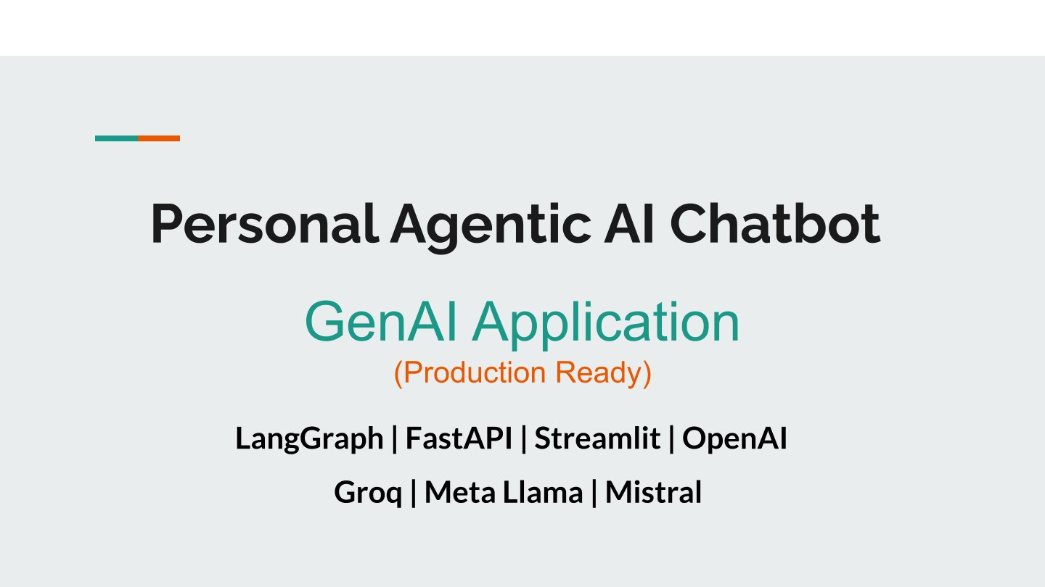
AI Agent Overview

Slide 3
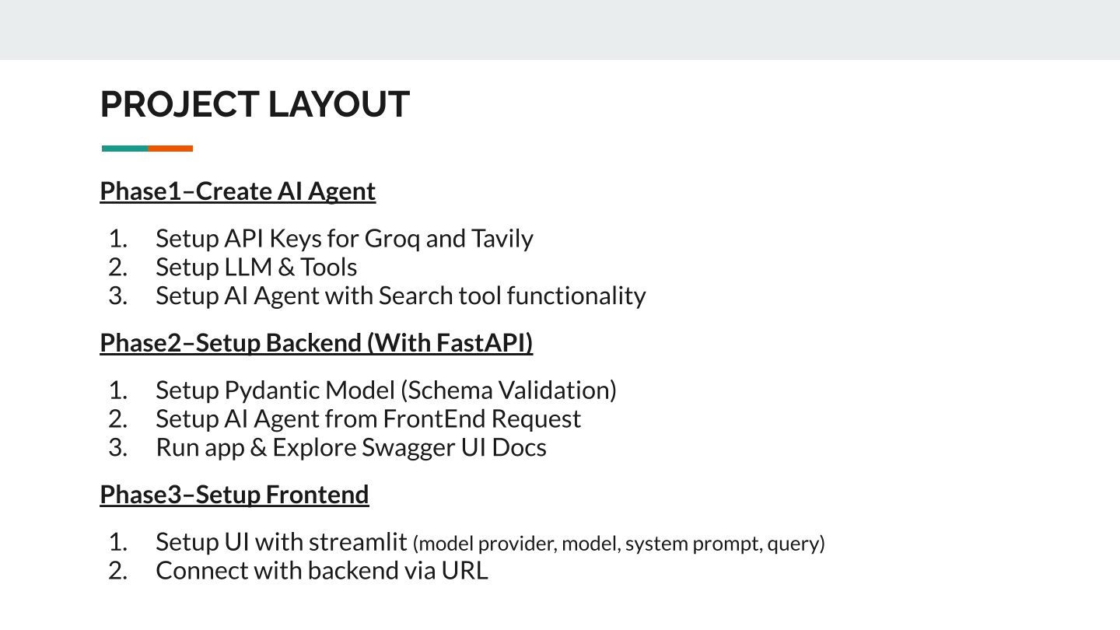
System Architecture

Slide 4
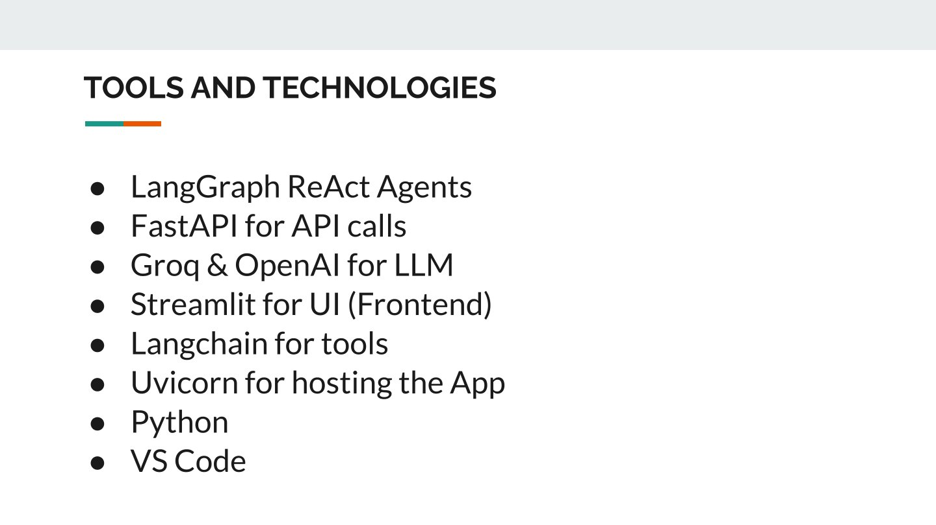
Modules/Workflow

Slide 5
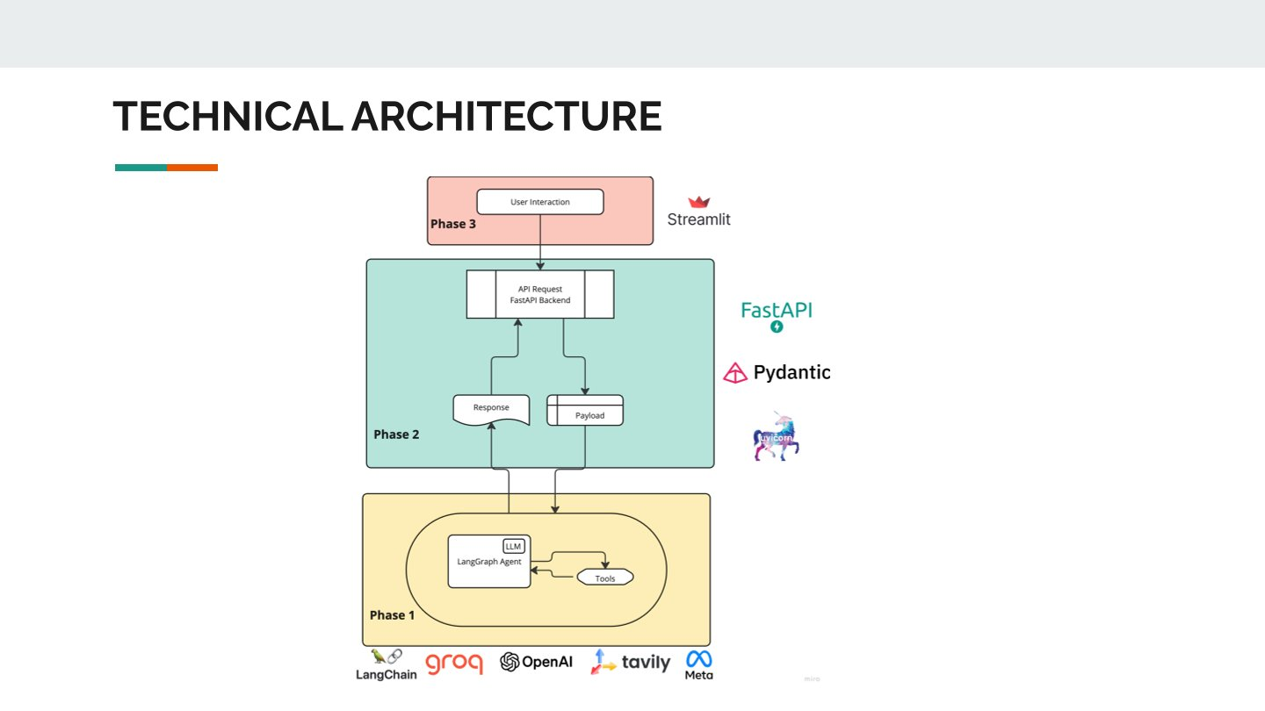
Additional Design Details

Slide 6
Main Python Files
- ai_agent.py: Defines agent behavior
- backend.py: Handles backend logic
- frontend.py: Manages UI components
- requirements.txt: Lists dependencies

Slide 7
Key Features
- Modular agent-based design
- Interactive frontend and backend
- Scalable architecture
- Easy to extend and maintain

Slide 8
Conclusion & Scope
- Innovative AI agent integration
- Can be extended for various real-world applications
- Future upgrades: better UI, real-time data, cloud support

