Slide 1

News Hunter
An AI-powered news summarizer and scraper using Python agents.
By :- Varun Rathour

Slide 2
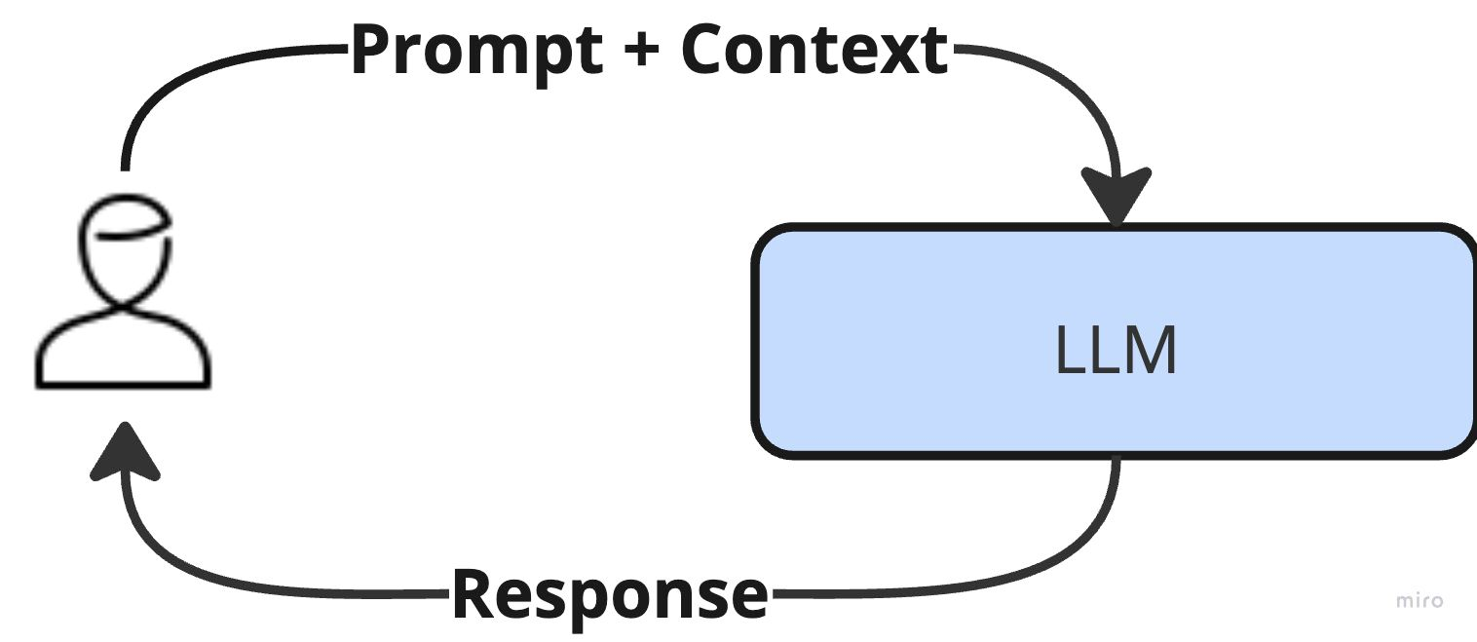
Architecture: LLM

Slide 3
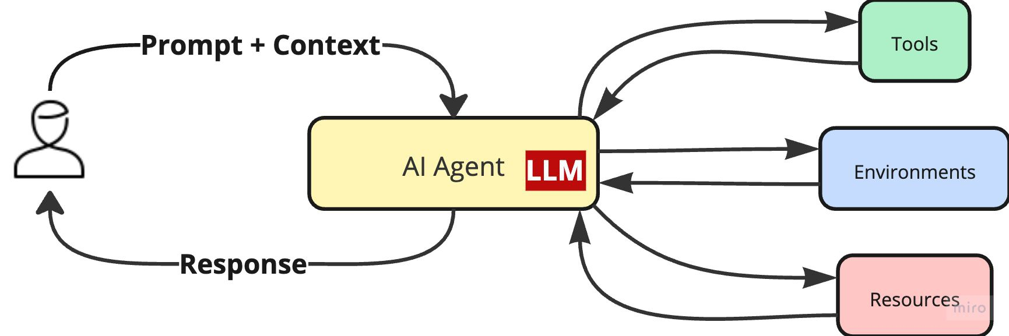
Architecture: Agent

Slide 4
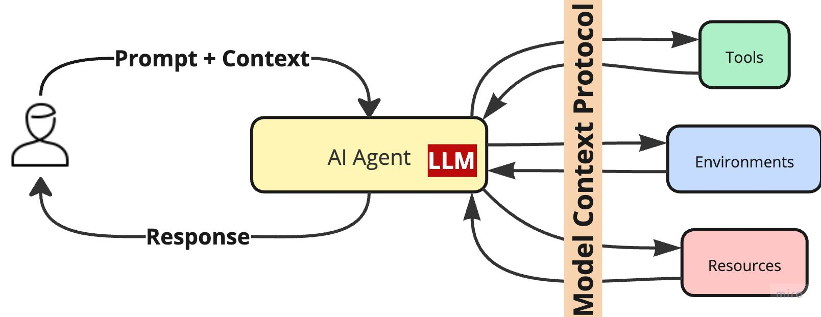
Architecture: MCP

Slide 5
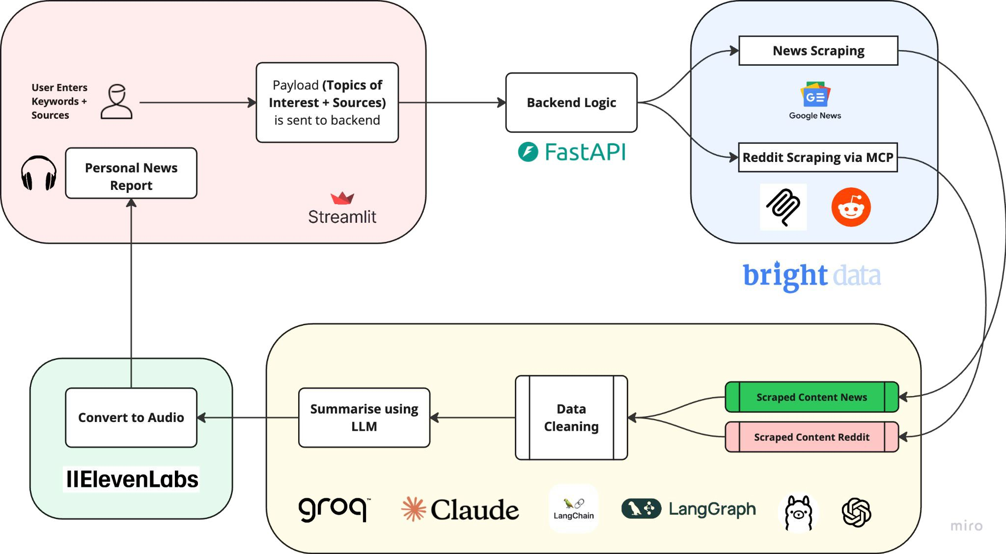
Project Workflow

Slide 6
Modules Description
- backend.py: Handles backend processing using fast API
- frontend.py: GUI/Frontend logic using streamlit UI
- news_scraper.py & reddit_scraper.py: Scrapes news from sources
- models.py: AI model interactions
- utils.py: Helper functions

Slide 7
Key Features
Modular Python structure
Reddit and general news scraping
AI agent-based news summarization
Audio output support

Slide 8
Audio Feature
News summaries are converted to speech using text-to-speech (TTS).
Example file: tts_20250616_013524.mp3
Using eleven labs

Slide 9
Conclusion & Future Scope
- Robust AI-based news system
- Can be extended with live feed integration
- UI improvements and voice assistant support

