Slide 1
Redfin Real Estate Project
By Varun Rathour

Slide 2
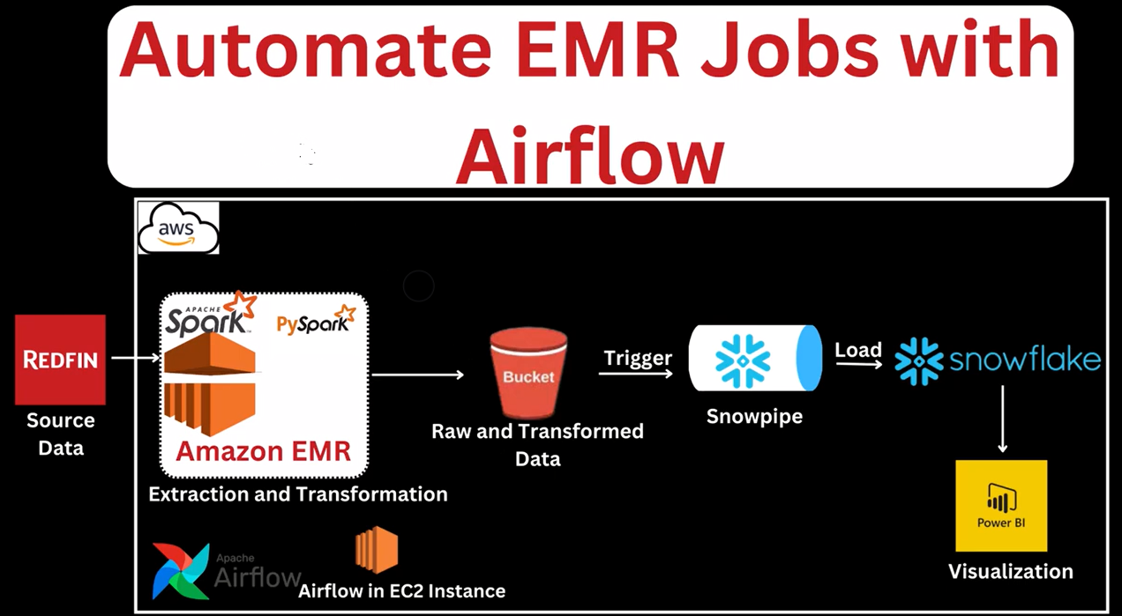
Project Architecture

Slide 3
Data Ingestion - Shell & Airflow
• Shell Script (`ingest.sh`) is used to trigger data pull from Redfin dataset sources.
• Airflow DAG automates the schedule to run ingestion and transformation tasks on EMR clusters.
• Files: `ingest.sh`,

Slide 4
Data Transformation - Python Scripts
• Python script `transform_redfin_data.py` used to clean, transform and enrich Redfin real estate data using py spark .
• Loaded processed data into a structured format ready for Snowflake upload.
• Used pandas, numpy libraries for data wrangling.

Slide 5
Data Storage - Snowflake
• Snowflake used as a Data Warehouse to store transformed data.
• Used SQL scripts to create databases, schemas, and tables.
• Refer: `snowflake script.txt`, `SCD_Project.pdf`

Slide 6
Analytics Layer - Power BI
• Power BI dashboard created to visualize real estate trends from Snowflake data.
• Key visualizations: Price trends, Region-wise listings, Sales over time.
•

Slide 7
Conclusion
• End-to-end pipeline implemented using Shell, Airflow, EMR, Python, and Snowflake.
• Automated, scalable and cloud-based.
• Visualized insights using Power BI.

