Slide 1
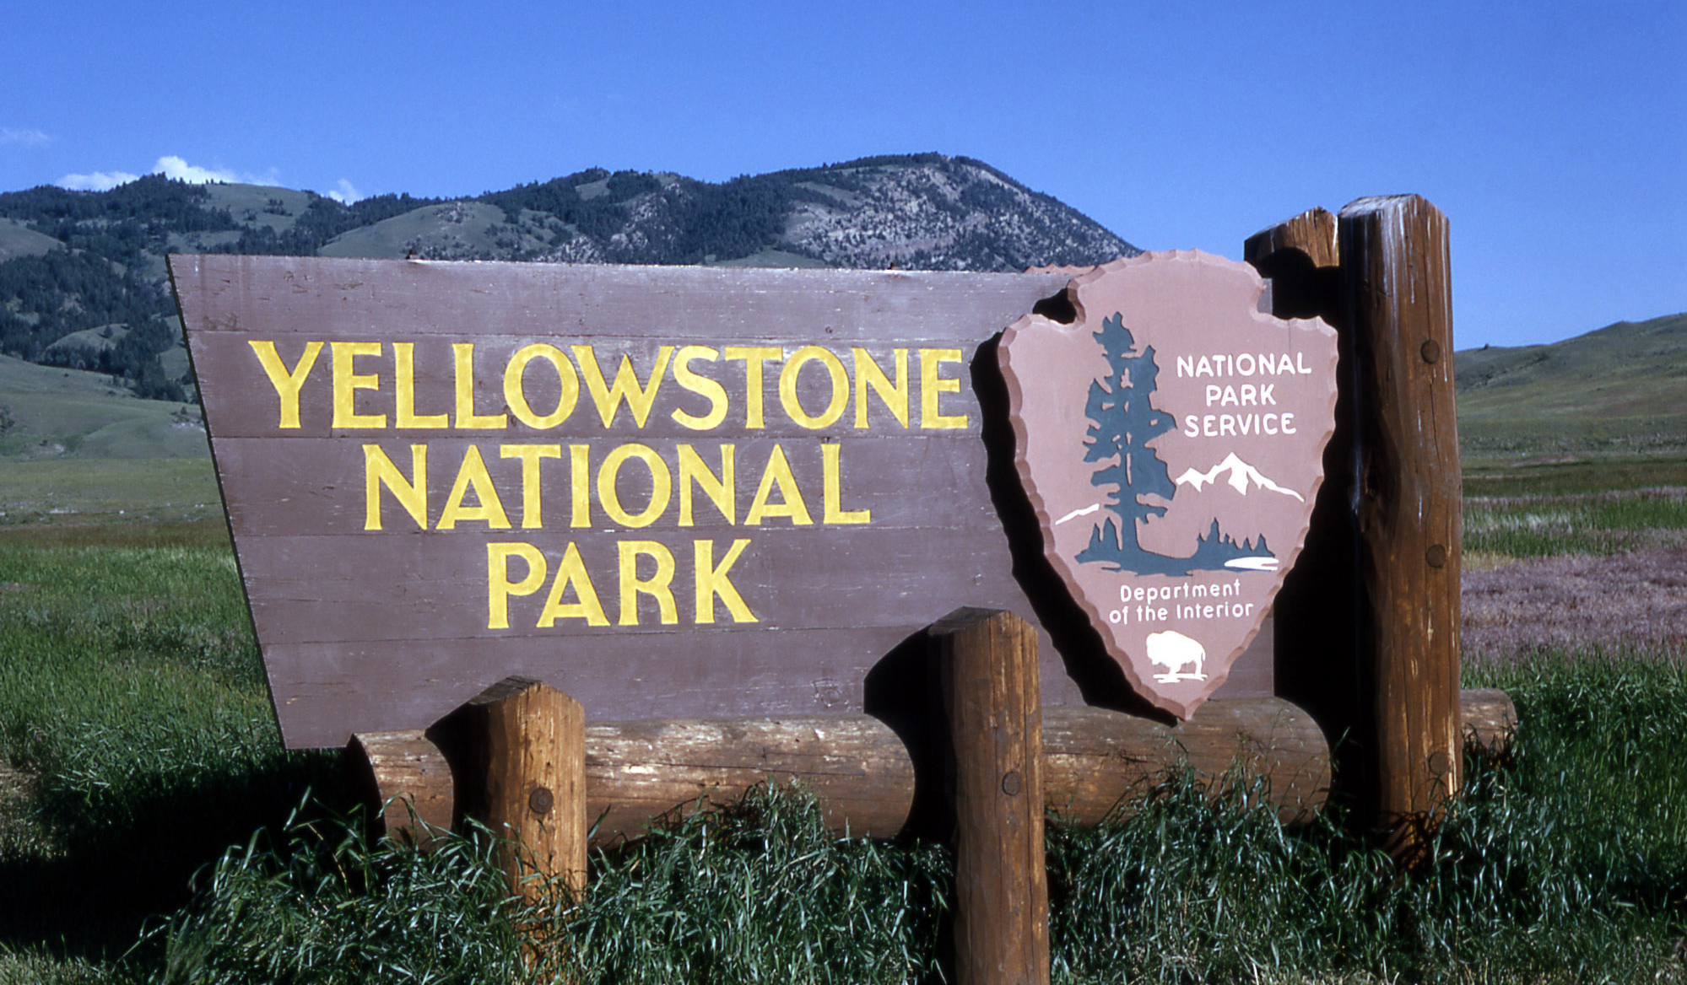
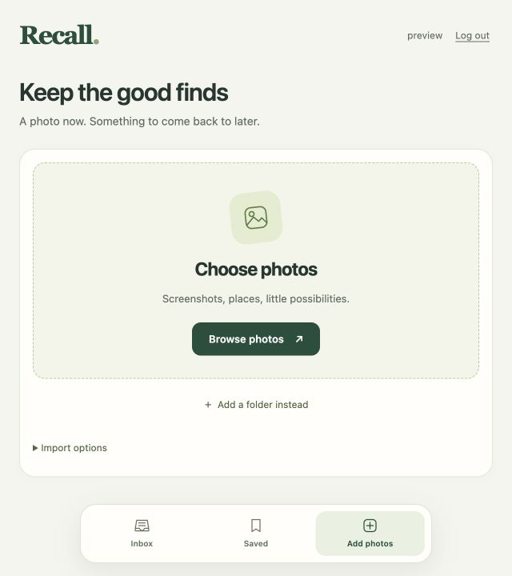
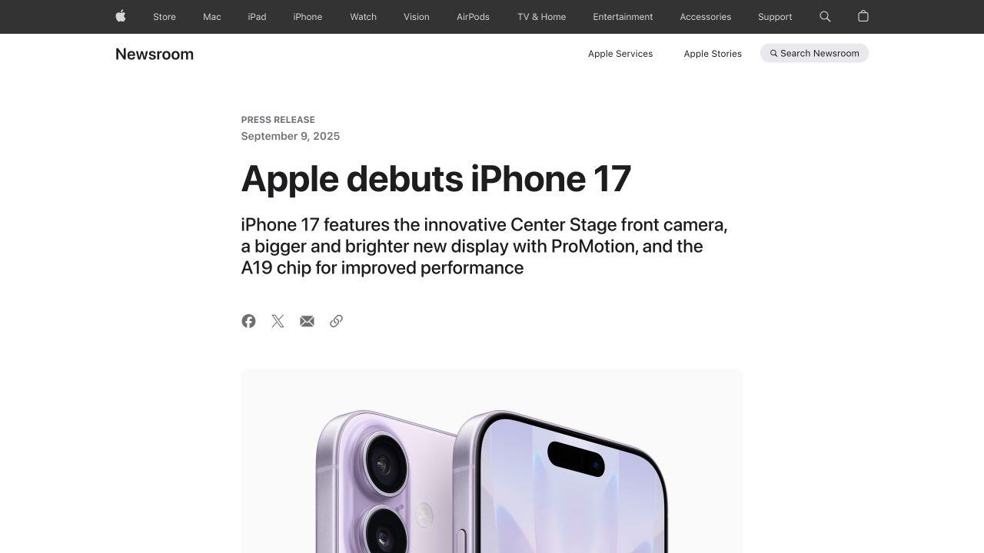
Typography
A recognizable name and readable details
A personal collection
The sign gives its name a distinct voice. Recall’s 32 px Georgia wordmark adds a bookish character that suits a collection of things to revisit.
[1] Park signage
A clear first step
Serif capitals make the park name the sign’s unmistakable focal point.
Apple separates its headline from details by size and weight. Recall uses a 31 px heading, then smaller guidance, so a new user can find the photo picker quickly.
Type suited to each task
System sans-serif text keeps controls consistent with the device. The 16 px search text supports reading and editing longer queries. The serif stays in the wordmark to keep forms simple.
[2] Apple Newsroom
Recall today: Add photos
Bold sans-serif headings establish order before the smaller details.
Recall / Visual design study / 1
Notes:
Typography study. [1] Yellowstone entrance sign photograph, Living on Earth: https://loe.org/shows/segments.html?programID=13-P13-00008&segmentID=1 . The sign contributes the idea of a distinct serif identity, not its all-capital treatment. [2] Apple Newsroom, Apple debuts iPhone 17: https://www.apple.com/newsroom/2025/09/apple-debuts-iphone-17/ . Screenshot captured October 19, 2026, cropped to the headline and supporting text. The visual observation concerns size and weight hierarchy, not a claim that Recall uses Apple's proprietary typeface. Recall Add photos screenshot captured October 19, 2026. Current values verified in frontend/src/style.css: Georgia wordmark 32px 600, page title 31px 600, inputs 16px, system sans-serif stack for controls. These are design intentions rather than measured usability findings. The serif wordmark lends a personal collection character while system text supports repeated reading and editing. One large page heading establishes purpose before the import action. External imagery retains its creators' rights and appears for classroom analysis.

Slide 2
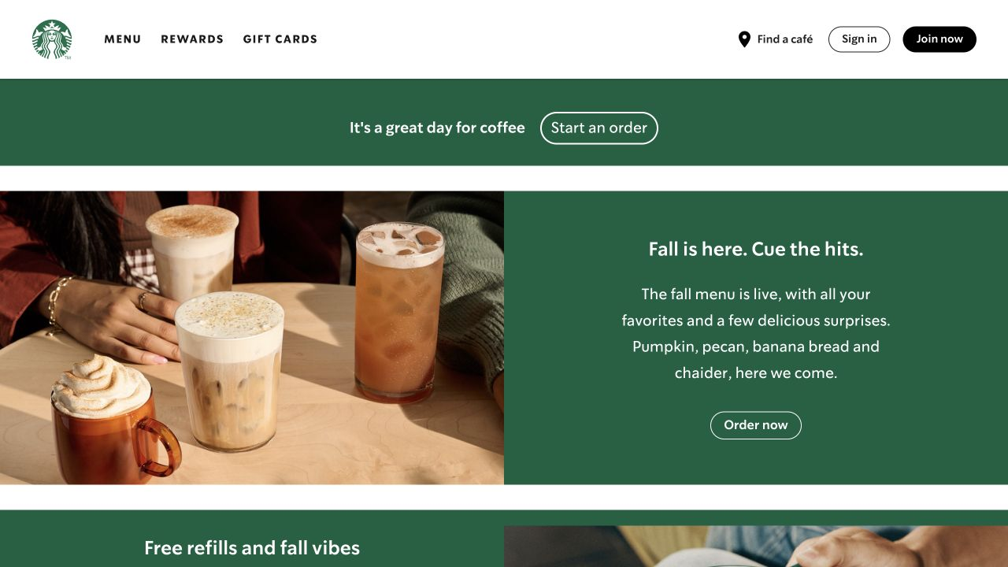
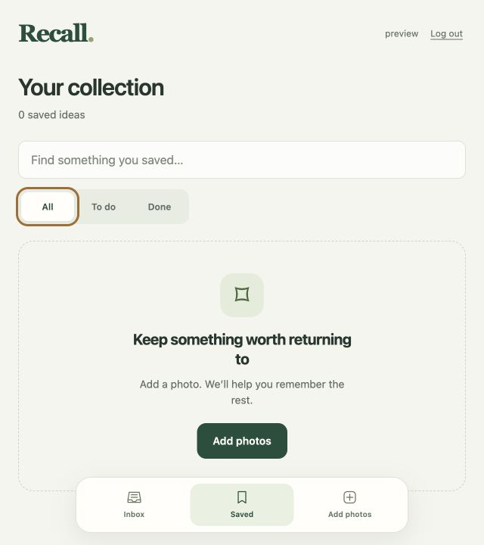
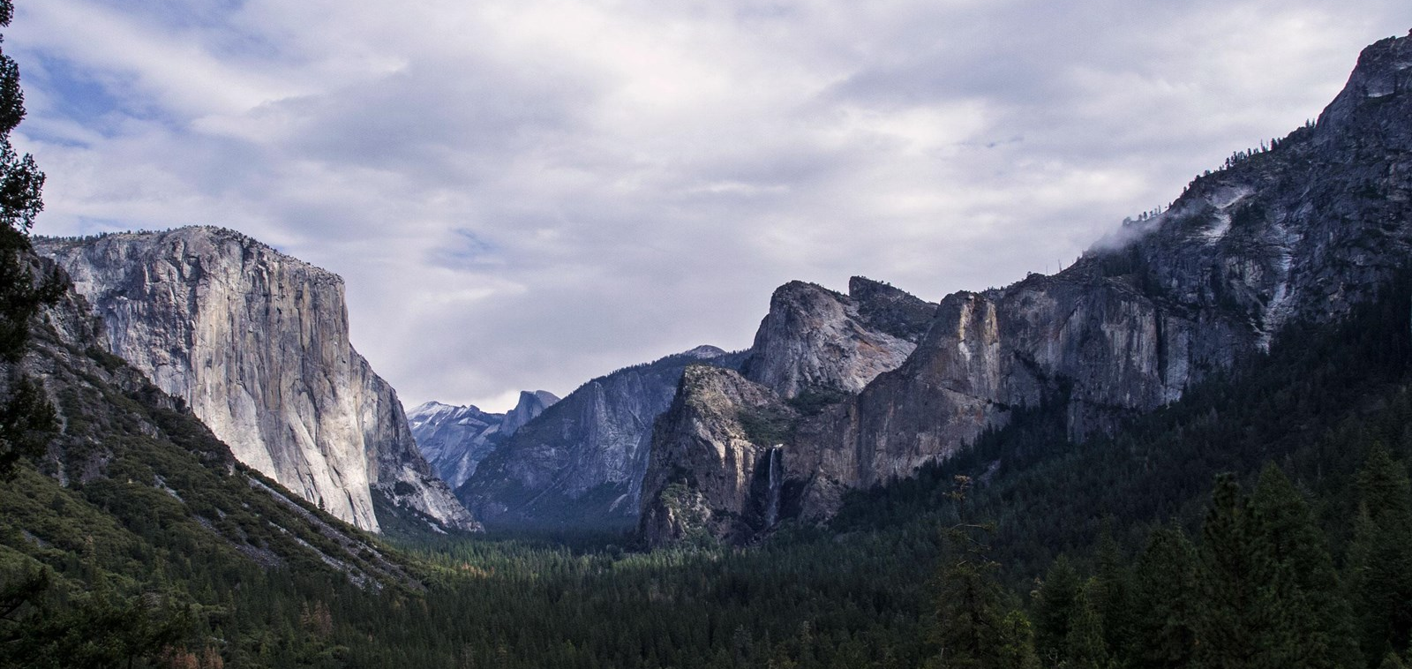
Color
Quiet surfaces and a visible next action
Room for varied photos
Page #F5F5EE / card #FFFEFA
Yosemite pairs pale rock with darker greens. Recall uses cream surfaces so a colorful product or event screenshot remains the focus.
[3] Starbucks website
One recognizable action
Deep green and light space frame the drinks without competing with them.
Action #214F3C / text #24372F
Starbucks repeats green across its page. Recall reserves solid forest green for primary actions, helping “Add photos” stand out from quieter filters.
A separate focus cue
Focus outline #A76B2E
The brown ring marks the current keyboard target even when “All” is already selected. Written filter labels keep the choices understandable beyond color.
[4] Yosemite, Tunnel View
Recall today: Saved
Pale granite contrasts with the valley’s dense green canopy.
Recall / Visual design study / 2
Notes:
Color study. [3] Starbucks home page: https://www.starbucks.com/ . Screenshot captured October 19, 2026. Observe repeated deep green and generous light separation around product photography. Recall borrows the restrained relationship between brand color, light surfaces and images, not Starbucks' exact colors or layout. [4] Tunnel View, Yosemite National Park, NPS Photo / C. Jacoby: https://www.nps.gov/places/000/tunnel-view.htm . Image: https://www.nps.gov/common/uploads/cropped_image/primary/0CFC2E25-B7B1-A12D-8621A2F88303D8EF.jpg?width=1600&quality=90&mode=crop . Observe pale granite above a darker green forest. Recall Saved screenshot captured October 19, 2026 with keyboard focus on All. Applied values verified in frontend/src/style.css: page #F5F5EE, cards #FFFEFA, primary #214F3C, text #24372F, focus-visible #A76B2E. Cream gives unpredictable user images a neutral setting. Solid green emphasizes the primary action. The brown outline identifies keyboard focus separately from selection, and filter labels provide meaning through text. These rationales describe intended benefits, not a completed accessibility or user study. External sources retain their original rights and appear for classroom design analysis.

