Slide 1
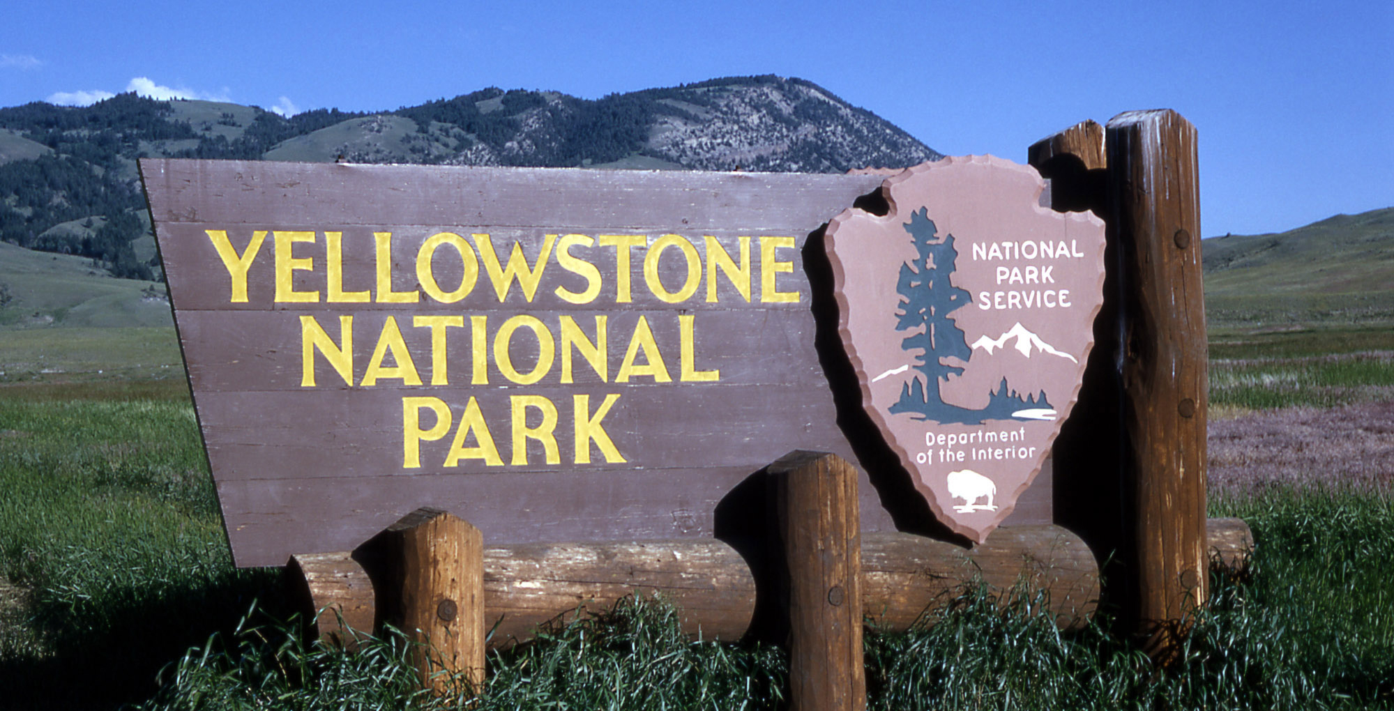
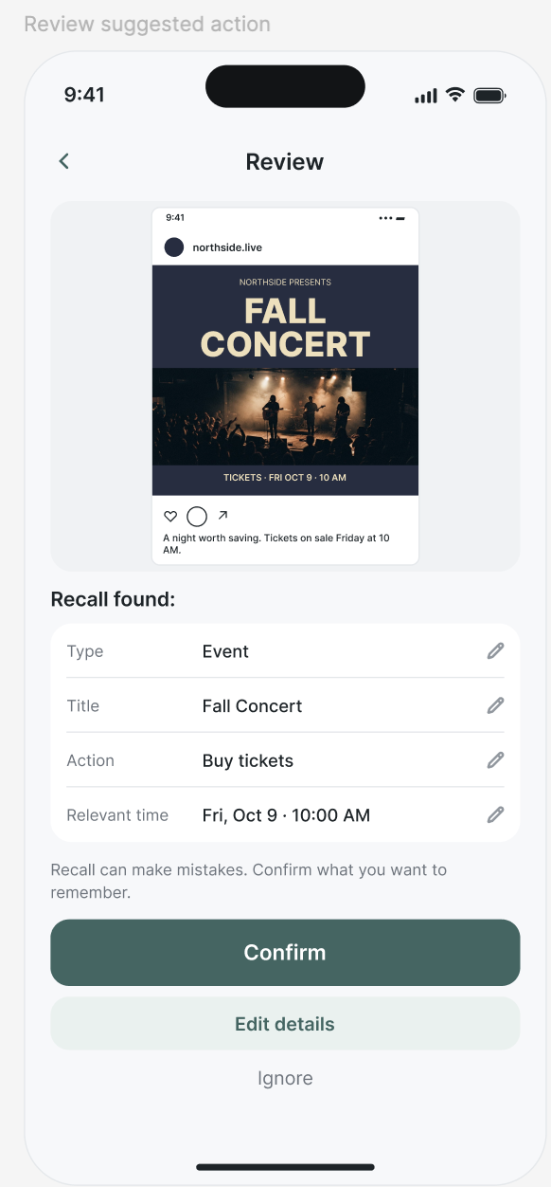
Typography: clear actions at a glance
Recall sketch
Compact labels separate the action from its time. Keep the form easy to scan, with labels beside each value.
Applied in the beta
Photographed signage
System sans serif; 16px controls; restrained bold headings. Each field has a visible label. Buttons name the action: Review suggestion, Confirm, Mark complete.
A short, prominent name makes the destination easy to find. Borrow the hierarchy, not the all-caps body text.
Reference photograph + interface sketch • Sources and design decisions in speaker notes
Notes:
Sources: https://loe.org/shows/segments.html?programID=13-P13-00008&segmentID=1 (Yellowstone sign photo, used for classroom design analysis); design_images/review.png (original Recall P1 sketch). These references inform hierarchy, not a claim that the app uses the sign font. Applied choices: frontend/src/style.css system font stack and 16px inputs; ReviewView.vue labels and action buttons.

Slide 2
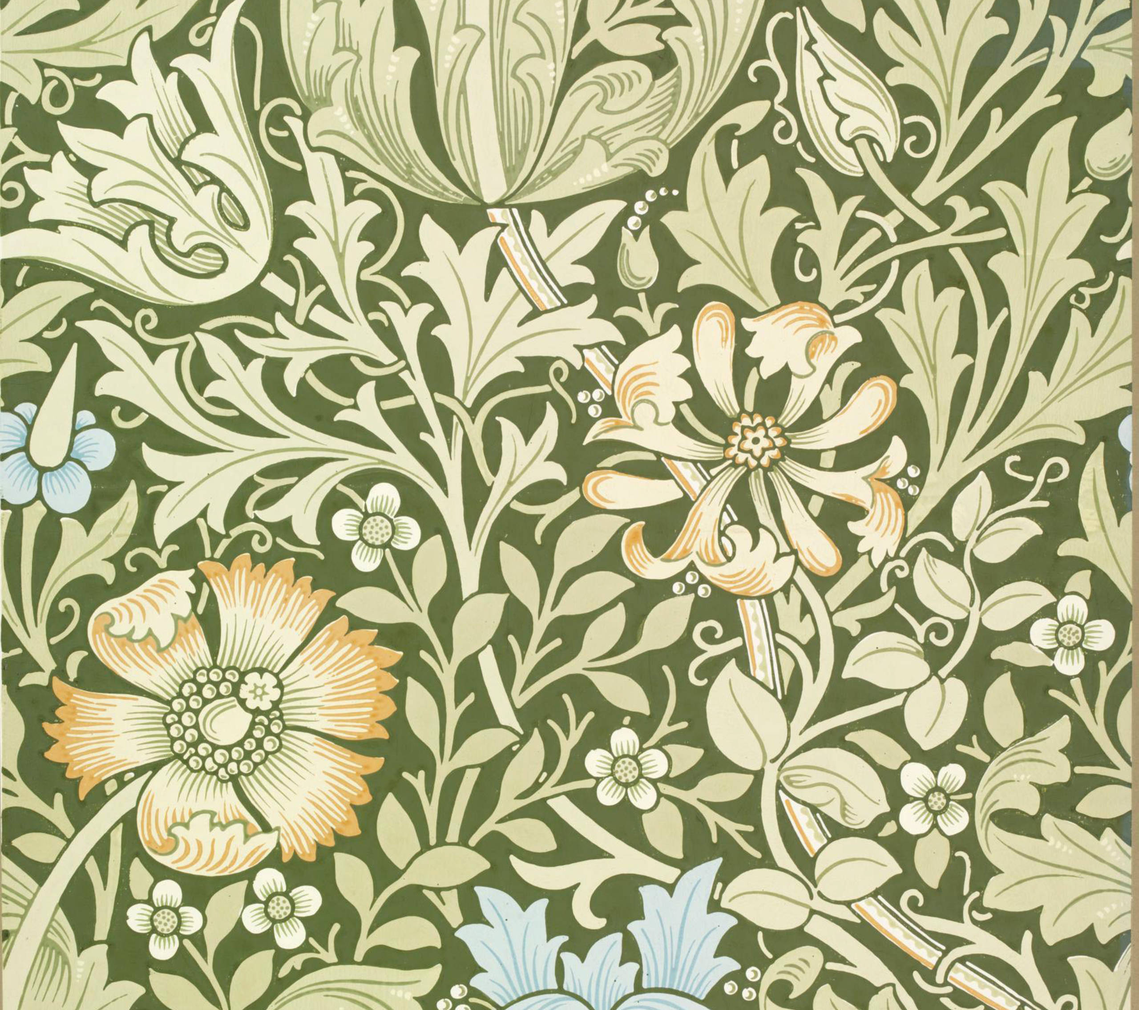
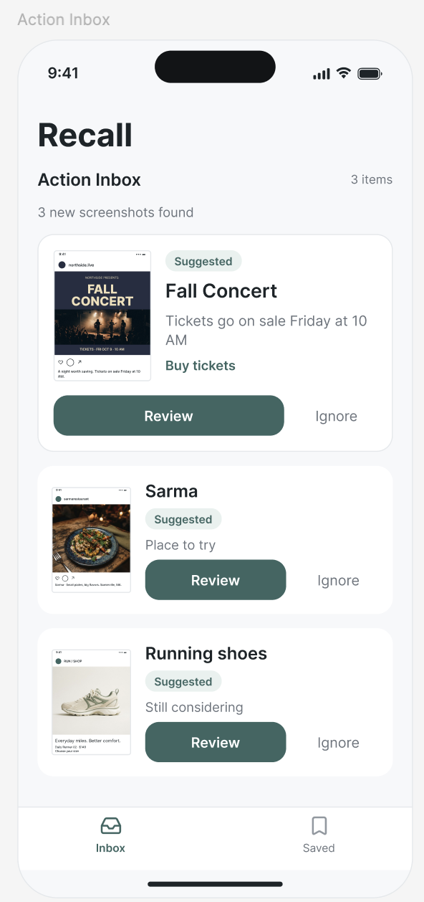
Color: quiet surfaces, visible decisions
Applied palette
#1F3D36 Primary action
#F5F6F8 Page background
#FFFFFF Reading surface
#525B68 Supporting text
#B91C1C Error text
Meaning beyond color
Suggested and Due badges include text. Errors announce themselves. A distinct focus outline identifies the current keyboard target.
Printed pattern
Borrow the muted green and pale ground. Keep the pattern out of the working interface.
Notes:
Sources: https://www.vam.ac.uk/articles/william-morris-and-wallpaper-design and image https://vanda-production-assets.s3.amazonaws.com/2017/11/27/15/33/51/b547ca34-492e-481f-a6eb-77a03a021de1/22.compton.2008BT7237_2500.jpg (V&A wallpaper reference, classroom design analysis); design_images/inbox.png (original Recall P1 sketch). Applied palette comes from frontend/src/style.css, including a darker secondary text color and brown keyboard focus outline. The references are photographs, a printed decorative work, and interface sketches; annotations explain the decisions adopted in Recall.

