Slide 1
Spiral Model

Slide 2
Spiral Model History
Evolved based upon refinements to the waterfall model which was applied to large government projects
Barry Boehm wrote an article in 1988 in which he described “A Spiral Model of Software Development and Enhancement”

Slide 3
Spiral Model Explanation
“A primary source of difficulty with the waterfall model has been its emphasis on fully elaborated documents as completion criteria for early requirements and design phases. For some classes of software, such as compilers or secure operating systems, this is the most effective way to proceed. (Boehm, 1988, p. 63)”

Slide 4
Spiral Model Explanation
“However, it does not work well for many classes of software, particularly interactive end-user applications. Document-driven standards have pushed many projects to write elaborate specifications of poorly understood user interfaces and decision support functions, followed by the design and development of large quantities of unusable code. (Boehm, 1988, p. 63)”

Slide 5
Spiral Model
Risk-driven process model that is used to guide multi-stakeholders s in software-intensive systems

Slide 6
Spiral Model
Two main features
Cyclic approach for incrementally growing a system’s degree of definition and decreasing its degree of risk
Set of anchor point milestones for ensuring stakeholder commitment

Slide 7
Spiral Model Terms
Process model
What should be done next?
How long should it continue?
Spiral model answers are driven by risk considerations
Risks
Situations or events that can cause a project to fail to meet its goals
May range from fatal risks to trivial

Slide 8
Spiral Model Terms
Cyclic
Rather than develop a product in one step, multiple cycles are used which focus on risk reduction
Anchor point milestone
Specific combination of artifacts and conditions that must be attained at some point

Slide 9
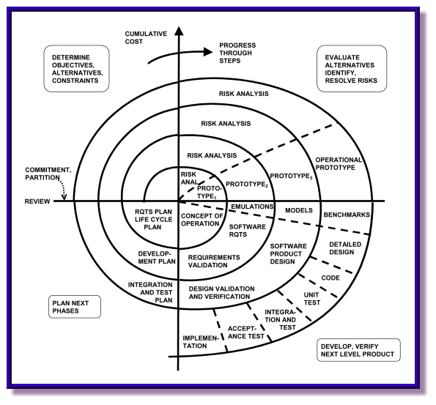
Image from: http://www.stsc.hill.af.mil/crosstalk/2001/05/boehm1.gif

Slide 10
Spiral Model Cycles
Each cycle
Determine objectives (performance, functionality, etc.), alternatives (which design? make or buy?) and constraints (costs, schedule, etc.)
Evaluate alternatives, identify and resolve risks
Develop, verify next level product
Plan next phase

Slide 11
Spiral Essentials
1. Concurrent determination of key artifacts
Should include operational concept, system and software requirements, plans systems and software design, code components, prototypes, success-critical components, algorithms
High technology systems, spiral products will be prototype-code intensive
Low-technology systems, spiral products will be requirements-intensive

Slide 12
Spiral Essentials
2. Objectives, constraints, alternatives, risks, review and commitment to proceed
If stakeholders are excluded from this process then critical risks will go undetected
3. Level of effort driven by risk considerations
Risk considerations answer difficult questions concerning how much is enough of a given activity
Determination of level of effort is important here

Slide 13
Spiral Essentials
4. Degree of detail driven by risk considerations
What is the result of efforts to minimize the risks?
If it is risky to not specify precisely, DO specify! (Prime-subcontractor interface for example)
If it is risky to specify precisely, DO NOT specify! (GUI layouts, Commercial Of The Shelf – COTS)

Slide 14
Spiral Essentials
5. Use Anchor Point Milestones
Life Cycle Objectives (LCO)
What should the system accomplish?
Life Cycle Architecture (LCA)
What is the structure of the system?
Initial Operating Capability
What is the first released version?

Slide 15
Spiral Essentials
6. Emphasis on System and Life Cycle Activities and Artifacts
Focus on overall systems and life-cycle concerns
Will the product satisfy stakeholders?
Will it meet cost and performance goals?
Will it integrate with existing business practices?
Will it adapt to organizational changes?

Slide 16
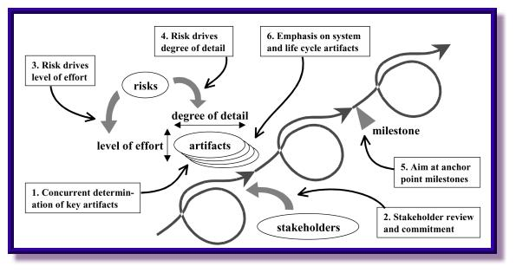
Image from: http://www.stsc.hill.af.mil/crosstalk/2001/05/boehm2.jpg

Slide 17
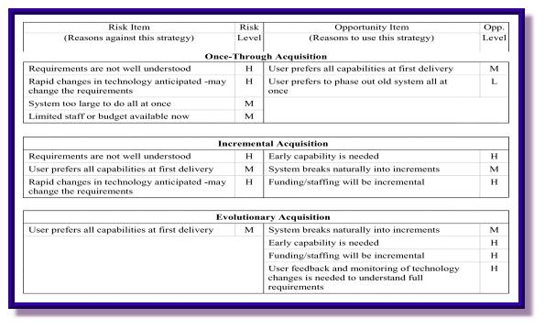
Risk Chart
Image from: http://www.stsc.hill.af.mil/crosstalk/2001/05/boehmt2.jpg

Slide 18
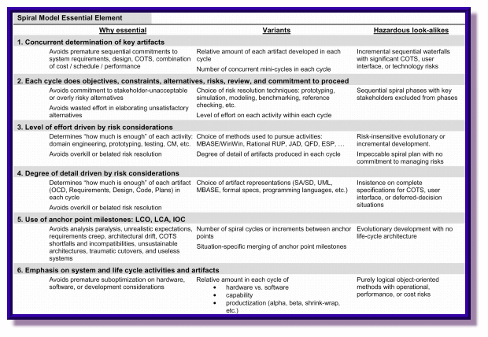
Image from: http://www.stsc.hill.af.mil/crosstalk/2001/05/boehmt3.gif

Slide 19
WinWin Spiral Model
Variation of Spiral Model
Developed for use with systems that have these characteristics
Rapidly moving technology
Many candidate approaches
Little user or developer experience with similar systems
Need for rapid completion

Slide 20
WinWin Spiral Model
Theory W
Management theory and approach, which says that making winners of the system’s key stakeholders is a necessary and sufficient condition for project success
WinWin Spiral Model
Adds Theory W to its model

Slide 21
WinWin Spiral Model
Developed for use with multimedia systems
Strengths
Flexibility
Able to adapt for risks and uncertainties
Discipline
LCO, LCA, IOA
Trust enhancement
Provides way for growing trust with stakeholders

Slide 22
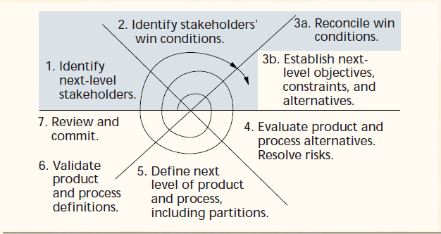
Win-Win Spiral Model

Slide 23
Spiral Model Advantages
Iterative process identifies risk analysis and handles risk reduction in each cycle
Every cycle includes stakeholder review
Model works with large scale projects

Slide 24
References
Boehm, B. (1988). A spiral model of software development and enhancement. Computer, 21(5). 62-72.
Boehm, B., Egyed, A., Kwan, J., Port, D., Shah, A., & Madachy, R. (1998). Using the WinWin spiral model: A case study. Computer 31(7). 33-34.

Slide 25
Spiral Model

