Slide 1
Scrum

Slide 2
What is Scrum?
Scrum is an agile software development framework
An iterative, incremental framework for developing any product or managing any work
It allows teams to deliver set of product functions every iteration which respond to changing requirements

Slide 3
Scrum Terms
Sprint
Basic unit of development
Usually lasts between one week to one month
Sprint length is determined by team
User stories
Customer requirements
Include list of high-level features and priorities for each features

Slide 4
Scrum Terms
Product backlog
High-level document for entire project
Contains descriptions of required features
Should be prioritized by the product owner

Slide 5
Scrum Terms
Sprint backlog
Property of the team
Contains information regarding how team will implement of features for a sprint
Contains breakdown of tasks
Tasks on backlog are not assigned
Rather team members sign up for tasks as needed
Who performs the task will depend upon team skills and priorities

Slide 6
Scrum Sprint Backlog

Slide 7
Scrum Terms
Task board
Used to display the status of various tasks during a sprint
Each row on a task board contains a user story
Status might be posted as “done”, “in progress”, “to do”

Slide 8
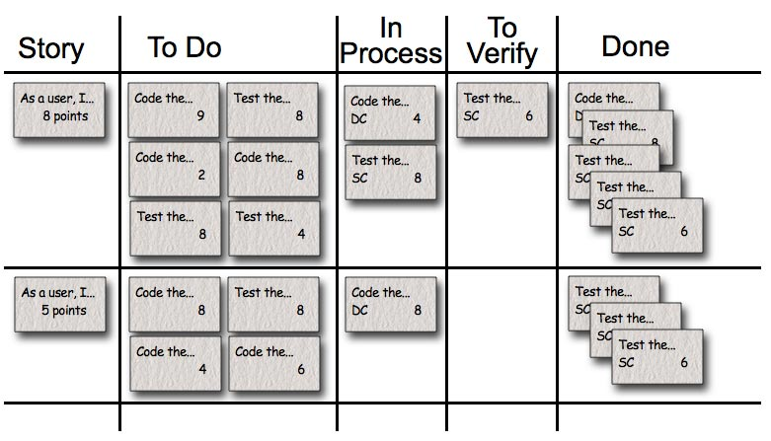
Scrum Task Board
Image from: http://www.mountaingoatsoftware.com/task-boards

Slide 9
Scrum Terms
Burn down chart
Graphical representation of what work is left to do versus time
Vertical axis is the backlog (work left to do)
Horizontal axis is time

Slide 10
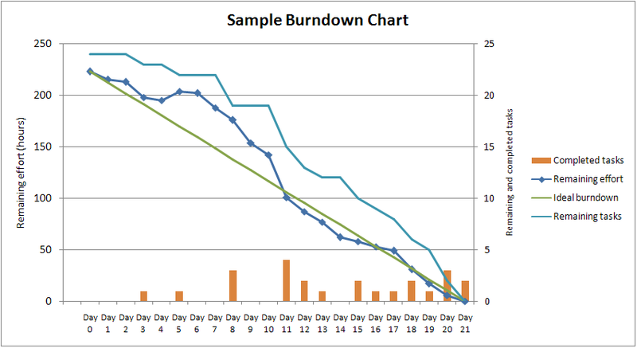
Scrum Burn Down Chart
Image from: http://en.wikipedia.org/wiki/File:SampleBurndownChart.png

Slide 11
Scrum Roles
Product Owner
Spokesperson for stakeholders
Define and prioritize product features
ScrumMaster
Like a project manager
Maintains the processes
Responsible for following Scrum practices

Slide 12
Scrum Roles
Team
Cross-functional group of up to 7 people
Perform actual analysis, design, programming, implementation, testing, etc.
Teams are self-organizing
Scrum Team
Product Owner, ScrumMaster, Team

Slide 13
Other Roles
Stakeholders
Customers, vendors, etc.
Management
People within the company that set up the product environment
Stakeholder and management are not part of the Scrum team

Slide 14
Sprint Planning Meeting
Sprint planning is completed by ScrumMaster and Team
Analyze the product backlog
Determine and select what tasks to include in sprint backlog
Determine and assign hours to complete a task for sprint backlog
Usually an eight hour limit for this meeting

Slide 15
Daily Scrum
Daily meeting usually up to 15 minutes
Usually meant to be a “stand-up” only meeting
Meeting location is usually at the same location and time every day
Often in the morning
Only ScrumMaster, Team and Product Owner are welcome

Slide 16
Daily Scrum
Daily Scrum questions
What have you accomplished since yesterday?
What are you planning to do today?
Are there any problems that are preventing you from finishing your goal today?
Answers to these questions are meant to commit team members to certain work in front of team

Slide 17
Sprint Review
Usually two to four hour limit for sprint review
Team presents demo to stakeholder showing features
Review work completed
Discuss work not completed
No incomplete work will be demonstrated to stakeholder

Slide 18
Sprint Retrospective
Usually attended by ScrumMaster, Team, Product Owner and sometimes stakeholders
Completed after every sprint
Typically lasts 15 to 30 minutes but may last up to 3 hours
Discuss what went well in sprint
Discuss what could be improved for next sprint

Slide 19
Scrum Characteristics
Scrum goal is to deliver a quality product
Self-organizing small teams
Series of sprints make up the product progress
Product backlog contains items in list which captures requirements

Slide 20
Scrum Characteristics
Good framework for changing customer requirements
Interactions and communication between team are improved by Scrum framework
Must have a client that knows what they want
Also needs someone to commit to become part of the Scrum team

Slide 21
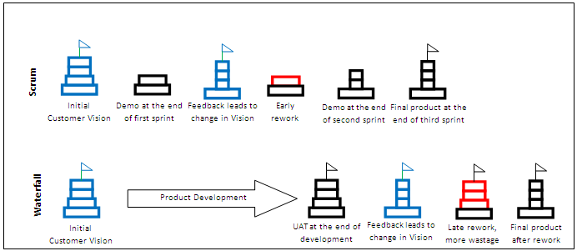
Scrum Versus Waterfall
Taken from: http://www.scrumalliance.org/articles/133-challenging-inertia-through-scrum

Slide 22
Scrum Criticisms
Scrum may fall apart if politics enter the arena or if teams do not function well

Slide 23
Scrum Resources
http://www.scrumalliance.org/
http://www.mountaingoatsoftware.com/scrum

Slide 24
Scrum

