Slide 1
Diabetes-Prediction
Varun Reddy Gopu

Slide 2
Dataset Description:
All patients here are females at least 21 years old of Pima Indian heritage.
Number of Instances: 768
Number of Attributes: eight plus class

Slide 3
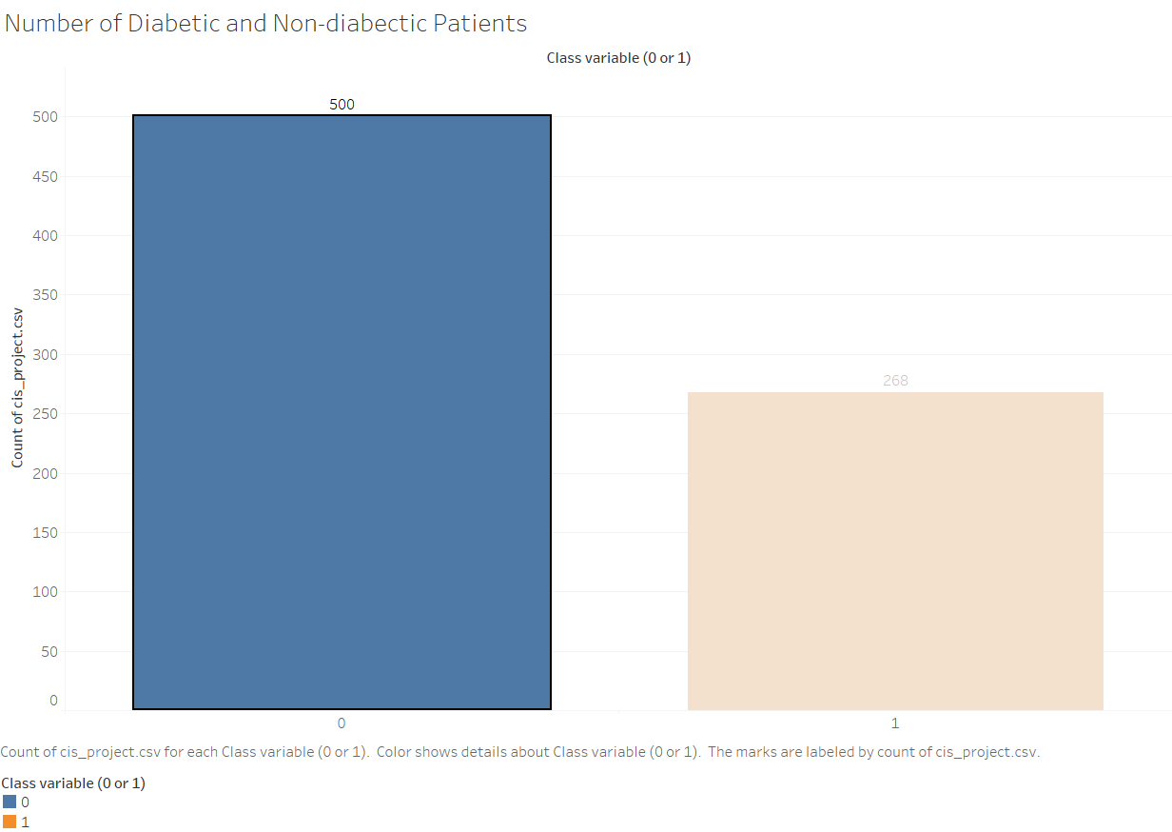
Number of Diabetic and Non-diabetic patients
0 indicate Non-diabetic patients.
1 indicate Diabectic patients.

Slide 4
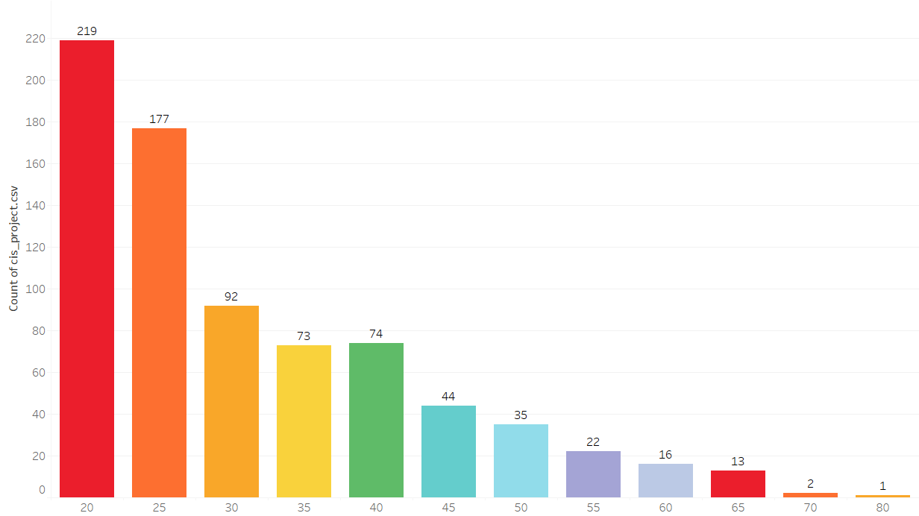
Population of data vs Age group

Slide 5
Attributes:
Number of times pregnant
Plasma glucose concentration 2 hours in an oral glucose tolerance test
Diastolic blood pressure (mm Hg)
Triceps skin fold thickness (mm)
2-Hour serum insulin (mu U/ml)
Body mass index (weight in kg/ (height in m) ^2)
Diabetes pedigree function
Age (years)
Class variable (0 or 1)

Slide 6
Data Insights
Mean age of the population is 33 years.
Average pregnancy is 3.84 ~ 4 times.
Plasma glucose concentration 2 hours in an oral glucose tolerance test is 120

Slide 8
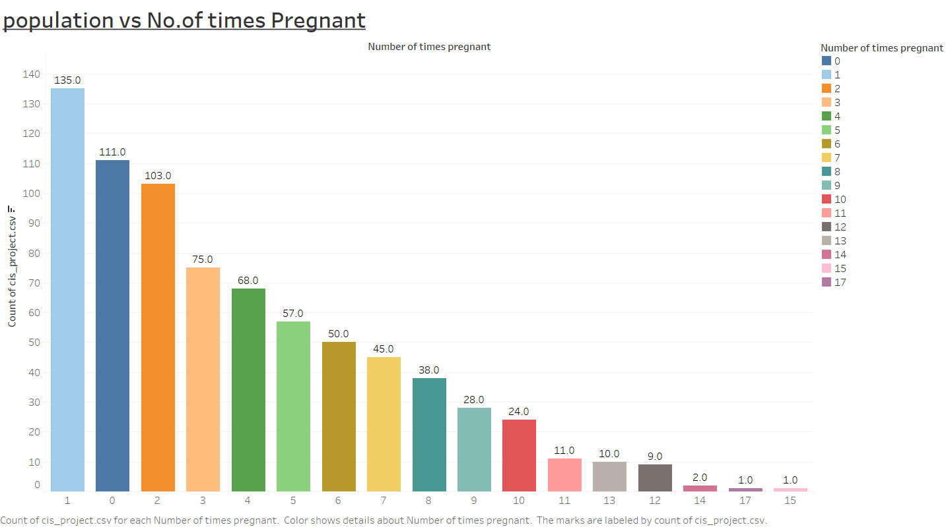

Slide 9
This Data set explains how gestational diabetes mellitus (GDM) has effect on type-2 Diabetes in near future.
Histogram in earlier slide explains how there is variation in data like there are around 111 patients who are not pregnant.
The data set has varied population from one time pregnant to 17 times pregnant.
In next few slides we will analyze the pattern for predication through Data mining.

