Slide 1
VALVE DATA ANALYSIS
Varun Rao
Intern at D-Sol HQ LSBC FVC Dept. Dunamis Exploration Sec.
YHQ
July 29th 2024

Slide 2
Valve Data Analysis
Problem Statement
Valve Data Analysis
In a Valve, the Final_Value which is the target value and Final_Position_Value which is the measured value needs to match
Normally, the error becomes small within a certain period of time(Approaching 0)
If the error increases drastically for a long duration of time, the valve will fail
The data used for analysis are Final_Value and Final_Position_Value
Objectives
To design an Algorithm to detect Valve failure based on historical data
To determine threshold value using the Abnormality in the data
To perform statistical study on the data to determine the relationship between variables

Slide 3
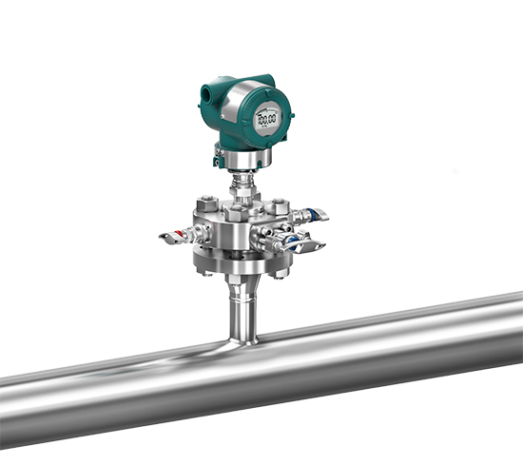
Criteria for valve to fail
The factors that influence valve failure are:-
1. The magnitude of the error
2. The duration of the error above a certain level
3. If the error occurs continuously

Slide 4
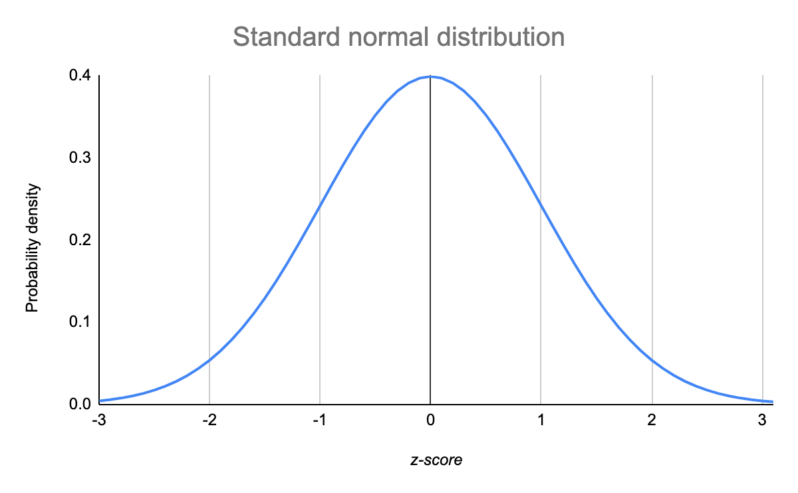
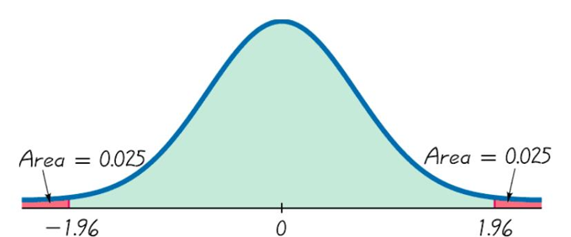
Magnitude of Error
Normal Distribution
Standard assumption is that the error values of abnormal data follow a normal distribution
95 % of the error data values are assumed to be ok
The remaining 5% of the error values is considered abnormal
The threshold value is 1.93
In this case, error values that are more than 1.93 are considered abnormal or indicate valve failure

Slide 5
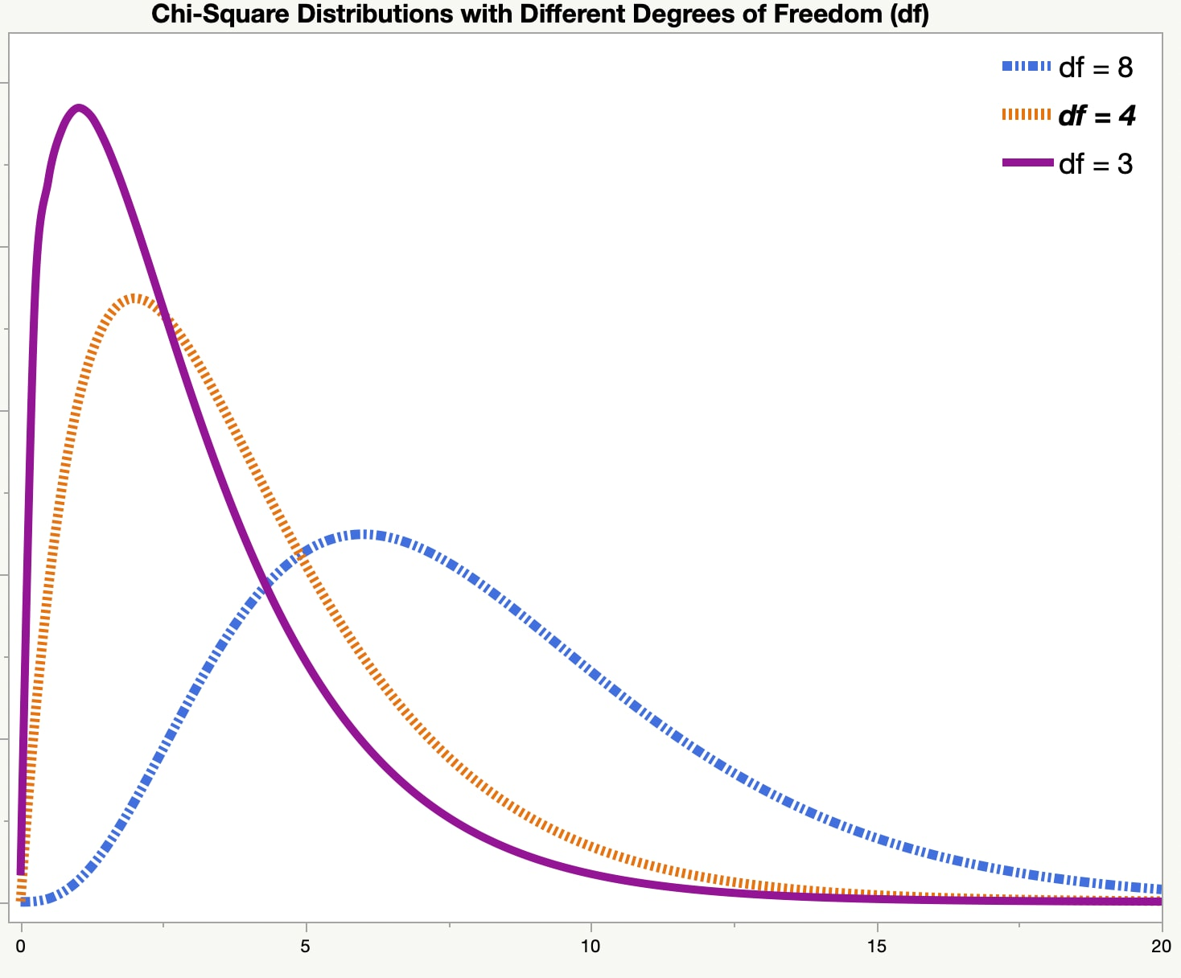
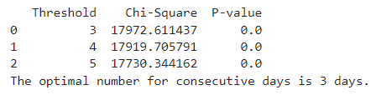
Duration of the error
Chi-Square Test
The chi-square test is suitable for categorical data
In this case, both the number of consecutive days and the valve failure status are categorical
Number of consecutive days can be categorized as "below threshold" or "above threshold.“
Valve failure status is binary (failure or no failure).
We can test if valve failure is associated with the number of consecutive days of increasing error magnitude
After testing the valve_data on Chi-Square, there is highest association for 3 days

Slide 6
Valve Failure Algorithm
INPUT: Threshold Value, Valve_Data excel file containing Date, Final_Value and Final_Position_Value
Step1: Compute Error column using the formula Error= Final_Position_Value-Final_Value
Step2: Create another excel sheet and Compute Error_Rolling_mean column which is the average of 144 Error values of each day and group the Column with date only excluding the time
Step3: Check Error_Rolling_mean for each day and check if it exceeds threshold value
If Yes, mark the day as 1
And check if next two consecutive days also exceeds the threshold value and mark them as 1
Else, move to next consecutive day and repeat Step 3
Step4: If the third consecutive day is marked as 1, extract the corresponding Date and conclude that the valve has failed on that day
OUTPUT: The valve “X” has failed on DD-MM-YYY or The valve “X” didn’t fail

Slide 7
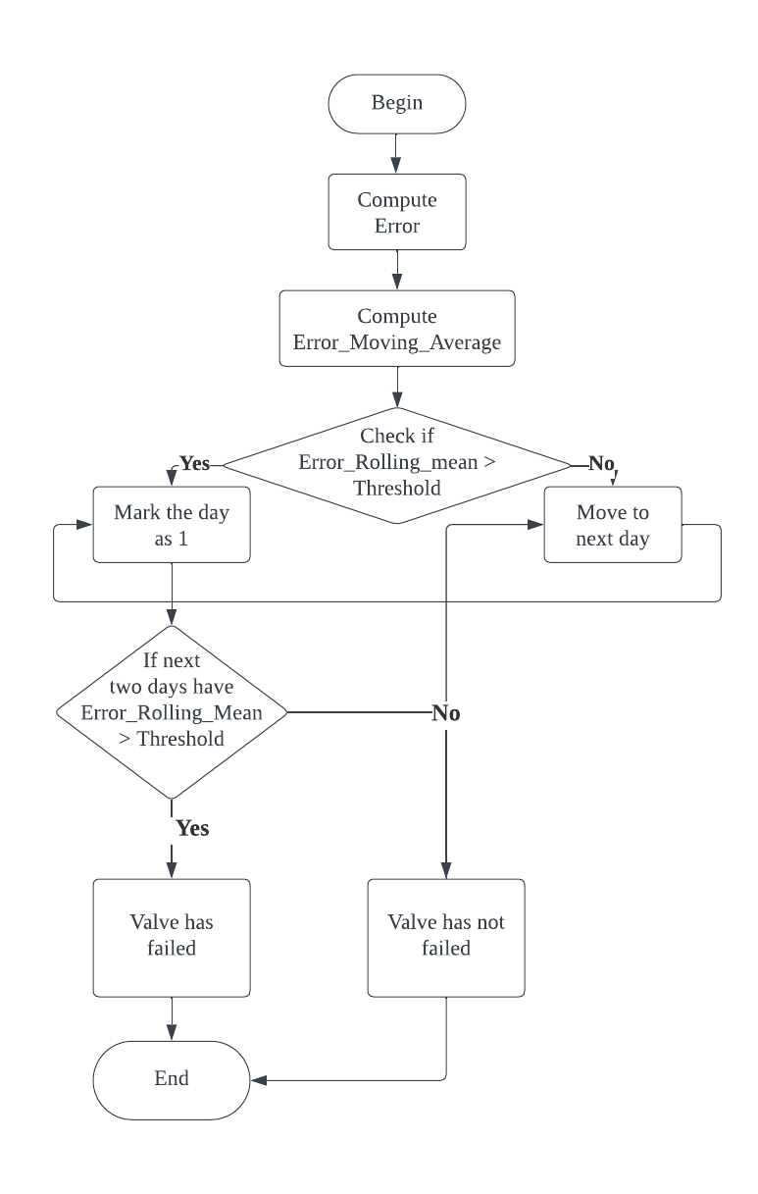
Algorithm Flowchart

Slide 8
Valve Data Analysis
Methodology
Preprocessing the data
Dealing with missing values
Calculating Error using the formula:- Error=Final_Position_Value - Final_Value
Calculate Error Moving Average for each day
Determine the threshold value using the abnormal data
Algorithm:- If the error moving average for a day exceeds the threshold value and it continues for three days or more then the valve will fail else the valve will not fail
Testing the algorithm on 50 valves from historical dataset of 2023-2024

Slide 9
Testing
Tested 50 valves from 2023-2024 data using the algorithm
One valve AFCV7119A was declared as defective
49 Valves were declared as non-defective
An excel sheet for each valve was created
Each excel sheet has the valve name as its filename
The testing data had around 100 valves
The Final_Value and Final_Position_Value was extracted
Error was calculated for each valve
Error rolling mean for each day was computed
Algorithm was run on each excel sheet to generate result
Valve Name | Count | Result
AFCV7003 AFCV7003A AFCV70051 AFCV70052 AFCV70062 AFCV7006B AFCV7006S AFCV70601 AFCV70602 AFCV7080A AFCV7084A AFCV7100C AFCV7131A AFCV7141C AFCV7141D AFCV71491 AFCV7149A AFCV7149B AFCV7150 AFCV7153A AFCV7159 AFCV71791 AFCV90077 AHCV7080 AHCV7131B AHCV7150 ALCV7171 APCV7003 APCV7005B APCV7151N APCV7151P APCV7A20S APCV7A2S0 APCV7A2SP APCV7A6S1 APCV9007D ATCV7012S ATCV7012W ATCV7113 ATCV7114 ATCV7115 ATCV7116 ATCV7119 ATCV7131 ATCV7131C ATCV7139C ATCV7141A ATCV7150 ATCV7171 | 49 | Didn’t Fail
AFCV7119A | 1 | Failed

Slide 10
Valve Data Analysis
Future Scope and Improvement
Valve variety: If data of more than one abnormal valves are available, we can achieve better accuracy
Define Failure: Create a binary target variable (label) indicating valve failure based on defined criteria (e.g., exact consecutive days of increasing error magnitude)
Model Selection: Select a set of models, such as Logistic Regression, Decision Trees, Random Forests, Gradient Boosting, and Neural Networks
Evaluate Models: Evaluate model performance using metrics like Accuracy, Precision, Recall, F1-Score, and ROC-AUC
Adaptability: If valve reading is weekly instead of daily, algorithm will be able to adapt
to determine valve failure
Failure Patterns: Use clustering algorithms like K-means or DBSCAN to identify distinct failure patterns or regimes in the data

