Slide 1

Seasonal Agriculture Performance Analysis
Varun Patil
VOIS AICTE Batch 2026-2027
AICTE STU ID : isSTU6a6b18358db7e1785403445

Slide 2

PROBLEM STATEMENT
Agricultural activities are influenced by seasonal variations in environmental conditions, farming practices, resource availability and market conditions. As a result, agricultural performance may differ from one season to another. However, raw agricultural data does not clearly explain how agricultural performance changes across seasons or what patterns can be observed in different seasonal conditions. The problem is to analyze the given agricultural dataset and investigate seasonal differences in agricultural performance by identifying meaningful patterns, trends, relationships and variations within the available data.

Slide 3
This project analyzes a seasonal agriculture performance dataset of 4,000 farm records across 28 variables covering environmental conditions, farming practices, resource usage and economic outcomes. Using Python (Pandas, NumPy, Matplotlib, Seaborn), the data is cleaned and explored through descriptive statistics and univariate, bivariate and multivariate analysis to understand how yield, profit and water usage vary across the Kharif, Rabi and Zaid seasons, and to derive evidence-based, data-driven agricultural insights and recommendations.
Project Description

Slide 4

WHO ARE THE END USERS?
Farmers and farm owners - to compare seasonal crop and irrigation choices
Agricultural policymakers and government agencies - for evidence-based seasonal planning
Agribusiness and agri-input companies - to align products with seasonal demand
Agricultural researchers and data analysts - to study seasonal patterns and trends
Banks, insurers and financial institutions - to assess seasonal risk for credit and crop insurance

Slide 5

Technology Used
  Python - core programming language for data analysis
  Pandas & NumPy - data cleaning, wrangling and numerical computation
  Matplotlib & Seaborn - univariate, bivariate and multivariate visualizations
  Jupyter Notebook / Google Colab - interactive analysis and documentation
  Dataset: seasonal_agriculture_performance_dataset.csv (4,000 records x 28 features)

Slide 6
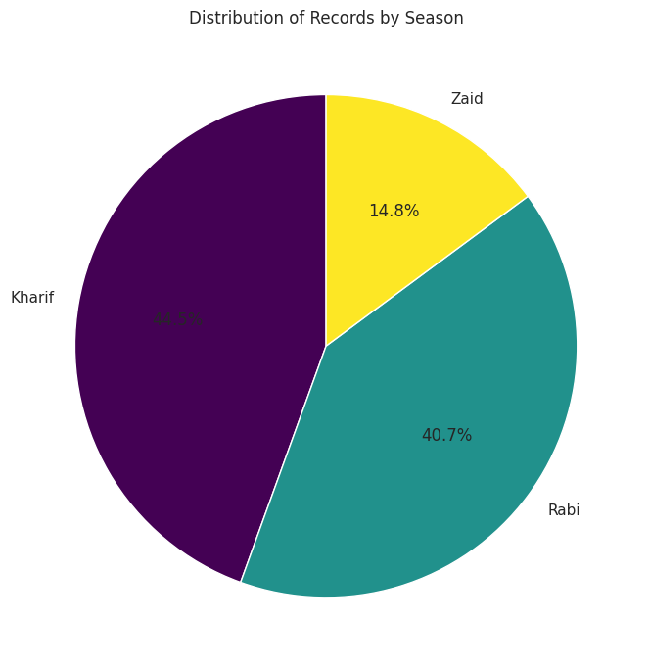
RESULTS
Dataset: 4,000 farm records | 28 variables | 3 seasons
Season split: Kharif 1,779 | Rabi 1,627 | Zaid 594 records

Slide 7
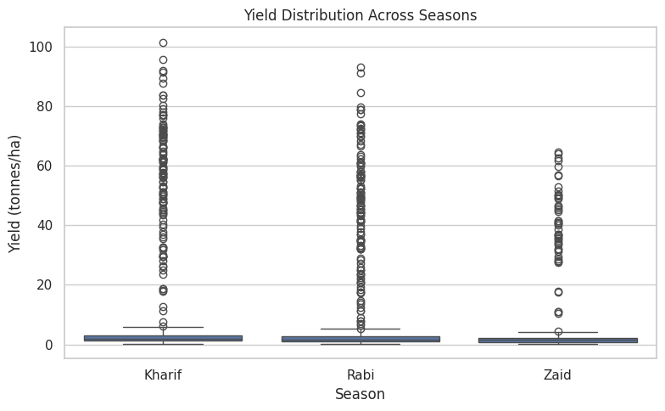
RESULTS
Average Yield (tonnes/ha)
Kharif 5.63 | Rabi 5.04 | Zaid 4.64
Yield is highest in Kharif and lowest in Zaid season, driven by rainfall availability.

Slide 8
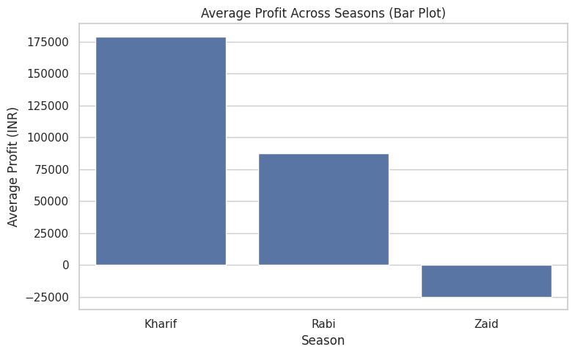
RESULTS
Kharif Rs.1,78,915 | Rabi Rs.87,689 | Zaid -Rs.24,805
Average Profit (INR)
Zaid season shows a net average loss, while Kharif is the most profitable season.

Slide 9
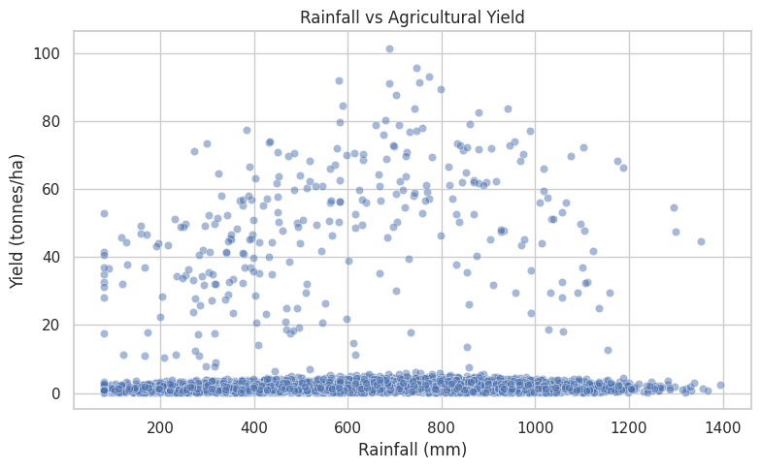
RESULTS
Positive association observed across seasons
Rainfall vs Yield
Higher rainfall is generally associated with higher yield, though variability remains high.

Slide 10
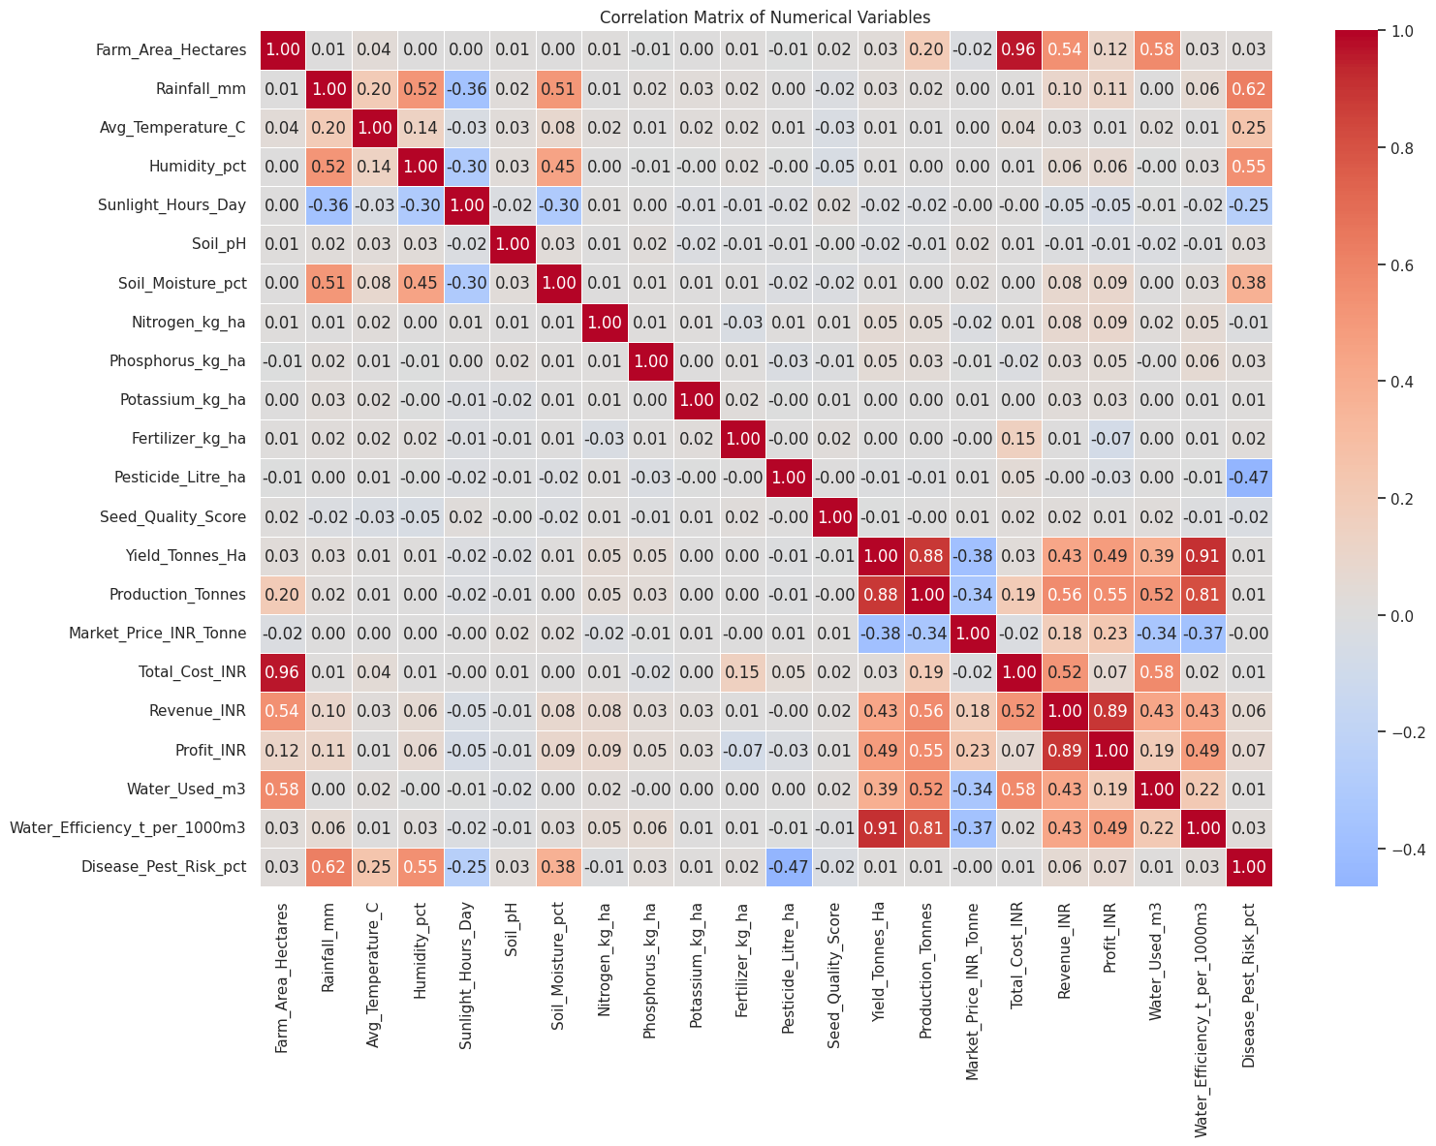
RESULTS
Yield and Profit are positively correlated
Correlation Analysis
Yield, production and profit move together; irrigation method and rainfall are key influencing factors.

Slide 11
Future scope
• Incorporate real-time weather and market price data for dynamic seasonal forecasting
• Apply machine learning (regression/classification) to predict yield, profit and risk
• Extend to district/state-level and multi-year trend analysis
• Build an interactive dashboard for farmers and policymakers
• Study the impact of climate change on long-term seasonal agricultural performance

Slide 12
GitHub Link
[Add your GitHub repository link here, e.g. https://github.com/<your-username>/seasonal-agriculture-performance-analysis]

Slide 13

VOIS Course completion certificate -
Course name- Data Visualization

Slide 14
Thank you
Varun Patil
Student ID
isSTU6a6b18358db7e1785403445
Project
Seasonal Agriculture Performance Analysis
Program
VOIS AICTE Batch 2026-2027

