Slide 1


SMART INDIA HACKATHON 2026
KISAN SETU (किसान सेतु)
AI-Driven Direct Farm-to-Market Supply Chain & Fair Price Settlement
Problem Statement ID – 26033
Problem Statement Title – Multiple intermediaries reduce farmers earnings and increase consumer prices.
Theme – Agriculture, FoodTech & Rural Development
PS Category – Software
Team Name – NexGen
Target Impact – 75%–85% Direct Farmer Payout | Multimodal AI Quality Assaying | 22kg Spoilage Prevented

Slide 2
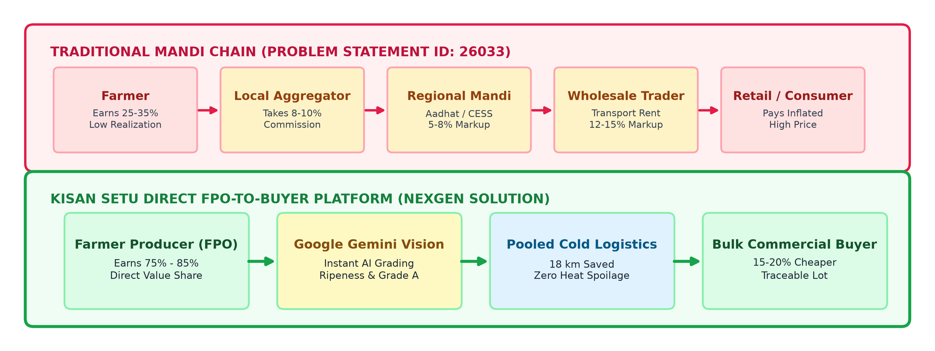
IDEA: KISAN SETU — DIRECT FPO-TO-BUYER MARKETPLACE WITH MULTIMODAL AI
Team NexGen
• Proposed Solution (Idea/Prototype): Kisan Setu by Team NexGen connects Farmer Producer Organizations (FPOs) directly with commercial buyers (supermarkets, kitchens), eliminating 4–7 intermediary markup tiers.
• How It Addresses PS 26033: Directly resolves high consumer prices and low farmer earnings by shifting farmer value realization from 25%–35% up to 75%–85%, with 100% price transparency visible on every lot.
• Innovation & Uniqueness: Google Gemini Multimodal AI Vision for instant harvest grading (Ripeness %, Firmness, Grade A) + Multilingual Ask Kisan AI Copilot + Pooled Milk-Run Logistics.

Slide 3
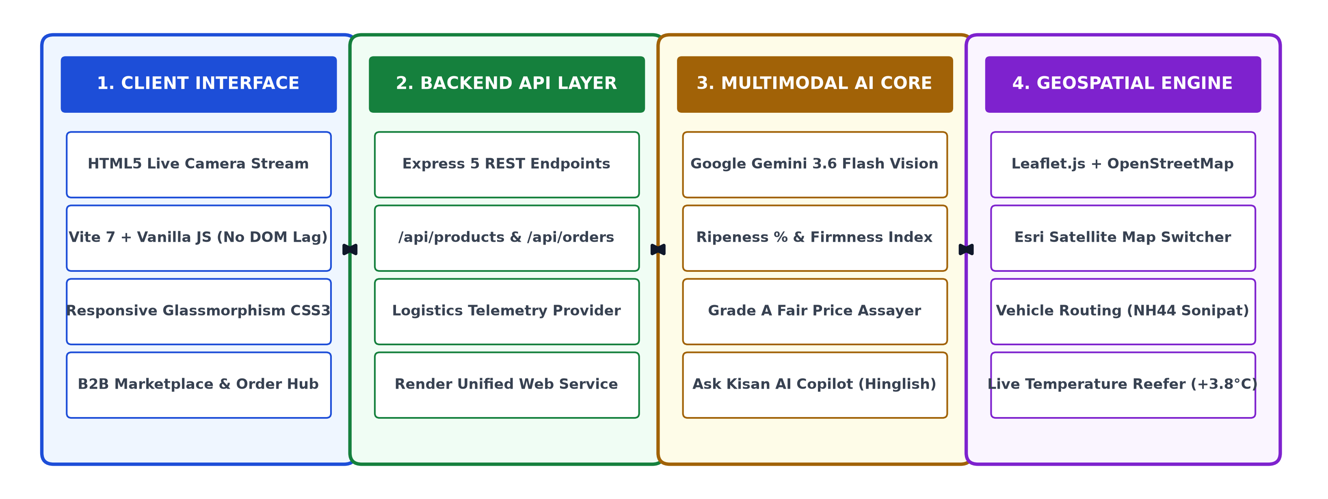
TECHNICAL APPROACH & MULTIMODAL SYSTEM ARCHITECTURE
Team NexGen
• Technologies Used: HTML5 Camera API, Vanilla JS (ES Modules), Vite 7, Node.js + Express 5 REST API, Google Gemini Vision (gemini-3.6-flash), Leaflet.js + OpenStreetMap (OSM) & Esri Satellite, Render Cloud.
• Implementation Methodology: Farmer Camera Snap ➔ Gemini AI Multi-metric Grade A Certification ➔ Real-time Marketplace Listing ➔ B2B Transparent Order ➔ Pooled Milk-Run GPS Route Execution ➔ Direct Payout Release.

Slide 4
FEASIBILITY, RISK ANALYSIS & MITIGATION STRATEGIES
Team NexGen
1. Feasibility & Operational Viability Analysis
• Technical Feasibility: Fully operational working prototype deployed on Render. Zero-install web architecture running on standard Android 4G/5G mobile browsers with native camera access.
• Economic & Commercial Viability: Self-sustaining unit economics. A minimal 4%–5% platform facilitation fee covers QC and cloud costs while delivering 75%–85% payout to farmers (vs 25%–35% in traditional mandis) and 15% net savings to commercial buyers.
• Operational Viability: Leverages existing cluster networks of FPOs in peri-urban corridors (Sonipat, Panipat, Gurugram) with Singhu/Kundli micro-fulfillment hubs.
2. Potential Challenges, Risks & Mitigation Strategies
• Digital & Tech Literacy Barrier: Risk: Rural growers may struggle with complex interfaces. -> Mitigation: Voice-assisted Ask Kisan AI Copilot in Hindi/Hinglish, icon-driven interface, and 1-tap camera inspection.
• Quality Dispute on Delivery: Risk: Buyer rejecting produce lot on delivery. -> Mitigation: Multimodal Gemini AI certifies ripeness, firmness, and defect score with tamper-proof photo certificates embedded into the digital order.
• Cold-Chain Logistics Disruption: Risk: Perishable spoilage from transit bottlenecks. -> Mitigation: Intelligent milk-run route pooling across nearby farms with live GPS telemetry monitoring reefer temperature (+3.8°C).

Slide 5
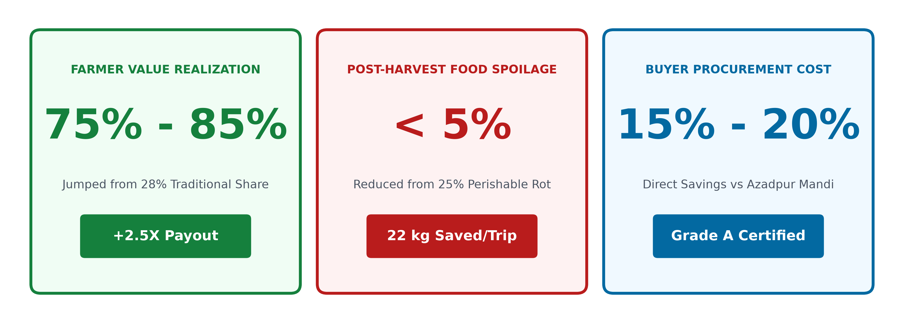
IMPACT AND VALUE CREATION (ADDRESSING PS 26033)
Team NexGen
• Impact on Target Audience (Farmers): Increases farmer earnings from 25%–35% to 75%–85% of retail value; completely eliminates arbitrary cuts, delayed payments, and commission extortion.
• Impact on Consumers & Buyers: Commercial buyers & consumers pay 15%–20% less by skipping 4–7 intermediary markups, with guaranteed Grade A quality assurance.
• Social & Environmental Benefits: Strengthens FPO collective bargaining power, cuts duplicate transit travel by 18 km per route, and prevents 22 kg of heat spoilage (aligns with UN SDG 2 & 12).

Slide 6
RESEARCH BACKING, FIELD REFERENCES & VERIFIED REPOSITORIES
Team NexGen
1. Government Reports & Economic Policy Studies:
• NITI Aayog Policy Report: Strategies on 'Doubling Farmers Income' highlighting the urgent need to bridge the farm-to-fork gap and empower FPO-driven direct retail linkages.
• Ministry of Agriculture & Farmers Welfare (MoA&FW) CIPHET Study: Documenting post-harvest perishable agricultural losses of ~₹92,651 Crore annually due to multi-hop transit delays.
• AGMARKNET & e-NAM Price Repositories: Official benchmark datasets for mandi arrival volumes and retail price spreads in Sonipat, Azadpur, and Delhi-NCR corridors.
2. Technological Research & Prototype Repositories:
• Google Gemini Multimodal Technical Documentation: Research on zero-shot visual inspection, RGB colorimetry for crop ripeness grading, and edge-assisted LLM reasoning.
• OpenStreetMap & Leaflet Geospatial Research: Vehicle Routing Problem (VRP) algorithms applied to agricultural milk-run consolidation and cold-chain temperature preservation.
• Working Prototype & Codebase Repository: https://github.com/varuns47866-creator/kisan-setu | Deployed live on Render web service.

Slide 7
IMPORTANT INSTRUCTIONS
Please ensure below pointers are met while submitting the Idea PPT:
Kindly keep the maximum slides limit up to six (6). ( Including the title slide)
Try to avoid paragraphs and post your idea in points /diagrams / Infographics /pictures
Keep your explanation precise and easy to understand
Idea should be unique and novel.
You can only use provided template for making the PPT without changing the idea details pointers (mentioned in previous slides).
You need to save the file in PDF and upload the same on portal. No PPT, Word Doc or any other format will be supported.
Note - You can delete this slide (Important Pointers) when you upload the details of your idea on SIH portal.

