Slide 1


SMART INDIA HACKATHON 2026
KISAN SETU (किसान सेतु)
AI-Driven Direct Farm-to-Market Supply Chain & Fair Price Settlement
Problem Statement ID – 26033
Problem Statement Title – Multiple intermediaries reduce farmers earnings and increase consumer prices.
Theme – Agriculture, FoodTech & Rural Development
PS Category – Software
Team Name – NexGen
Target Impact – 75%–85% Direct Farmer Payout | Multimodal AI Quality Assaying | 22kg Spoilage Prevented

Slide 2
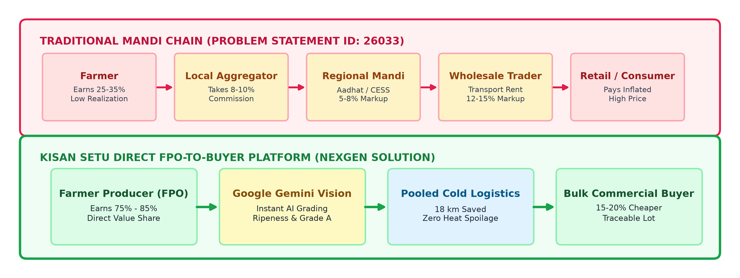
IDEA: KISAN SETU — DIRECT FPO-TO-BUYER MARKETPLACE WITH MULTIMODAL AI
Team NexGen
• Proposed Solution (Idea/Prototype): Kisan Setu by Team NexGen connects Farmer Producer Organizations (FPOs) directly with commercial buyers (supermarkets, kitchens), eliminating 4–7 intermediary markup tiers.
• How It Addresses PS 26033: Directly resolves high consumer prices and low farmer earnings by shifting farmer value realization from 25%–35% up to 75%–85%, with 100% price transparency visible on every lot.
• Innovation & Uniqueness: Google Gemini Multimodal AI Vision for instant harvest grading (Ripeness %, Firmness, Grade A) + Multilingual Ask Kisan AI Copilot + Pooled Milk-Run Logistics.

Slide 3
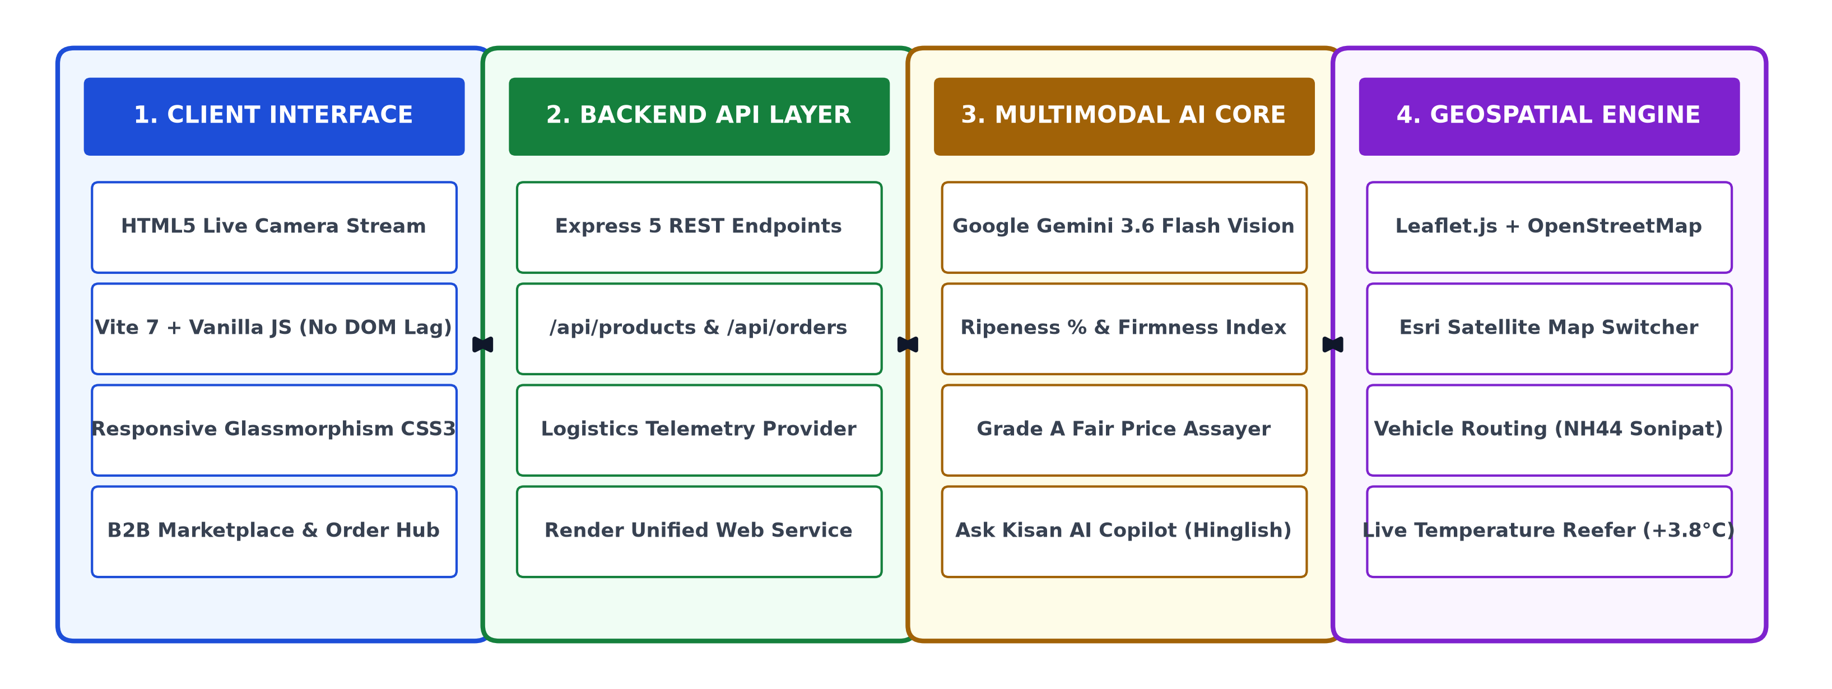
TECHNICAL APPROACH & MULTIMODAL SYSTEM ARCHITECTURE
Team NexGen
• Technologies Used: HTML5 Camera API, Vanilla JS (ES Modules), Vite 7, Node.js + Express 5 REST API, Google Gemini Vision (gemini-3.6-flash), Leaflet.js + OpenStreetMap (OSM) & Esri Satellite, Render Cloud.
• Implementation Methodology: Farmer Camera Snap ➔ Gemini AI Multi-metric Grade A Certification ➔ Real-time Marketplace Listing ➔ B2B Transparent Order ➔ Pooled Milk-Run GPS Route Execution ➔ Direct Payout Release.

Slide 4
FEASIBILITY, RISK ANALYSIS & MITIGATION STRATEGIES
Team NexGen
1. Feasibility & Operational Viability Analysis
• Technical Feasibility: Fully operational working prototype deployed on Render. Zero-install web architecture running on standard Android 4G/5G mobile browsers with native camera access.
• Economic & Commercial Viability: Self-sustaining unit economics. A minimal 4%–5% platform facilitation fee covers QC and cloud costs while delivering 75%–85% payout to farmers (vs 25%–35% in traditional mandis) and 15% net savings to commercial buyers.
• Operational Viability: Leverages existing cluster networks of FPOs in peri-urban corridors (Sonipat, Panipat, Gurugram) with Singhu/Kundli micro-fulfillment hubs.
2. Potential Challenges, Risks & Mitigation Strategies
• Digital & Tech Literacy Barrier: Risk: Rural growers may struggle with complex interfaces. -> Mitigation: Voice-assisted Ask Kisan AI Copilot in Hindi/Hinglish, icon-driven interface, and 1-tap camera inspection.
• Quality Dispute on Delivery: Risk: Buyer rejecting produce lot on delivery. -> Mitigation: Multimodal Gemini AI certifies ripeness, firmness, and defect score with tamper-proof photo certificates embedded into the digital order.
• Cold-Chain Logistics Disruption: Risk: Perishable spoilage from transit bottlenecks. -> Mitigation: Intelligent milk-run route pooling across nearby farms with live GPS telemetry monitoring reefer temperature (+3.8°C).

Slide 5
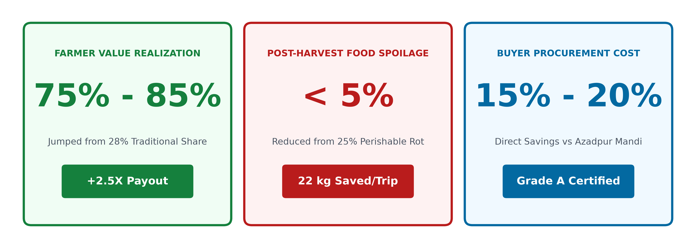
IMPACT AND VALUE CREATION (ADDRESSING PS 26033)
Team NexGen
• Impact on Target Audience (Farmers): Increases farmer earnings from 25%–35% to 75%–85% of retail value; completely eliminates arbitrary cuts, delayed payments, and commission extortion.
• Impact on Consumers & Buyers: Commercial buyers & consumers pay 15%–20% less by skipping 4–7 intermediary markups, with guaranteed Grade A quality assurance.
• Social & Environmental Benefits: Strengthens FPO collective bargaining power, cuts duplicate transit travel by 18 km per route, and prevents 22 kg of heat spoilage (aligns with UN SDG 2 & 12).

Slide 6
RESEARCH BACKING, FIELD REFERENCES & VERIFIED REPOSITORIES
Team NexGen
1. Government Reports & Economic Policy Studies:
• NITI Aayog Policy Report: Strategies on 'Doubling Farmers Income' highlighting the urgent need to bridge the farm-to-fork gap and empower FPO-driven direct retail linkages.
• Ministry of Agriculture & Farmers Welfare (MoA&FW) CIPHET Study: Documenting post-harvest perishable agricultural losses of ~₹92,651 Crore annually due to multi-hop transit delays.
• AGMARKNET & e-NAM Price Repositories: Official benchmark datasets for mandi arrival volumes and retail price spreads in Sonipat, Azadpur, and Delhi-NCR corridors.
2. Technological Research & Prototype Repositories:
• Google Gemini Multimodal Technical Documentation: Research on zero-shot visual inspection, RGB colorimetry for crop ripeness grading, and edge-assisted LLM reasoning.
• OpenStreetMap & Leaflet Geospatial Research: Vehicle Routing Problem (VRP) algorithms applied to agricultural milk-run consolidation and cold-chain temperature preservation.
• Working Prototype & Codebase Repository: https://github.com/varuns47866-creator/kisan-setu | Deployed live on Render web service.

